Slide 1
Introduction to Software Requirements
Modern Iterative Development. Pitfall: Agile Waterfall™
define:Software Requirements
Software Requirements: Levels & Types
  Functional/Non-Functional (esp. Quality Attributes)
  External/Internal
  Product/Project
  Today/Tomorrow
Design Metamodel. Design Tradeoffs
Requirements Management
System Vision
User Stories

Slide 2
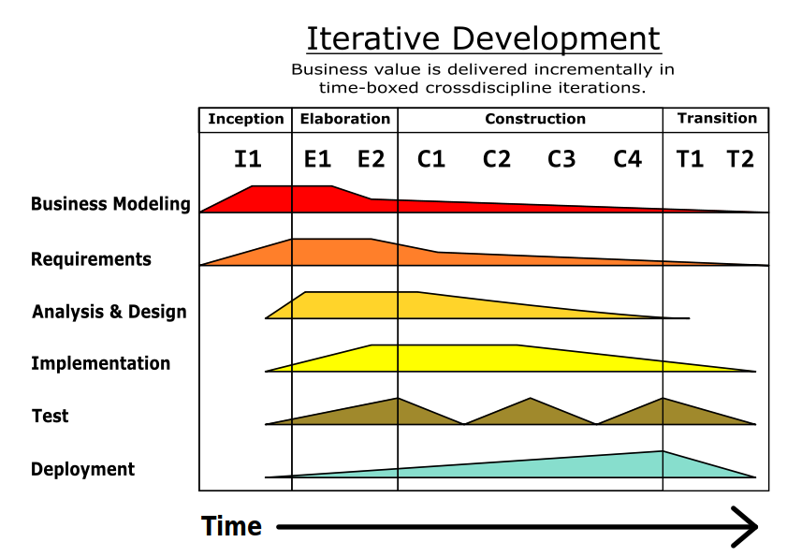
https://en.wikipedia.org/wiki/Unified_Process#/media/File:Unified_Process_Model_for_Iterative_Development.svg
(CC0, Author: Jakob Farian Krarup)

Slide 3
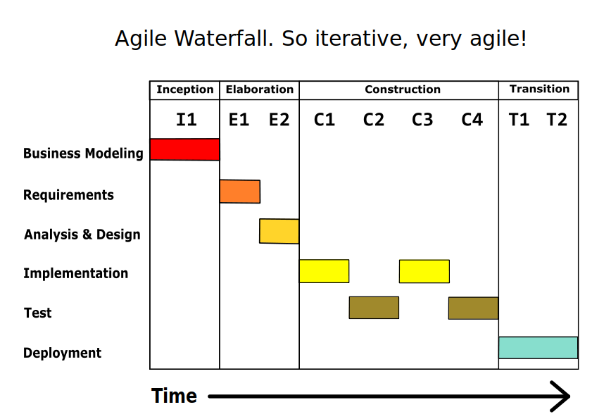
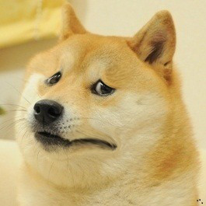

Slide 4
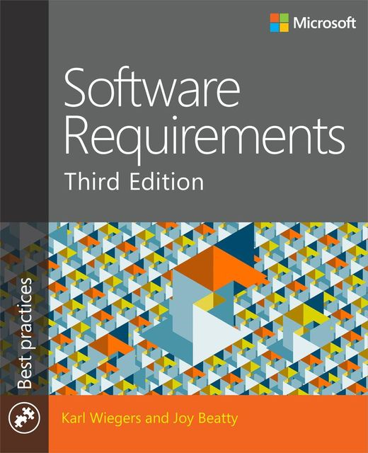
Software Requirements
…are a definition of what should be implemented.
They are descriptions of how a system should behave, or of a system property or attribute.
They may be a constraint on the development process of the system.
Ian Sommerville, Pete Sawyer. Requirements Engineering: A Good Practice Guide. (Wiley, 1997)
via: Karl Wiegers, Joy Beatty. Software Requirements, 3rd Ed.
(Microsoft Press, 2013)

Slide 5
Business
Requirements
Business
Rules
«influences»
«is put into…»
Vision and Scope Document
User
Requirements
Quality
Attributes
User Requirements Document
External
Interfaces
System
Requirements
Functional
Requirements
Constraints
Software Requirements Specification
Karl Wiegers, Joy Beatty. Software Requirements, 3rd Ed. Ch. 1, p. 8, Fig. 1-1
(Microsoft Press, 2013)

Slide 6
Set by the course
Business Model
Specified by you
«abstraction»
Process Model
Required artifact
«abstraction»
Requirements Model
Domain Model
Product Vision
Internal
QA
External
F
User Stories
QA
«abstraction»
Architecture
Architecture (High-Level Design)
CRC Cards
Design Model
Cplx
Coupling
Cohesion
UML Diagrams
Micro-design (e.g. for 1 OO Class)
«abstraction»
Implementation Model
Source Code
Build & Deploy Specs
Executable Artifact

Slide 7
Design Tradeoffs
{Testability, Flexibility} → Complexity
  Conflicts with Simplicity
  Too much Flexibility is Overengineering
{Scalability, Resilience, Independent Evolution} → Consistency
  Microservices. Now you have lots of stores instead of one, and Transactions are gone. There are only Sagas
Availability → Consistency (CAP Theorem)

Slide 8
Requirements Management
Elicitation
Analysis
Specification
rewrite
reevaluate
Validation
confirm & correct
Karl Wiegers, Joy Beatty. Software Requirements, 3rd Ed. Fig. 3-1
(Microsoft Press, 2013)

Slide 9
System Vision
Birds' Eye View of the System
For Stakeholders
  Business (management, financial etc.)
  Prominent Users
Outlines System Scope (what it IS and IS NOT)
Main Questions
  Why should the Product exist? (What is the need for it?)
  Why would it be successful?
Elevator Test

Slide 10
User Stories
As a <role> I can <capability>, so that <receive benefit>
As <who> <when> <where>, I want <what> because <why>
As an amateur skier,
I can rent ski equipment
So that I post a cool skiing photo on Instagram to impress my pretentious friends
As a professional skier,
I can rent high-end ski equipment
So that I regularly train for Winter Olympics
https://en.wikipedia.org/wiki/User_story
https://pmclub.pro/articles/user-story-pora-primenyat-pravilno

Slide 11

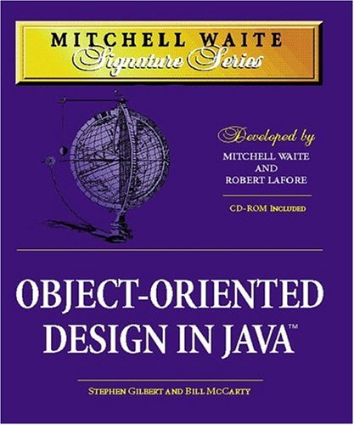

Recommended Reading
Chapter 1
Chapter 3
OOD: (This Seminar + 1)
Chapters 5..8
Patterns:
(This Seminar + 2)

Slide 12
Recommended Reading (Contd.)
Head First Patterns by Eric & Elizabeth Freeman
Code Complete by Steve McConnell
Object-Oriented Design in Java
by Gilbert & McCarty (https://www.amazon.com/MWSS-Object-Oriented-Design-Mitchell-Signature/dp/1571691340)
@see Chapters 5..8

