Slide 1
Object-Oriented Design
Class-Based OOP
  Classes as Abstract Data Types and Domain Models
  Encapsulation, Inheritance and Polymorphism
Iterative Design Process
CRC Cards (Class-Responsibility-Collaboration)
UML 101
  Class Diagrams. Association, Aggregation, Composition
  Sequence Diagrams and State Machines
OO Design Principles
  SOLID (esp. LSP)
  Low Coupling, High Cohesion
  Fun Acronyms: KISS, DRY, YAGNI…

Slide 2
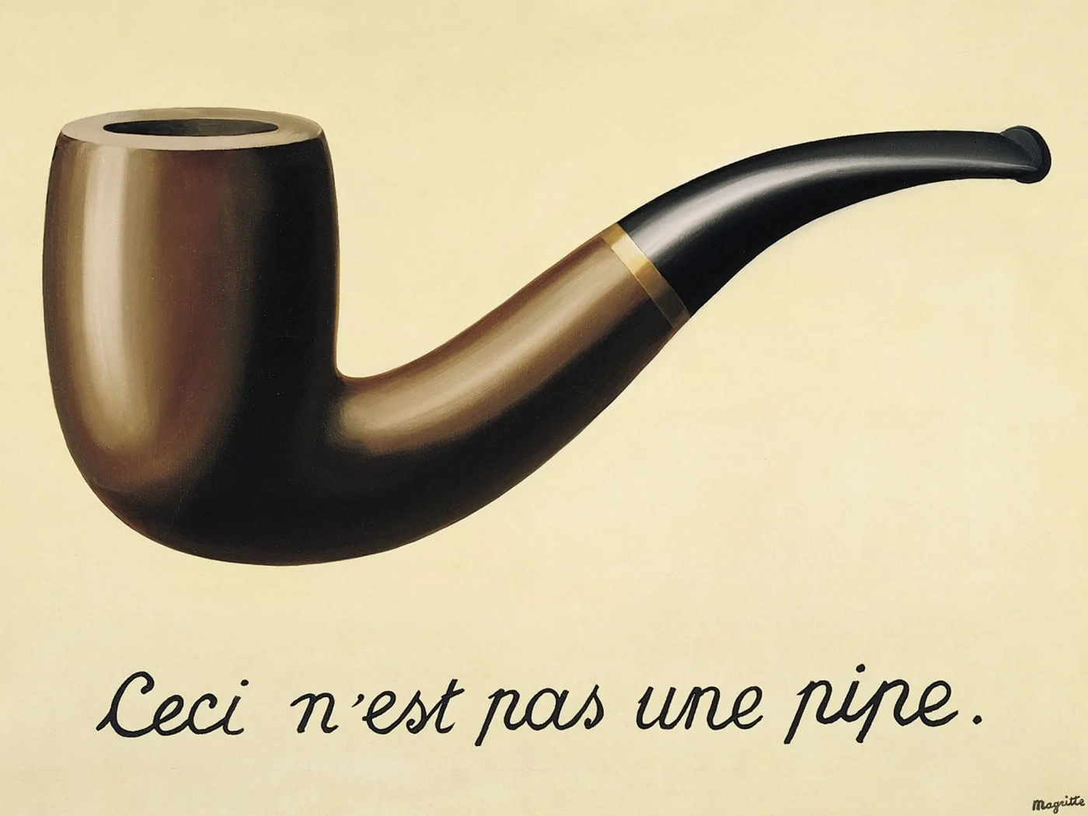
Classes and Objects
Abstract Data Types
(Data + Operations)
Formally an Algebra
Model of the Real World™
Metamodel: a Model of a Model
head
5
6
42
tail
cons(e: T, tail: List) → List(e: T, tail)
head() → T
tail() → List
prepend(lst: List, e: T) → List
concat(a: List, b: List) → List

Slide 3
Class-Based OOP (Java, C#, C++)
Encapsulation (aka Data Hiding)
  @see Visibility Modifiers (public, protected, private, package-private)
Inheritance
Polymorphism
  That is, Subtype Polymorphism (cf. Generics: Parametric Polymorphism)
  Virtual dispatch, specifically Single Dispatch
Contrast other OOP styles:
  Prototype-Based OOP (JavaScript, Self)
  Message Passing (Obj-C, Lua, Smalltalk)
  Dynamic Class-Based (Python, Ruby, Perl, Common Lisp)

Slide 4
Iterative Design Process (1)
Collect Requirements
Product Vision
User Stories

Slide 5
Iterative Design Process (2)
Identify Classes and Objects
CRC Cards
(Class-Responsibility-Collaboration)
Nouns → Classes
Verbs → Responsibilities
(Class × Class) → Collaborations

Slide 6
Iterative Design Process (3)
Describe
Classes and Object Collaborations
Static Model
(Structure)
Dynamic Model
(Behavior)
UML
Sequence,
State Machine, Activity
UML
Class

Slide 7
CRC Cards
(front)
Class: Resource Pool
(back)
Attributes:
LRU Queue
Max Resource Count
Responsibilities
(i.e. Public Methods):
Collaborators:
Borrow Resource
Return Resource
Print Statistics
Allocator, Resource
Allocator, Resource
–
Resource Pool allocates expensive Resources and keeps them for a while, to amortize resource creation cost. Resource Pool might pre-allocate resources. Borrowing from the pool returns an LRU resource.

Slide 8
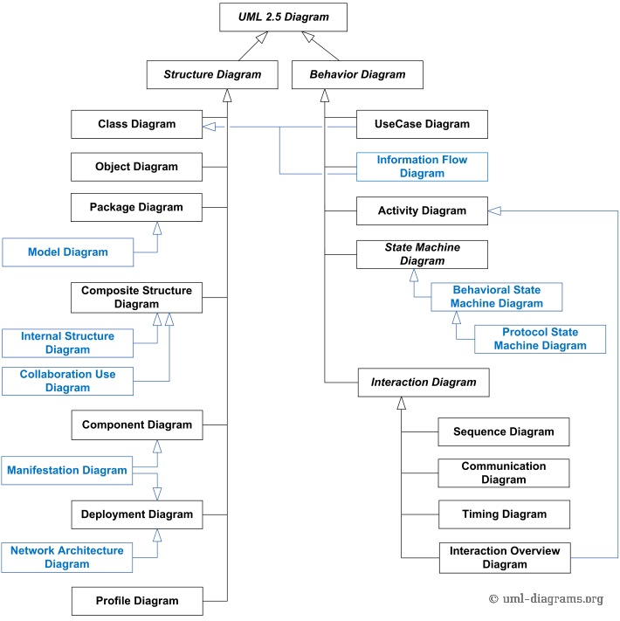
UML
https://www.uml-diagrams.org
Structure (=Static)
  Class
  Package
  Component, Deployment
  Object, Collaboration Use
Behavior (=Dynamic)
  Use Case
  Sequence
  State Machine
  Activity

Slide 9
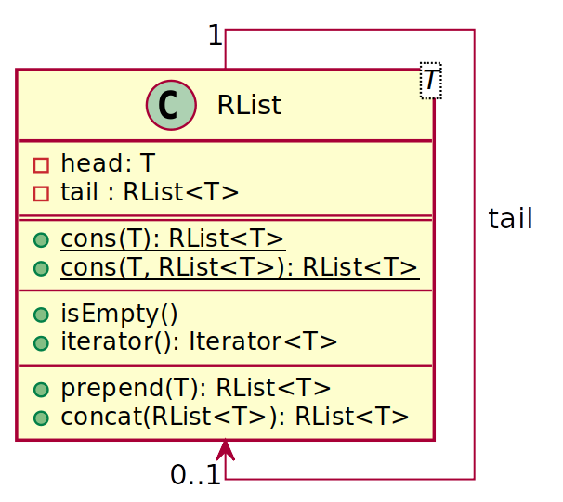
UML Class Diagram: Members
This is a Class!
Generics
Private Fields:
List is represented recursively as
list node RList(head, tail)
where tail is also an RList
Relationship:
One list node can have
either no tail, or a single tail
Public Methods
static
abstract
Cardinality

Slide 10
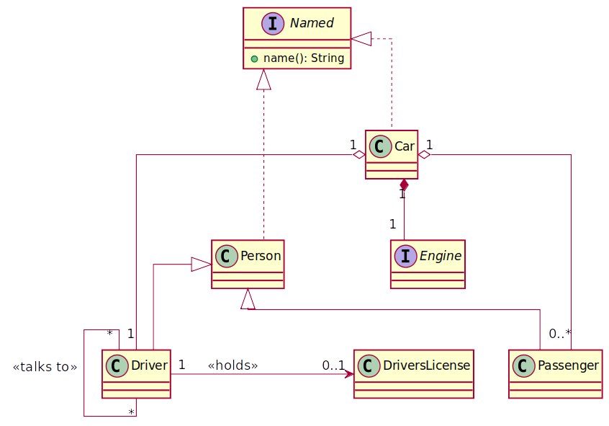
UML Class Diagram: Relationships
Aggregation
(Car has-a Driver)
Interface Implementation
(Car is-a Named entity)
Composition
(Car has-a Engine)
Inheritance
(Driver is-a Person)
Association

Slide 11
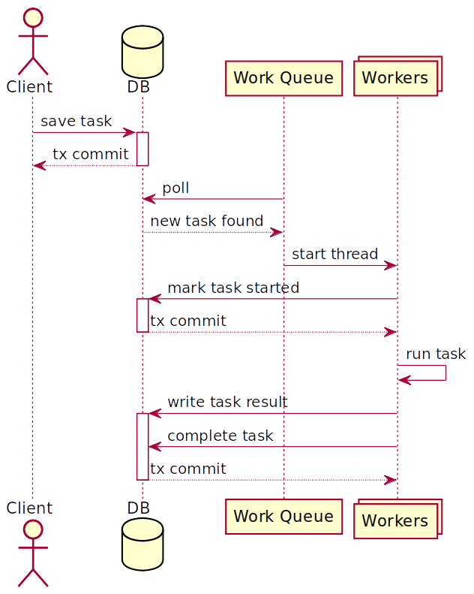
UML Sequence Diagram
Client saves a Task to DB
Work Queue polls DB
When a new task is found, Work Queue starts a Worker
Workers on multiple hosts race to mark task started in the DB
The winning Worker runs the task
When the task is completed, Worker writes result to the DB and marks the task complete

Slide 12
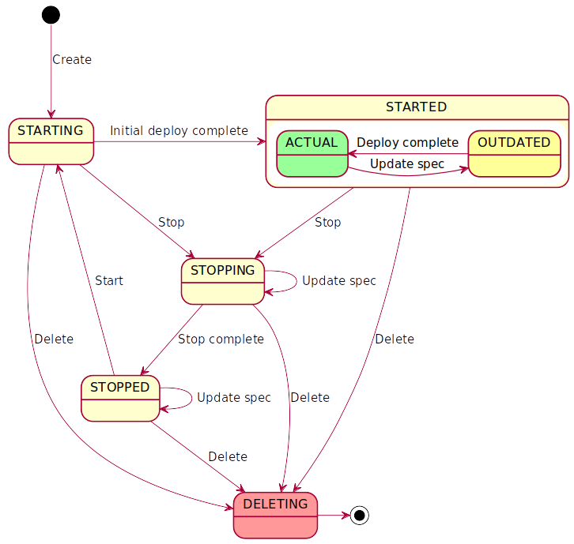
UML State Machine
When Instance is Created, it is put into STARTING state
When the initial deploy is complete, Instance becomes STARTED…
A STARTED Instance can be either ACTUAL or OUTDATED
  STARTED/OUTDATED Instances become STARTED/ACTUAL when spec changes are applied to them
etc.

Slide 13
SOLID OO Design Principles
Single Responsibility
  Class must have a Single reason for Change
  E.g., in Logging frameworks: separate Logger vs Appender vs Layout
Open-Closed
  Open for Extension (well-defined extension points)
  Closed for Modification (well-defined public interface)
Liskov Substitution Principle
  Subtypes must be substitutable for supertypes without altering program correctness
  Class invariants and method pre- and postconditions
Interface Segregation: Smaller client-specific interfaces vs God Object. Also: API & SPI
Dependency Inversion: Depend upon abstractions, not concrete classes

Slide 14
OO Design Principles (Contd.)
Low Coupling + High Cohesion (from GRASP Patterns)
Prefer Composition to Inheritance
  …and Interface Inheritance to Implementation Inheritance
API Design: Design for both Extension and Backward Compat
DRY (Do not Repeat Yourself)
YAGNI (Agile vs BDUF, Big Design Up Front)
KISS (Keep it Simple Stupid)

Slide 15

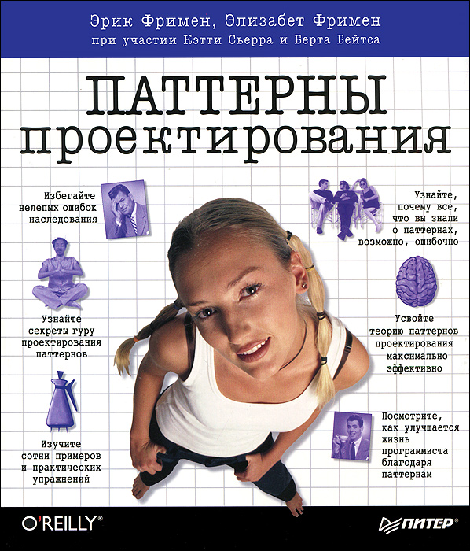
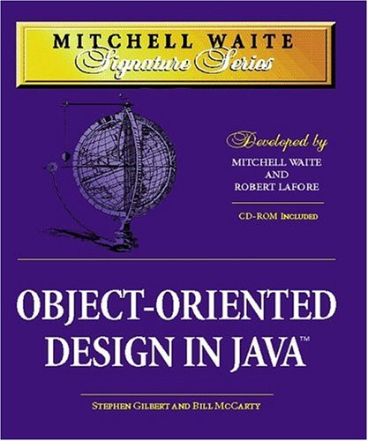
Recommended Reading
Chapters 5..8
For the Next Seminar

Slide 16
Recommended Reading (Contd.)
Head First Patterns by Eric & Elizabeth Freeman
Code Complete by Steve McConnell
Object-Oriented Design in Java
by Gilbert & McCarty (https://www.amazon.com/MWSS-Object-Oriented-Design-Mitchell-Signature/dp/1571691340)
@see Chapters 5..8

