Slide 1

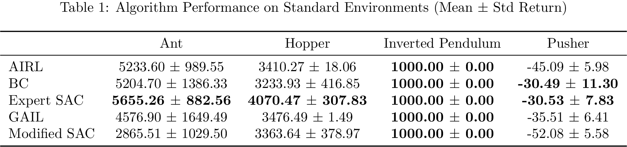
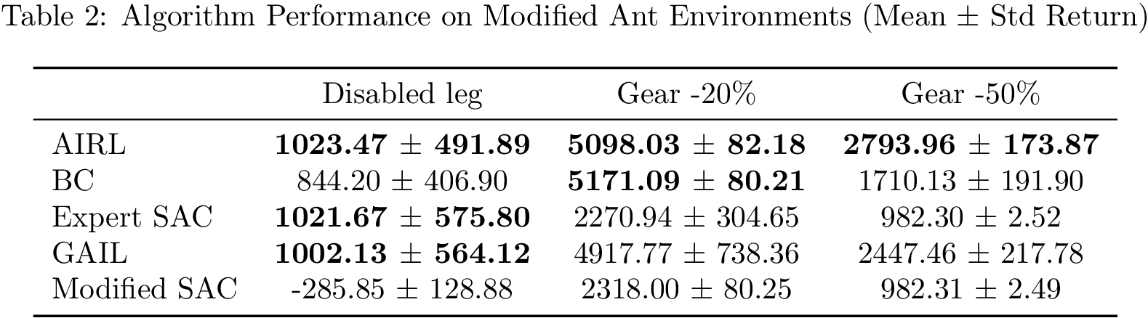
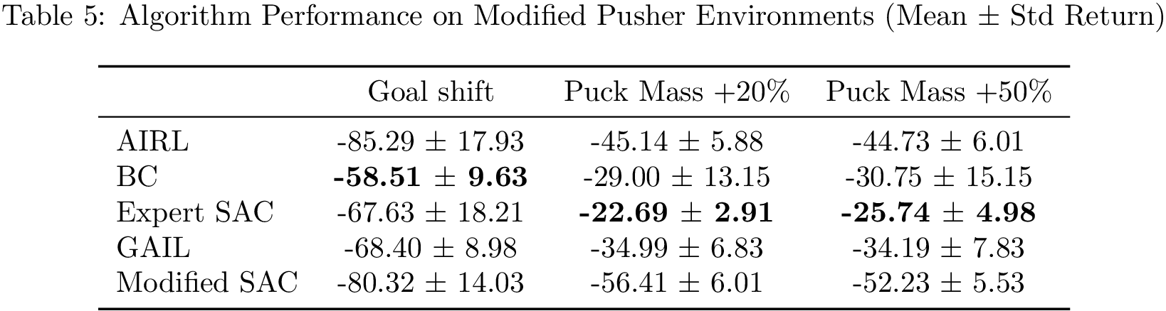
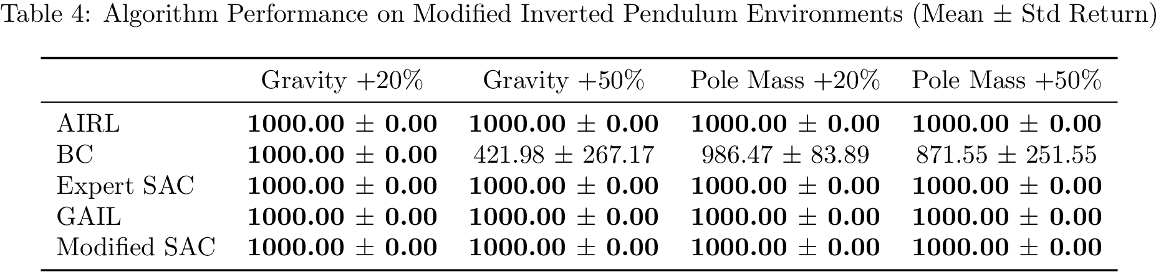
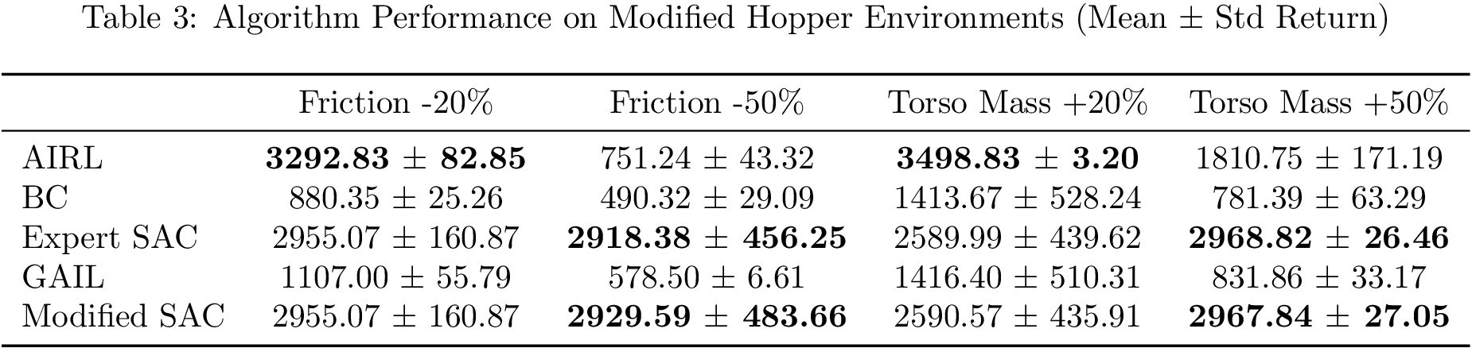
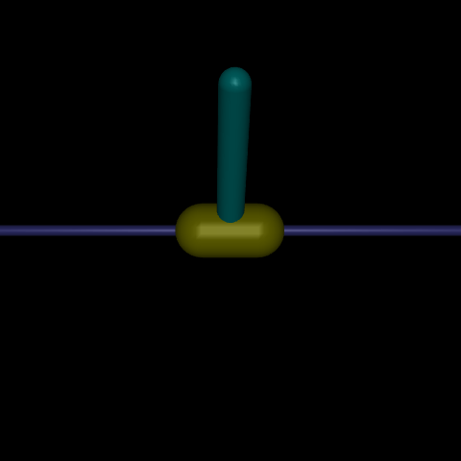
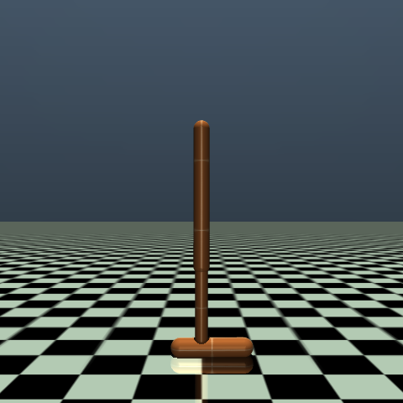
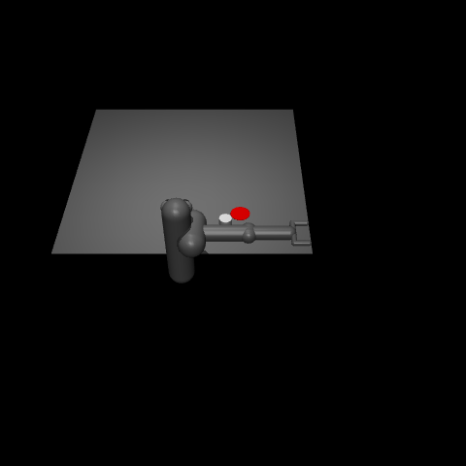
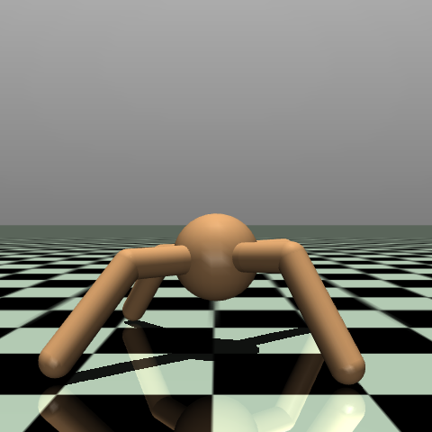
From Demonstrations to Adaptation: Assessing Imitation Learning Robustness and Learned Reward Transferability
Nathan Van Utrecht
Department of Mechanical Engineering, Iowa State University
Introduction
Results
Conclusions
What is Reinforcement Learning (RL)?: This is a common way to train AI agents (like robots or game characters) to learn complex tasks. The AI learns through guided trial and error, receiving rewards for good actions and penalties for bad ones. The AI’s goal is to maximize its total rewards over time.
The Reward Design Problem: For many real-world tasks (like driving safely or performing surgery), manually designing the reward function is difficult.
Learning from Examples: An alternative is to show the AI what a human expert does instead of giving it a reward. Imitation Learning (IL) is where the AI learns to copy the expert’s actions. Inverse Reinforcement Learning (IRL) tries to learn the reward function that best explains the expert’s actions.
All results were averaged over 100 randomly generated seeds. The top
Put results here
Methods
Future Work
Algorithms
Behavioral Cloning (BC): Direct supervised learning of state-action pairs. It’s an easy, naïve baseline for IL.
Generative Adversarial Imitation Learning (GAIL): State of the art IL approach which trains an agent to discriminate between the expert trajectories and GAIL’s policy’s trajectories.
Adversarial Inverse Reinforcement Learning (AIRL): State of the art IRL approach which learns a policy and attempts to learn a reward function
Training Data
The training data was collected by training a Soft Actor-Critic agent until it reached expert level performance. Then one million timesteps of data was collected with deterministic actions and no added noise.
Testing Environments
Each algorithm was trained on the original environments in Figure 1, and then they were evaluated on altered versions. These alterations included changing physical parameters (gravity, friction, etc.) and goal changes (disabling joints, shifting the goal location, etc.).
Put results here
Figure 1: Environment names from left to right in ascending difficulty: Hopper, Pusher, Ant, Inverted Pendulum

