Slide 1
Continuously deploying SQL code
using Powershell
presented by @nvarscar

Slide 2

about:me
Kirill Kravtsov - @nvarscar
DBA at xMatters (Canada)
Major contributor to dbatools
Automation and CI/CD enthusiast
Powershell + Jenkins = <3

Slide 3
sql deployment scenarios
Model-based deployments
Script-based deployments
Stored as a full schema definition
Compares schema states
Generates migrations on the fly
Controlled by a framework
Rudimentary data management
Deployed through migrations
Performs predefined sequence of changes
Good old plaintext scripts
Full control of the changes
Not bound to any framework
Related blogpost: https://nvarscar.wordpress.com/2017/11/21/deploying-sql-server-code-the-good-the-bad-the-ugly/

Slide 4
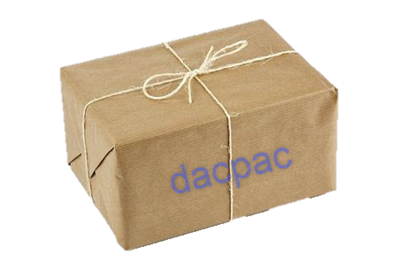
model-based approach: dacpacs
Developed in Visual Studio with the Data Tools plugin
The model is packaged into a .dacpac file
Deployment parameters should be defined, with care
Deployment options:
SSMS -> Deploy Data-Tier Application
SqlPackage.exe tool
Powershell
DacFx.x64 library
dbatools

Slide 5
dacpac CI/CD flow
SQL
DELIVERY PIPELINE
Dev
EXPORT
dacpac
Test
CI
Stage
Prod
Visual Studio Data Tools
BUILD
Artifact
Deployment Framework

Slide 6
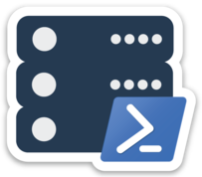
dacpacs and dbatools
Export database as a dacpac:
Export-DbaDacPackage
Deploy dacpac onto the server
Publish-DbaDacPackage
Define custom parameters
New-DbaDacOption
Related blogpost: https://dbatools.io/clone/

Slide 7
script-based deployments
SQL
001-TableA.sql
002-ProcedureInsertA.sql
003-ViewB.sql
Script names stored in a schema versions table
Alphabetical deployment order
Each script deployed only once
dbo.SchemaVersions
001-TableA.sql
002-ProcedureInsertA.sql
003-ViewB.sql

Slide 8

dbops powershell module
Continuous deployment of SQL code
Powered by DbUp .Net libraries
Flexible deployment configuration model
Build system
All-in-One deployment pipeline solution
Cross-platform:
Windows, Linux, MacOS
SqlServer, MySQL, PostgreSQL, Oracle

Slide 9

Deployment package
Build 1.0
Build 1.1
CreateTableA.sql
CreateTableB.sql
CreateTableC.sql
AlterTableA.sql
CreateViewD.sql
Build 1.2
AlterTableB.sql
CreateTableF.sql
Build 1.3
DeploySPs.sql
Database C
(empty)
dbo.SchemaVersions
1.0\CreateTableA.sql
1.0\CreateTableB.sql
1.0\CreateTableC.sql
DbUp
Database A
(version 1.0)
DbUp
dbo.SchemaVersions
1.0\CreateTableA.sql
1.0\CreateTableB.sql
1.0\CreateTableC.sql
1.1\AlterTableA.sql
1.1\CreateViewD.sql
Database B
(version 1.1)
DbUp

Slide 10
dbops CI/CD flow
Build (artifact)
storage
Get-DBOPackageArtifact
Promote
build
Publish-DBOPackageArtifact
PACKAGE
PACKAGE
Successful deployment
SQL
Build
New-DBOPackage
Add-DBOBuild
PACKAGE
Deploy
Install-DBOPackage
Deploy.ps1
CODE
DbUp
PACKAGE
Validate
Dev
Test
Stage
Prod
CI deployment
Install-DBOPackage
Deploy.ps1
DbUp
CI

Slide 11
Links
More about dbops: https://github.com/sqlcollaborative/dbops
DbUp project: https://github.com/DbUp/DbUp/
Introducing dbops: https://nvarscar.wordpress.com/2018/09/18/introducing-dbops-powershell-module-devops-for-databases/
Contacts
Twitter: @nvarscar
Sqlcommunity.slack.com: @nvarscar
Blog: https://nvarscar.wordpress.com

Slide 12
Q&A

