Slide 1
Benchmark key metrics of different cloud offering for ML Based Application
Group Cloud9
Team Ramnath Krishnamurthy
Agamani Parida
Smriti Gupta
Nithin Vasudevan

Slide 2
Outline
Introduction
Environmental Setup for the Homegrown application
Experiments conducted in terms of performance evaluation on different cloud providers
Using the services provided by the cloud providers (Storage and Machine Learning Services)
Inference from the conducted experiments
Challenges Faced
Conclusion of the experiment

Slide 3
Problem Statement
The detailed runtime performance of the instances for self-developed applications are unknown.
The awareness of which cloud platform to use in terms of accuracy and ease of use for classification and regression problems is limited.

Slide 4
Purpose and Goals
Build application model to execute two machine learning algorithms on three cloud providers.
Chosen Algorithms
Support Vector Machine (SVM).
Artificial Neural Network (ANN).
Cloud Providers
AWS
GCP
MS Azure
Benchmark the key metrics (CPU, Memory, I/O, Cost) on different cloud providers for the developed application.
Study the features provided by MLaaS by different cloud providers.

Slide 5
What’s Our Approach ?
We implemented
Homegrown Classification and Regression Algorithms on different cloud offering instances and benchmarked them on key metrics.
Used the same dataset to understand the performance in terms of accuracy on different cloud offerings.
To do a fair comparison on the homegrown part , we standardized all the input parameters across the platforms used.

Slide 6
Dataset
HIGGS Dataset
It has 28 features and one target column.
Output is 1 for signal and 0 for background.
Size of dataset is 7.8 GB.
Used for Homegrown Classification (ANN) algorithm and MLaaS.
Source : https://archive.ics.uci.edu/ml/datasets/HIGGS
Iris Dataset
It has 3 features and one target column.
Outputs are setosa, versicolor and verginica.
Size of dataset is 15 MB.
Used for Homegrown Support Vector Machine algorithm (Tuned to work for both classification and regression problem)
Source: https://archive.ics.uci.edu/ml/datasets/iris

Slide 7
Environmental Setup
Instance configuration across all the clouds
2 vCPU
8 GB RAM
30 GB Disk
Ubuntu 16.04
Required Packages
Python 2.7 or above
Keras using Tensorflow backend
SciPy, Pandas, numPy, SkLearn libraries

Slide 8
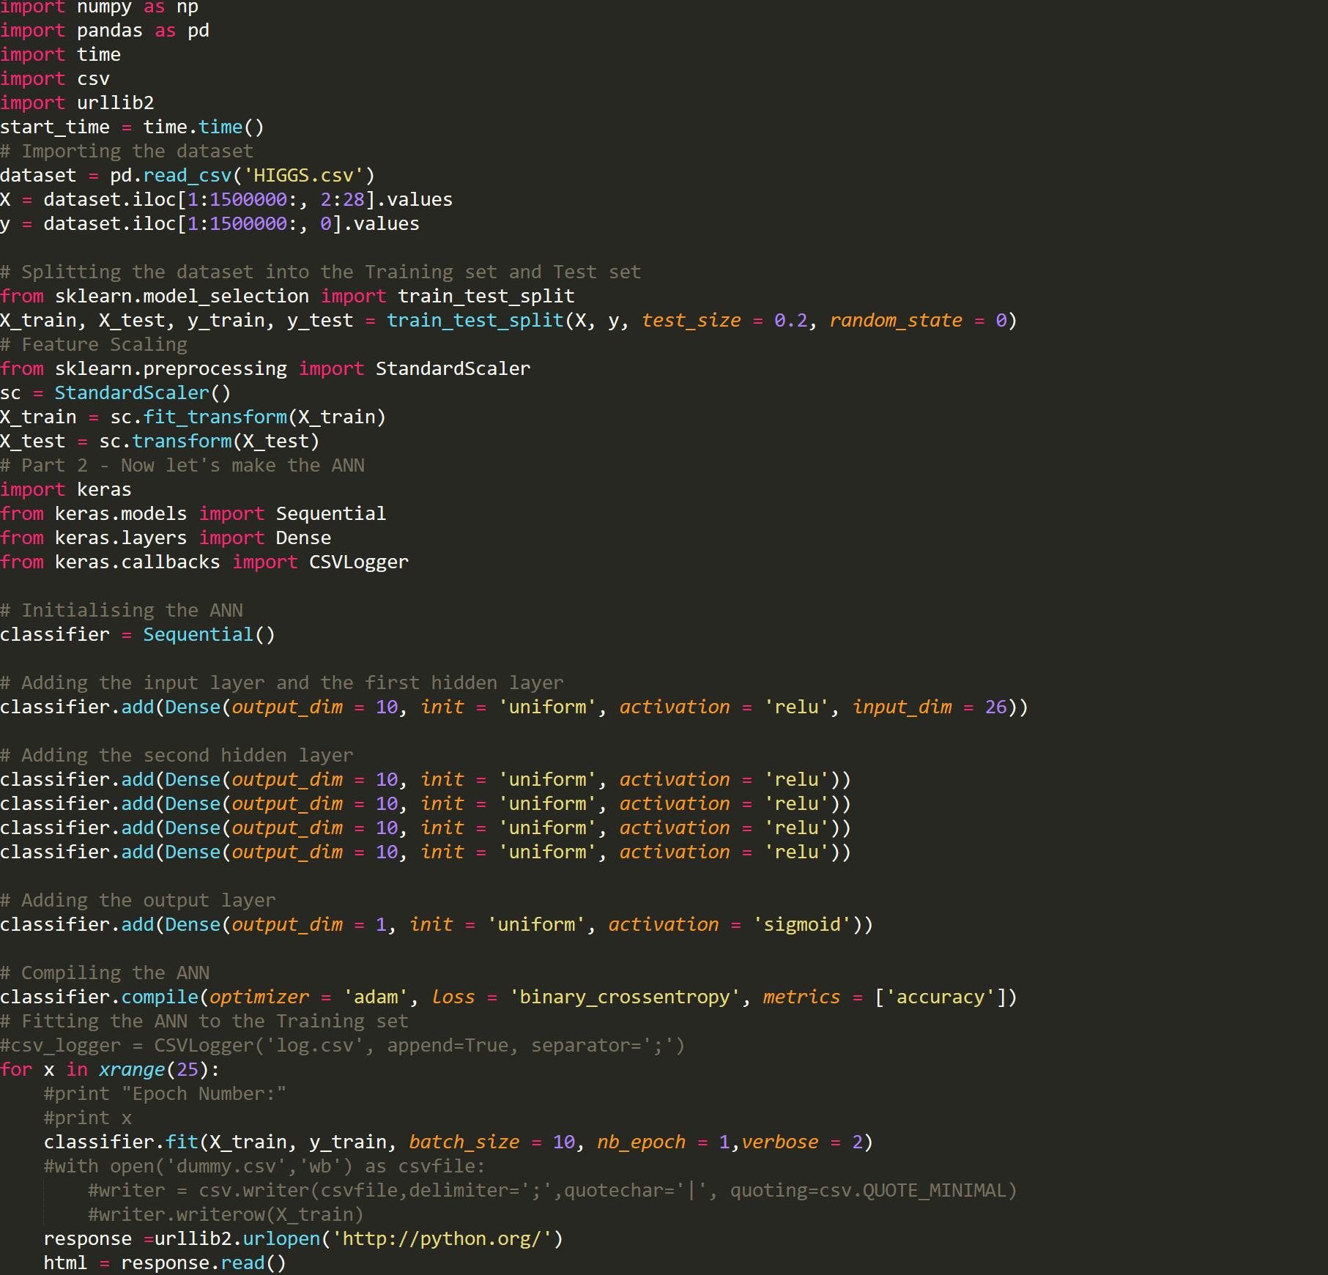
Home Grown Algorithms
Artificial Neural Network
Supervised learning model
Used for both Classification and Regression problem
Support Vector Machine
Supervised learning model
Used for both Regression and Classification problem

Slide 9
Demo

Slide 10
Performance Monitoring Commands
CPU Utilization
vmstat -t 1
mpstat -P ALL 1
cpudist 1
runqlat 1
IO Utilization
iostat -xz 1
biolatency -m 1
Memory Utilization
vmstat 1
cachestat 1

Slide 11
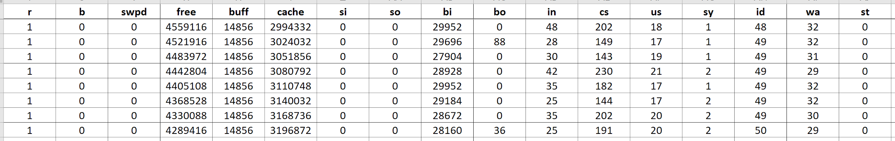
Vmstat Data

Slide 12
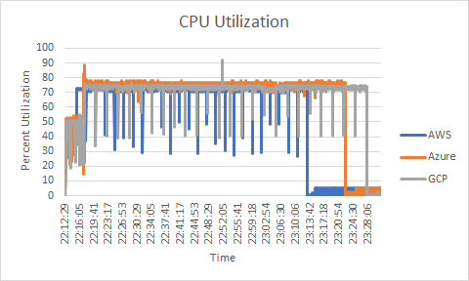
CPU Utilization for ANN
CPU Utilization is relatively less in AWS compared to other two cloud providers.
Based on the total response times, we are able to see the drop in CPU.

Slide 13
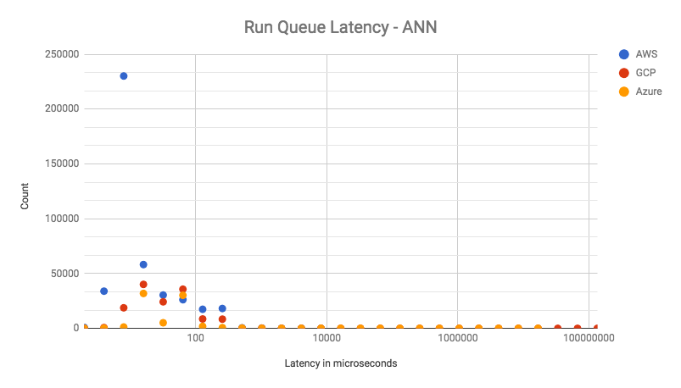
Run Queue Latency for ANN
The time from a task being enqueued on a run queue to its context switch and execution.

Slide 14
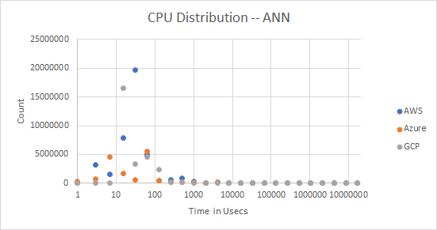
CPU Distribution for ANN
This measures the time a task spends on or off the CPU.

Slide 15
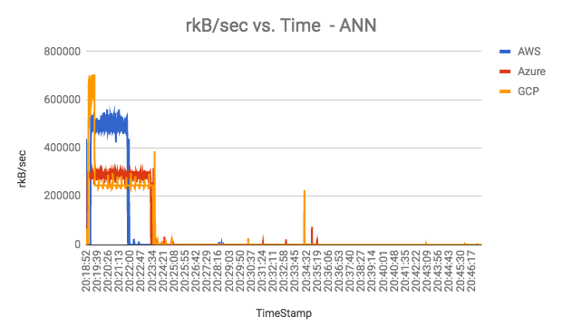
I/O Utilization for ANN
Reads in kBs/sec.
Since AWS is reading faster, it starts the data processing soon.

Slide 16
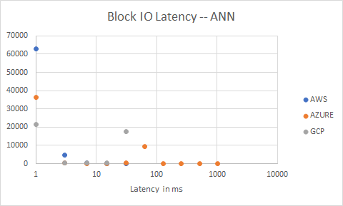
Biolatency for ANN
Why is the disk read slower ?

Slide 17
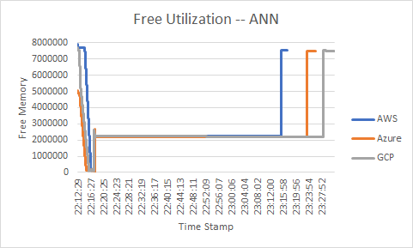
Memory Utilization for ANN

Slide 18
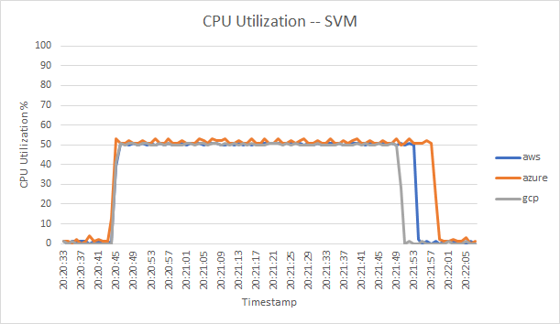
CPU Utilization for SVM

Slide 19
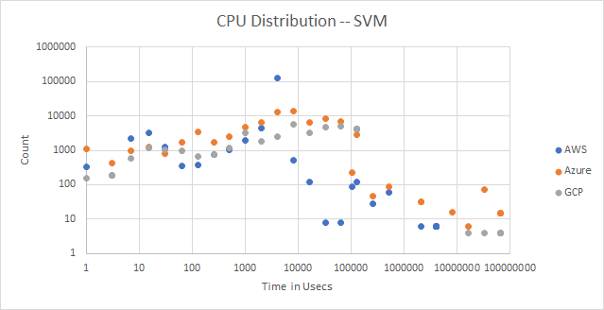
CPU Distribution for SVM

Slide 20
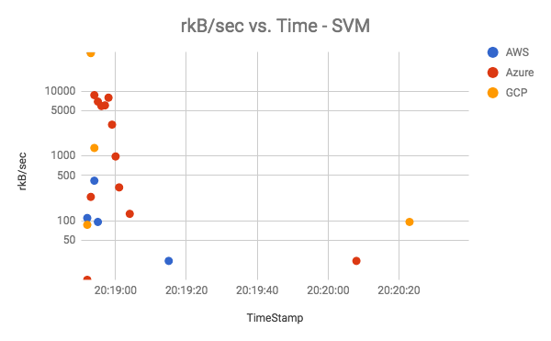
I/O Utilization for SVM

Slide 21
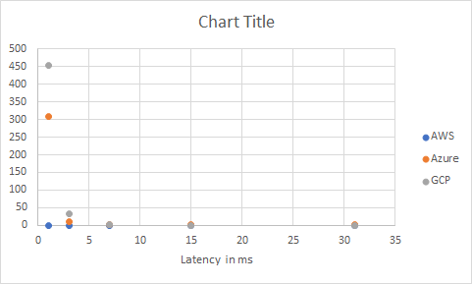
Biolatency for SVM

Slide 22
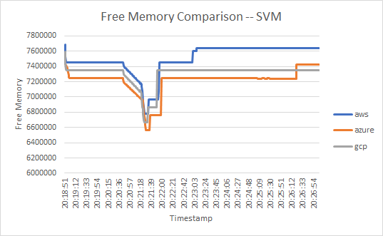
Memory Utilization for SVM

Slide 23
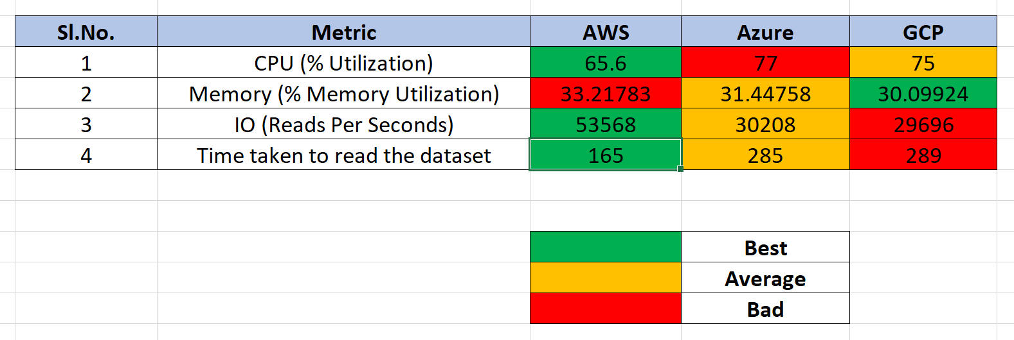
Comparison Metrics
Note: All the values are calculated based on 90th percentile.

Slide 24
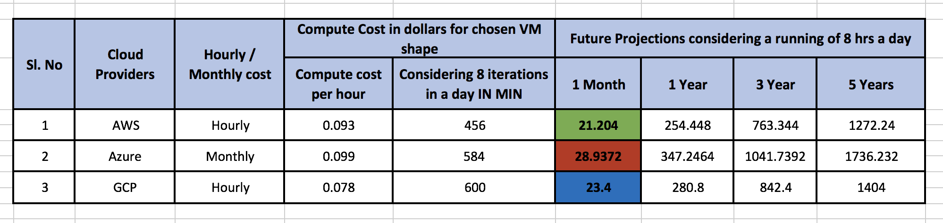
Cost Comparison between Clouds
Green - Lowest
Blue - Medium
Red - Highest

Slide 25
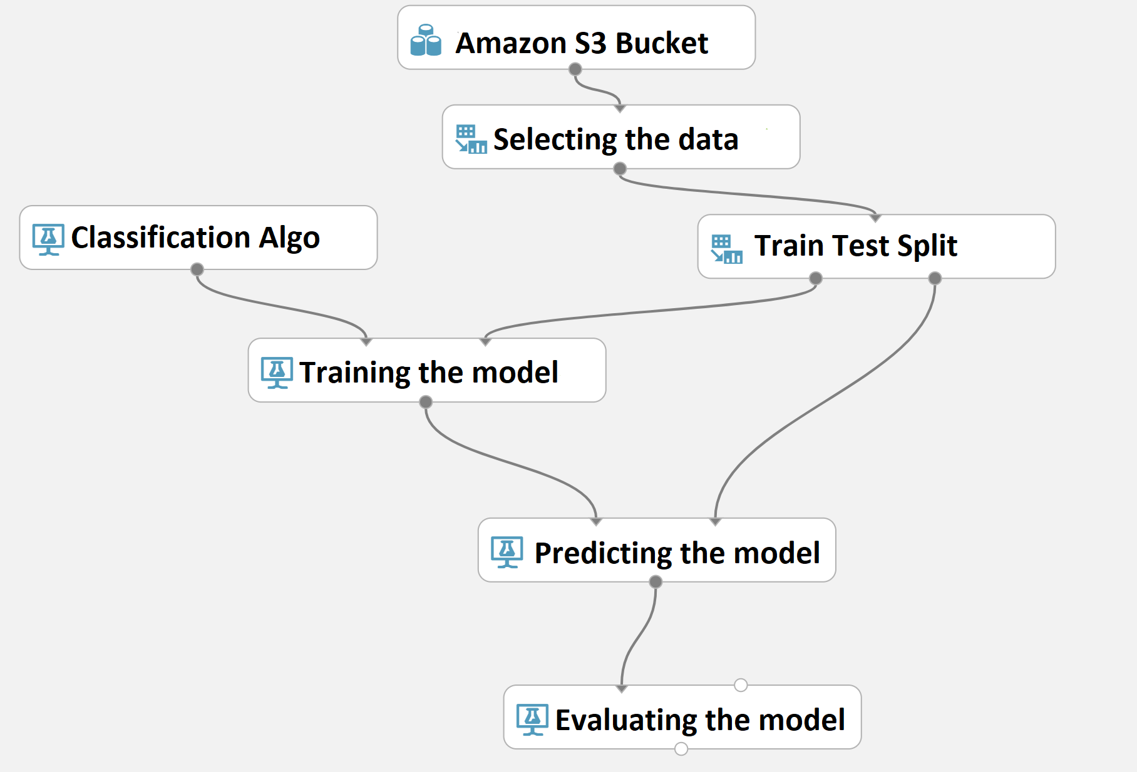
MLaaS on AWS
Cloud Services used:
Amazon Machine Learning
Amazon S3 (Storage as a Service)

Slide 26
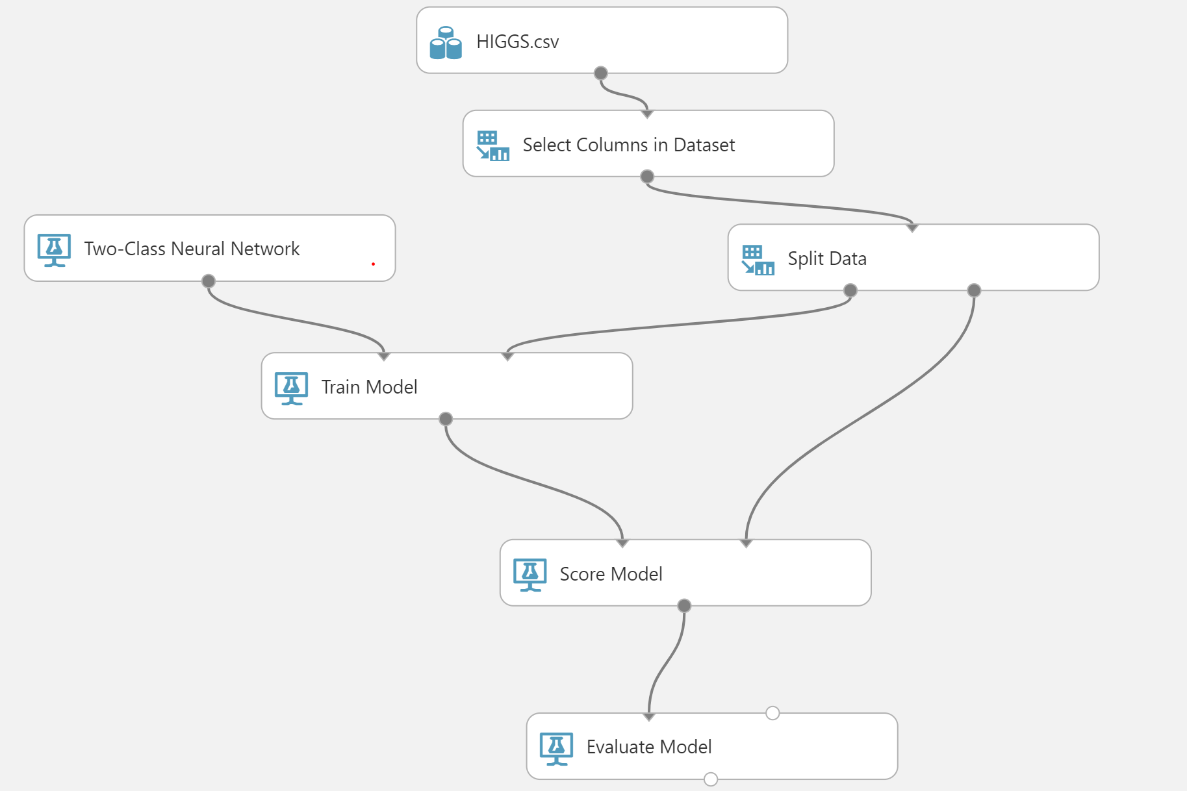
MLaaS on MS Azure
Cloud Service used:
Microsoft Azure Machine Learning Studio

Slide 27
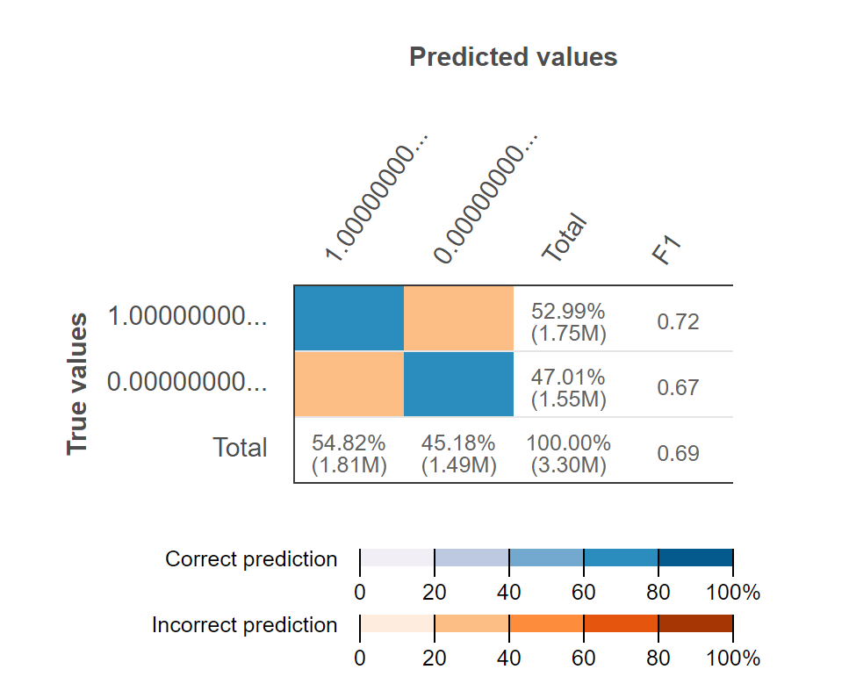
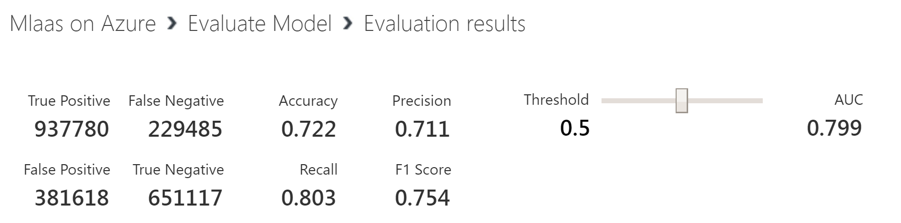
Comparison Between Accuracy for MLaaS
AWS Accuracy: 83.5%
Azure Accuracy: 72.2%

Slide 28
Challenges Faced
Storage as Service for MS Azure
Unable to upload HIGGS dataset to MS storage bucket due to the size of dataset i.e 7.8 GB.
Work around is to create a local copy of the dataset on Azure Machine Learning Studio.
Google Cloud Platform for MLaaS
Built-in machine learning algorithms are available only for language translation and analysis of image, text, speech and video.
To use other algorithms we have to port in our trained models into the studio which will not fetch us a different accuracy.
Memory Reference error

Slide 29
Conclusion
For the developed application, AWS is found to be better in terms of overall execution time by ~25%.
Also it was found that the AWS instances were better in terms of CPU and IO latency.
In terms of cost and performance, based on the analysis we did on the chosen application we would recommend to use AWS.
For MLaaS, azure was a preferable choice in terms of use but AWS was better choice in terms of accuracy.

Slide 30
Reference
https://www.youtube.com/watch?v=csFDLUYnq4w
https://www.accenture.com/t20161013T060358Z__w__/us-en/_acnmedia/PDF-34/Accenture-Oracle-Cloud-Performance-Test-October2016.pdf
https://docs.aws.amazon.com/machine-learning/latest/dg/tutorial.html
http://searchbusinessanalytics.techtarget.com/feature/Machine-learning-platforms-comparison-Amazon-Azure-Google-IBM
https://www.altexsoft.com/blog/datascience/comparing-machine-learning-as-a-service-amazon-microsoft-azure-google-cloud-ai/
https://docs.microsoft.com/en-us/azure/machine-learning/studio/create-experiment
http://scikit-learn.org/stable/modules/svm.html
http://www.drdobbs.com/tools-of-the-trade-iostat-vmstat-and/199102130
https://scottlinux.com/2012/09/12/iostat-and-vmstat-awesome-system-statistics-for-linux/

Slide 31
THANK YOU!!

Slide 32


