Slide 1
JPA 2.2
Java Persistence API (JPA):
Standard API for object-relational mapping (ORM)
Query objects stored in the underlying database using Java Persistence Query Language (JPQL)
Is a Java application programming interface specification. Famous implementations: Hibernate, EclipseLink, Toplink, OpenJPA

Slide 2
JPA 2.2
Back To Past
Most of the data that our applications manipulate has to be stored in databases, retrieved, and analyzed.
Relational databases store data in tables made of rows and columns
We write SQL statements INSERT, SELECT, UPDATE, DELETE to manipulate data from / to database. As a consequence, code is complicated and difficult to maintain.

Slide 3
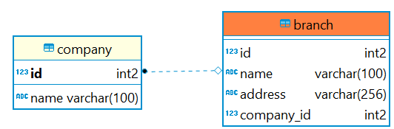
JPA

Slide 4
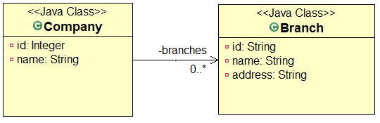
JPA
Back To Past
In Java, data is stored in objects that are instances of classes
Objects inherit from others or have collections of other objects.

Slide 5
How to bring the world of database and objects together?
Object – relational mapping (ORM)

Slide 6
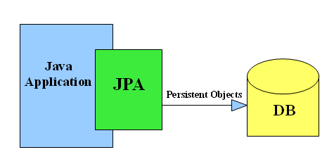
JPA

Slide 7
Topics are addressed
Entity
Embeddable class
Object-Relational Mapping
Inheritance mapping
Entity Manager
Querying Entities
Persistence Unit
Entity Life Cycle and Callbacks
Controlling Concurrent Access to Entity Data with Locking
Troubleshooting

Slide 8
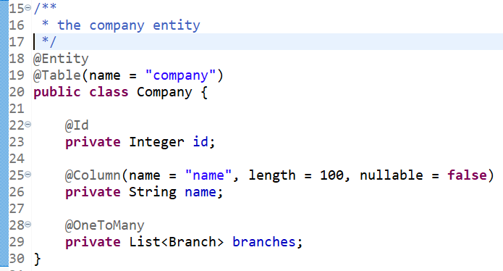

Entity
When an object mapped to a relational database (persisting object or querying object). It’s called “entity”
Entities are objects that live shortly in memory and persistently in a database

Slide 9
Entity
Characteristics:
Represent a table in database
Each instance is respective to a row in the table
It’s annotated as @Entity
Has a public or protected no-arg constructor
Field mapping: @Basic (optional, lazy), @Column (column definition)

Slide 10
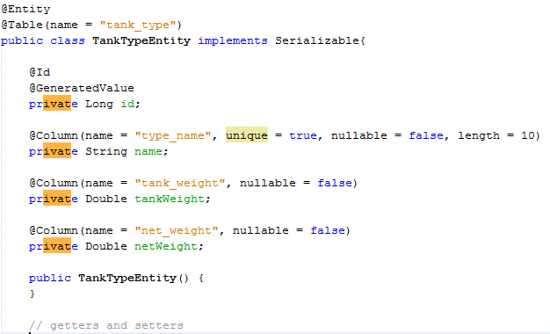
Entity
An example

Slide 11
Entity-related annotations for a column
@Basic
@Column
@Transient
@Enumerated
@ElementCollection (advance)
….

Slide 12
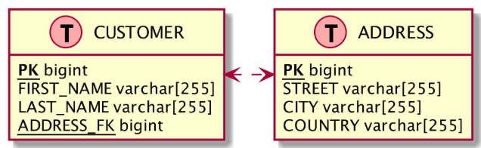


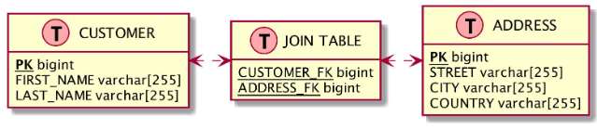

Mapping relationships
Concepts
Relationships in Objects
Relationships in db

Slide 13
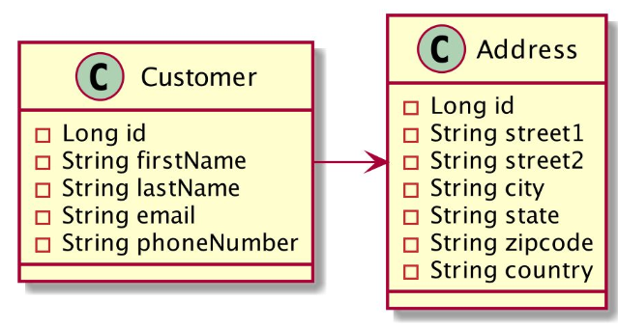
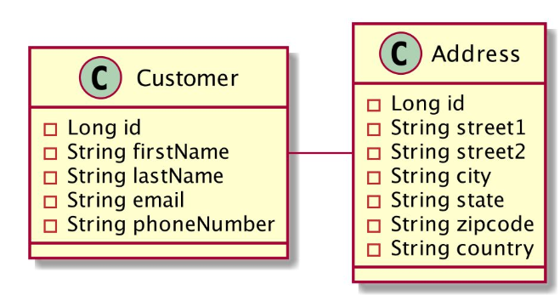
Mapping relationships
Entity relationships
Unidirectional relationship
Bidirectional relationship

Slide 14
Mapping relationships
Entity relationships
@oneToOne
@oneToMany
@manyToOne
@manyToMany

Slide 15
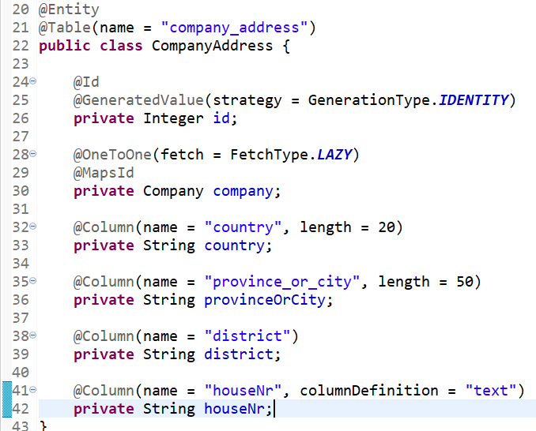
Mapping relationships
An example of @oneToOne
Notes:
Best practice:
Use lazy
Use @MapsId

Slide 16
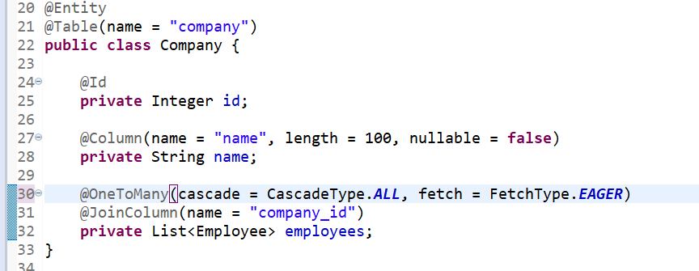
Mapping relationships
An example of @OneToMany
Notes:
Best practices:
Don’t use unidirectional one-to-many associations
Avoid the mapping of huge to-many associations
Implement helper methods to update bidirectional associations
Use lazy

Slide 17
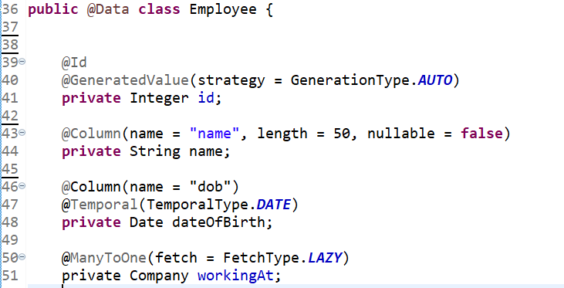
Mapping relationships
An example of @ManyToOne
Notes:
Best practices:
Define FetchType.LAZY for @ManyToOne association
If relationship is not bi-directional relationship, add mapping on Many side

Slide 18
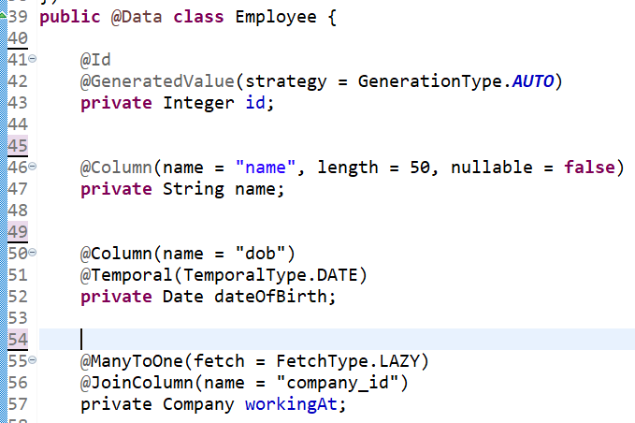
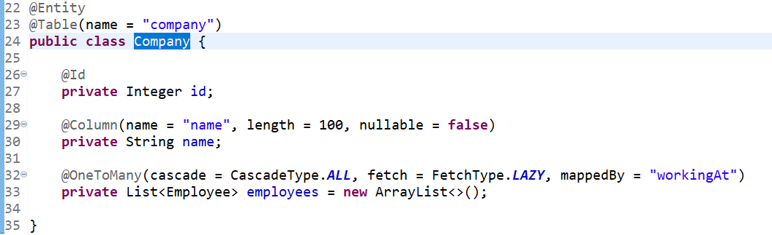
Mapping relationships
Bi-directional relationship

Slide 19
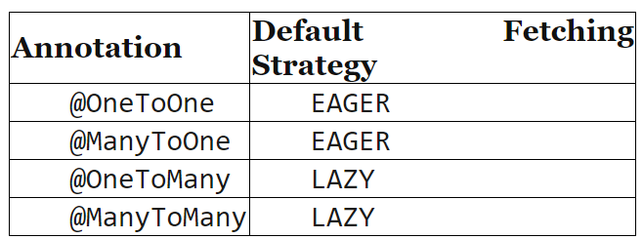
Fetching relationships
Default strategy

Slide 20
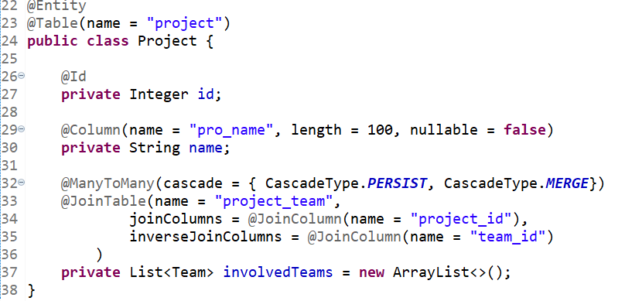
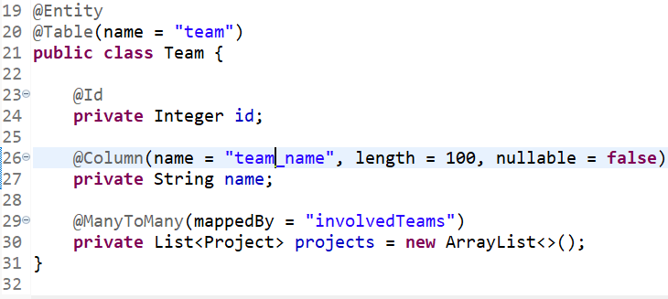
Mapping relationships
An example of @ManyToMany

Slide 21
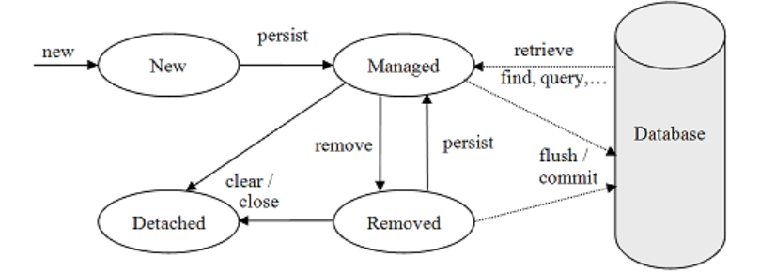
Entity Manager
Entity lifecycle

Slide 22
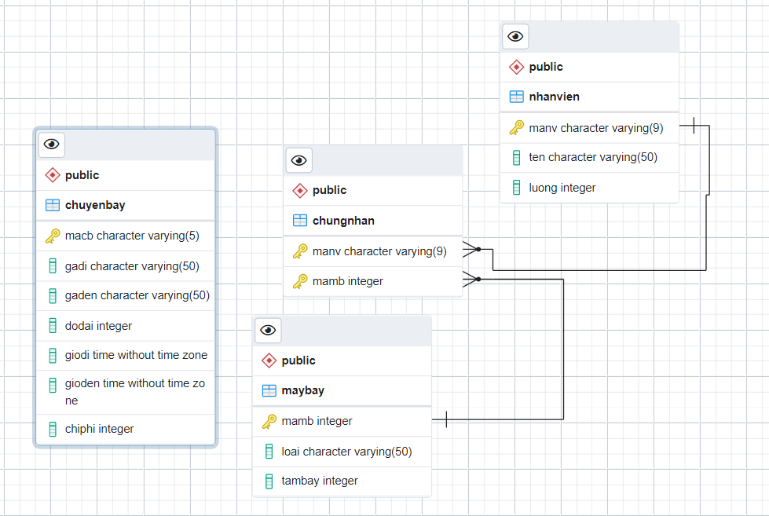
ORM exercises

Slide 23
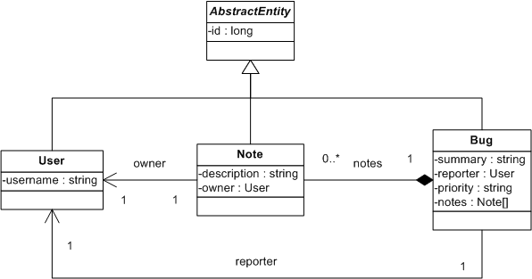
ORM exercises (cont.)

Slide 24
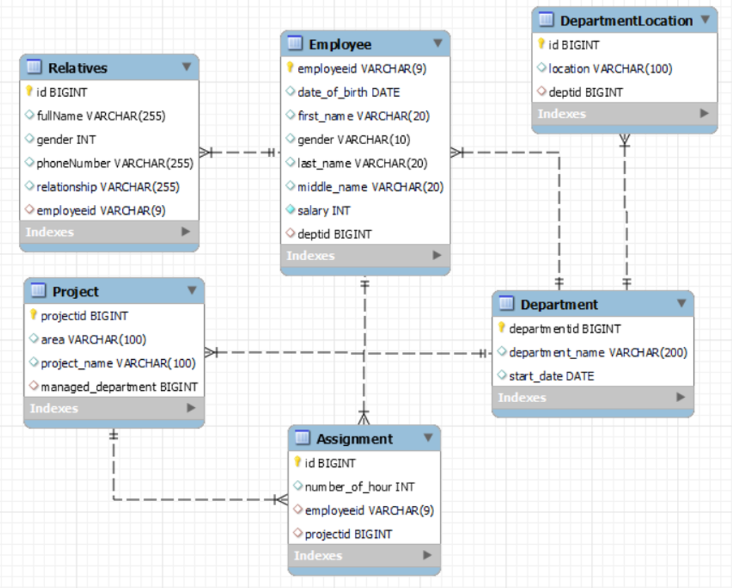
ORM exercises (cont.)

Slide 25
Entity Manager
Manage entities
Container-managed entity manager:
@PersistenceContext EntityManager em;
Application-managed entity manager
Some APIs: createQuery, persist, find, merge, remove, detach

Slide 26
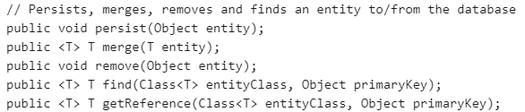


Entity manager
APIs

Slide 27
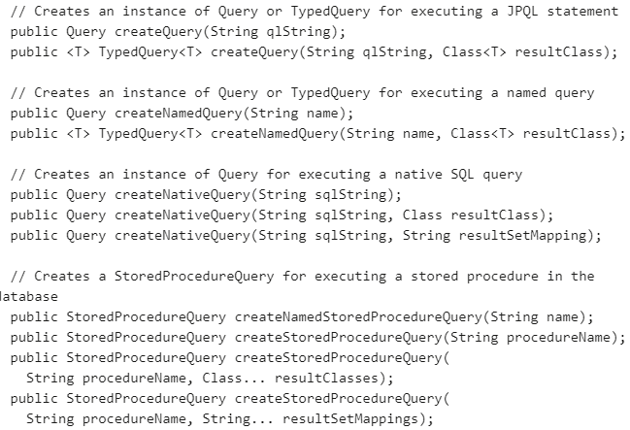
Entity manager
APIs

Slide 28
Query Entities
JPQL
Similar to SQL in terms of syntax
Works with Java classes and instances
Returned entities are in managed status
@NameQuery can be defined in Entity class
To query: use EntityManager.createQuery or EntityManager.createNamedQuery

Slide 29
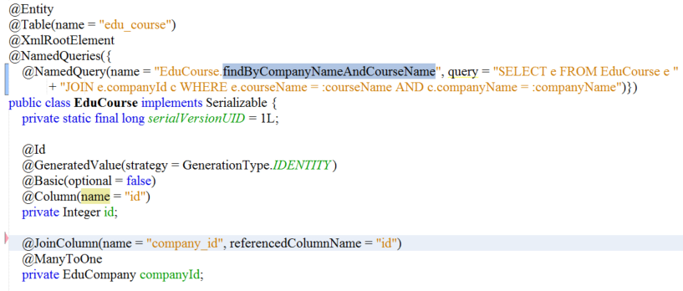
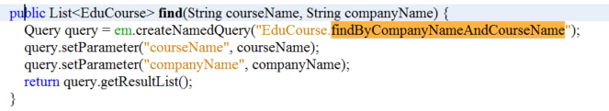
@NamedQuery

Slide 30
JPA Query Exercises
Method name (20)
https://docs.spring.io/spring-data/jpa/docs/1.5.0.RELEASE/reference/html/jpa.repositories.html
@Query (15)
NamedQuery (15)
Using HangKhong + Company ERD

