Slide 1
Competitive Searching over Terrains
Sarita de Berg Utrecht University
Nathan van Beusekom, Max van Mulken, Kevin Verbeek, Jules Wulms TU Eindhoven
Notes:
Motivation (2D) -> Line -> 1.5D Terrain -> 2.5D Terrain
Explain Competitive Ratio better, before mentioning as goal
Separation of p0 and t
Explain Beck paper better
And Lower bound on 1.5D Terrain better
Don’t spend so much time of explanation of 1.5D terrain and just define as height function
2.5D Terrain planes at intervals and reachable cells with MST
Visibility Rays
Vertical ray not clear
Bound length of strategy
Balance of correctness
No flying points
Better plane with pits
No target visibility
Not Yellow

Slide 2
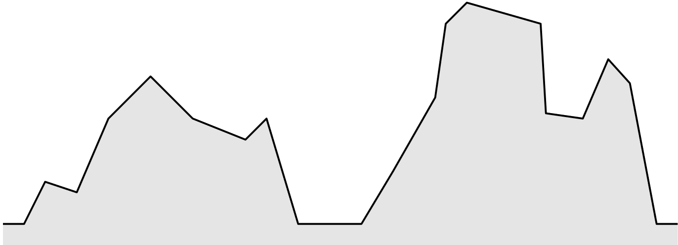


Searching over Terrain
$$t$$

Slide 3

Searching over Terrain
$$t$$

Slide 4

Competitive Ratio $c$
Considers worst-case instance
$c=\max_{}{\frac{\left|Strategy Path\right|}{|Shortest Path|}}$
Goal: minimize $c$

Slide 5


Competitive Searching on a Line
Line with unit distances
Doubling strategy (Beck & Newman, 1970)
$$t$$
$$p_{0}$$

Slide 6
Competitive Searching on a Line
Line with unit distances
Doubling strategy (Beck & Newman, 1970)
$$t$$
$$p_{0}$$

Slide 7
Competitive Searching on a Line
Line with unit distances
Doubling strategy (Beck & Newman, 1970)
$$t$$
$$p_{0}$$

Slide 8
Competitive Searching on a Line
Line with unit distances
Doubling strategy (Beck & Newman, 1970)
$$t$$
$$p_{0}$$

Slide 9
Competitive Searching on a Line
Line with unit distances
Doubling strategy (Beck & Newman, 1970)
$$t$$
$$p_{0}$$

Slide 10
Competitive Searching on a Line
Line with unit distances
Doubling strategy (Beck & Newman, 1970)
$$t$$
$$p_{0}$$

Slide 11
Competitive Searching on a Line
Line with unit distances
Doubling strategy (Beck & Newman, 1970)
$$t$$
$$p_{0}$$

Slide 12
Competitive Searching on a Line
Line with unit distances
Doubling strategy (Beck & Newman, 1970)
$$t$$
$$p_{0}$$

Slide 13

Competitive Searching on a Line
Competitive ratio?
$$p_{0}$$
$$t$$

Slide 14

Competitive Searching on a Line
Competitive ratio?
$$p_{0}$$
$$t$$
$$x$$

Slide 15

Competitive Searching on a Line
Competitive ratio?
Distance traveled: $3x$
$$p_{0}$$
$$t$$
$$x$$

Slide 16

Competitive Searching on a Line
Competitive ratio?
Distance traveled: $4x$
$$p_{0}$$
$$t$$
$$x$$

Slide 17


Competitive Searching on a Line
Competitive ratio?
Distance traveled: $6x$
$$p_{0}$$
$$t$$
$$2x$$
$$x$$

Slide 18

Competitive Searching on a Line
Competitive ratio?
Distance traveled: $8x$
$$p_{0}$$
$$t$$
$$2x$$
$$x$$

Slide 19

Competitive Searching on a Line
Competitive ratio?
Distance traveled: $9x+1$
$$p_{0}$$
$$t$$
$$2x$$
$$x$$

Slide 20

Competitive Searching on a Line
Competitive ratio?
Competitive ratio: $\frac{9x+1}{x+1}$
$$p_{0}$$
$$t$$
$$2x$$
$$x$$

Slide 21

Competitive Searching on a Line
Competitive ratio?
Competitive ratio: $\lim_{x→∞}{\frac{9x+1}{x+1}=9}$
Optimal
$$p_{0}$$
$$t$$
$$2x$$
$$x$$

Slide 22
Competitive Searching over 1.5D Terrain
1-dimensional height function
$$t$$

Slide 23
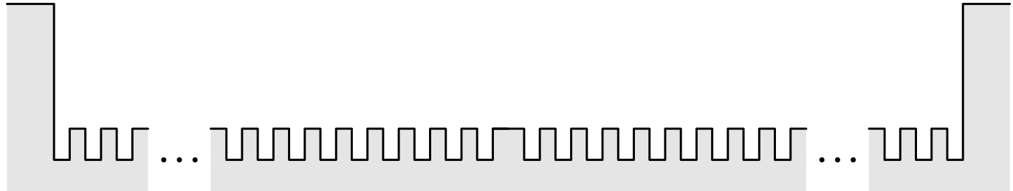
1.5D Terrains – Lower Bound

Slide 24
1.5D Terrains – Lower Bound

Slide 25




1.5D Terrains – Lower Bound
Lower bound for any searching strategy:
$$c≥ \sqrt{82}$$
$$\sqrt{82}$$
$$1$$
$$9$$

Slide 26


1.5D Terrains – Strategy
$$t$$
$$p_{0}$$

Slide 27

1.5D Terrains – Strategy
$$r$$
$$t$$
$$p_{0}$$

Slide 28
1.5D Terrains – Strategy
$$r$$
$$t$$
$$p_{0}$$

Slide 29
1.5D Terrains – Strategy
$$r$$
$$t$$
$$p_{0}$$

Slide 30
1.5D Terrains – Upper Bound
$$r$$
$$t$$
$$p_{0}$$

Slide 31


1.5D Terrains – Upper Bound
Worst-case instance
Vertical ray $r$
$$p_{0}$$

Slide 32

1.5D Terrains – Upper Bound
Worst-case instance
Obstructing terrain
$$p_{0}$$

Slide 33
1.5D Terrains – Upper Bound
Worst-case instance
Obstructing terrain
$$p_{0}$$

Slide 34

1.5D Terrains – Upper Bound
Worst-case instance
Obstructing terrain
Choose suitable slope: $s= \frac{\sqrt{2}}{6}$
$$c ≤3\sqrt{19/2}$$
$$9.055 ≤c≤9.247$$
$$p_{0}$$

Slide 35
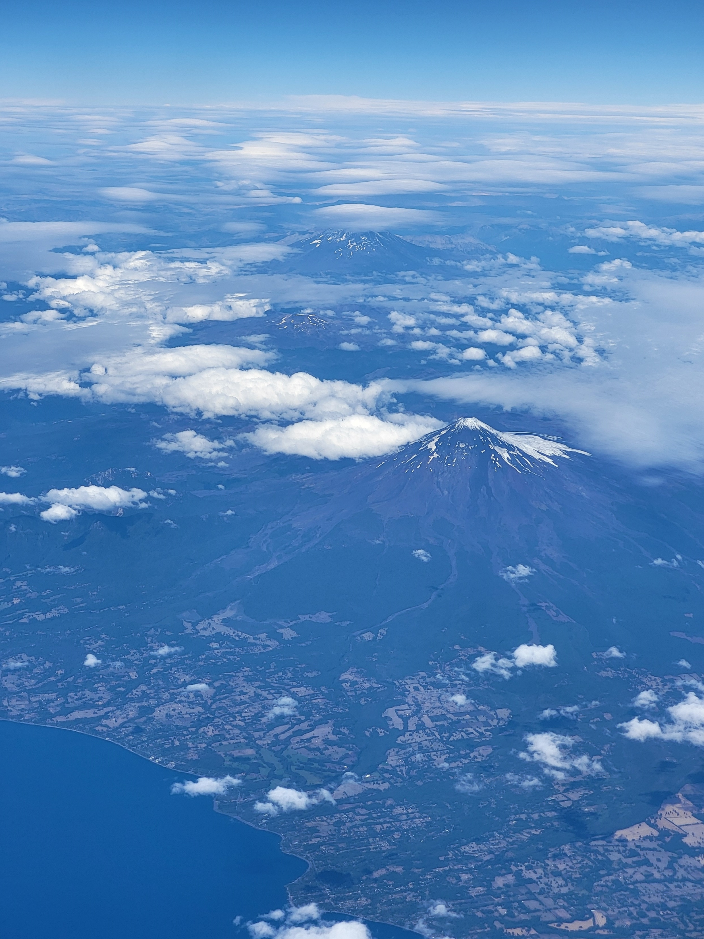
2.5D Terrain
Can we do anything?

Slide 36
2.5D Terrain

Slide 37
2.5D Terrain

Slide 38
2.5D Terrain

Slide 39
2.5D Terrain

Slide 40

2.5D Terrain
Cannot do anything without knowledge of terrain
Bound maximum slope $λ$ of the terrain

Slide 41

2.5D Terrain – Bounds
$$p_{0}$$

Slide 42
2.5D Terrain – Bounds
$$p_{0}$$

Slide 43
2.5D Terrain – Bounds
$$p_{0}$$

Slide 44

2.5D Terrain – Bounds
Moving upwards: O($λ$)
$$p_{0}$$
Notes:
Can we do better?

Slide 45

2.5D Terrain – Lower Bound
$c∊Ω$($\sqrt{λ}$)

Slide 46
2.5D Terrain – Strategy

Slide 47


2.5D Terrain – Upper Bound
$c∊O$($\sqrt{λ}$)
$$p$$

Slide 48

Conclusion
1.5D Terrain
$$c≥ \sqrt{82}$$
$$c ≤3\sqrt{19/2}$$
2.5D Terrain
$c∊Ω$($\sqrt{λ}$)
$c∊O$($\sqrt{λ}$)
Notes:
No morph for general

