Slide 1

FINAL REPORT
PRESENTED BY CAO NGUYEN, MINH HOANG
CONTENT BY TUAN KIET, HONG VU

Slide 2
Table of contents
01
02
03
JUNIT
TEST COVERAGE
RESULT

Slide 3
01
JUNIT
Testing with JUnit in Java

Slide 4
JUNIT
01
1. Android Testing
Android testing is the process of evaluating and verifying the functionality, performance, and stability of an Android application to ensure it works as expected across different devices and conditions.
Tools Used for Android Testing:
JUnit
Espresso
Mockito
UI Automator
Robolectric

Slide 5
JUNIT
01
2. JUnit
JUnit is a widely-used testing framework for the Java programming language. It provides a set of tools and annotations to help developers write and run tests for their Java applications, ensuring that individual units of code (such as methods or classes) work as expected.

Slide 6
JUNIT
01
2. JUnit
Features of Junit:
JUnit is an open-source framework used to write and run tests.
It provides annotations to define test methods.
It provides assertions to check expected results.
It provides test runners to execute test scripts.
JUnit test cases can be run automatically.
JUnit test cases can be organized into test suites.
JUnit shows test results visually: pass (no errors) is green, and fail (errors) is red.

Slide 7
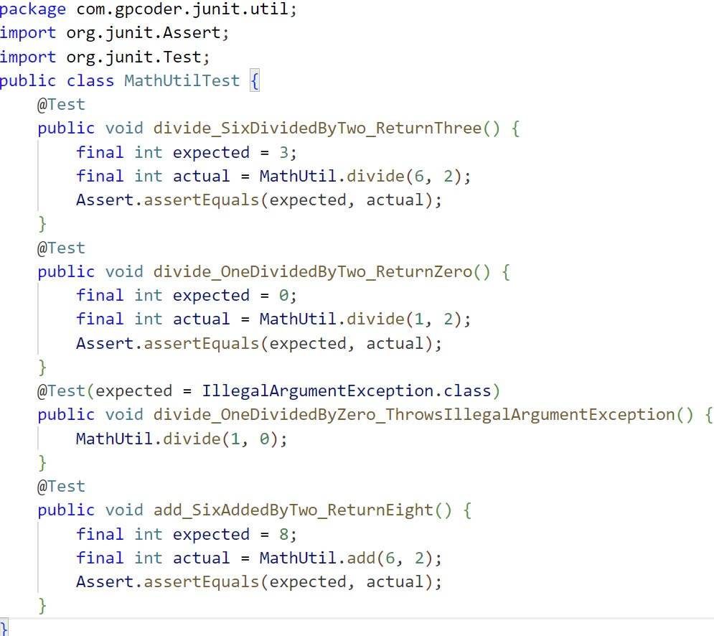
JUNIT
01
2. JUnit
Examples:

Slide 8
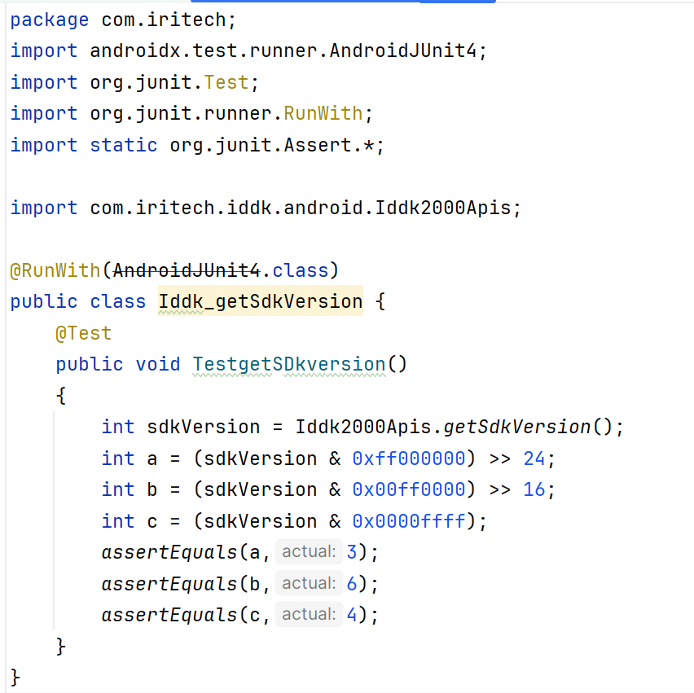
JUNIT
01
2. JUnit
Examples in IriShield Demo:

Slide 9
02
TEST COVERAGE

Slide 10
TEST COVERAGE
02
1. What is Code coverage?
Code coverage is a software testing metric used to measure the extent to which the source code of a program is executed when a particular test suite runs. It helps assess the effectiveness of tests by showing which parts of the code are covered (executed) by tests and which parts are not.

Slide 11
TEST COVERAGE
02
2. How Code coverage is caculated?
Code coverage tools use one or more criteria to determine how the code was exercised or not during the execution of the test suite. Common metrics mentioned in coverage reports include:

Slide 12
TEST COVERAGE
02
2. How Code coverage is caculated?
Function coverage: how many of the functions defined have been called.
Statement coverage: how many of the statements in the program have been executed.
Branches coverage: how many of the branches of the control structures (if statements for instance) have been executed.
Line coverage: how many of lines of source code have been tested.

Slide 13
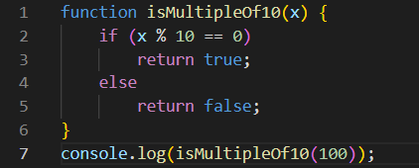
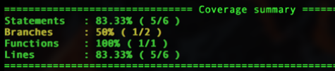
TEST COVERAGE
02
2. How Code coverage is caculated?
These metrics are usually represented as the number of items actually tested, the items found in your code, and a coverage percentage (items tested / items found).
Examples:
With one function call:
Result:

Slide 14
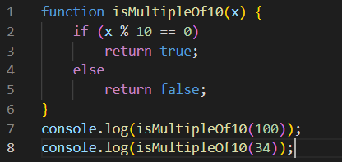
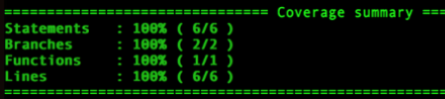
TEST COVERAGE
02
2. How Code coverage is caculated?
With one function call:
Result:

Slide 15
TEST COVERAGE
02
3. JaCoCo

Slide 16
03
RESULT

Slide 17
RESULT
03
IriShield Demo Test Plan
IriShield Demo Test Case
IriShield Demo Unit Test with JUnit

Slide 18
THANKS FOR WATCHING!

