Slide 1
Linear Algebra
Lecture 6: Convex Sets
Nikolay V. Bogachev
Moscow Institute of Physics and Technology
Department of Discrete Mathematics
Laboratory of Advanced Combinatorics and Network Applications

Slide 2

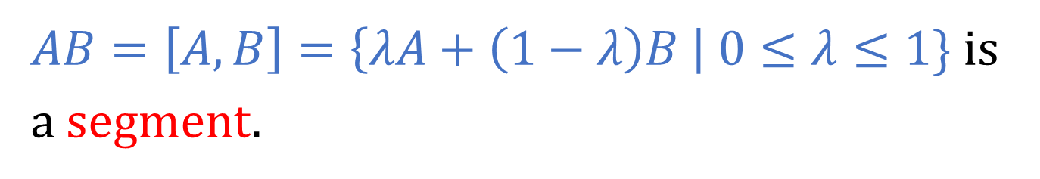
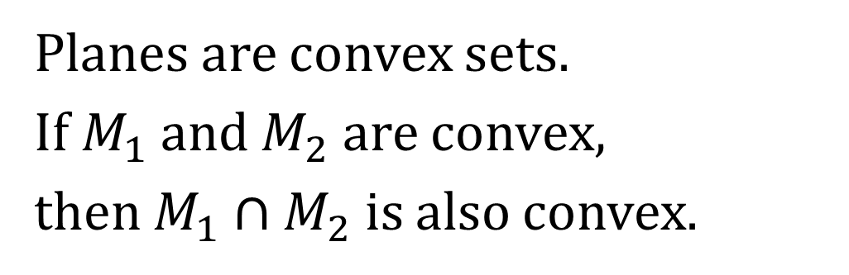


Convex Sets
Suppose 𝔸 is an affine space.
$AB=\left[A,B\right]=\left\{λA+\left(1−λ\right)B \right| 0≤λ≤1\}$ is a segment.
$$B$$
M is convex if:
$$A$$
$$M$$
Planes are convex sets.
If $M_{1}$ and $M_{2}$ are convex,
then $M_{1}∩M_{2}$ is also convex.

Slide 3
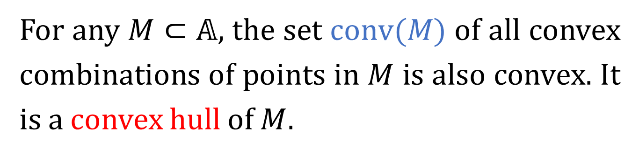
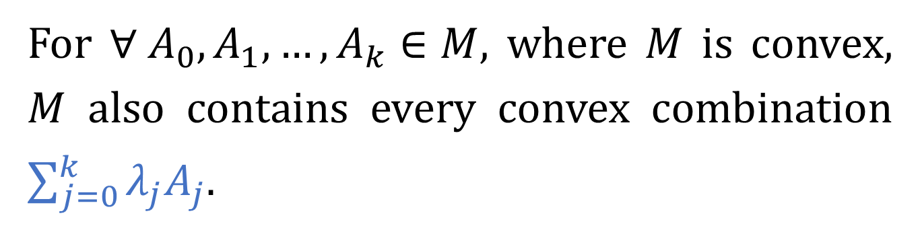
Convex Hull
A convex linear combination of points in 𝔸 is
their barycentric combination with non-negative coefficients.
For ${∀ A}_{0},A_{1},…, A_{k}∈M,$ where $M$ is convex, $M$ also contains every convex combination $\sum_{j=0}^{k}{λ_{j}A_{j}}$.
For any $M⊂\text{𝔸}\text{,}$ the set $conv(M)$ of all convex combinations of points in $M$ is also convex. It is a convex hull of $M.$

Slide 4

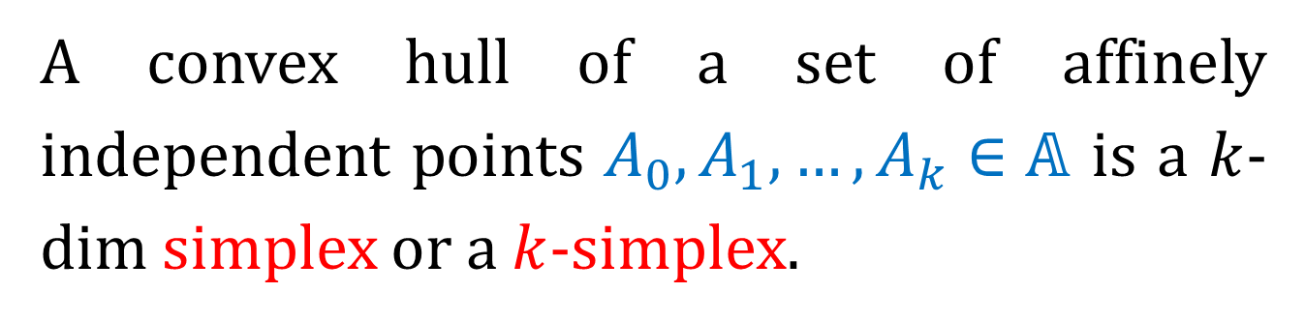



Simplex
A convex hull of a set of affinely independent points $A_{0},A_{1},…, A_{k}∈\text{𝔸}$ is a $k$-dim simplex or a $k$-simplex.
0-simplex is a point, 1-simplex is a segment, 2-simplex is a triangle, etc.
$$k=0$$
$$k=1$$
$$k=2$$
$$k=3$$

Slide 5
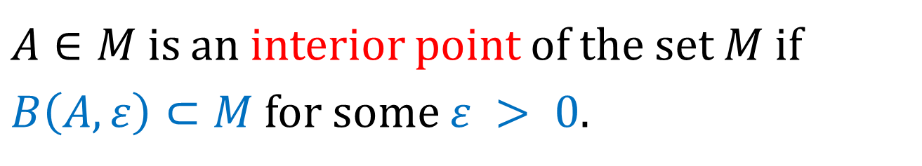
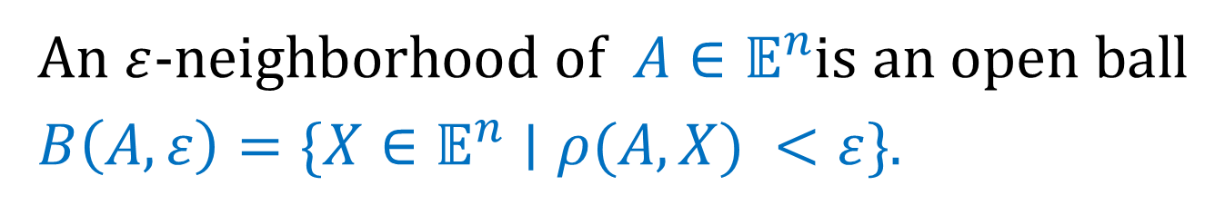
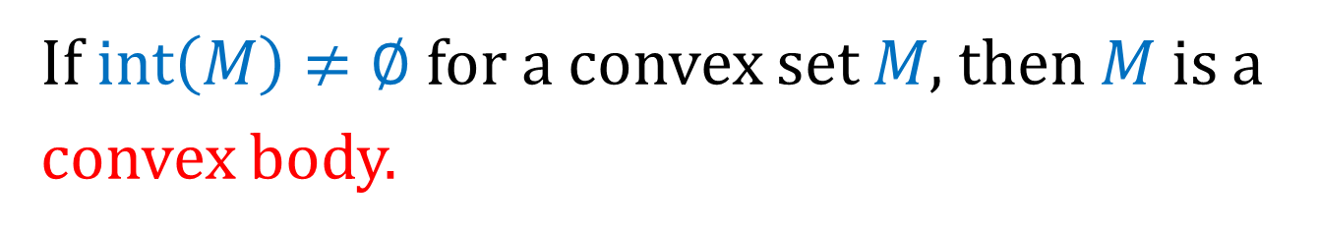
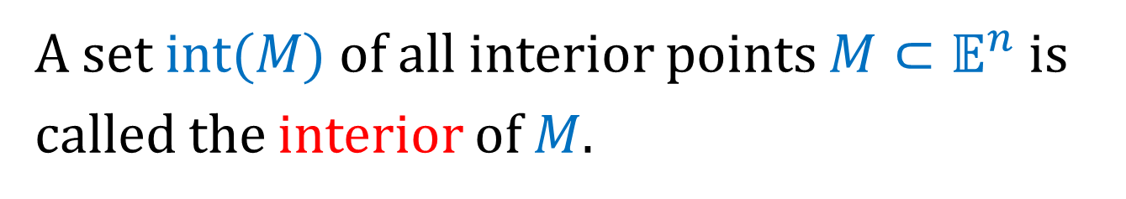
Neighborhoods and Interior Points
An $ε$-neighborhood of $A∈𝔼^{n}$is an open ball $B\left(A,ε\right)=\{X∈𝔼^{n}∣ρ(A,X) <ε\}$.
$A∈M$ is an interior point of the set $M$ if $B\left(A, ε\right)⊂M$for some $ε > 0.$
A set $int(M)$of all interior points $M⊂𝔼^{n}$ is called the interior of $M$.
If $int\left(M\right)≠∅$ for a convex set $M$, then $M$ is a convex body.

Slide 6
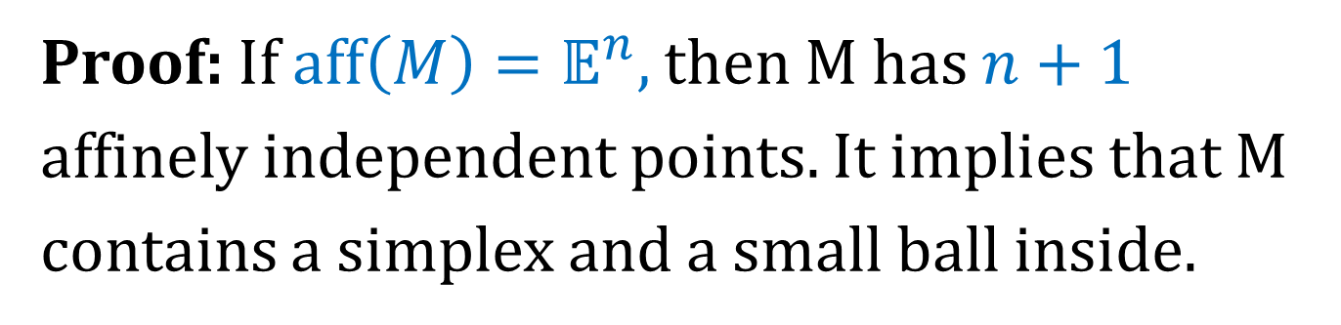

Convex Body
Suppose M is convex. Then
$int\left(M\right)≠∅⇔aff\left(M\right)=𝔼^{n}$.
Proof: If $aff\left(M\right)=𝔼^{n},$ then M has $n+1$ affinely independent points. It implies that M contains a simplex and a small ball inside.
The converse is obvious.

Slide 7
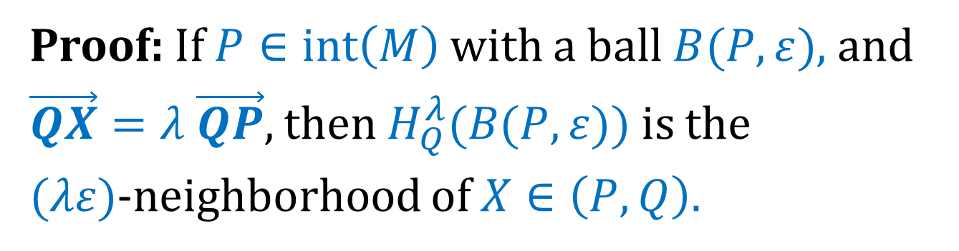
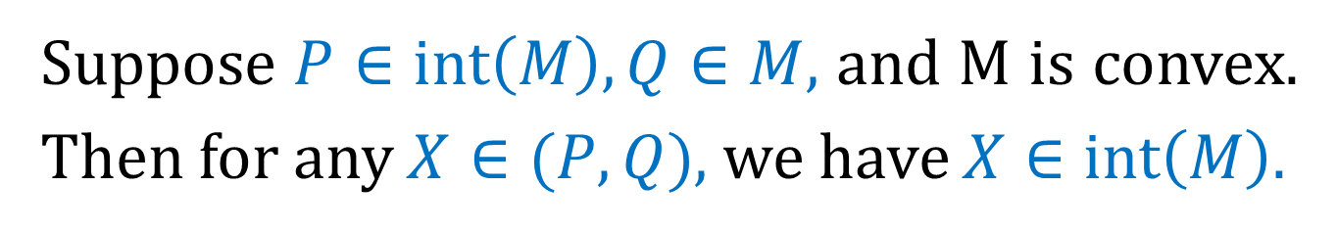



Neighborhoods and Interior Points
Suppose $P∈int\left(M\right), Q∈M,$ and M is convex. Then for any $X∈(P,Q)$, we have $X∈int\left(M\right).$
Proof: If $P∈int\left(M\right)$ with a ball $B(P, ε)$, and $\vec{QX}=λ \vec{QP},$then $H_{Q}^{λ}(B(P, ε))$ is the
$(λε)$-neighborhood of $X∈\left(P,Q\right).$
$$P$$
$$X$$
$$Q$$

Slide 8
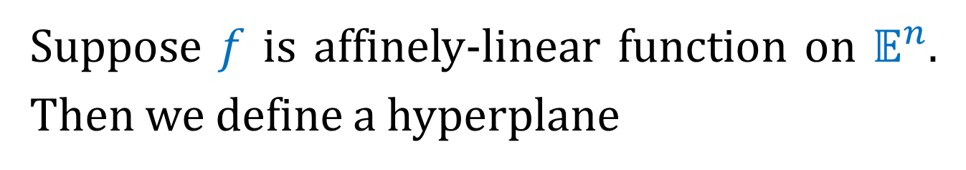
Hyperplanes and Half-Spaces
Suppose $f$ is affinely-linear function on $𝔼^{n}$. Then we define a hyperplane
$$H_{f}≔\{x∈𝔼^{n}∣f\left(x\right)=0\}$$
and half-spaces
$$H_{f}^{+}≔\{x∈𝔼^{n}∣f\left(x\right)≥0\}$$
$$H_{f}^{−}≔\left\{x∈𝔼^{n} ∣ f\left(x\right)≤0\right\}.$$

Slide 9

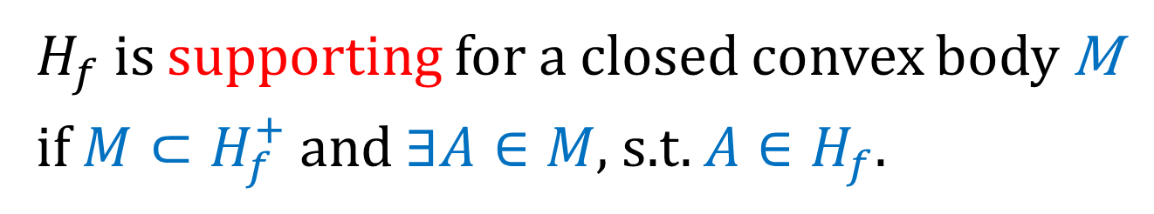

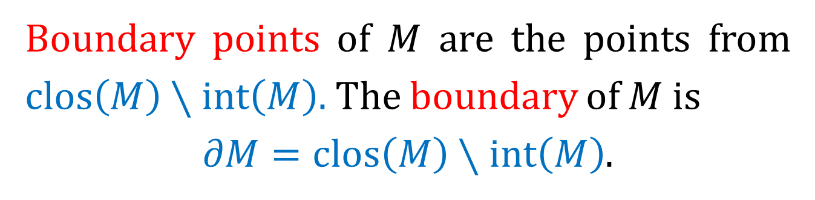



Hyperplanes and Half-Spaces
Boundary points of $M$ are the points from $clos\left(M\right)∖int\left(M\right).$ The boundary of $M$ is
$∂M=clos\left(M\right)∖int\left(M\right)$.
$H_{f}$ is supporting for a closed convex body M if $M⊂H_{f}^{+}$ and $∃A∈M$, s.t. $A∈H_{f}.$
$$H_{f}^{+}$$
$$M$$
$$A$$
$$H_{f}^{−}$$
$$H_{f}^{}$$

Slide 10



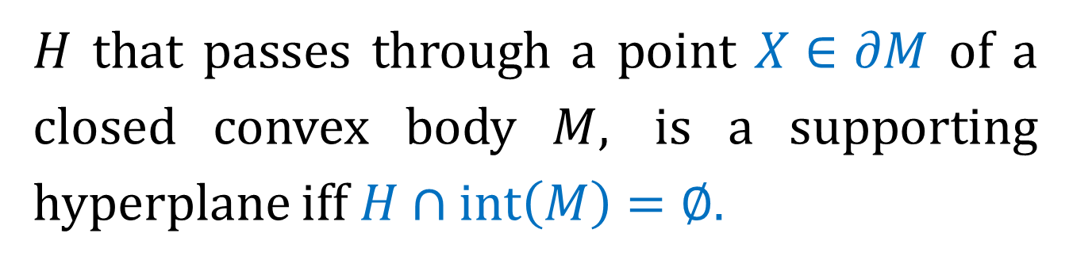


Supporting Hyperplanes
$H$ that passes through a point $X∈∂M$ of a closed convex body $M,$ is a supporting hyperplane iff $H∩int\left(M\right)=∅$.
Proof: If $H∩int\left(M\right)≠∅,$ then points of $int(M)$ lie in both sides of $H.$ Conversely, if points of $M$ lie in both sides of $H,$ then $∃\left(A,B\right),$ connecting $A∈H^{+}∩int(M)$ and $B∈H^{−}∩int\left(M\right),$ since any $X∈M$ is a limit point for $int\left(M\right).$ Clearly, $\left(A,B\right)∩H≠∅.$
$$H_{}^{+}$$
$$M$$
$$X$$
$$H_{}^{−}$$
$$H_{}^{}$$

Slide 11
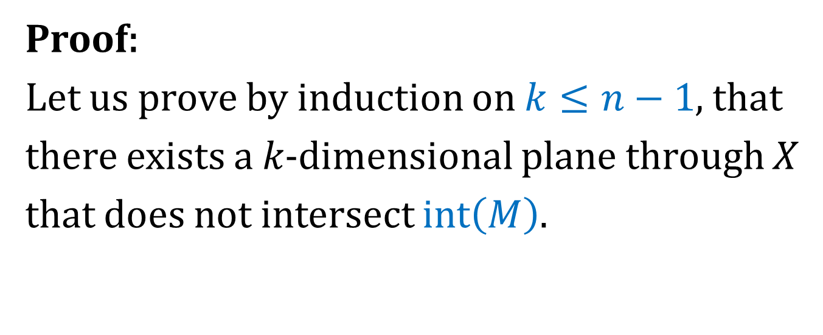
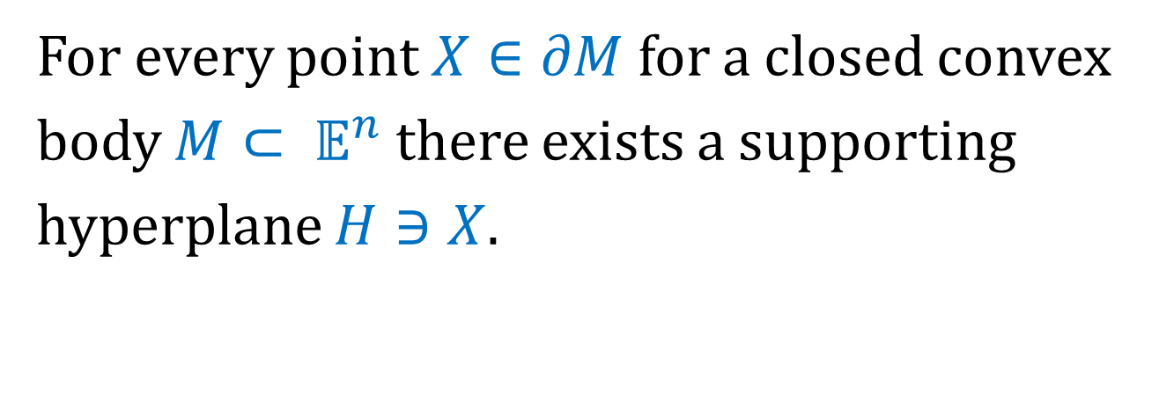
The Separation Theorem
For every point $X∈∂M$ for a closed convex body $M⊂ 𝔼^{n}$ there exists a supporting hyperplane $H∋X$.
Proof:
Let us prove by induction on $k≤n−1$, that there exists a 𝑘-dimensional plane through 𝑋 that does not intersect $int\left(M\right).$

Slide 12
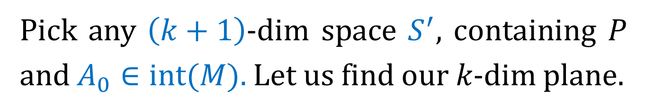
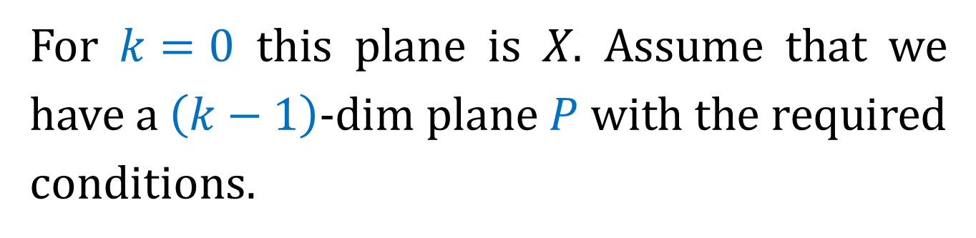
The Separation Theorem
For $k=0$ this plane is 𝑋. Assume that we have a $\left(k−1\right)$-dim plane $P$ with the required conditions.
Pick any $\left(k+1\right)$-dim space $S^{′},$ containing 𝑃 and $A_{0}∈int(M).$Let us find our 𝑘-dim plane.

Slide 13

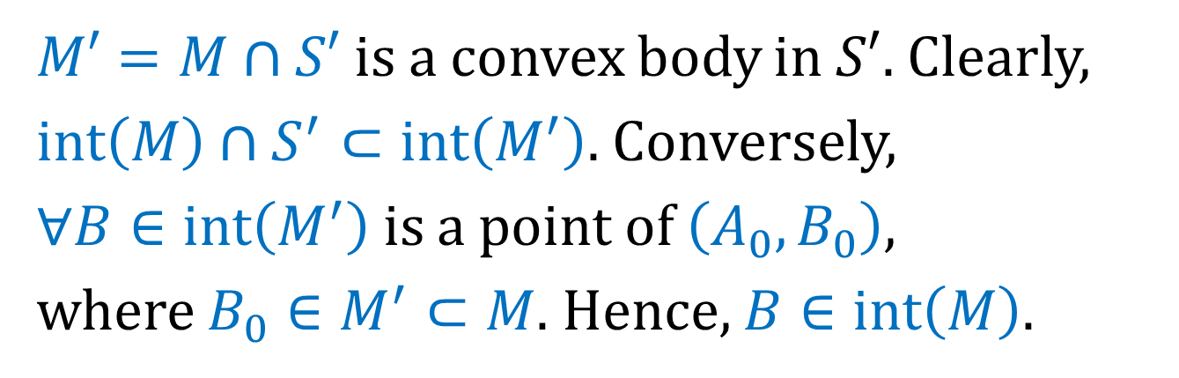



The Separation Theorem
$M′=M∩S′$is a convex body in $S′$. Clearly, $int\left(M\right)∩S^{′}⊂int\left(M^{′}\right).$ Conversely,
$∀B∈int\left(M^{′}\right)$ is a point of $\left(A_{0},B_{0}\right)$,
where $B_{0}∈M^{′}⊂M.$ Hence, $B∈int\left(M\right).$
$$M′$$
$$A_{0}$$
$$B$$
$$B_{0}$$

Slide 14

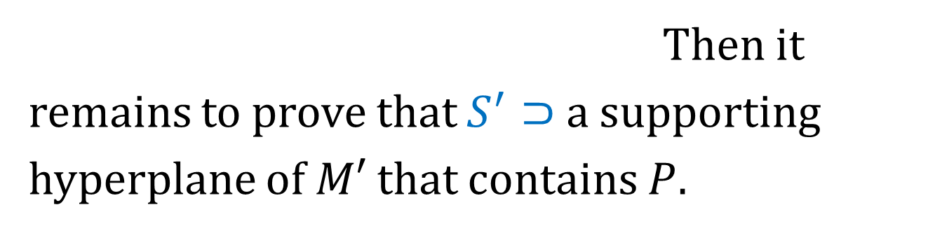



The Separation Theorem
Therefore,
$$int\left(M^{′}\right)=int\left(M\right)∩S^{′}.$$
Hence, $B∈int\left(M\right).$
Then it remains to prove that $S^{′}⊃$ a supporting hyperplane of $M′$ that contains $P.$
It follows that $P∩int\left(M^{′}\right)=∅.$
We change the notation:
$$S^{′}=S, M^{′}=M, k+1=n.$$

Slide 15
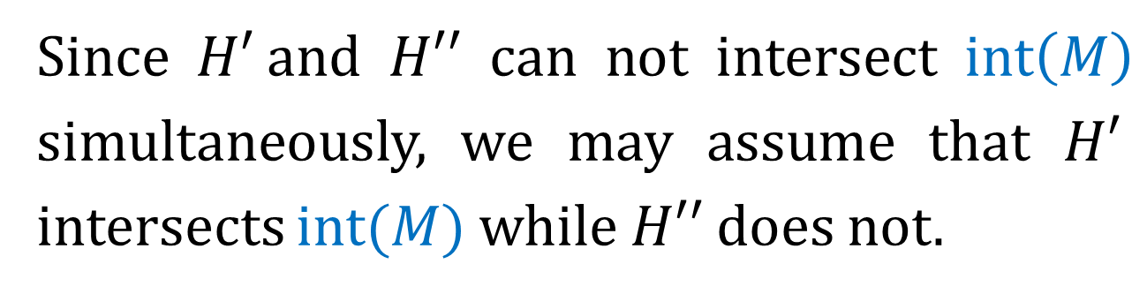
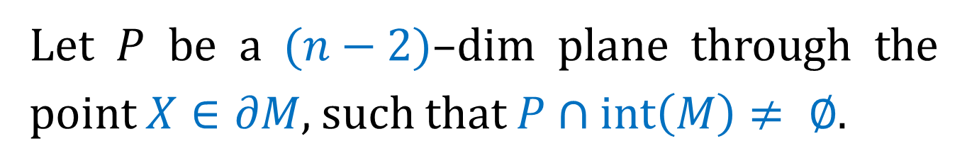
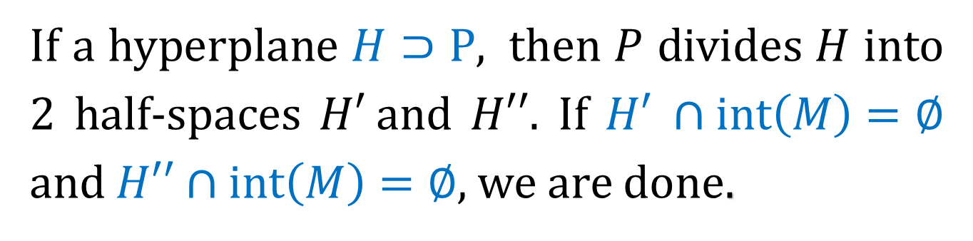
The Separation Theorem
Let $P$ be a $(n−2)$–dim plane through the point $X∈∂M,$ such that $P∩int\left(M\right)≠ ∅$.
If a hyperplane $H⊃P,$ then $P$ divides $H$ into 2 half-spaces $H′$and $H′′.$ If $H′ ∩int\left(M\right)=∅$ and $H′′∩int\left(M\right)=∅,$ we are done.
Since $H′$and $H′′$ can not intersect $int\left(M\right)$ simultaneously, we may assume that $H′$ intersects $int(M)$ while $H′′$does not.

Slide 16







The Separation Theorem
Let us rotate $H$ around $P,$ clockwise.
$$H_{}^{′}$$
$$H_{0}^{′}$$
$$M$$
$$P$$
$$H_{}^{′′}$$
$$H_{0}^{′′}$$

