Slide 1
Linear Algebra
Lecture 7: Linear Operators I
Nikolay V. Bogachev
Moscow Institute of Physics and Technology
Department of Discrete Mathematics
Laboratory of Advanced Combinatorics and Network Applications

Slide 2
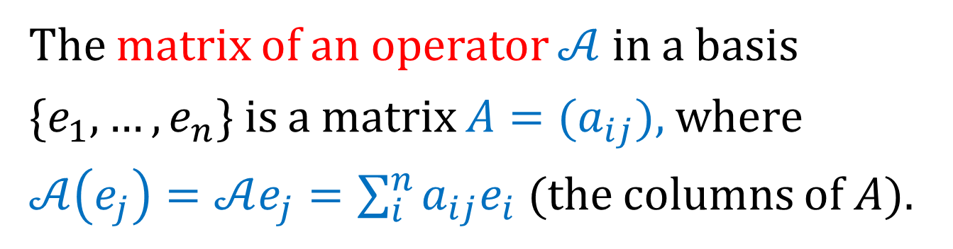
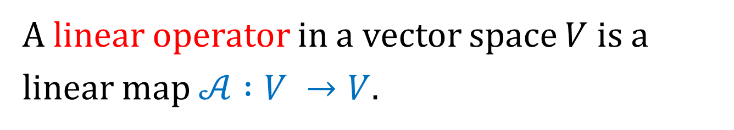
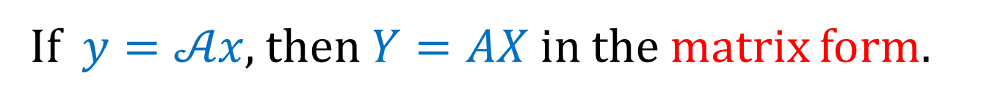

Linear Operators: Preliminaries
A linear operator in a vector space $V$ is a linear map $𝒜 :V →V$.
The matrix of an operator $𝒜$ in a basis $\{e_{1},…, e_{n}\}$ is a matrix $A=(a_{ij})$, where
$𝒜\left(e_{j}\right)=𝒜e_{j}=\sum_{i}^{n}{a_{ij}e_{i}}$ (the columns of $A$).
That is, $\left(𝒜e_{1},…,𝒜e_{n}\right)=\left(e_{1},…,e_{n}\right)A$.
If $y=𝒜x$, then $Y=AX$ in the matrix form.

Slide 3
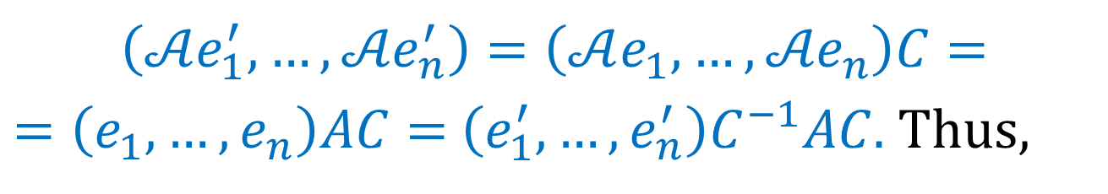

Transition of Coordinates
Let $\left(e_{1}^{′},…, e_{n}^{′}\right)=\left(e_{1},…,e_{n}\right)C$. Then we have
$$\left(𝒜e_{1}^{′},…, {𝒜e}_{n}^{′}\right)=\left(𝒜e_{1},…,{𝒜e}_{n}\right)C=$$
$=\left(e_{1},…,e_{n}\right)AC=$ $\left(e_{1}^{′},…, e_{n}^{′}\right)C^{−1}AC.$ Thus,
$$A^{′}=C^{−1}AC .$$
Main question: how can we change a basis in such a way that the matrix has a simple form?
Invariant subspaces and eigenvectors are coming!

Slide 4

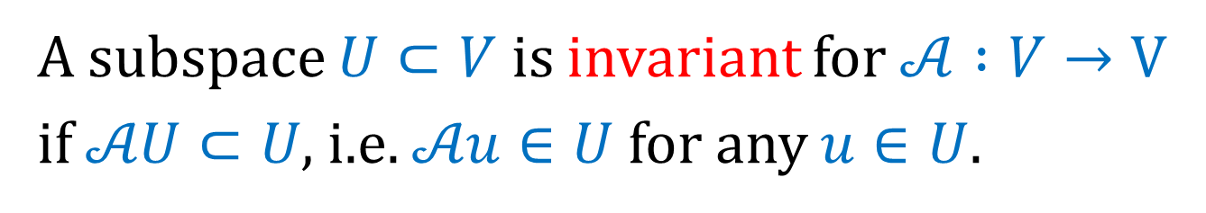
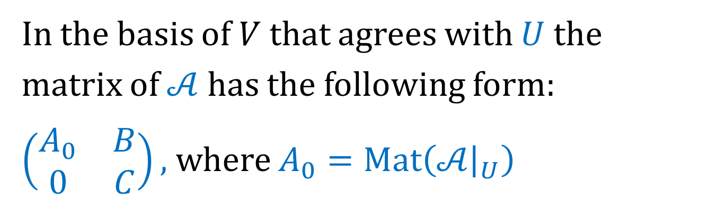
Invariant Subspaces
A subspace $U⊂V$ is invariant for $𝒜 :V→V$ if $𝒜U⊂U$, i.e. $𝒜u∈U$ for any $u∈U.$
The restriction $𝒜{\left.​\right|}_{U}$ is an operator in $U.$
In the basis of $V$ that agrees with $U$ the matrix of $𝒜$ has the following form:
$\left(\begin{matrix}A_{0} & B \\ 0 & C\end{matrix}\right),$ where $A_{0}=Mat\left(𝒜{\left.​\right|}_{U}\right)$

Slide 5
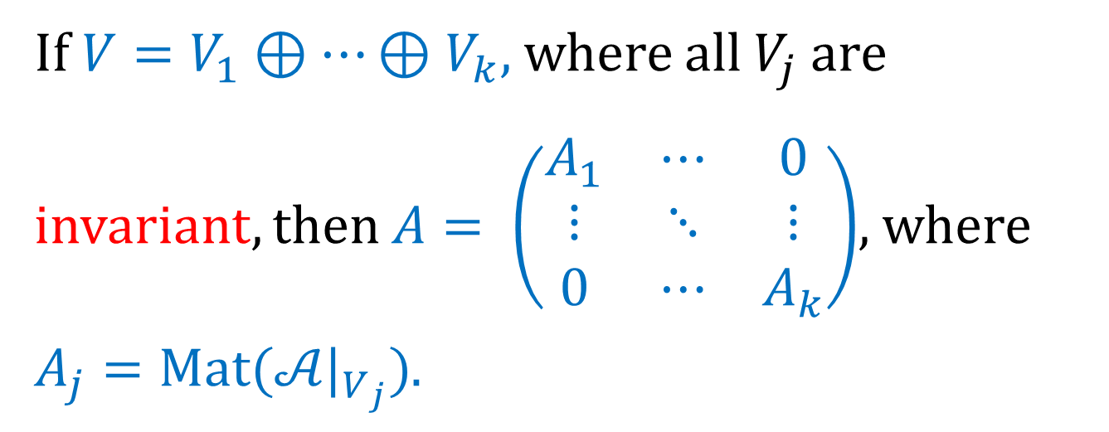
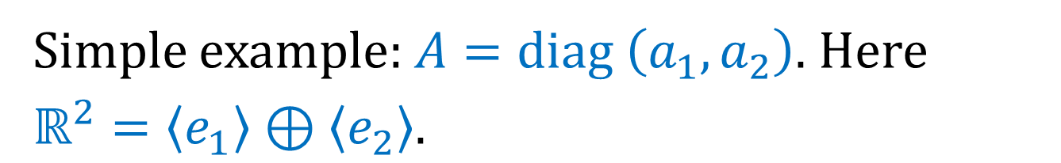
Direct Sum of Invariant Subspaces
If $V=V_{1}⊕…⊕V_{k}$, where all $V_{j}$ are invariant, then $A= \left(\begin{matrix}A_{1} & ⋯ & 0 \\ ⋮ & ⋱ & ⋮ \\ 0 & ⋯ & A_{k}\end{matrix}\right)$, where $A_{j}=Mat(𝒜|_{V_{j}})$.
Simple example: $A=diag \left(a_{1},a_{2}\right).$ Here $ℝ^{2}=〈e_{1}〉⊕〈e_{2}〉.$

Slide 6
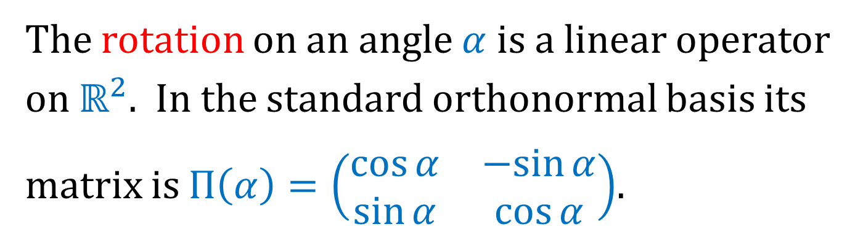
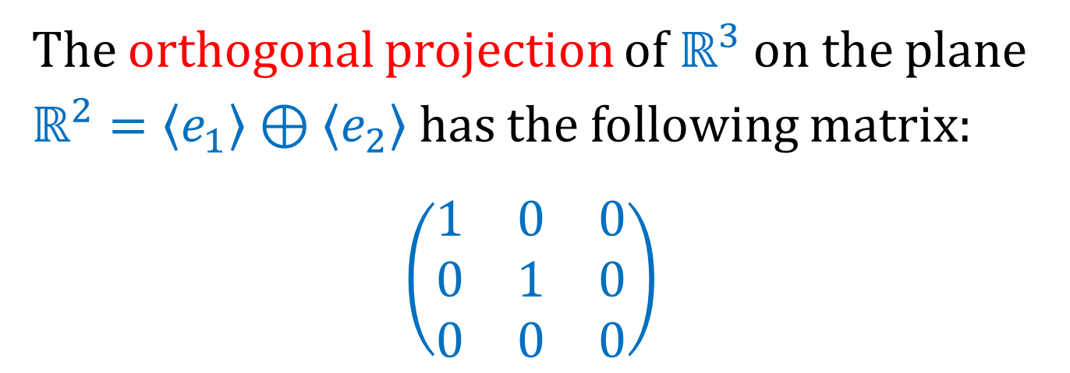
Examples
The rotation on an angle $α$ is a linear operator on $ℝ^{2}$. In the standard orthonormal basis its matrix is $П\left(α\right)=\left(\begin{matrix}\cos{α} & −sin{α} \\ \sin{α} & \cos{α}\end{matrix}\right)$.
The orthogonal projection of $ℝ^{3}$ on the plane $ℝ^{2}=〈e_{1}〉⊕〈e_{2}〉$ has the following matrix:
$$\left(\begin{matrix}1 & 0 & 0 \\ 0 & 1 & 0 \\ 0 & 0 & 0\end{matrix}\right)$$

Slide 7

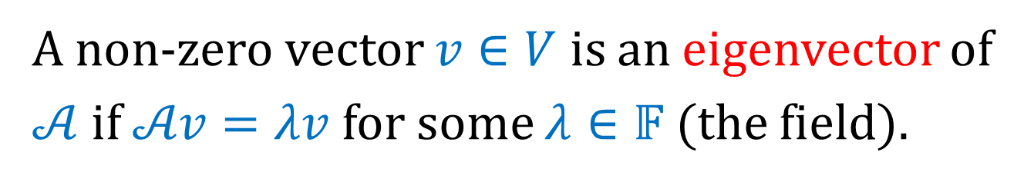

Eigenvectors and Eigenvalues
A non-zero vector $v∈V$ is an eigenvector of $𝒜$ if $𝒜v=λv$ for some $λ∈𝔽$ (the field).
The corresponding number $λ∈𝔽$ is called an eigenvalue of $𝒜$ corresponding to $v.$
In the basis of eigenvectors $v_{1},…, v_{n}$:
$$A=diag \left(λ_{1},{…,λ}_{n}\right).$$

Slide 8
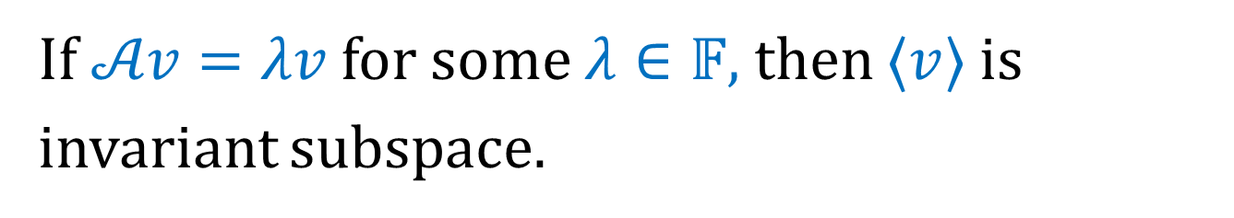
Eigenvectors and Eigenvalues
If $𝒜v=λv$ for some $λ∈𝔽,$ then $〈v〉$ is invariant subspace.
Geometrically, eigenvectors are exactly the directions, where the operator acts by stretching of a space by the corresponding eigenvalues.

Slide 9

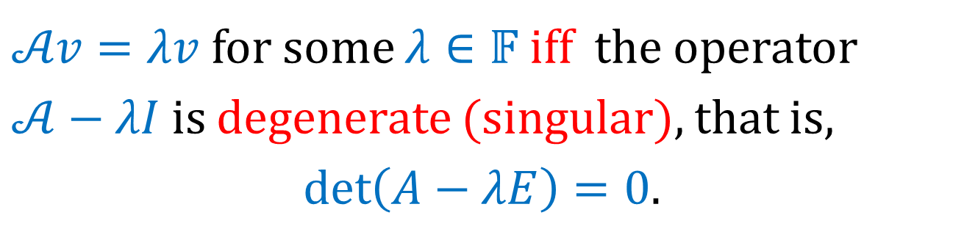
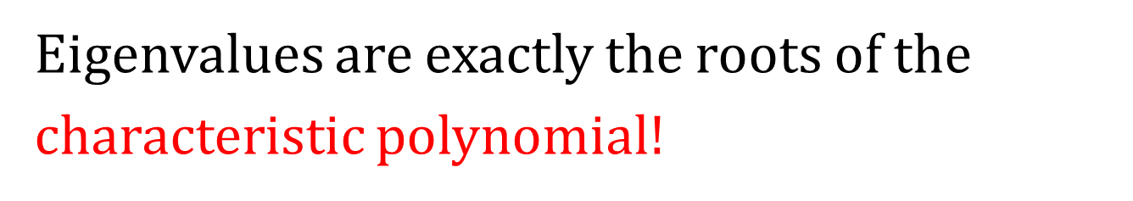
Characteristic Polynomial
$𝒜v=λv$ for some $λ∈𝔽$ iff the operator
$𝒜−λI$ is degenerate (singular), that is,
$$\det\left(A−λE\right)=0.$$
The characteristic polynomial of $𝒜$ is
$$f_{𝒜}\left(λ\right)={\left(−1\right)}^{n}\det\left(A−λE\right).$$
Eigenvalues are exactly the roots of the characteristic polynomial$!$

