Slide 1
Linear Algebra
Lecture 6: Convex Polyhedra I
Nikolay V. Bogachev
Moscow Institute of Physics and Technology
Department of Discrete Mathematics
Laboratory of Advanced Combinatorics and Network Applications

Slide 2



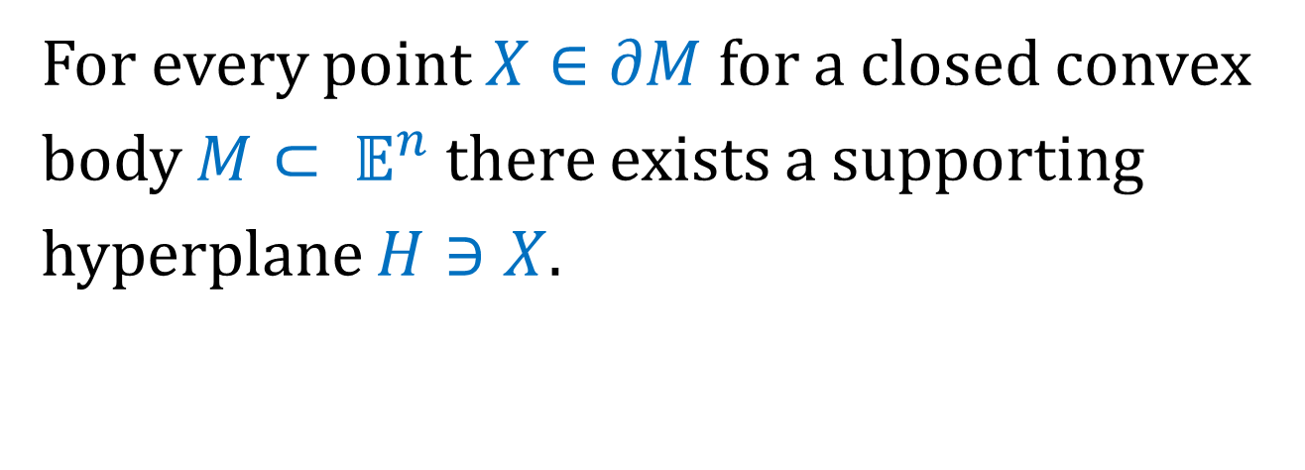


The Separation Theorem
For every point $X∈∂M$ for a closed convex body $M⊂ 𝔼^{n}$ there exists a supporting hyperplane $H∋X$.
$$H_{}^{+}$$
$$M$$
$$X$$
$$H_{}^{−}$$
$$H$$

Slide 3
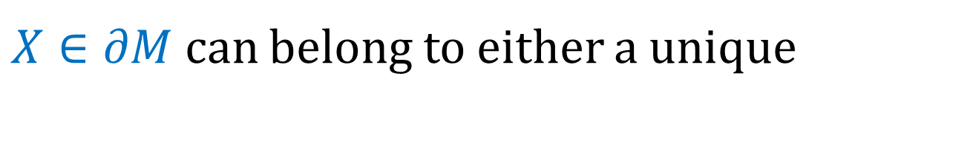
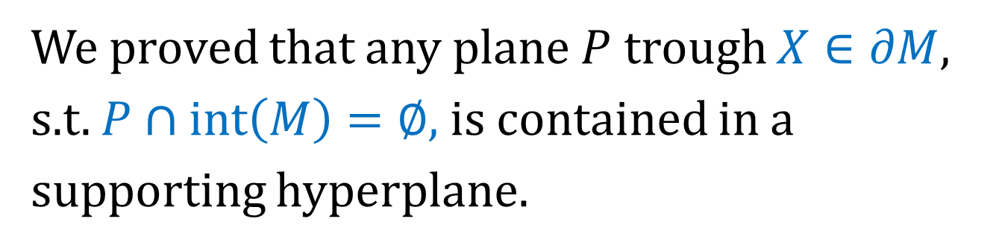


The Separation Theorem
We proved that any plane $P$ trough $X∈∂M,$ s.t. $P∩int\left(M\right)=∅,$ is contained in a supporting hyperplane.
or infinitely many supporting hyperplanes.
$X∈∂M$ can belong to either a unique
$$X$$
$$X$$

Slide 4
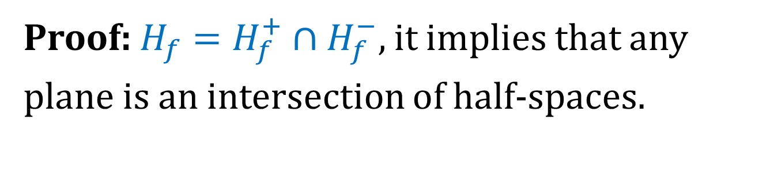
Intersection of Half-Spaces
Every closed convex set is an intersection of (perhaps infinitely many) half-spaces.
Proof: $H_{f}=H_{f}^{+}∩H_{f}^{−},$ it implies that any plane is an intersection of half-spaces.
Thus, it remains to prove the theorem for a convex body.
Every convex body is the intersection of half-spaces of its supporting hyperplanes.

Slide 5
Polyhedron
A convex polyhedron is an intersection of finitely many half-spaces (sometimes, non-empty interior is required).
Parallelepiped
Simplex

Slide 6

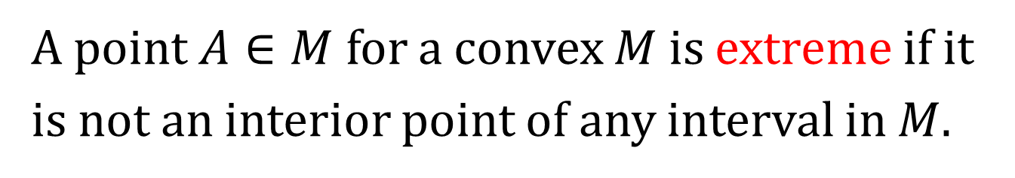
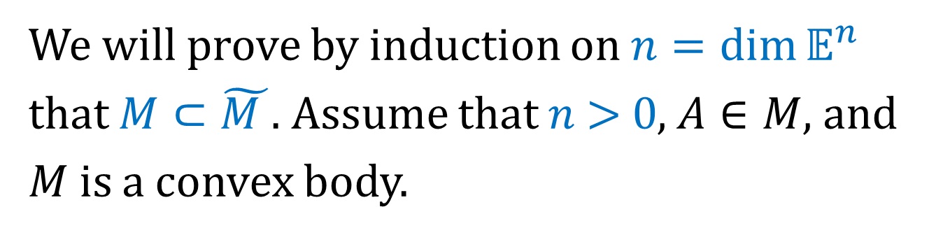
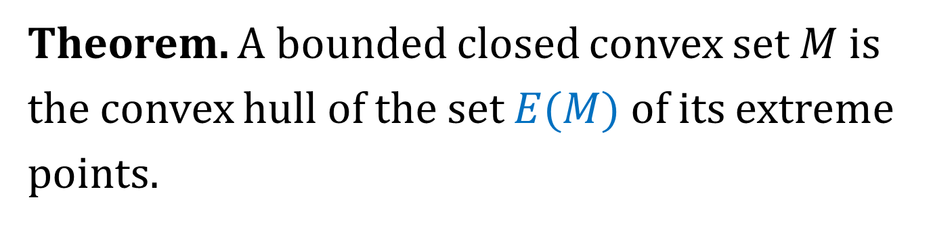
Extreme Points
A point $A∈M$ for a convex $M$ is extreme if it is not an interior point of any interval in $M$.
Theorem. A bounded closed convex set $M$ is the convex hull of the set $E(M)$ of its extreme points.
Proof: Let $\tilde{M }=conv E\left(M\right).$ Clearly, $\tilde{M }⊂M.$
We will prove by induction on $n=\dim{𝔼^{n}}$ that $M⊂\tilde{M }$. Assume that $n \text{> 0}$, $A∈M$, and $M$ is a convex body.

Slide 7
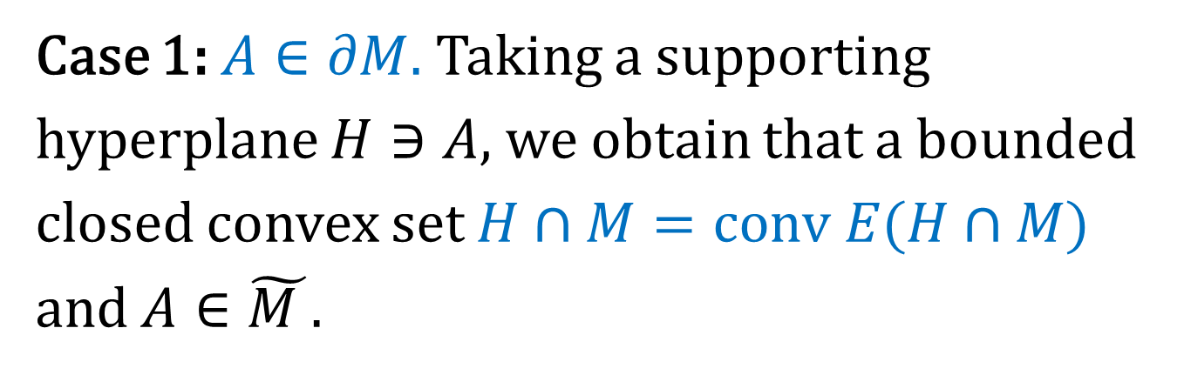
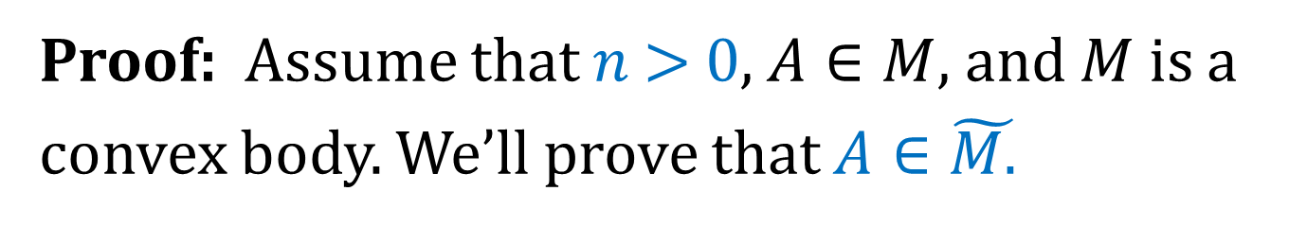
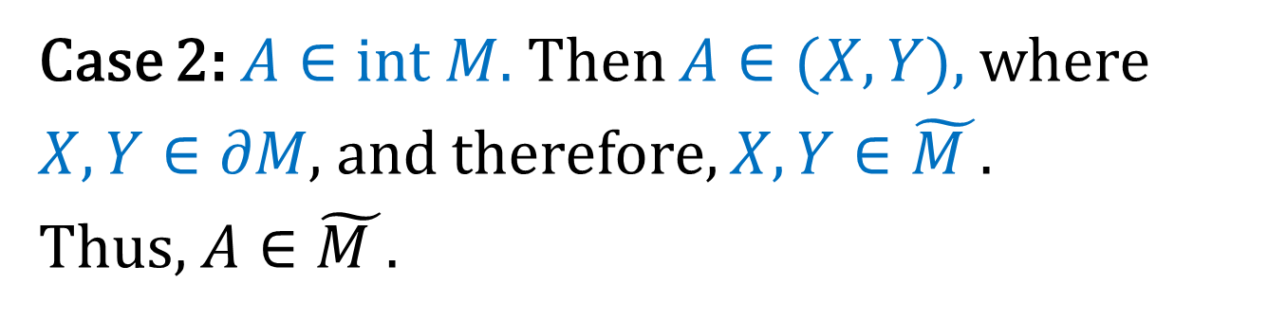
Extreme Points
Proof: Assume that $n \text{> 0}$, $A∈M$, and $M$ is a convex body. We’ll prove that $A∈\tilde{M.}$
Case 1: $A∈∂M.$ Taking a supporting hyperplane $H∋A$, we obtain that a bounded closed convex set $H∩M=conv E(H∩M)$ and $A∈\tilde{M }.$
Case 2: $A∈int M.$ Then $A∈(X,Y)$, where $X,Y∈∂M,$ and therefore, $X,Y∈\tilde{M }.$
Thus, $A∈\tilde{M }.$

Slide 8
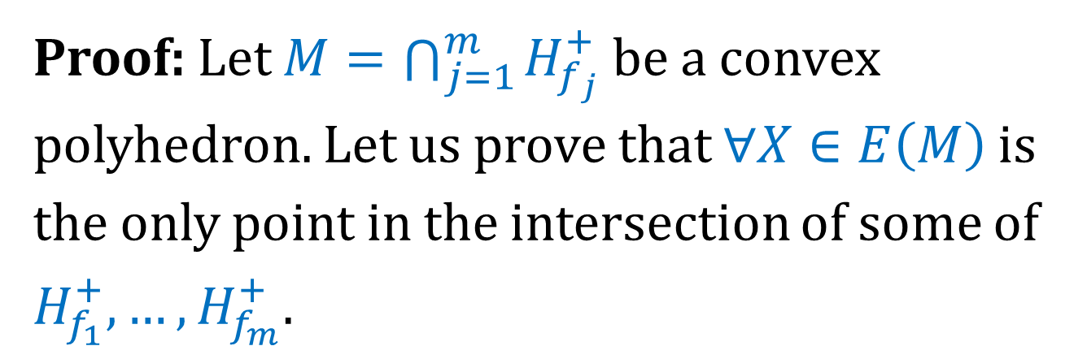
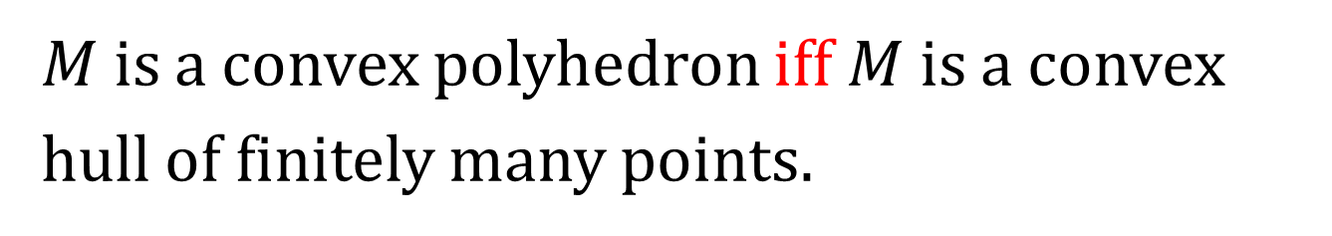
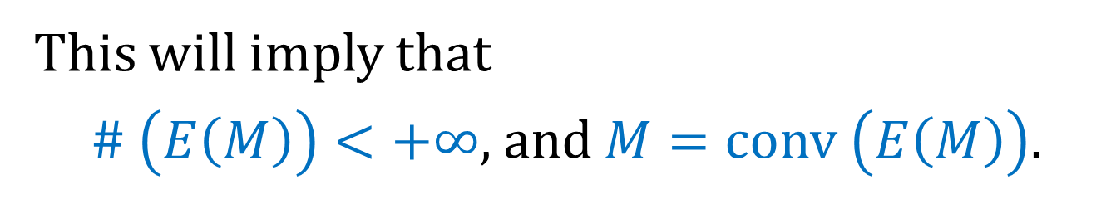
Minkowski-Weyl Theorem
$M$ is a convex polyhedron iff $M$ is a convex hull of finitely many points.
Proof: Let $M=\bigcap_{j=1}^{m}{H_{f_{j}}^{+}}$ be a convex polyhedron. Let us prove that $∀X∈E\left(M\right)$ is the only point in the intersection of some of $H_{f_{1}}^{+}, …,H_{f_{m}}^{+}.$
This will imply that
$\# \left(E\left(M\right)\right)<+∞,$ and $M=conv \left(E\left(M\right)\right).$

Slide 9
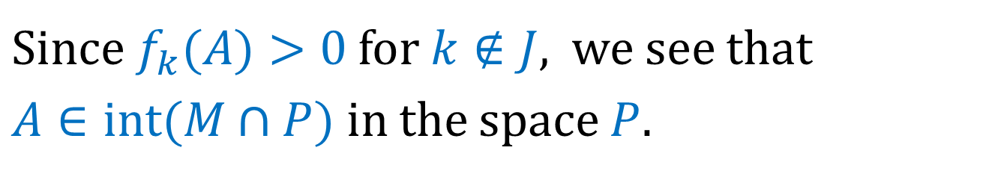
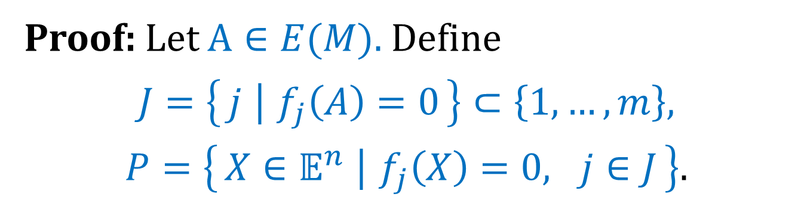
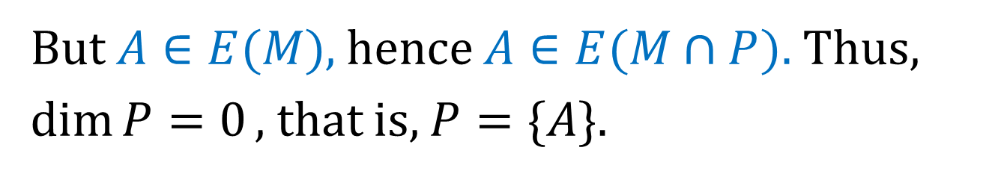
Minkowski-Weyl Theorem
Proof: Let $A∈E(M).$ Define
$$J=\left\{j ∣ f_{j}\left(A\right)=0\right\}⊂\left\{1, …, m\right\},$$
$$P=\left\{X∈𝔼^{n} ∣ f_{j}\left(X\right)=0, j∈J\right\}.$$
$\text{Since}$ $f_{k}(A)>0$ for $k∉J$, we see that
$A∈int(M∩P)$ in the space $P$.
But $A∈E(M)$, hence $A∈E(M∩P).$ Thus, $\dim{P=0},$ that is, $P=\{A\}$.

Slide 10
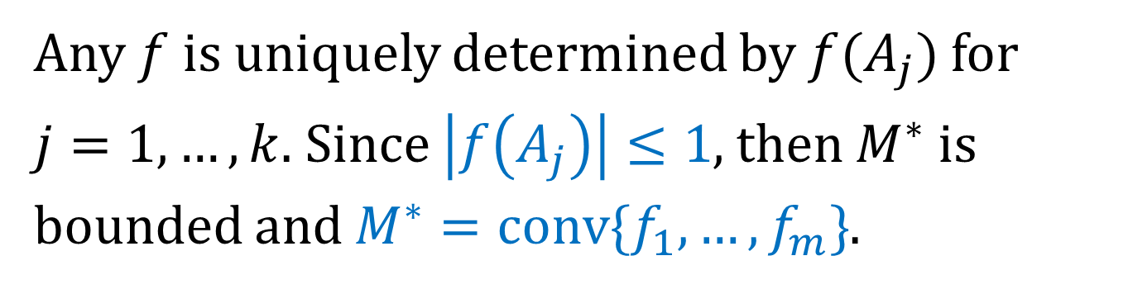
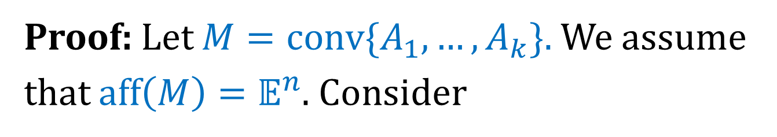
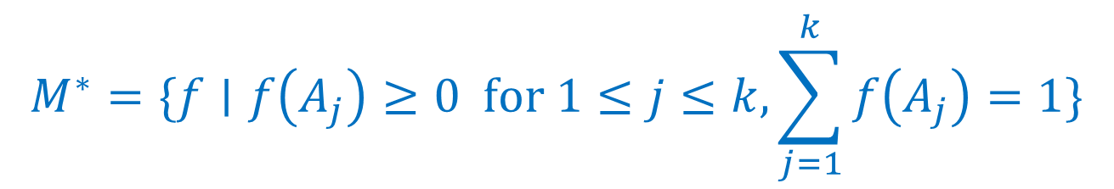
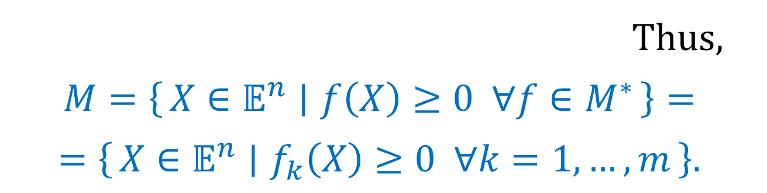
Minkowski-Weyl Theorem
Proof: Let $M=conv\{A_{1},…, A_{k}\}.$ We assume that $aff\left(M\right)=𝔼^{n}$. Consider
$$M^{∗}=\{f∣f\left(A_{j}\right)≥0 for 1≤j≤k, \sum_{j=1}^{k}{f\left(A_{j}\right)=1}\}$$
Any $f$ is uniquely determined by $f(A_{j})$ for
$j=1,…, k.$ Since $\left|f\left(A_{j}\right)\right|≤1$, then $M^{∗}$ is bounded and $M^{∗}=conv\{f_{1},…, f_{m}\}$.
Thus,
$$M=\left\{X∈𝔼^{n} ∣ f\left(X\right)≥0 ∀f∈M^{∗}\right\}=$$
$$=\left\{X∈𝔼^{n} ∣ f_{k}\left(X\right)≥0 ∀k=1,…, m\right\}.$$

