Slide 1
Linear Algebra
Lecture 6: Convex Polyhedra II
Nikolay V. Bogachev
Moscow Institute of Physics and Technology
Department of Discrete Mathematics
Laboratory of Advanced Combinatorics and Network Applications

Slide 2
Convex Polyhedron
A convex polyhedron (or a convex polytope) is an intersection of finitely many half-spaces (sometimes, nonempty interior is required).
Parallelepiped
Simplex

Slide 3
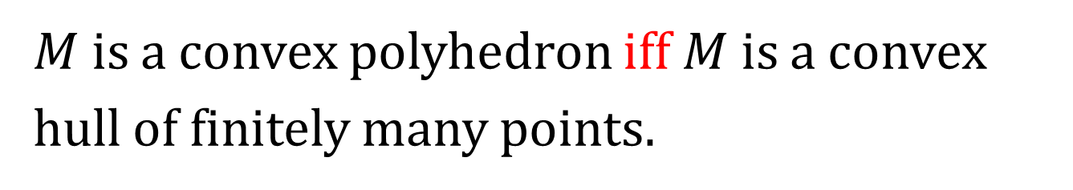
Minkowski-Weyl Theorem
$M$ is a convex polyhedron iff $M$ is a convex hull of finitely many points.
$$M=conv \left\{vertices of M\right\} ?$$

Slide 4
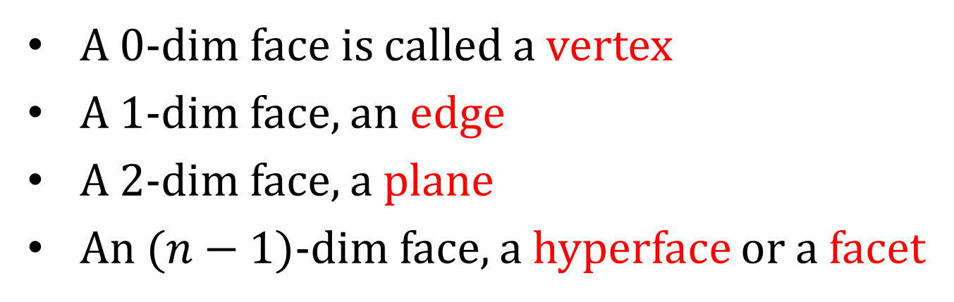
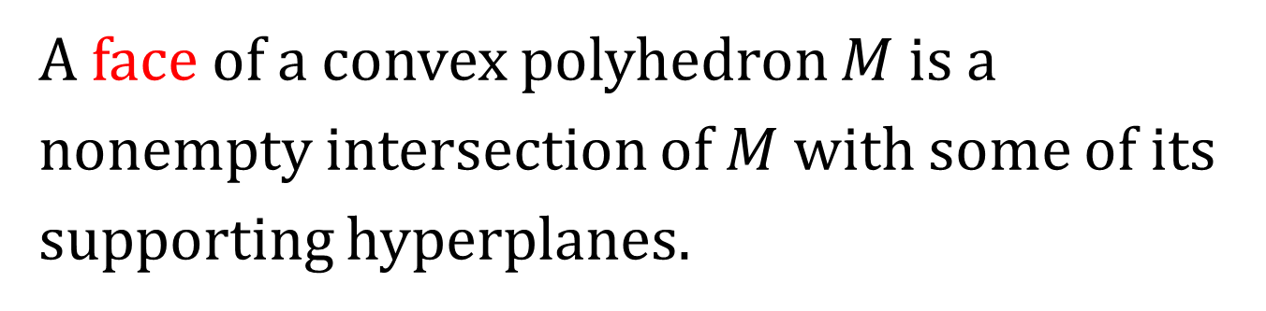
Faces of Polyhedra
A face of a convex polyhedron $M$ is a nonempty intersection of $M$ with some of its supporting hyperplanes.
A 0-dim face is called a vertex
A 1-dim face, an edge
A 2-dim face, a plane
An $(n−1)$-dim face, a hyperface or a facet

Slide 5
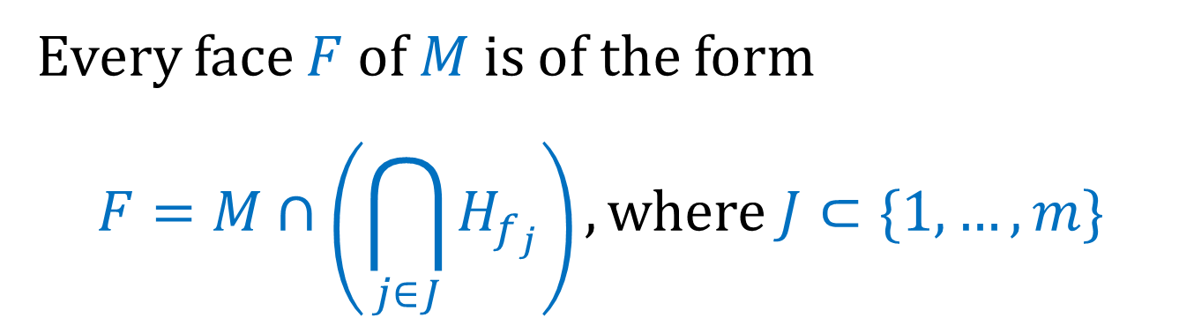
Faces of Polyhedra
Every face $F$ of $M$ is of the form
$$F=M∩\left(\bigcap_{j∈J}{H_{f_{j}}}\right), where J⊂\{1,…, m\}$$
Since a convex polyhedron is determined by a system of linear inequalities, its faces can be obtained by replacing some of these inequalities with equalities.

Slide 6
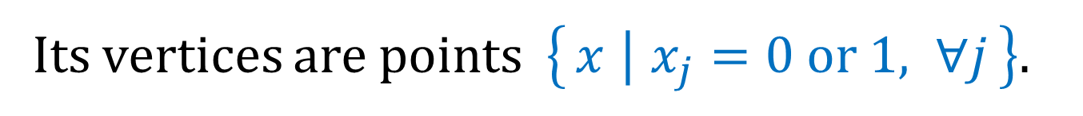
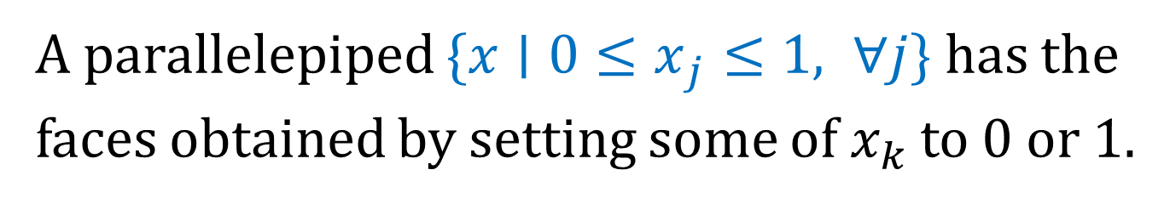
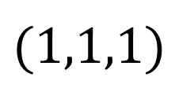
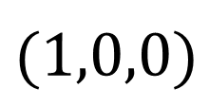
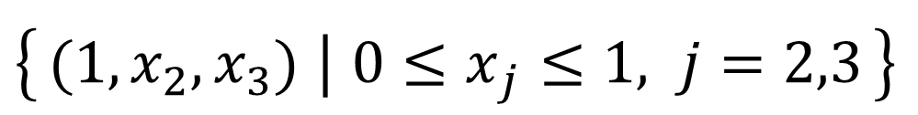
Example
A parallelepiped $\{x∣{0≤x}_{j}≤1, ∀j\}$ has the faces obtained by setting some of $x_{k}$ to 0 or 1.
Its vertices are points $\left\{x ∣ x_{j}=0 or 1, ∀j\right\}.$
$$(1,1,1)$$
$$\left\{(1,x_{2},x_{3}) ∣ {0≤x}_{j}≤1, j=2,3\right\}$$
$$(1,0,0)$$

Slide 7
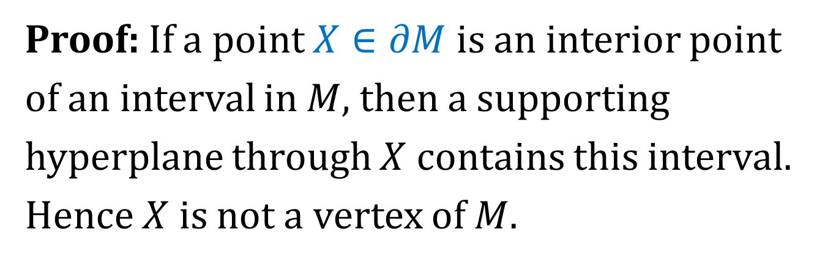
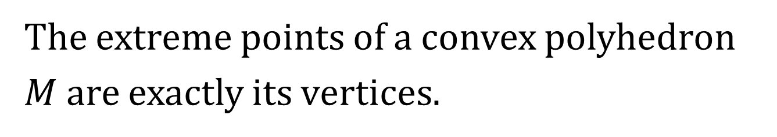
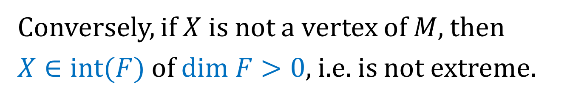
Vertices as Extreme Points
The extreme points of a convex polyhedron $M$ are exactly its vertices.
Proof: If a point $X∈∂M$ is an interior point of an interval in $M$, then a supporting hyperplane through $X$ contains this interval. Hence $X$ is not a vertex of $M$.
Conversely, if $X$ is not a vertex of $M$, then
$X∈int(F)$ of $dim F>0$, i.e. is not extreme.

Slide 8
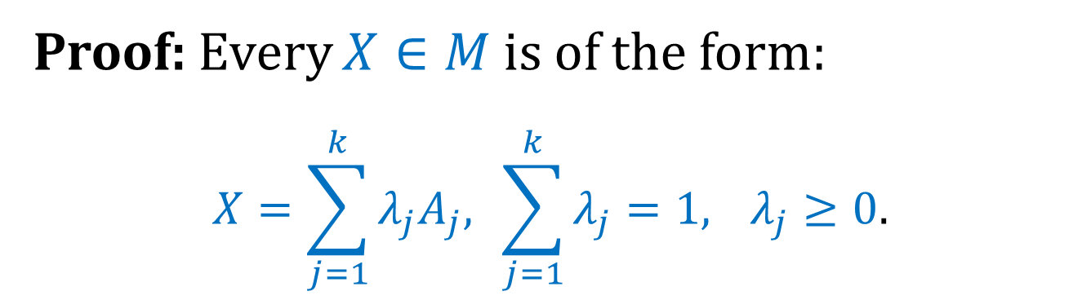
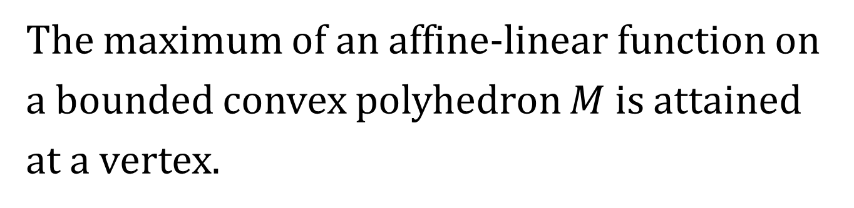
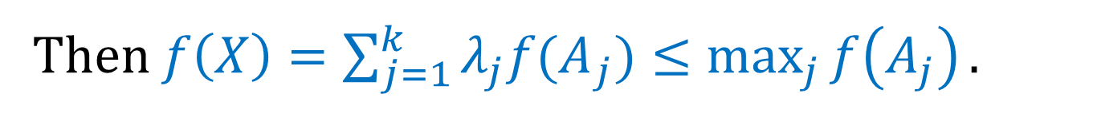
Linear Programming
The maximum of an affine-linear function on a bounded convex polyhedron $M$ is attained at a vertex.
Proof: Every $X∈M$ is of the form:
$$X=\sum_{j=1}^{k}{λ_{j}A_{j},} \sum_{j=1}^{k}{λ_{j}=1,} λ_{j}≥0.$$
Then $f\left(X\right)=\sum_{j=1}^{k}{λ_{j}{f(A}_{j})}≤\max_{j}{f\left(A_{j}\right)}.$

Slide 9
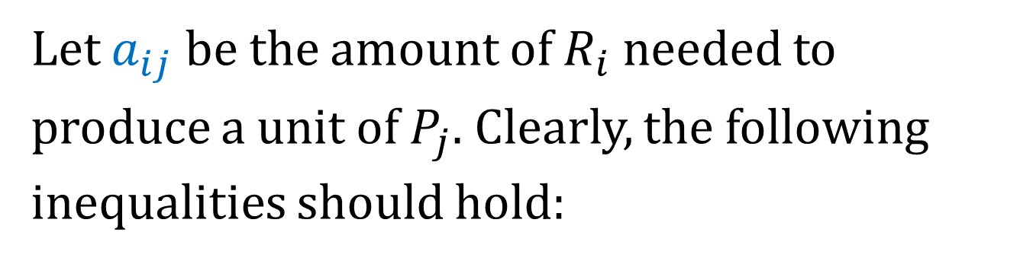
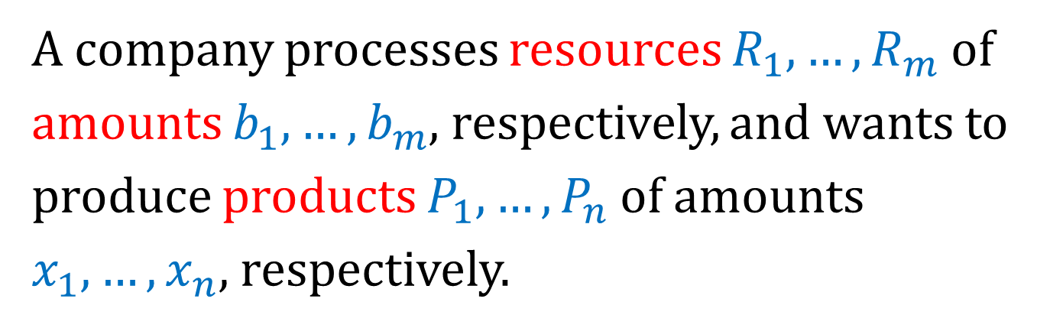
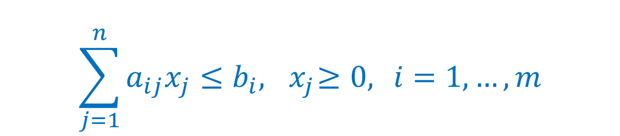
The Maximum Profit Problem
A company processes resources $R_{1},…, R_{m}$ of amounts $b_{1},…, b_{m}$, respectively, and wants to produce products $P_{1},…, P_{n}$ of amounts $x_{1},…, x_{n}$, respectively.
Let $a_{ij}$ be the amount of $R_{i}$ needed to produce a unit of $P_{j}$. Clearly, the following inequalities should hold:
$$\sum_{j=1}^{n}{a_{ij}x_{j}≤b_{i}, { x}_{j}≥0, } i=1, …, m$$

Slide 10
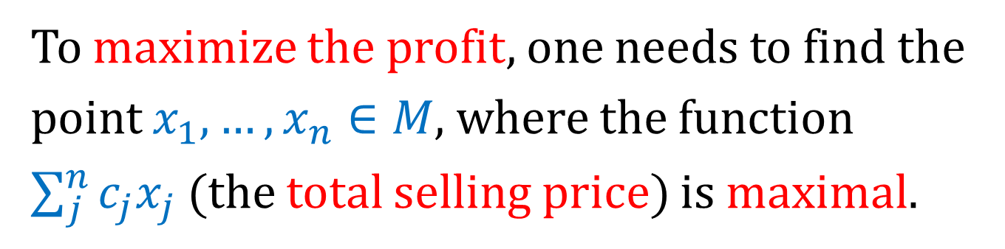
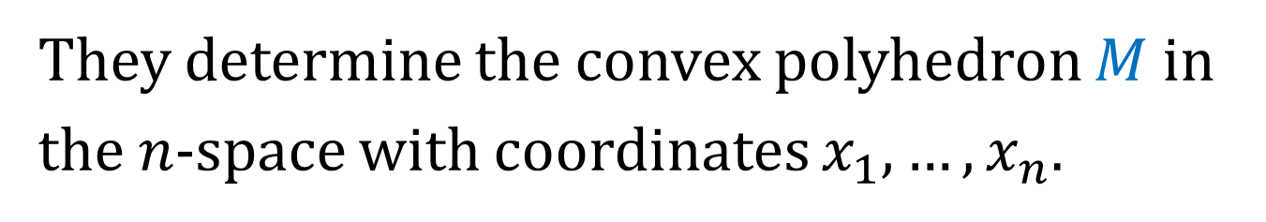
The Maximum Profit Problem
They determine the convex polyhedron $M$ in the $n$-space with coordinates $x_{1},…, x_{n}$.
To maximize the profit, one needs to find the point $x_{1},…, x_{n}∈M$, where the function $\sum_{j}^{n}{c_{j}x_{j}}$ (the total selling price) is maximal.
The basic problem of linear programming naturally arises here.

Slide 11
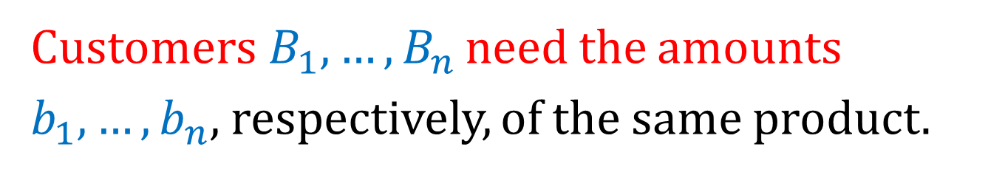
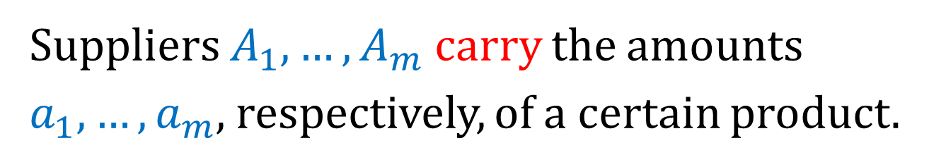
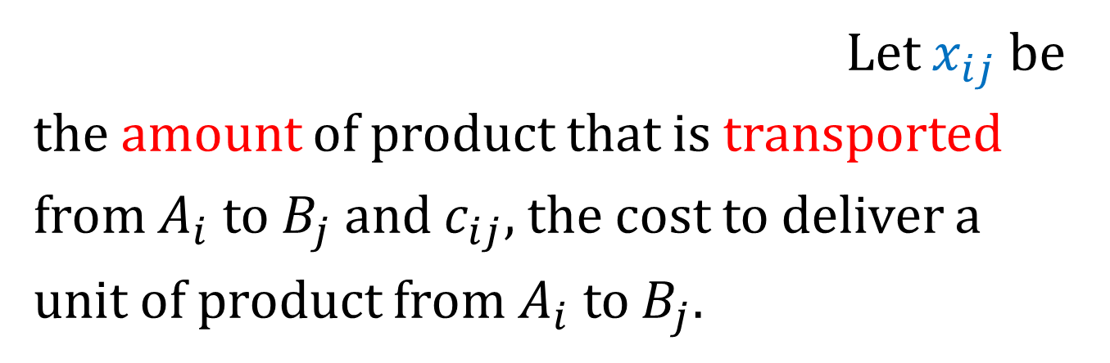

The Transportation Problem
Suppliers $A_{1},…, A_{m}$ carry the amounts $a_{1},…, a_{m}$, respectively, of a certain product.
Customers$B_{1},…, B_{n}$ need the amounts $b_{1},…, b_{n}$, respectively, of the same product.
It is also given that $\sum_{i}^{m}{a_{i}}=\sum_{j}^{n}{b_{j}}.$
Let $x_{ij}$ be the amount of product that is transported from $A_{i}$ to $B_{j}$ and $c_{ij}$, the cost to deliver a unit of product from $A_{i}$ to $B_{j}.$

Slide 12
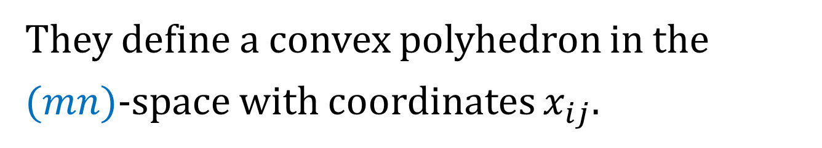
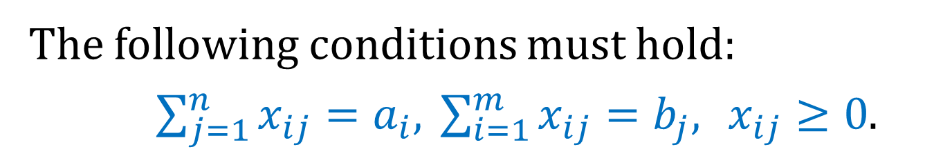
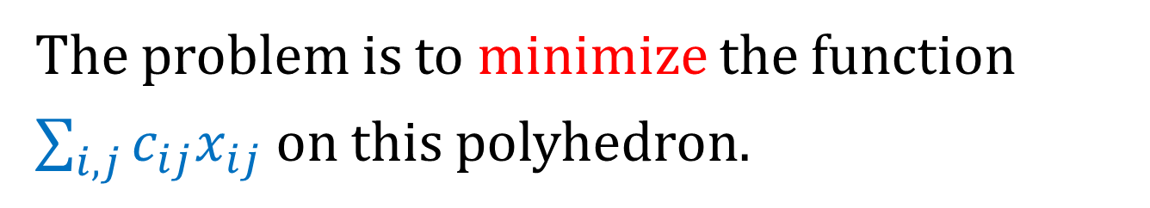
The Transportation Problem
The following conditions must hold:
$\sum_{j=1}^{n}{x_{ij}=a_{i},} \sum_{i=1}^{m}{x_{ij}=b_{j},} x_{ij}≥0$.
They define a convex polyhedron in the $(mn)$-space with coordinates $x_{ij}$.
The problem is to minimize the function $\sum_{i,j}{c_{ij}x_{ij}}$ on this polyhedron.

Slide 13


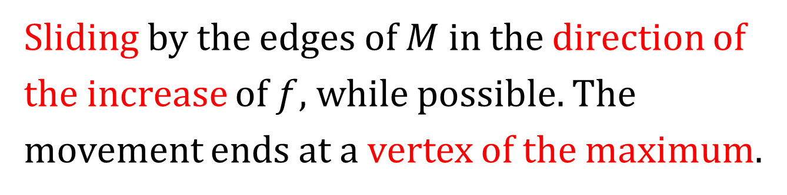



The Simplex Method
Sliding by the edges of $M$ in the direction of the increase of $f$, while possible. The movement ends at a vertex of the maximum.
$$f=max$$
$$P_{3}$$
$$P_{2}$$
$$P_{1}$$
$$P_{0}$$

