Slide 1
Project

Slide 2
Background
Personal investment skills have never been more critical
Investing in a balanced asset class portfolio is step 1)
In every portfolio an investor decides based on their long term goals and risk appetite their tendency towards investing versus trading.
Trading is a more active, short term focused strategy
A professional day trader has time to monitor the market in real time its manageable to work in realtime and react to opportunities
For the part-time day trader, they need to prepare a daily strategy overnight and often have a fixed entry (9.45am and exit 3.30pm) decided each day
This project is aimed to create an automated tool to aid the part time investor with a ML model to add to their technical analysis when planning a trade.

Slide 3
Trading analysis manual model (Bull)
Identify the equity to be considered (Ensure high liquidity stock – no illiquid trades ever)
Identify any relevant market shocks or earnings announcements that are impacting this equity during this neat timeframe. No trade allowed in market corrections or earnings windows
Identify if the stock is trending or oscillating (use ADX >25 or similar)
If oscillating evaluate the full stochastic indicator. If the stock is oversold and EMA crossing the signal upwards from the bottom – continue
If trending evaluate the MACD. If the stock is oversold and EMA crossing the signal updwards from the bottom – continue
Is the stock currently priced in the bottom of its Bollinger bands continue.
Is the Japanese candlesticks of the last 4 days bullish or has the stock reversed for 2 days or 3% continue
If yes to all above, then set up a limit buy order for tomorrows session and sell market order 30 mins before close or other profit based rule to sell. No overnight holding of equities.

Slide 4
A successful trade example (AAPL) – KPI ( selling a stock for a gain which covers the trading fee)
Overnight between 10pm and 10:30pm
Automated transactions via trading platform next trading day
If AAPL meets criteria of the Bull model create a limit order to buy 100 shares
100 AAPL are sold for target ?% profit during the trading day
Trading platform completes purchase if opening price is below limit order price
9pm - Manually screen the stock using manual model (Bull or Bear)
100 AAPL are sold at market price before the market closes
Create a sell limit order for 100 AAPL at the buy price +?%
Create a sell market order for 3.30pm

Slide 5
Business Case
A technical analysis on a specific equity for a seasoned trader with background in the industry, market and trading using a defined trading model takes (3-5) minutes (optimistic) to decide
This is why day traders tend to focus on a particular industry ( Energy, Tech, Real-Estate, Banking etc)
To screen of all S&P 500 stocks would take 2500 minutes or 41 hours. To screen 50 equities in a specific vertical would take 250 minutes or 40 hours. Both Impractical for a human on a daily basis.
Currently successful trade rate 75% (70% is considered a floor)

Slide 6
Hypothesis
The manual model success rate can be improved by an AI model screening insights from all S&P500 every night. This widens the net for finding opportunities.
I would like my AI model to propose the top 3 candidates to consider for an overnight planned day trade from an index (S&P500). The trader ultimately makes the final decision based on their technical analysis trading model.

Slide 7
Why a cloud solution?
The goal of the model is to save time and expand opportunities.
GCP Cloud provides IaaS opportunities to release a user from managing environments
GCP cloud also has significant opportunities within a free tier to do low volume activities.
This continuously improved model has a usage life of at least 30+ years. Owning hardware to maintain this model over that time period is both costly and time consuming even at a retail user level. Pay as you Go serverless compute is attractive in the long run
I want to learn about GCP and enjoy learning by doing

Slide 8
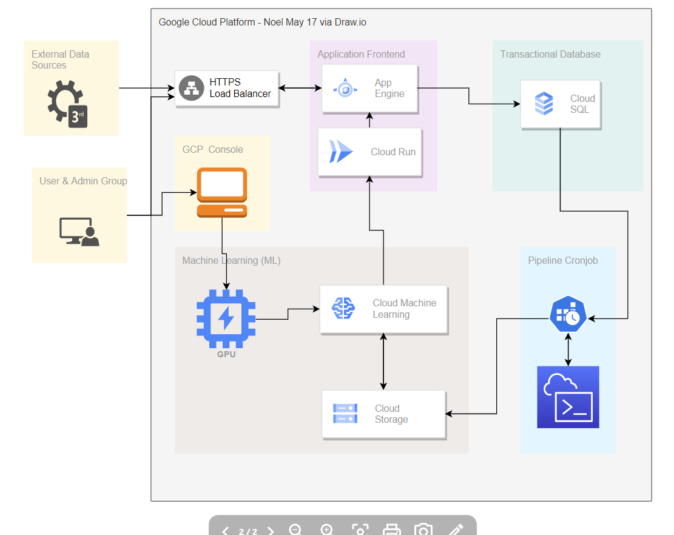
GCP Architecture

