Slide 1
How to Use the Three AXI Configurations

Slide 2
Objectives
After completing this module, you will be able to:
List the three AXI system architectural models (configurations)
Name the five AXI channels
Summarize the AXI valid/ready acknowledgement model
Describe the operation of the AXI streaming protocol

Slide 3
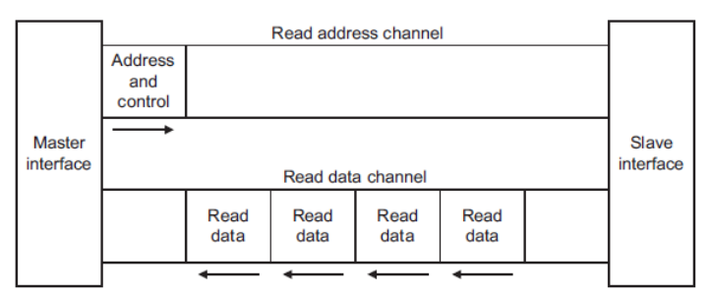
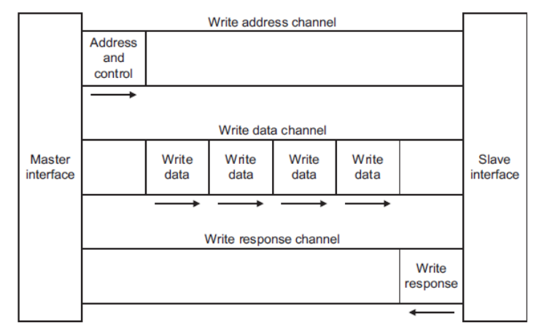
Basic AXI Transactions
Read address channel
Read data channel
Write address channel
Write data channel
Write response channel
  Non-posted write model:
  there will always be a “write
  response”
Notes:
The AXI interface has separate and independent read and write channels that can be used simultaneously.
Each channel has its own address and data buses.
Both channels are non-posted; that is, there is always a response.
In the read case the response is simply the read data coming back.
For a write, a separate response bus acknowledges data delivery
Summary of the five AXI channels:
Read address channel
Read data channel
Write address channel
Write data channel
Write response channel

Slide 4
AXI Interface: AXI4
Also called Full AXI or AXI Memory Mapped
Single address multiple data
Burst up to 256 data beats
AXI4 Read
AXI4 Write
Notes:
The AXI Memory Mapped model is an improved version of AXI3.
This model is more traditional in embedded processor systems as it has address, data, and control lines and allows for full-featured operation and interconnect schemes as found in the PLBv46 bus standard.
Remember, however, that the interconnect can be:
Shared bus
Point to point
Crossbar
Note that the PLBv46 bus, while typically manifested as a shared bus, can also operate in a point-to-point fashion if only a single master and slave are involved. The PLBv46 can also operate in a crossbar, such as with the PowerPC® 440 processor.

Slide 5
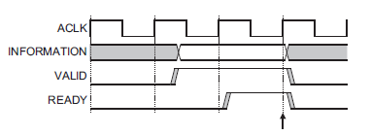
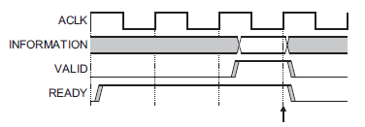
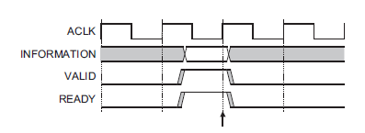
AXI Interface: Handshaking
AXI uses a valid/ready handshake
acknowledge
Each channel has its own valid/ready
  Address (read/write)
  Data (read/write)
  Response (write only)
Flexible signaling functionality
  Inserting wait states
  Always ready
  Same cycle acknowledge
Inserting Wait States
Always Ready
Same Cycle Acknowledge
Notes:
It is up to the master to assert the valid signal and the slave to assert the ready signals for all channels except the read data channel where the slave asserts valid to indicate that it is returning data.
The agent that asserts ready determines the flexibility as seen in the three waveform options.

Slide 6
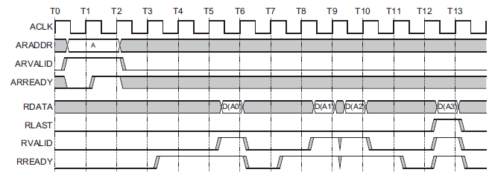
AXI Interface: Read
Two channels
  Address
  Data
Up to 256 transfer data phase
Selectable data transfer size
See notes for signal detail of each channel
AXI – Burst Read
Notes:
The AXI4 read interfaces allows for data phase transfer up to 256 beats as opposed to the 16 beats that were supported for AXI3.
Some signal features may not be required for all types of transfer, depending on user requirements and capabilities.
Read Address Channel:
ARID[3:0] - Master Read address ID. This signal is the identification tag for the read address group of signals.
ARADDR[31:0] - Master Read address. The read address bus gives the initial address of a read burst transaction. Only the start address of the burst is provided and the control signals that are issued alongside the address detail how the address is calculated for the remaining transfers in the burst.
ARLEN[7:0] - Master Burst length. The burst length gives the exact number of transfers in a burst. This information determines the number of data transfers associated with the address.
ARSIZE[2:0] - Master Burst size. This signal indicates the size of each transfer in the burst.
ARBURST[1:0] - Master Burst type. The burst type, coupled with the size information, details how the address for each transfer within the burst is calculated.
ARLOCK[1:0] - Master Lock type. This signal provides additional information about the atomic characteristics of the transfer.
ARCACHE[3:0] - Master Cache type. This signal provides additional information about the cacheable characteristics of the transfer.
ARPROT[2:0] - Master Protection type. This signal provides protection unit information for the transaction.
ARVALID - Master Read address valid. This signal indicates, when HIGH, that the read address and control information is valid and will remain stable until the address acknowledge signal, ARREADY, is high. 1 = address and control information valid 0 = address and control information not valid.
ARREADY - Slave Read address ready. This signal indicates that the slave is ready to accept an address and associated control signals: 1 = slave ready 0 = slave not ready.
Read Data Channel:
RID[3:0] - Slave Read ID tag. This signal is the ID tag of the read data group of signals. The RID value is generated by the slave and must match the ARID value of the read transaction to which it is responding.
RDATA[31:0] - Slave Read data. The read data bus can be 8, 16, 32, 64, 128, 256, 512, or 1024 bits wide.
RRESP[1:0] - Slave Read response. This signal indicates the status of the read transfer. The allowable responses are OKAY, EXOKAY, SLVERR, and DECERR.
RLAST - Slave Read last. This signal indicates the last transfer in a read burst.
RVALID - Slave Read valid. This signal indicates that the required read data is available and the read transfer can complete: 1 = read data available 0 = read data not available.
RREADY - Master Read ready. This signal indicates that the master can accept the read data and response information: 1= master ready 0 = master not ready.

Slide 7
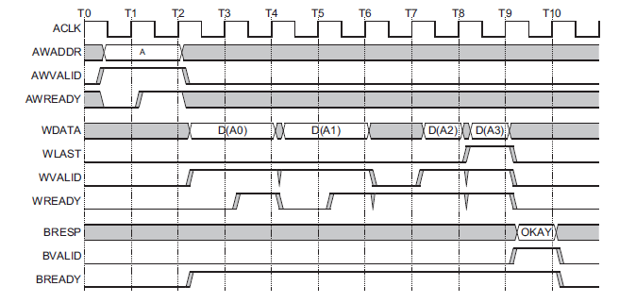
AXI Interface: Write
Three channels
  Address
  Data
  Response
Up to 256 transfer data phase
Selectable data transfer size
See notes for signal detail of each channel
AXI Burst Write
Notes:
The AXI4 read interfaces allows for data phase transfer up to 256 beats as opposed to the 16 beats that were supported for AXI3.
Some signal features may not be required for all types of transfer, depending on user requirements and capabilities.
Write Address Channel:
AWID[3:0] - Master Write address ID. This signal is the identification tag for the write address group of signals.
AWADDR[31:0] - Master Write address. The write address bus gives the address of the first transfer in a write burst transaction. The associated control signals are used to determine the addresses of the remaining transfers in the burst.
AWLEN[3:0] - Master Burst length. The burst length gives the exact number of transfers in a burst. This information determines the number of data transfers associated with the address.
AWSIZE[2:0] - Master Burst size. This signal indicates the size of each transfer in the burst. Byte lane strobes indicate exactly which byte lanes to update.
AWBURST[1:0] - Master Burst type. The burst type, coupled with the size information, details how the address for each transfer within the burst is calculated.
AWLOCK[1:0] - Master Lock type. This signal provides additional information about the atomic characteristics of the transfer.
AWCACHE[3:0] - Master Cache type. This signal indicates the bufferable, cacheable, write-through, write-back, and allocate attributes of the transaction.
AWPROT[2:0] - Master Protection type. This signal indicates the normal, privileged, or secure protection level of the transaction and whether the transaction is a data access or an instruction access.
AWVALID - Master Write address valid. This signal indicates that valid write address and control information are available: 1 = address and control information available 0 = address and control information not available. The address and control information remain stable until the address acknowledge signal, AWREADY, goes HIGH.
AWREADY - Slave Write address ready. This signal indicates that the slave is ready to accept an address and associated control signals: 1 = slave ready 0 = slave not ready.
Write Data Channel:
WID[3:0] - Master Write ID tag. This signal is the ID tag of the write data transfer. The WID value must match the AWID value of the write transaction.
WDATA[31:0] - Master Write data. The write data bus can be 8, 16, 32, 64, 128, 256, 512, or 1024 bits wide.
WSTRB[3:0] - Master Write strobes. This signal indicates which byte lanes to update in memory. There is one write strobe for each eight bits of the write data bus. Therefore, WSTRB[n] corresponds to WDATA[(8 × n) + 7:(8 × n)].
WLAST - Master Write last. This signal indicates the last transfer in a write burst.
WVALID - Master Write valid. This signal indicates that valid write data and strobes are available: 1 = write data and strobes available 0 = write data and strobes not available.
WREADY - Slave Write ready. This signal indicates that the slave can accept the write data: 1 = slave ready 0 = slave not ready.
Write Response Channel:
BID[3:0] - Slave Response ID. The identification tag of the write response. The BID value must match the AWID value of the write transaction to which the slave is responding.
BRESP[1:0] - Slave Write response. This signal indicates the status of the write transaction. The allowable responses are OKAY, EXOKAY, SLVERR, and DECERR.
BVALID - Slave Write response valid. This signal indicates that a valid write response is available: 1 = write response available 0 = write response not available.
BREADY - Master Response ready. This signal indicates that the master can accept the response information. 1 = master ready 0 = master not ready.

Slide 8
AXI Interface: Lite
No burst
Data width 32 or 64 only
  Xilinx IP will only support 32 bits
Simple “logic shim” to connect AXI4 master to AXI4-Lite slave
  Reflect master’s transaction ID
This is best for simple systems with minimal peripherals
AXI4-Lite Read
AXI4-Lite Write
Notes:
The AXI4-Lite interface is targeted towards optimizing for fabric in system implementation. This is mainly accomplished by limiting the transaction data phase to a single operation, as a burst or multiple transfer data phase requires a lot more fabric.

Slide 9
AXI4-Lite
The AXI4-Lite interface is a subset of the AXI4 interface intended for communication with control registers in components
The aim of AXI4-Lite is to allow simple component interfaces to be built that are smaller and also require less design and validation effort
Having a defined subset of the full AXI4 interface allows many different components to be built using the same subset and also allows a single common conversion component to be used to move between AXI4 and AXI4-Lite interfaces
Notes:
The key features of the AXI4-Lite interface are:
All transactions are burst length of 1.
All data accesses are the same size as the width of the data bus.
Support for data bus width of 32 or 64 bits.
All accesses are equivalent to AWCACHE, or ARCACHE equal to b0000.
Exclusive accesses are not supported.

Slide 10
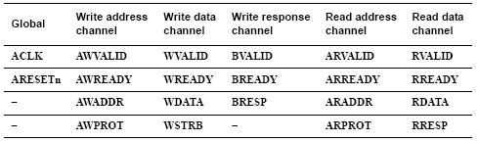
AXI Lite Signal list
Subset of AXI signal set
Simple traditional signaling
Targeted applications: simple, low-performance peripherals
  GPIO
  Uart Lite

Slide 11
AXI Interface: Streaming
No address channel
Not read and write, always master to
slave
Unlimited burst length
AXI4-Streaming Transfer
Notes:
AXI streaming does not have an address phase; all transactions go to the same place.
Note that the direction is always from master to slave. Philosophically this made cloud the concept of master and slave.
AXI streaming is very close to the MicroBlaze™ processor FSL except that there is no requirement that a processor be involved.

Slide 12
AXI Additional Features
ID fields for each of the five channels facilitate overlapped transactions
  Provides for a transaction tag
Transaction burst type determines address bus behavior
  Fixed, increment, or wrap
Optional address Lock signals facilitates exclusive and atomic access protection
System cache support
Protection unit support
Error support
Unaligned address
Notes:
Burst Options
Fixed burst: In a fixed burst, the address remains the same for every transfer in the burst. This burst type is for repeated accesses to the same location such as when loading or emptying a peripheral FIFO.
Incrementing burst: In an incrementing burst, the address for each transfer in the burst is an increment of the previous transfer address. The increment value depends on the size of the transfer. For example, the address for each transfer in a burst with a size of four bytes is the previous address plus four.
Wrapping burst: A wrapping burst is similar to an incrementing burst, in that the address for each transfer in the burst is an increment of the previous transfer address. However, in a wrapping burst the address wraps around to a lower address when a wrap boundary is reached. The wrap boundary is the size of each transfer in the burst multiplied by the total number of transfers in the burst.
Atomic and lock operations: The AXI protocol defines mechanisms for both exclusive and locked accesses.
System cache support: The cache-support signal of the AXI protocol enables a master to provide to a system-level cache the bufferable, cacheable, and allocate attributes of a transaction.
Protection unit support: To enable both privileged and secure accesses, the AXI protocol provides three levels of protection unit support.
Error support: The AXI protocol provides error support for both address decode errors and slave-generated errors.
Unaligned address: To enhance the performance of the initial accesses within a burst, the AXI protocol supports unaligned burst start addresses.

Slide 13
Documentation
Xilinx AXI Reference Guide, UG761
  AXI Usage in Xilinx FPGAs
    Introduce key concepts of the AXI protocol
    Explains what features of AXI Xilinx has adopted
ARM specifications
  AMBA AXI Protocol Version 2.0
  AMBA 4 AXI4-Stream Protocol Version 1.0
  http://infocenter.arm.com/help/topic/com.arm.doc.set.amba

Slide 14
Summary
AXI has separate, independent read and write interfaces implemented with channels
Each AXI channel supports a valid/ready acknowledgement handshake
AXI supports bursts and overlapped transactions
The AXI4 interface offers improvements over AXI3 and defines
  Full AXI memory mapped
  AXI Lite
  AXI Streaming

Slide 15
Where Can I Learn More?
Xilinx Training www.xilinx.com/training
  Embedded Systems Development course
    EDK tool training
    How to build custom IP
    How to build your system software
  Advanced Features and Techniques of Embedded Systems Design course
    How to debug your software on your hardware system with ChipScope
    How to optimize the use of the available memory controllers
    How to design a Flash memory-based system and boot load from an off-chip memory
    How to add an interrupt controller into your hardware and software system
  Embedded Systems Software Development course
    Software development and debugging with SDK
    How to profile your software and develop custom device drivers

Slide 16
Trademark Information
Xilinx is disclosing this Document and Intellectual Propery (hereinafter “the Design”) to you for use in the development of designs to operate on, or interface with Xilinx FPGAs. Except as stated herein, none of the Design may be copied, reproduced, distributed, republished, downloaded, displayed, posted, or transmitted in any form or by any means including, but not limited to, electronic, mechanical, photocopying, recording, or otherwise, without the prior written consent of Xilinx. Any unauthorized use of the Design may violate copyright laws, trademark laws, the laws of privacy and publicity, and communications regulations and statutes.
Xilinx does not assume any liability arising out of the application or use of the Design; nor does Xilinx convey any license under its patents, copyrights, or any rights of others. You are responsible for obtaining any rights you may require for your use or implementation of the Design. Xilinx reserves the right to make changes, at any time, to the Design as deemed desirable in the sole discretion of Xilinx. Xilinx assumes no obligation to correct any errors contained herein or to advise you of any correction if such be made. Xilinx will not assume any liability for the accuracy or correctness of any engineering or technical support or assistance provided to you in connection with the Design.
THE DESIGN IS PROVIDED “AS IS" WITH ALL FAULTS, AND THE ENTIRE RISK AS TO ITS FUNCTION AND IMPLEMENTATION IS WITH YOU. YOU ACKNOWLEDGE AND AGREE THAT YOU HAVE NOT RELIED ON ANY ORAL OR WRITTEN INFORMATION OR ADVICE, WHETHER GIVEN BY XILINX, OR ITS AGENTS OR EMPLOYEES. XILINX MAKES NO OTHER WARRANTIES, WHETHER EXPRESS, IMPLIED, OR STATUTORY, REGARDING THE DESIGN, INCLUDING ANY WARRANTIES OF MERCHANTABILITY, FITNESS FOR A PARTICULAR PURPOSE, TITLE, AND NONINFRINGEMENT OF THIRD-PARTY RIGHTS.
IN NO EVENT WILL XILINX BE LIABLE FOR ANY CONSEQUENTIAL, INDIRECT, EXEMPLARY, SPECIAL, OR INCIDENTAL DAMAGES, INCLUDING ANY LOST DATA AND LOST PROFITS, ARISING FROM OR RELATING TO YOUR USE OF THE DESIGN, EVEN IF YOU HAVE BEEN ADVISED OF THE POSSIBILITY OF SUCH DAMAGES. THE TOTAL CUMULATIVE LIABILITY OF XILINX IN CONNECTION WITH YOUR USE OF THE DESIGN, WHETHER IN CONTRACT OR TORT OR OTHERWISE, WILL IN NO EVENT EXCEED THE AMOUNT OF FEES PAID BY YOU TO XILINX HEREUNDER FOR USE OF THE DESIGN. YOU ACKNOWLEDGE THAT THE FEES, IF ANY, REFLECT THE ALLOCATION OF RISK SET FORTH IN THIS AGREEMENT AND THAT XILINX WOULD NOT MAKE AVAILABLE THE DESIGN TO YOU WITHOUT THESE LIMITATIONS OF LIABILITY.
The Design is not designed or intended for use in the development of on-line control equipment in hazardous environments requiring fail-safe controls, such as in the operation of nuclear facilities, aircraft navigation or communications systems, air traffic control, life support, or weapons systems (“High-Risk Applications”). Xilinx specifically disclaims any express or implied warranties of fitness for such High-Risk Applications. You represent that use of the Design in such High-Risk Applications is fully at your risk.
© 2009 Xilinx, Inc. All rights reserved. XILINX, the Xilinx logo, and other designated brands included herein are trademarks of Xilinx, Inc. All other trademarks are the property of their respective owners.
Xilinx is disclosing this Document and Intellectual Propery (hereinafter “the Design”) to you for use in the development of designs to operate on, or interface with Xilinx FPGAs. Except as stated herein, none of the Design may be copied, reproduced, distributed, republished, downloaded, displayed, posted, or transmitted in any form or by any means including, but not limited to, electronic, mechanical, photocopying, recording, or otherwise, without the prior written consent of Xilinx. Any unauthorized use of the Design may violate copyright laws, trademark laws, the laws of privacy and publicity, and communications regulations and statutes.
Xilinx does not assume any liability arising out of the application or use of the Design; nor does Xilinx convey any license under its patents, copyrights, or any rights of others. You are responsible for obtaining any rights you may require for your use or implementation of the Design. Xilinx reserves the right to make changes, at any time, to the Design as deemed desirable in the sole discretion of Xilinx. Xilinx assumes no obligation to correct any errors contained herein or to advise you of any correction if such be made. Xilinx will not assume any liability for the accuracy or correctness of any engineering or technical support or assistance provided to you in connection with the Design.
THE DESIGN IS PROVIDED “AS IS" WITH ALL FAULTS, AND THE ENTIRE RISK AS TO ITS FUNCTION AND IMPLEMENTATION IS WITH YOU. YOU ACKNOWLEDGE AND AGREE THAT YOU HAVE NOT RELIED ON ANY ORAL OR WRITTEN INFORMATION OR ADVICE, WHETHER GIVEN BY XILINX, OR ITS AGENTS OR EMPLOYEES. XILINX MAKES NO OTHER WARRANTIES, WHETHER EXPRESS, IMPLIED, OR STATUTORY, REGARDING THE DESIGN, INCLUDING ANY WARRANTIES OF MERCHANTABILITY, FITNESS FOR A PARTICULAR PURPOSE, TITLE, AND NONINFRINGEMENT OF THIRD-PARTY RIGHTS.
IN NO EVENT WILL XILINX BE LIABLE FOR ANY CONSEQUENTIAL, INDIRECT, EXEMPLARY, SPECIAL, OR INCIDENTAL DAMAGES, INCLUDING ANY LOST DATA AND LOST PROFITS, ARISING FROM OR RELATING TO YOUR USE OF THE DESIGN, EVEN IF YOU HAVE BEEN ADVISED OF THE POSSIBILITY OF SUCH DAMAGES. THE TOTAL CUMULATIVE LIABILITY OF XILINX IN CONNECTION WITH YOUR USE OF THE DESIGN, WHETHER IN CONTRACT OR TORT OR OTHERWISE, WILL IN NO EVENT EXCEED THE AMOUNT OF FEES PAID BY YOU TO XILINX HEREUNDER FOR USE OF THE DESIGN. YOU ACKNOWLEDGE THAT THE FEES, IF ANY, REFLECT THE ALLOCATION OF RISK SET FORTH IN THIS AGREEMENT AND THAT XILINX WOULD NOT MAKE AVAILABLE THE DESIGN TO YOU WITHOUT THESE LIMITATIONS OF LIABILITY.
The Design is not designed or intended for use in the development of on-line control equipment in hazardous environments requiring fail-safe controls, such as in the operation of nuclear facilities, aircraft navigation or communications systems, air traffic control, life support, or weapons systems (“High-Risk Applications”). Xilinx specifically disclaims any express or implied warranties of fitness for such High-Risk Applications. You represent that use of the Design in such High-Risk Applications is fully at your risk.
© 2009 Xilinx, Inc. All rights reserved. XILINX, the Xilinx logo, and other designated brands included herein are trademarks of Xilinx, Inc. All other trademarks are the property of their respective owners.

