Slide 1
System Busses / Networks-on-Chip
EECE 579 - Advanced Topics in VLSI Design
Spring 2009
Brad Quinton

Slide 2
Outline
Simple systems busses
    Overview
    AMBA APB
    Advantages/Limitations
Complex systems busses
    Overview
    AMBA AHB
    Advantages/Limitations
Networks-on-Chip (NoC)
    Overview
    AMBA AXI
    Research Topics: Topology, Protocol, VLSI Implementation...
    Review: “A Generic Architecture for On-Chip Packet-Switched Interconnections”
Notes:
IBM Cell, ADM’s Opteron and Fusion, Intel’s Atom and Core 2 Duo…
In fact I am working with a company right now architecting a 65nm SoC, and when you run the numbers you are compelled to integrate…

Slide 3
Bluetooth “Platform” SoC
Processor
Application Specific Logic
Memory Controller
System Bus / Hardware I/F
Low-speed I/O and Support Logic
Notes:
IBM Cell, ADM’s Opteron and Fusion, Intel’s Atom and Core 2 Duo…
In fact I am working with a company right now architecting a 65nm SoC, and when you run the numbers you are compelled to integrate…

Slide 4
Simple System Busses

Slide 5
Simple System Busses
The primary goal of a simple system bus is to allow software (running on a processor) to communicate with other hardware in the SoC
There are many different implementation ... but they are all very similar

Slide 6
Embedded Processor I/O
RISC-based embedded processors communicate with external hardware using two simple instructions:

Slide 7
Embedded Processor I/O
RISC-based embedded processors communicate with external hardware using two simple instructions:
  Load Operation: Copies a word of data from a specific address to a local register
  Store Operation: Copies a word of data from a local register to a specific address

Slide 8
Embedded Processor I/O
RISC-based embedded processors communicate with external hardware using two simple instructions:
  Load Operation: Copies a word of data from a specific address to a local register
  Store Operation: Copies a word of data from a local register to a specific address
The simple system bus is just a direct extension of this model

Slide 9
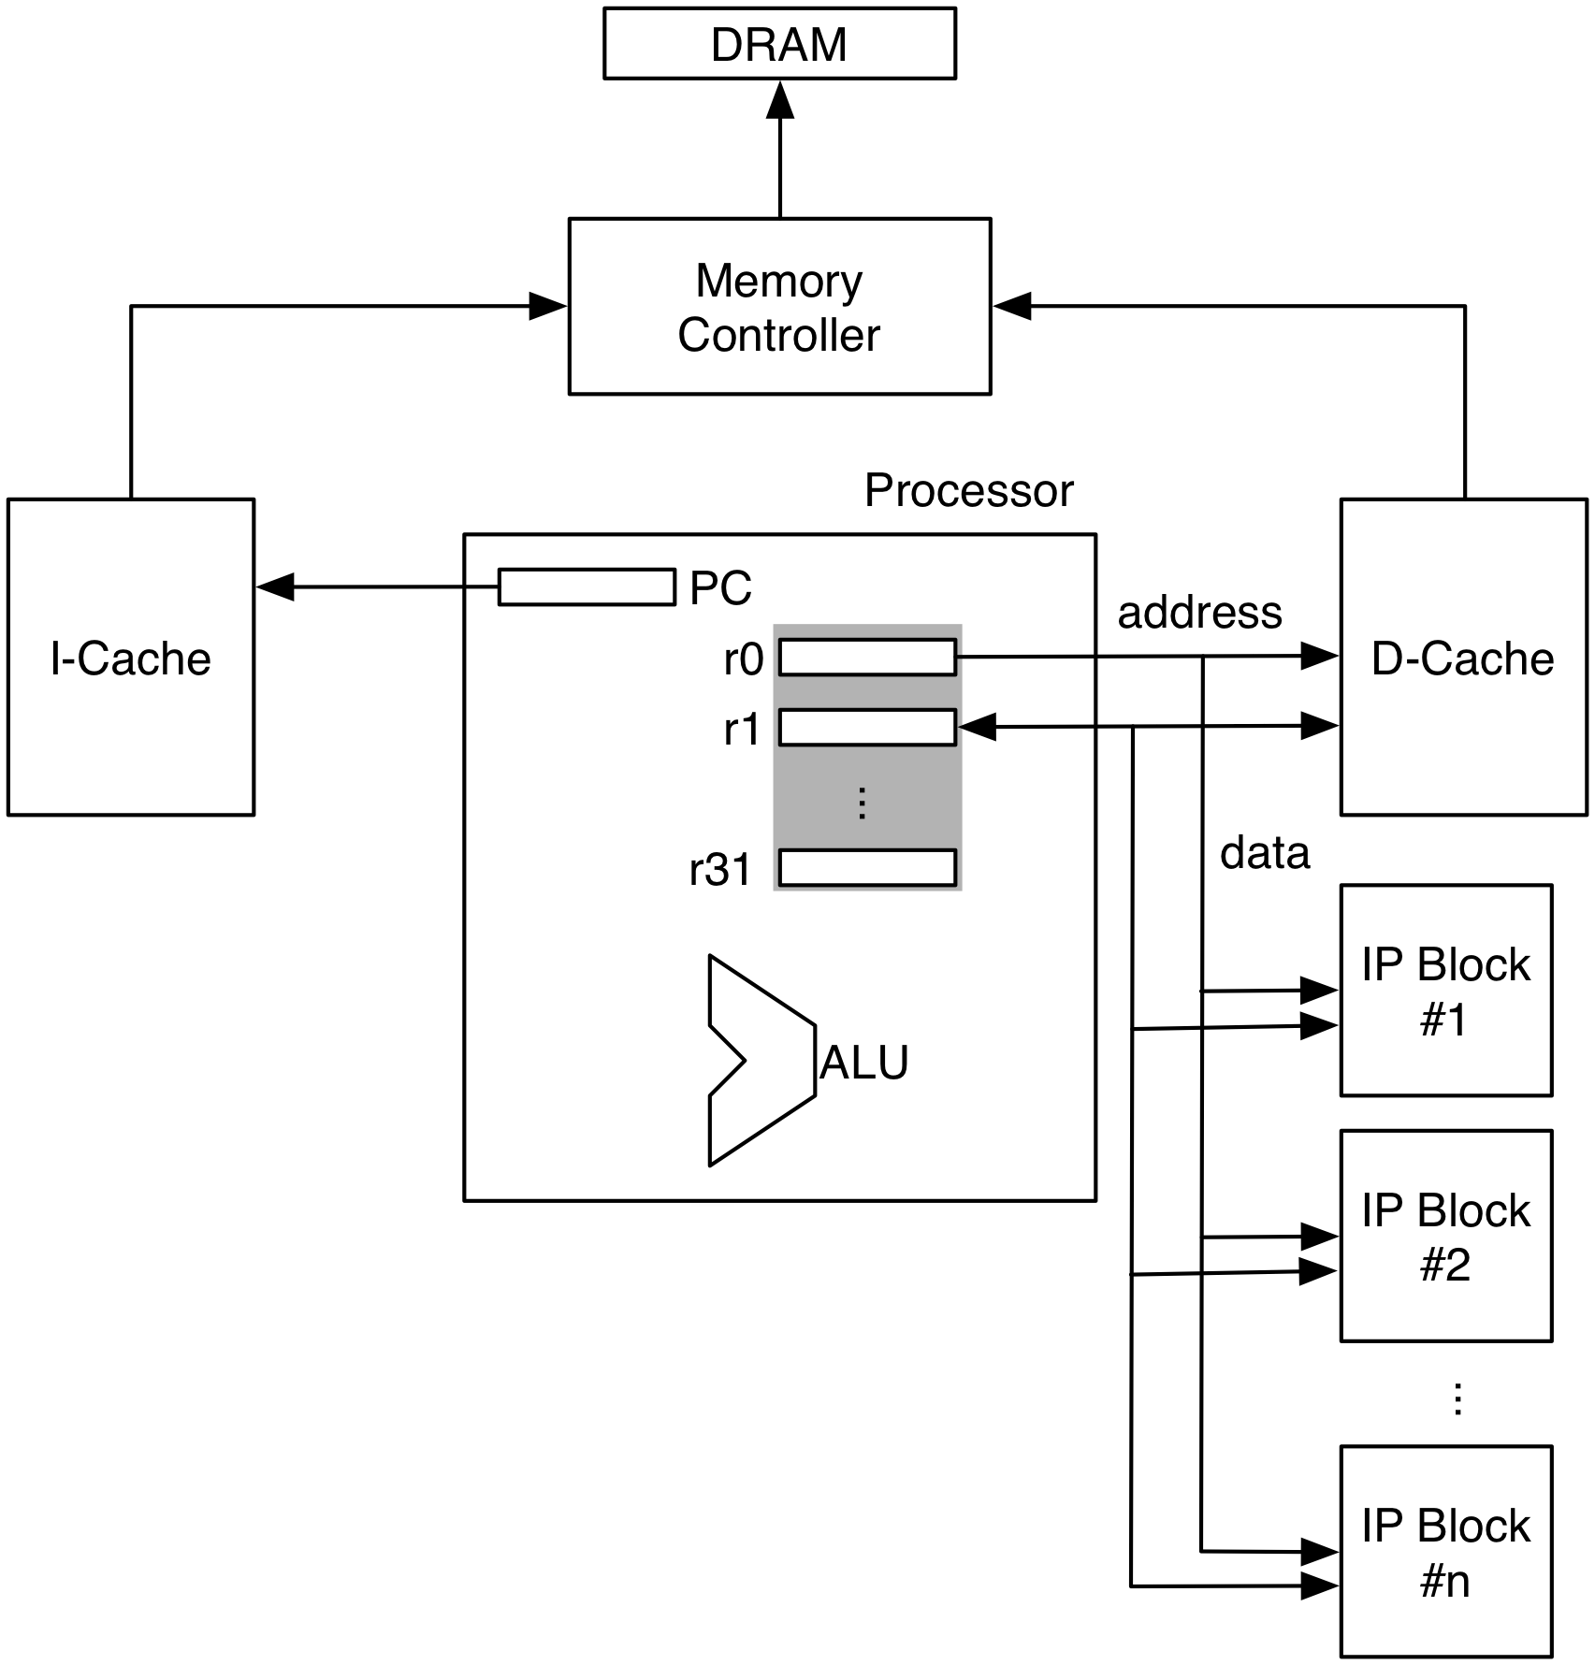
Embedded Processor I/O

Slide 10
Embedded Processor I/O
Software sets up the register with the address and data ...

Slide 11
Embedded Processor I/O
Blocks decode addresses to see if they are the targets...
Software sets up the register with the address and data ...

Slide 12
Embedded Processor I/O
Blocks decode addresses to see if they are the targets...
Software sets up the register with the address and data ...
Data transferred between register and hardware

Slide 13
AMBA Specification
AMBA: Advanced Microcontroller Bus Architecture
Created by ARM to enable standardized interfaces to their embedded processors
Actually three standards: APB, AHB, and AXI
Very commonly used for commercial IP cores

Slide 14
AMBA Specification
AMBA: Advanced Microcontroller Bus Architecture
Created by ARM to enable standardized interfaces to their embedded processors
Actually three standards: APB, AHB, and AXI
Very commonly used for commercial IP cores
Simple Bus

Slide 15
AMBA Specification
AMBA: Advanced Microcontroller Bus Architecture
Created by ARM to enable standardized interfaces to their embedded processors
Actually three standards: APB, AHB, and AXI
Very commonly used for commercial IP cores
Simple Bus
Complex Bus

Slide 16
AMBA Specification
AMBA: Advanced Microcontroller Bus Architecture
Created by ARM to enable standardized interfaces to their embedded processors
Actually three standards: APB, AHB, and AXI
Very commonly used for commercial IP cores
Simple Bus
Complex Bus
NoC

Slide 17
AMBA APB: Read Operation

Slide 18
AMBA APB: Read Operation
Target Address

Slide 19
AMBA APB: Read Operation
Target Address
Transaction Type

Slide 20
AMBA APB: Read Operation
Target Address
Transaction Type
Address Decode

Slide 21
AMBA APB: Read Operation
Target Address
Transaction Type
Address Decode
Optional (for asynchronous implementations...)

Slide 22
AMBA APB: Read Operation
Target Address
Transaction Type
Address Decode
Optional (for asynchronous implementations...)
Read Data

Slide 23
AMBA APB: Write Operation

Slide 24
AMBA APB: Write Operation
Common Signals Between Read and Write

Slide 25
AMBA APB: Write Operation
Common Signals Between Read and Write
Write Data

Slide 26
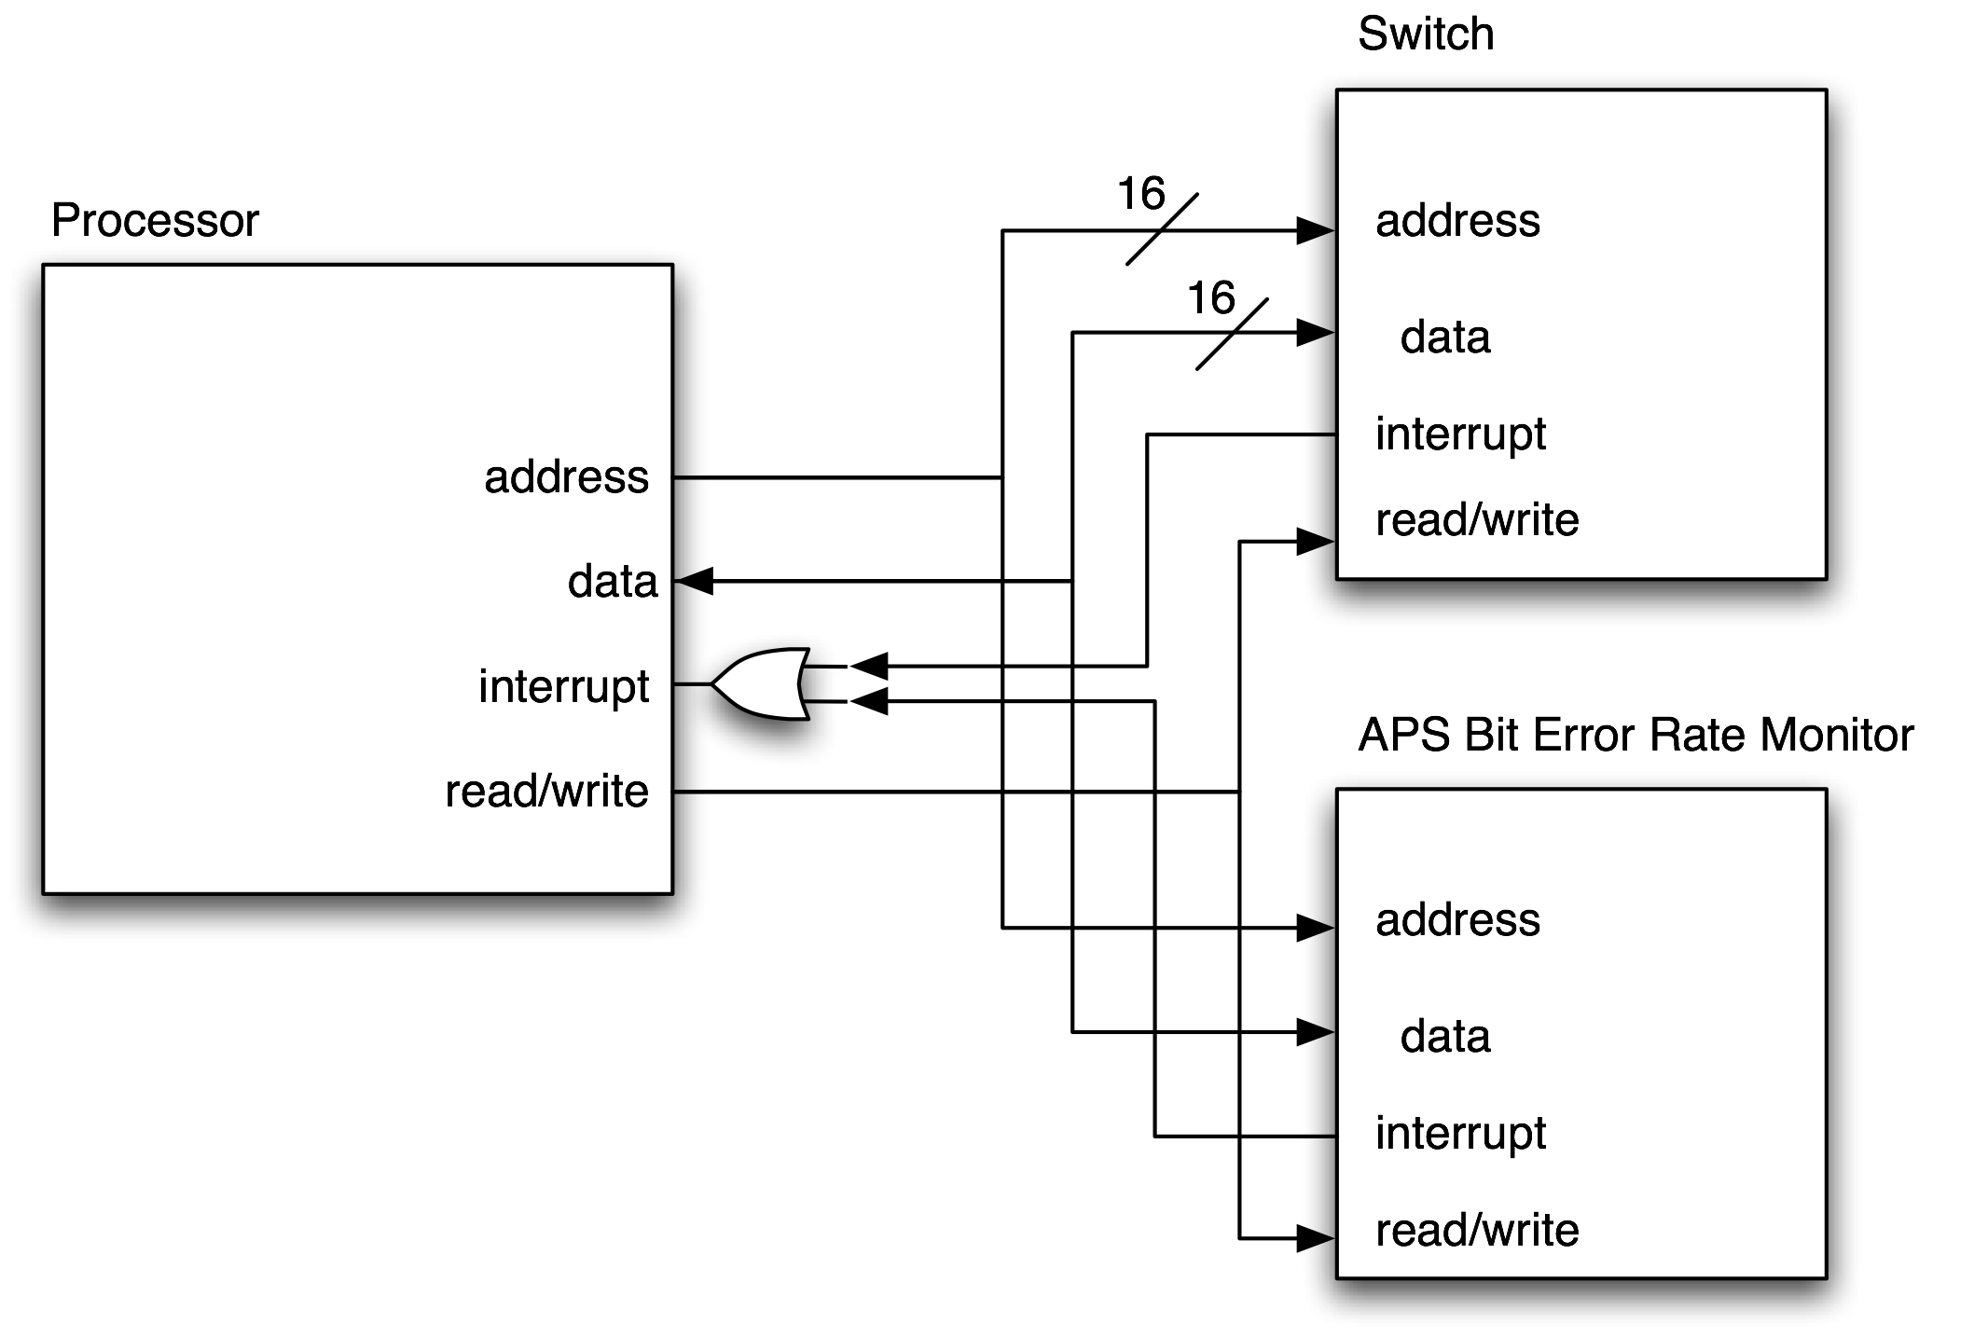
Remember Our Case Study
Simple generic processor interface:
data width:16 bits
address width: 16 bits
read cycle time: 50 ns
write cycle time: 50 ns

Slide 27
Remember Our Case Study
Simple generic processor interface:
data width:16 bits
address width: 16 bits
read cycle time: 50 ns
write cycle time: 50 ns
System bus

Slide 28
Simple Bus Advantages
Simple to implement
Easy to understand
Simple programming model
Easy to add new hardware blocks
Minimal hardware requirements (most of the signals are shared)

Slide 29
Simple Bus Limitations
Single Master - limits parallelism
Scalability - performance suffers as bus is loaded...
Single outstanding request - poor throughput and multi-threading performance bottleneck

Slide 30
Case Study: Single Master
Imagine a new partition:
  APS Bit Error Monitor communicates directly with Switch
Simple bus doesn’t work...

Slide 31
Case Study: Single Master
Imagine a new partition:
  APS Bit Error Monitor communicates directly with Switch
Simple bus doesn’t work...
No Path

Slide 32
Case Study: Single Master
Imagine a new partition:
  APS Bit Error Monitor communicates directly with Switch
Simple bus doesn’t work...
No Path
This can make software the bottleneck in the system....

Slide 33
Single Master Summary
A bus that is limited to a single master:
  Makes inter-block communication inefficient
  Limits parallelism between hardware and software
  Increases reliance on interrupts
  Creates software performance bottlenecks
  Is not compatible with multiple processors

Slide 34
Scalability

Slide 35
Scalability
Blocks are functionally easy to add, but....

Slide 36
Scalability
Each new block increases the delay on the address and data
Blocks are functionally easy to add, but....

Slide 37
Scalability Summary
Simple busses are not scaleable because:
  The address and data “fan-out” to each target
  Adding a new block increases the load on the bus
  Increased fanout + greater load = reduce performance

Slide 38
Single Outstanding Request

Slide 39
Single Outstanding Request
Processor is stalled waiting for response...

Slide 40
Single Outstanding Request
Processor is stalled waiting for response...
best-case <= 50% efficiency

Slide 41
Single Outstanding Request Summary
Busses limited to a single outstanding request:
  Reduce software performance since the software must “stall” on the first transaction
  Are not able to achieve full bus throughput since the data bus is idle during the address phase

Slide 42
Complex System Busses

Slide 43
Complex Systems Busses
The complex system bus is attempts to address some of the issues with the simple bus:
  Multi-master
  Pipelined transactions
There are many different ways to go about this...

Slide 44
AMBA AHB
AHB addresses many of the limitations of APB:
  multi-master
  multiple outstanding transactions (sort of...)
  back-to-back transactions
Unfortunately, this adds significant complexity

Slide 45
Bring on the complexity...

Slide 46
Bring on the complexity...
IP Block #1
CPU #1
IP Block #2
CPU #2
IP Block #3
IP Block #1
IP Block #4

Slide 47
Bring on the complexity...
Request
IP Block #1
CPU #1
IP Block #2
CPU #2
IP Block #3
IP Block #1
IP Block #4

Slide 48
Bring on the complexity...
Request
IP Block #1
Grant
CPU #1
IP Block #2
CPU #2
IP Block #3
IP Block #1
IP Block #4

Slide 49
Bring on the complexity...
Request
IP Block #1
Grant
CPU #1
Transaction
IP Block #2
CPU #2
IP Block #3
IP Block #1
IP Block #4

Slide 50
Bus Arbitration
When multiple masters share a bus there must be some central resource to manage the bus: an arbiter
Once there is competition for the bus, it is possible that it is not ready when you need it: backpressure
Backpressure adds complexity and hurt performance

Slide 51
Request / Grant Protocol

Slide 52
Request / Grant Protocol
Before a transaction a master makes a request to the central arbiter

Slide 53
Request / Grant Protocol
Before a transaction a master makes a request to the central arbiter
Eventually the request is granted

Slide 54
Request / Grant Protocol
Then the transaction proceeds
Before a transaction a master makes a request to the central arbiter
Eventually the request is granted

Slide 55
Request / Grant Protocol
Performance Impact
Then the transaction proceeds
Before a transaction a master makes a request to the central arbiter
Eventually the request is granted

Slide 56
Pipelined Transactions
To help improve bus efficiency the transactions on the bus can be pipelined
This is really a simple implementation of multiple outstanding transactions
The address for one transaction can be presented before the data from the previous transaction has been completed

Slide 57
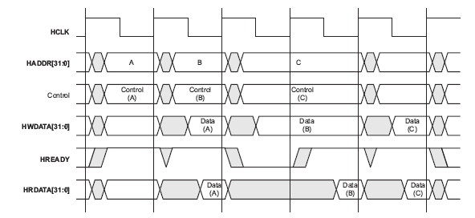
Pipelined Transactions

Slide 58
Pipelined Transactions
Transaction A Starts

Slide 59
Pipelined Transactions
Transaction A Starts
Transaction B Starts

Slide 60
Pipelined Transactions
Transaction A Starts
Transaction A Completes
Transaction B Starts

Slide 61
Pipelined Transactions
Notice backpressure
Transaction A Starts
Transaction A Completes
Transaction B Starts

Slide 62
Advantages
Relatively easy to add new blocks
Still has the familiar bus structure
Low hardware cost
Bus arbitration “solves” many ordering problems

Slide 63
Disadvantages
Busses that require arbitration:
  must route signals to the arbitration logic and back
  must find a “fair” way to share the bus
  slaves are not always available => backpressure
  difficult to provide performance guarantees...
Still potentially a bandwidth bottleneck
Still doesn’t scale well when blocks are added
Multiple outstanding transactions not handled well - no ordering information

Slide 64
Networks-on-Chip (NoCs)

Slide 65
Networks-on-Chip
It is clear that even with significant design effort the bus-style interconnect is not going to sufficient for large SoCs:
  the physical implementation does not scale: bus fanout, loading, arbitration depth all reduce operating frequency
  the available bandwidth does not scale: the single bus must be shared by all masters and slaves

Slide 66
Networks-on-Chip
It is clear that even with significant design effort the bus-style interconnect is not going to sufficient for large SoCs:
  the physical implementation does not scale: bus fanout, loading, arbitration depth all reduce operating frequency
  the available bandwidth does not scale: the single bus must be shared by all masters and slaves
Lets start again: Leverage research from data networking

Slide 67
What do we want?
The SoCs of the future will:
  have 100s of hardware blocks,
  have billions of transistors,
  have multiple processors,
  have large wire-to-gate delay ratios,
  handle large amounts of high-speed data,
  need to support “plug-and-play” IP blocks
Our NoC needs to be ready for these SoCs...

Slide 68
The Ideal Network
What would the ideal network look like?:
  Low area overhead
  Simple implementation
  High-speed operation
  Low-latency
  High-bandwidth
  Operate at a constant frequency even with additional blocks
  Increase available bandwidth as blocks are added
  Provide performance guarantees
  Have a “universal” interface

Slide 69
The Ideal Network
What would the ideal network look like?:
  Low area overhead
  Simple implementation
  High-speed operation
  Low-latency
  High-bandwidth
  Operate at a constant frequency even with additional blocks
  Increase available bandwidth as blocks are added
  Provide performance guarantees
  Have a “universal” interface
These are competing requirements: Design a network that is the “best” fit.

Slide 70
What do we need to decide?
Network Interface
Network Protocol / Transaction Format
Network Topology
VLSI Implementation

Slide 71
Network Interface
We want our network to be “plug-and-play” so industry standardization is key
However the standard be universal enough to address many different needs
AMBA AXI is an example of an attempt at this

Slide 72
AMBA AXI
ARM added the AXI specification to Version 3.0 of the AMBA standard
New approach: define the interface and leave the interconnect up to the designers
Good plan since a specific bus implementation is no longer required
It is possible to use AXI to build many different NoCs

Slide 73
AMBA AXI
Interface divided into 5 channels:
  Write Address
  Write Data
  Write Response
  Read Address
  Read Data/Response
Each channel is independent and use two-way flow control

Slide 74
AMBA AXI Read Channels

Slide 75
AMBA AXI Read Channels
Independent

Slide 76
AMBA AXI Read Channels
Give me some data
Independent

Slide 77
AMBA AXI Read Channels
Give me some data
Independent
Here you go

Slide 78
AMBA AXI Read Channels
channels synchronized with ID # or “tags”
Give me some data
Independent
Here you go

Slide 79
AMBA AXI Write Channels

Slide 80
AMBA AXI Write Channels
Independent
Independent

Slide 81
AMBA AXI Write Channels
I’m sending data. Please store it.
Independent
Independent

Slide 82
AMBA AXI Write Channels
I’m sending data. Please store it.
Independent
Here is the data.
Independent

Slide 83
AMBA AXI Write Channels
I’m sending data. Please store it.
Independent
Here is the data.
Independent
I received that data correctly.

Slide 84
AMBA AXI Write Channels
I’m sending data. Please store it.
Independent
Here is the data.
Independent
I received that data correctly.
channels synchronized with ID # or “tags”

Slide 85
AMBA AXI Flow-Control
Information moves only when:
  Source is Valid, and
  Destination is Ready
On each channel the master or slave can limit the flow
Very flexible

Slide 86
AMBA AXI Flow-Control
Information moves only when:
  Source is Valid, and
  Destination is Ready
On each channel the master or slave can limit the flow
Very flexible
Transfer

Slide 87
AMBA AXI Flow-Control
This definition of very independent, fully flow-controlled channels is very useful
However, there is a potential problem:

Slide 88
AMBA AXI Flow-Control
This definition of very independent, fully flow-controlled channels is very useful
However, there is a potential problem: DEADLOCK

Slide 89
AMBA AXI Flow-Control
This definition of very independent, fully flow-controlled channels is very useful
However, there is a potential problem: DEADLOCK
On a write transaction the master must not wait for AWREADY before asserting WVALID

Slide 90
AMBA AXI Read

Slide 91
AMBA AXI Read
Read Address Channel
Read Data Channel

Slide 92
AMBA AXI Write

Slide 93
AMBA AXI Write
Write Address Channel
Write Data Channel
Write Response Channel

Slide 94
A True Interface Specification
Because of the channel independence and the two-way flow-control the interface does not dictate the network protocol, transaction format, network topology, or VLSI implementation
For example:
  if you want to build a packet-based network, you can “backpressure” the data channel while you build the packet header from the address channel information,
  you can use store-and-forward, or cut-through,
  etc.

Slide 95
Network Protocol / Transaction Format
There are many choice for network protocols and transactions formats:
  circuit-switched : plan and provision a connection before communication starts
  packet-switched : issues packets which compete for network resources
  hybrids: schedule connectivity (dynamic or static)

Slide 96
Network Protocol / Transaction Format
There are many choice for network protocols and transactions formats:
  circuit-switched : plan and provision a connection before communication starts
  packet-switched : issues packets which compete for network resources
  hybrids: schedule connectivity (dynamic or static)
There is still lots of research here....

Slide 97
Network Topology
How should your network elements be interconnected:
  Fully Connected (N²): high area cost, high performance
  Mesh: low area cost, potential poor performance
  Hypercube: medium area, traffic dependent performance
  Fat-tree: medium area, traffic dependent performance
  Torus: medium area, traffic dependent performance

Slide 98
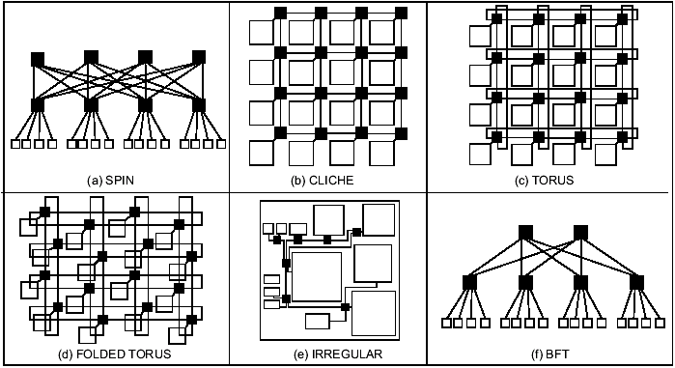
Network Topology
There is lots of research here....

Slide 99
Network Topology - Caveat
There has been a lot of research on topologies for NoCs, however it is important to realize that the performance of a topology is highly dependent on the traffic patterns!
Traffic patterns in an SoC that you are designing yourself are NOT random, therefore much of the topology research is not applicable to most SoCs!

Slide 100
VLSI Implementation
Once you have a topology there is still the mater of implementing it on your SoC
There are many considerations:
  Clocking: Synchronous, Asynchronous
  Buffer Insertion: Trade-off power, area, performance
  Register Insertion / Pipelining: Trade-off clock frequency, area, and latency
  Packet Buffers: Trade-off area, latency and throughput
Again, lots of research on-going...

Slide 101
Bluetooth “Platform” SoC
Processor
Application Specific Logic
Memory Controller
System Bus / Hardware I/F
Low-speed I/O and Support Logic
Notes:
IBM Cell, ADM’s Opteron and Fusion, Intel’s Atom and Core 2 Duo…
In fact I am working with a company right now architecting a 65nm SoC, and when you run the numbers you are compelled to integrate…

Slide 102
Research Paper
Lets look at:
Guerrier, P.; Greiner, A., "A generic architecture for on-chip packet-switched interconnections ," Design, Automation and Test in Europe Conference and Exhibition 2000. Proceedings , vol., no., pp.250-256, 2000

