Slide 1
STATIC TIMING ANALYSIS
Notes:
Till now we have learned about hdl verification synthesis and now we will be learning STA
STA is an effective methodology for verifying the timing characteristics of a design without the use of test vectors.session presents the methodology for verifying and fixing timing violations using STA.
Verification bottle neck as the design gets larger the task of testing all the timing paths using logic simulation becomes too time consuming.it requires several hours of simulation time for designs over 100k gates.there are two factors that that influences the successful analysis of timing in synchronous designs namely methodology and tool.a good methodology is based on identifying and fixing timing problems.when developing a timing analysis methodology it must be done with the entire design flow including clock tree synthesis, parasitic extraction, delay calculation and logic synthesis in perspective.

Slide 2
Introduction
Effective methodology for verifying the timing characteristics of a design without the use of test vectors
Conventional verification techniques are inadequate for complex designs
  Simulation time using conventional simulators
    Thousands of test vectors are required to test all timing paths using logic simulation
  Increasing design complexity & smaller process technologies
    Increases the number of iterations for STA
Notes:
Timing characteristics – setup, hold, recovery, removal, pulse width
Time – Days of simulation using conventional simulators
Large number of Test vectors required to test all the design timing paths exhaustively
Conventional technologies have serious limitations when we are dealing with complex designs.

Slide 3
Simulation vs. Static timing
True timing paths
False timing paths
Timing Simulation
(adding vectors)
Static timing analysis
(eliminating false paths)
0%
100%
STA approach typically takes a fraction of the time it takes to run
logic simulation on a large design and guarantees 100% coverage
of all true timing paths in the design without having to generate test
vectors
Notes:
Drawback of STA – cannot determine the timing errors related to logic operations because it does not perform functional simulation. Eg. Race conditions cannot be detected.coverage of all the possible timing paths in the design without having to generate test vectors
Timing tools are most appropriate for purely synchronous design.
Objective of timing tool is to cover all the true timing path.
With simulation actual functional vectors are used..so all paths covered are true paths
But full coverage in large designs is difficult to achieve so false path is important

Slide 4
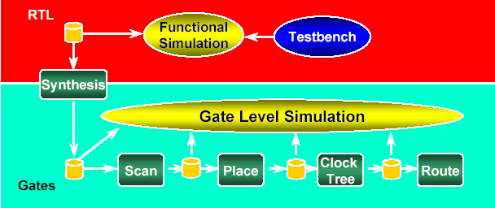
OVERVIEW
Previous Verification Flow
Notes:
The previous design flow is an iterative one which involves a lots of time.
Interconnect capacitance contribute to the total cell delay
After initial synthesis and floor planning and layout the simulation of net list is very time consuming and requires many iterations.not feasible to do timing analysis for large designs

Slide 5
OVERVIEW
• Requires extensive vector creation
• Valid for FPGAs and smaller ASICs
• Falls apart on multi-million gate ASICs

Slide 6
What is Static Timing Analysis?
Static Timing Analysis is a method for determining if a circuit meets timing constraints without having to simulate
Much faster than timing-driven, gate-level simulation
Proper circuit functionality is not checked
Vector generation NOT required
Notes:
STA is a technique used to determine all the possible timing violations including setup, hold, recovery removal and pulse width in a design for a specified clock.without applying test vectors.STA is done on true timing paths ie where functional checks are done (synchronous designs).After synthesis timing analysis is done to to generate a list of paths which violates the timing requirements.

Slide 7
STA in ASIC Design Flow – Pre layout
Logic Synthesis
Constraints
(clocks, input drive,
output load)
Design For test
Floor planning
Static Timing Analysis
Static Timing Analysis
(estimated parasitics)
Notes:
Floor planning to Logic synthesis - custom wire load model re-optimization
STA is performed on the synthesized net list to do possible timing checks in the design.Resynthesis of the design might be required to fix timing violations.
Fp and placement and parasitic are estimated.pre-layout static timing analysis is performed using the estimated parasitics. Re optimization of the design using custom wire load model might be required from the source hdl.
Clock tree not synthesized during logic synthesis.(don’t_touch)
Estimated clock tree impact should be specified while specifying the clock during logic synthesis.
Again static timing analysis is done for the ckts based on sdf back annotation.parasitic extraction with all pin-pin delays with capacitance resistance information will be there in sdf.
(for post-layout )
Then a detailed analysis of the ckts along with the netlist which include clock tree and other parasitic information is then used for post-layout analysis.

Slide 8
STA in ASIC Design Flow – Post Layout
Floor planning
Constraints
(clocks, input drive,
output load)
Clock Tree Synthesis
Place and Route
Static Timing Analysis
(estimated parasitics)
Parasitic Extraction
Static Timing Analysis
(extracted parasitics)
SDF
(extracted parasitics)

Slide 9
2 Types of Timing Verification
Dynamic Timing Simulation
Advantages
Can be very accurate (spice-level)
Disadvantages
Analysis quality depends on stimulus vectors
Non-exhaustive, slow
Examples:
VCS,Spice,ACE

Slide 10
2 Types of Timing Verification
Static Timing Analysis (STA)
Advantages
Fast, exhaustive
Better analysis checks against timing requirements
Disadvantage
Less accurate
Must define timing requirements/exceptions
Difficulty handling asynchronous designs, false paths

Slide 11
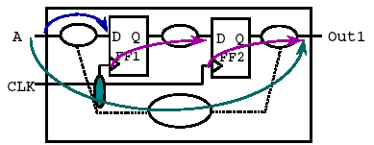
Three Steps in Static Timing Analysis
Circuit is broken down into sets of timing paths
Delay of each path is calculated
Path delays are checked to see if timing constraints
have been met

Slide 12
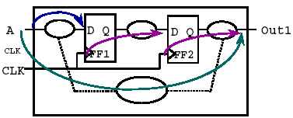
What is a Timing Path?
A Timing Path is a point-to-point path in a design which
can propagate data from one flip-flop to another
Each path has a start point and an endpoint
Start point:
  Input ports Clock pins of flip-flops
Endpoints:
  Output ports Data input pins of flip-flops

Slide 13
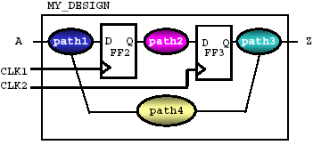
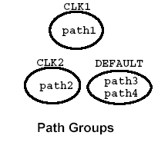
Organizing Timing Paths Into Groups
Timing paths are grouped into path groups by the
clocks controlling their endpoints
Synthesis tools like PrimeTime and Design Compiler organize timing reports by path groups

Slide 14
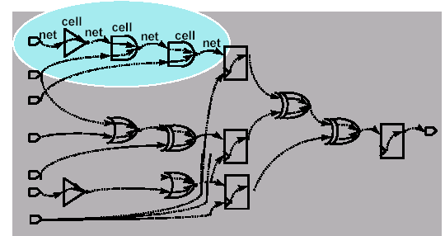
Net and Cell Timing Arcs
The actual path delay is the sum of net and cell delays along the timing path

Slide 15

Net and Cell Delay
“Net Delay” refers to the total time needed to charge or discharge all of the parasitics of a given net
Total net parasitics are affected by
  net length
  net fanout
Net delay and parasitics are typically
  Back-Annotated (Post-Layout) from data obtained from
  an extraction tool
  Estimated (Pre-Layout)

Slide 16
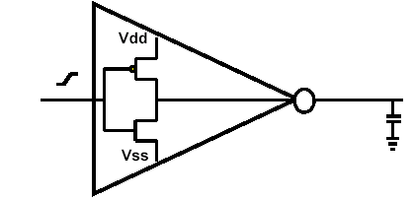
Cell Delay
In ASICs, the delay of a cell is affected by:
  The input transition time (or slew rate)
  The total load “seen” by the output transistors
Net capacitance and “downstream” pin capacitances
  These will affect how quickly the input and output transistors can “switch”
  Inherent transistor delays and “internal” net delays

Slide 17
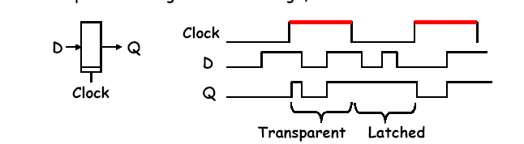
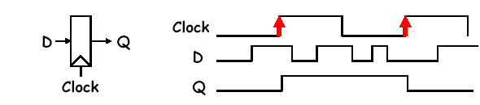
Clocked Storage Elements
Transparent Latch, Level Sensitive
– data passes through when clock high, latched when clock low
D-Type Register or Flip-Flop, Edge-Triggered
– data captured on rising edge of clock, held for rest of cycle

Slide 18
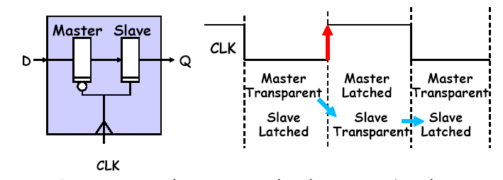
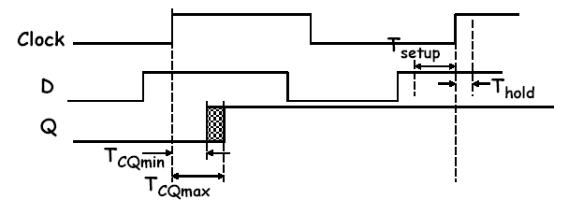
Flip-Flops

Slide 19
Basic terminologies
Pulse Width
Setup & Hold times
Signal slew
Clock latency
Clock Skew
Input arrival time
Output required time
Slack and Critical path
Recovery & Removal times
False paths
Multi-cycle paths

Slide 20
Pulse Width
Pulse width
  It is the time between the active and inactive states of the same signal

Slide 21
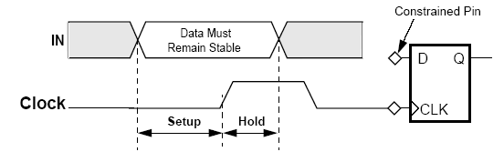
Setup and Hold time
Setup time
  For an edge triggered sequential element, the setup time is the time interval before the active clock edge during which the data should remain unchanged
Hold time
  Time interval after the active clock edge during which the data should remain unchanged
  Both the above 2 timing violations can occur in a design when clock path delay > data path delay

Slide 22
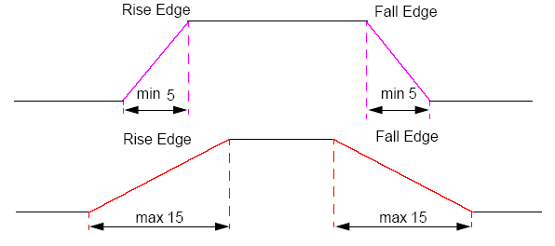
Signal Slew
Signal (Clock/Data) slew
  Amount of time it takes for a signal transition to occur
  Accounts for uncertainty in Rise and fall times of the signal
  Slew rate is measured in volts/sec

Slide 23
Clock Latency
Clock Latency
  Difference between the reference (source) clock slew to the clock tree endpoint signal slew values
  Rise latency and fall latency are specified
INV
INV
INV
INV
INV
CLKA
Rise=7
Fall=4
Rise=7
Fall=4
Rise=7
Fall=4
Rise=7
Fall=4
CLK
INV
BUF
CLKB
Rise=7
Fall=4
Rise=7
Fall=4
BUF
CLKC
Rise=7
Fall=4

Slide 24
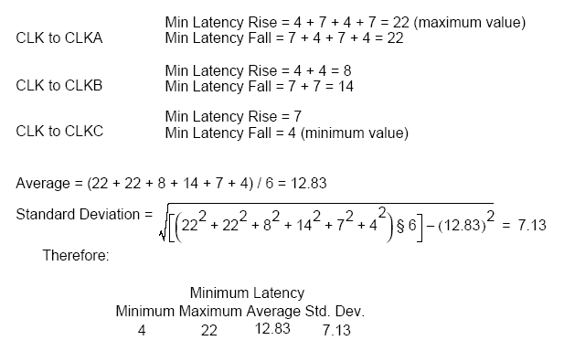
Clock Latency

Slide 25
Clock Skew
Clock Skew is a measure of the difference in latency between any two leaf pins in a clock tree.
  between CLKA and CLKB
  rise = 22-8 = 14
  fall = 22-14 = 8
  between CLKB and CLKC
  rise = 8-7 = 1
  fall = 14-4 = 10
  between CLKA and CLKC
  rise = 22-7 = 15
  fall = 22-4 = 18
  It is also defined as the difference in time that a single clock signal takes to reach two different registers

Slide 26
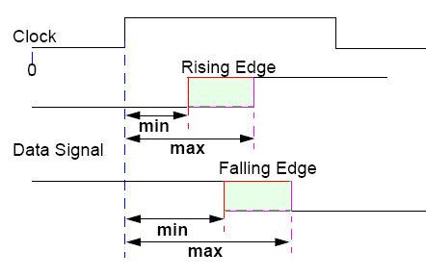
Input Arrival time
Input Arrival time
  An arrival time defines the time interval during which a data signal can arrive at an input pin in relation to the nearest edge of the clock signal that triggers the data transition

Slide 27
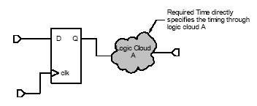
Output required time
Output required time
  Specifies the data required time on output ports.

Slide 28
Slack and Critical path
Slack
  It is the difference between the required (constraint) time and the arrival time (inputs and delays).
  Negative slack indicates that constraints have not been met, while positive slack indicates that constraints have been met.
  Slack analysis is used to identify timing critical paths in a design by the static timing analysis tool
Critical path
  Any logical path in the design that violates the timing constraints
  Path with a negative slack

Slide 29
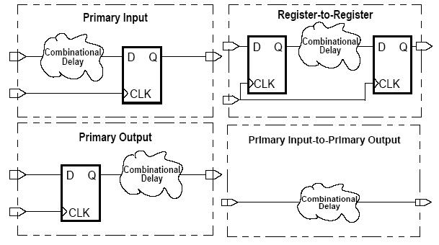
Slack Analysis – Data Path types

Slide 30
Slack analysis – data path types
Primary input-to-register paths
  Delays off-chip + Combinational logic delays up to the first sequential device.
Register-to-primary output paths
  Start at a sequential device
  CLK-to-Q transition delay + the combinational logic delay + external delay requirements
Register-to-register paths
  Delay and timing constraint (Setup and Hold) times between sequential devices for synchronous clocks + source and destination clock propagation times.
Primary input-to-primary output paths
  Delays off-chip + combinational logic delays + external delay requirements.

Slide 31
Hold Slack calculation
Actual data arrival time definition
  Data Input Arrival Timemin + Data path delaymin
    If the data path starts in a primary input,
      Data Input arrivalmin = Input arrival timemin
    If the data path starts at a register,
      (Source Clock Edgemin + Source Clock Path Delaymin) = Data Input Arrivalmin
Required Stability time definition
  (Destination Clock Edgemax + Destination Clock Path Delaymax) + Hold = Required Stability Timemax
Hold Slack definition
  Actual Data Arrivalmin - Required Stability Timemax
Notes:
Slack = Earliest (=> minimum) data change – Maximum required stability time

Slide 32
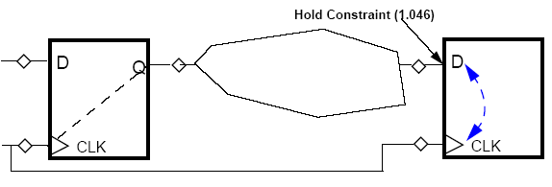
Calculate the hold slack
Source Clock signal timing parameters:
Min Edge = 8.002 ns
Min clock path delay = 0.002 ns
Min Data path delay = 0.802 ns
Hold time constraint = 1.046 ns
Destination Clock signal timing parameters:
Max Edge = 2.020 ns
Max clock path delay = 0.500 ns

Slide 33
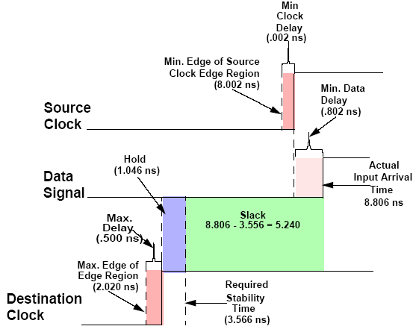
Hold slack calculation

Slide 34
Setup Slack calculation
Actual data arrival time definition
  Data Input Arrival Timemax + Data path delaymax
    If the data path starts in a primary input,
      Data Input arrivalmax = Input arrival timemax
    If the data path starts at a register,
      (Source Clock Edgemax + Source Clock Path Delaymax) = Data Input Arrivalmax
Required Stability time definition
  (Destination Clock Edgemin + Destination Clock Path Delaymin) - Setup = Required Stability Timemin
Setup slack definition
  Required Stability Timemin - Actual Data Arrivalmax

Slide 35
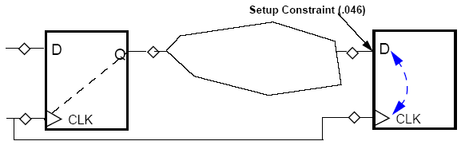
Calculate the setup slack
Source Clock signal timing parameters:
Max Edge = 2.002 ns
Max clock path delay = 0.002 ns
Min Data path delay = 13.002 ns
Setup time constraint = 0.046 ns
Destination Clock signal timing parameters:
Min Edge = 20.02 ns
Min clock path delay = 0.500 ns

Slide 36
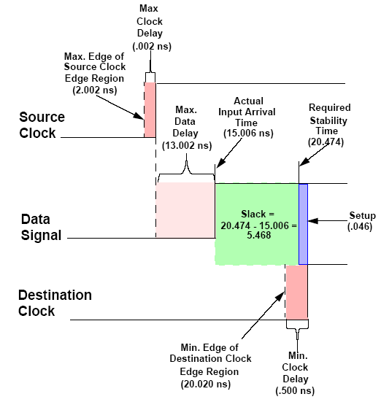
Setup slack calculation

Slide 37
Recovery and Removal time
Recovery time
  Like setup time for asynchronous port (set, reset)
Removal time
  Like hold time for asynchronous port (set, reset)
Recovery time
  It is the time available between the asynchronous signal going inactive to the active clock edge
Removal time
  It is the time between active clock edge and asynchronous signal going inactive

Slide 38
False Paths
False paths
  Paths that physically exist in a design but are not logic/functional paths
  These paths never get sensitized under any input conditions
Mux 1
Mux 2
A
C
C1
C2
OUT
B1
B2
B
S
Notes:
Total 4 timing paths
Path 1 – A-C-C1-C2-OUT
PATH 2 – A-C-OUT
PATH 3 – B-B1-B2-C-C1-C2-OUT
PATH 4 – B-B1-B2-C-OUT
Only path1 and 4 above are valid logic paths as select line for the 2 muxes are the same

Slide 39
Multi-cycle paths
Multi-cycle paths
  Data Paths that require more than one clock period for execution
2 clock period delay

Slide 40
Sequential Circuit Timing
Objectives
This section covers several timing considerations encountered in the design of synchronous sequential circuits. It has the following objectives:
  Define the following global timing parameters and show how they can be derived from the basic timing parameters of flip-flops and gates.
    Maximum Clock Frequency
    Maximum allowable clock skew
    Global Setup and Hold Times
  Discuss ways to control the loading of data into registers and show why gating the clock signal to do this is a poor design practice.

Slide 41
Maximum Clock Frequency
The clock frequency for a synchronous sequential circuit is limited by the timing parameters of its flip-flops and gates. This limit is called the maximum clock frequency for the circuit. The minimum clock period is the reciprocal of this frequency.
Relevant timing parameters
  Gates:
    Propagation delays: min t_{PLH}, min t_{PHL}, max t_{PLH}, max t_{PHL}
  Flip-Flops:
    Propagation delays: min t_{PLH}, min t_{PHL}, max t_{PLH}, max t_{PHL}
    Setup time: t_{su}
    Hold time: t_{h}

Slide 42
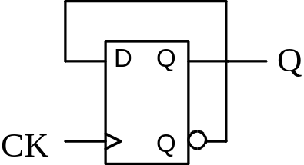
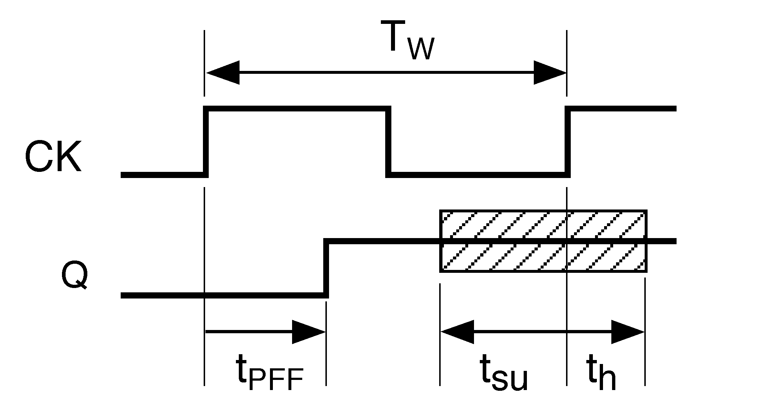
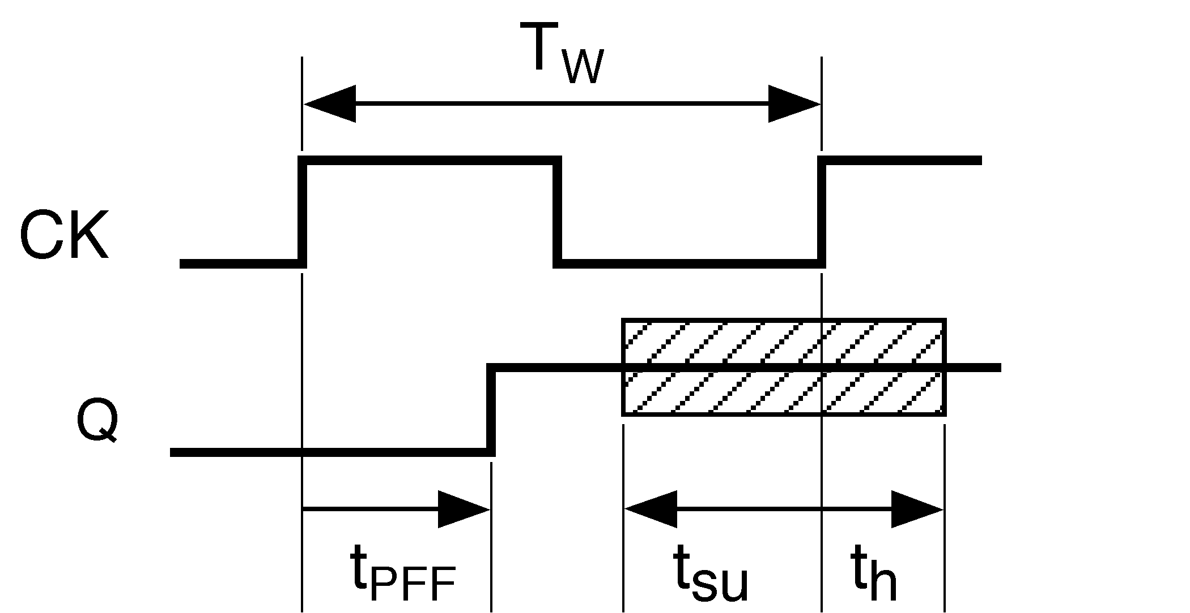
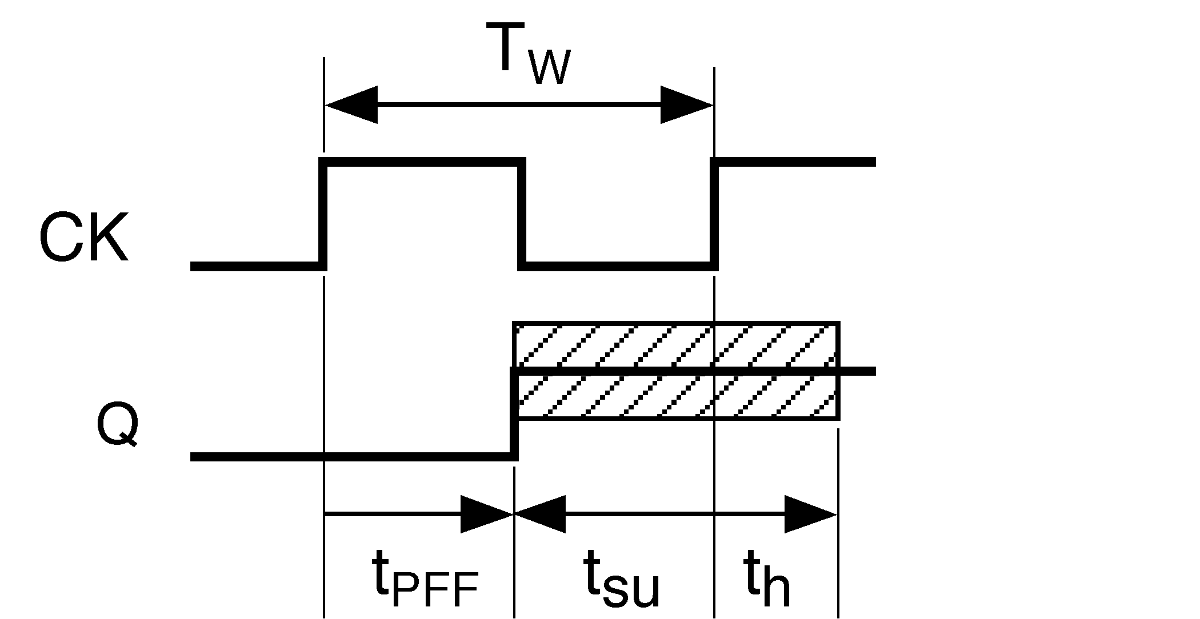
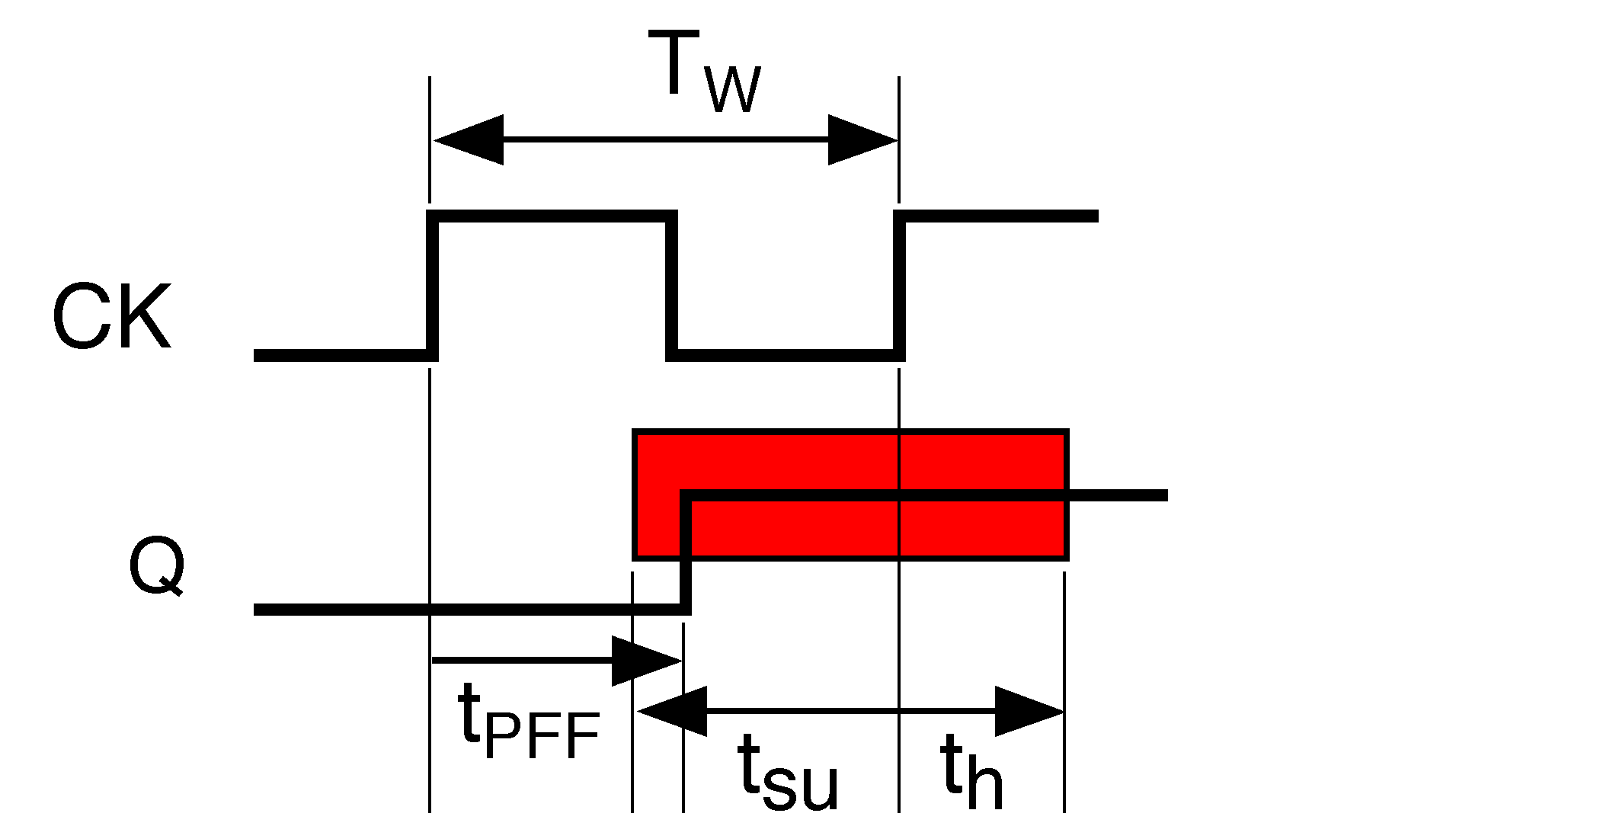
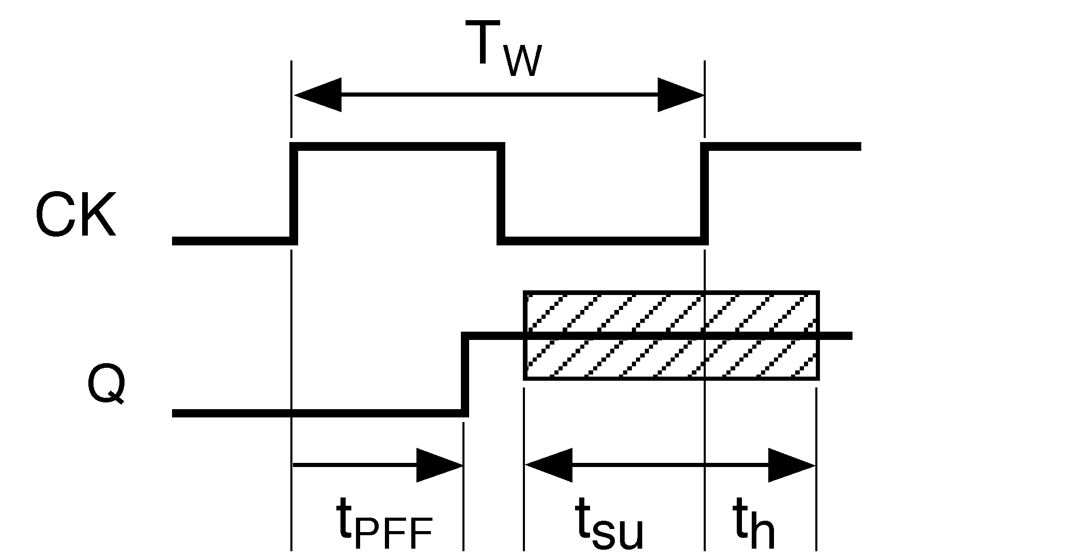
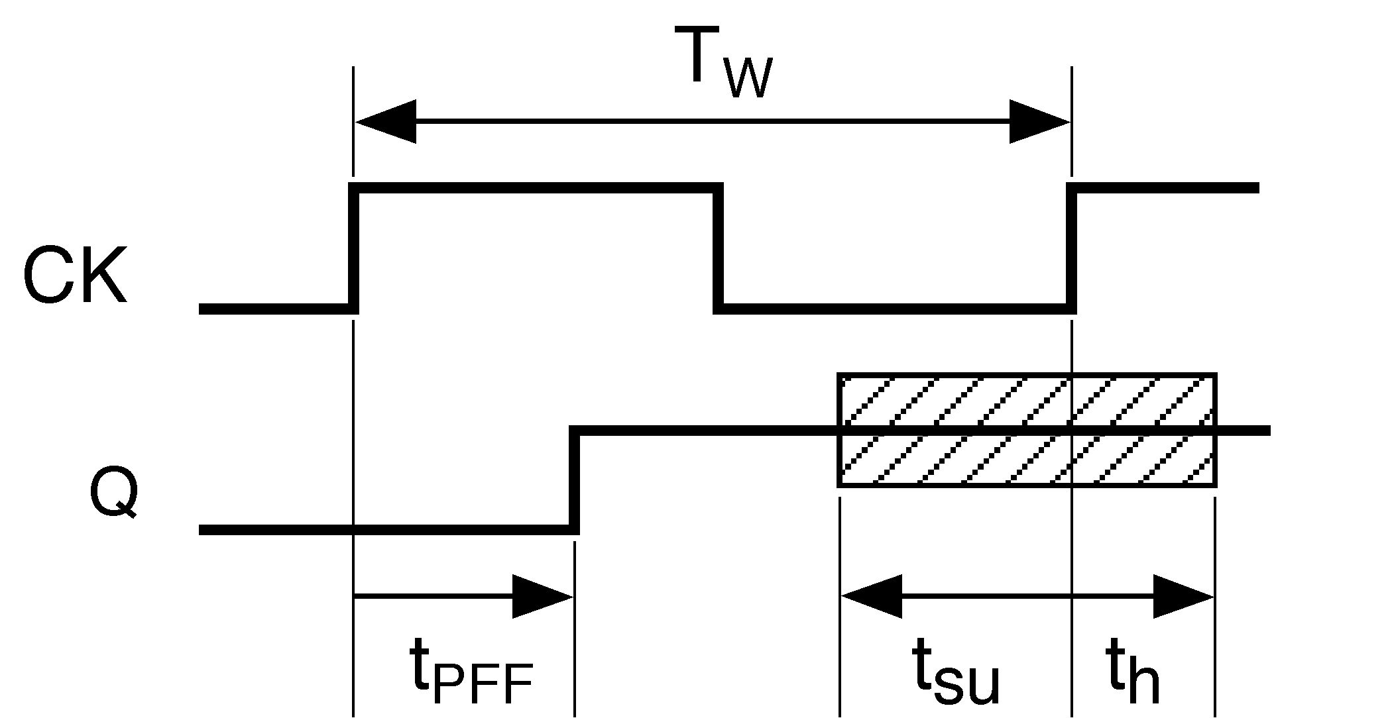
Example
T_{W} ≥ max t_{PFF} + t_{su}
  For the 7474, max t_{PLH} = 25ns, max t_{PHL} = 40ns, t_{su} = 20ns
    T_{W} ≥ max (max t_{PLH} + t_{su,} max t_{PHL} + t_{su)}
    T_{W} ≥ max (25+20, 40+20) = 60

Slide 43
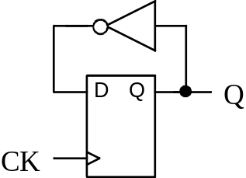
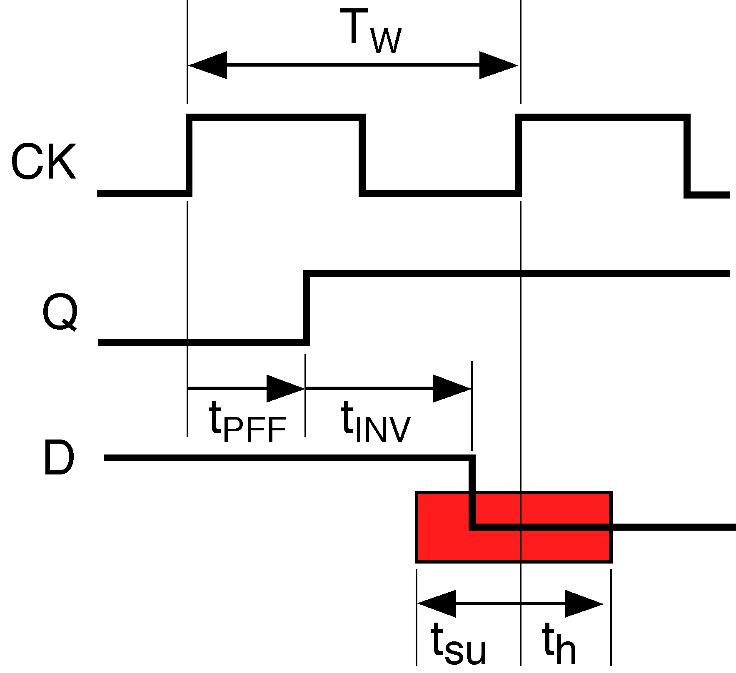
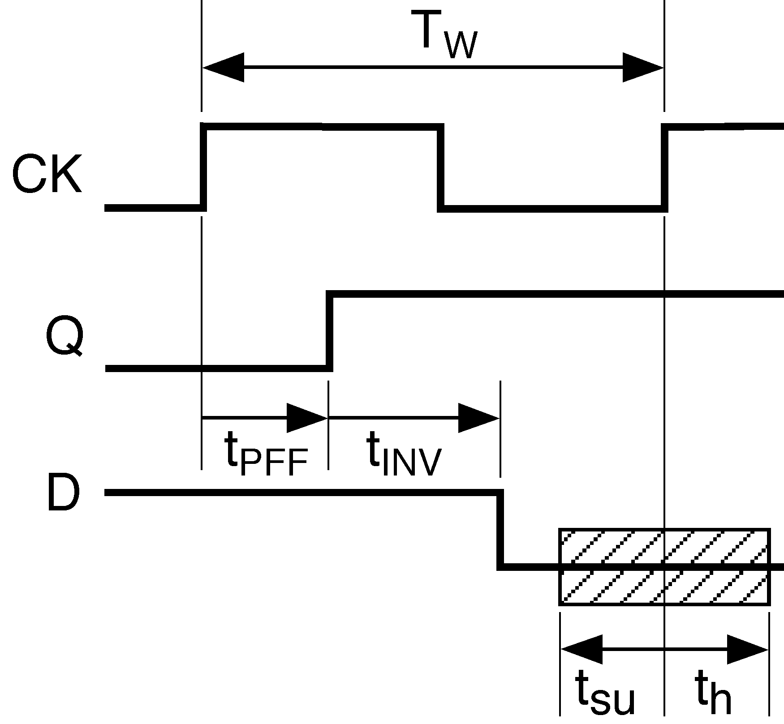
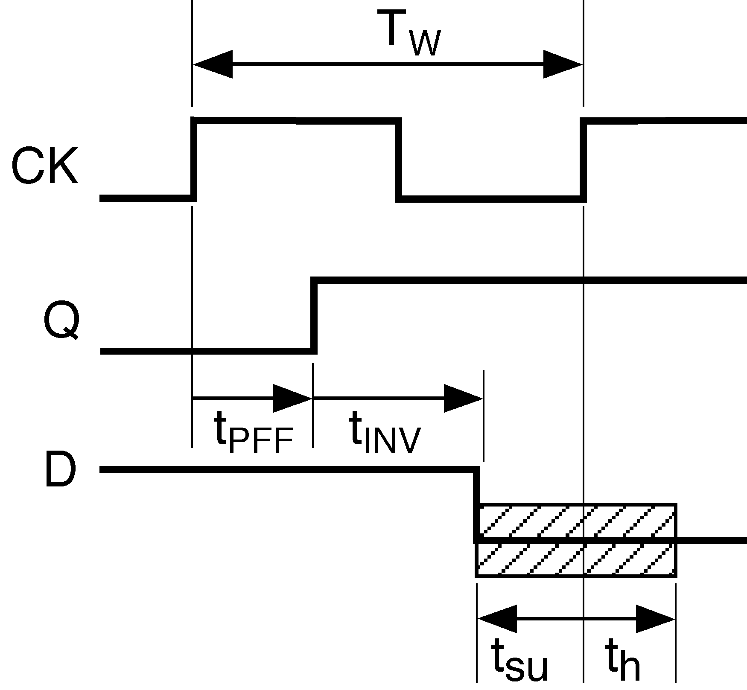
Example
T_{W} ≥ max t_{PFF} + max t_{PINV} + t_{su}

Slide 44
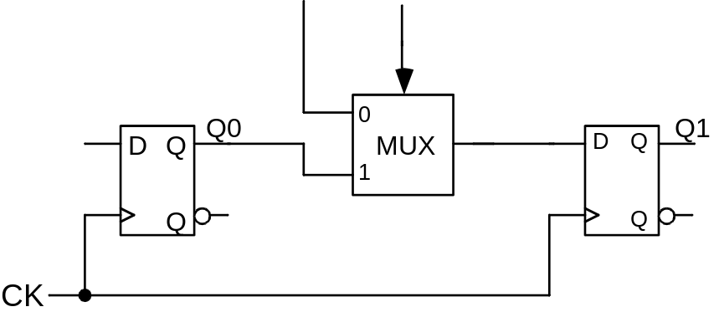
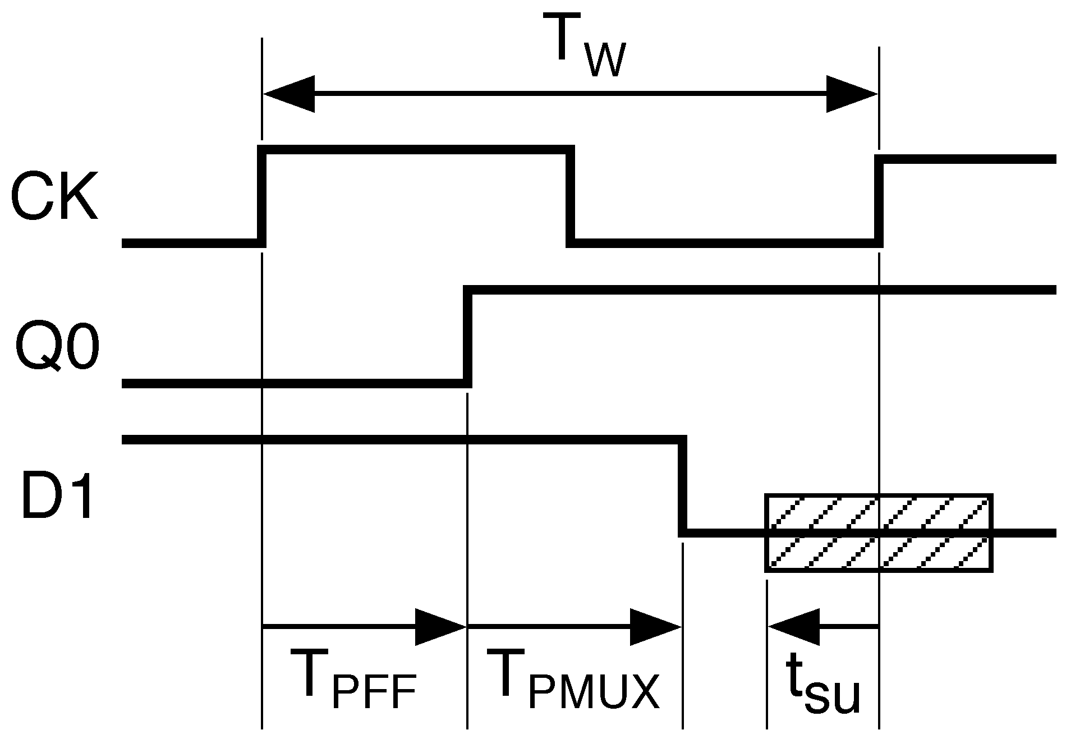
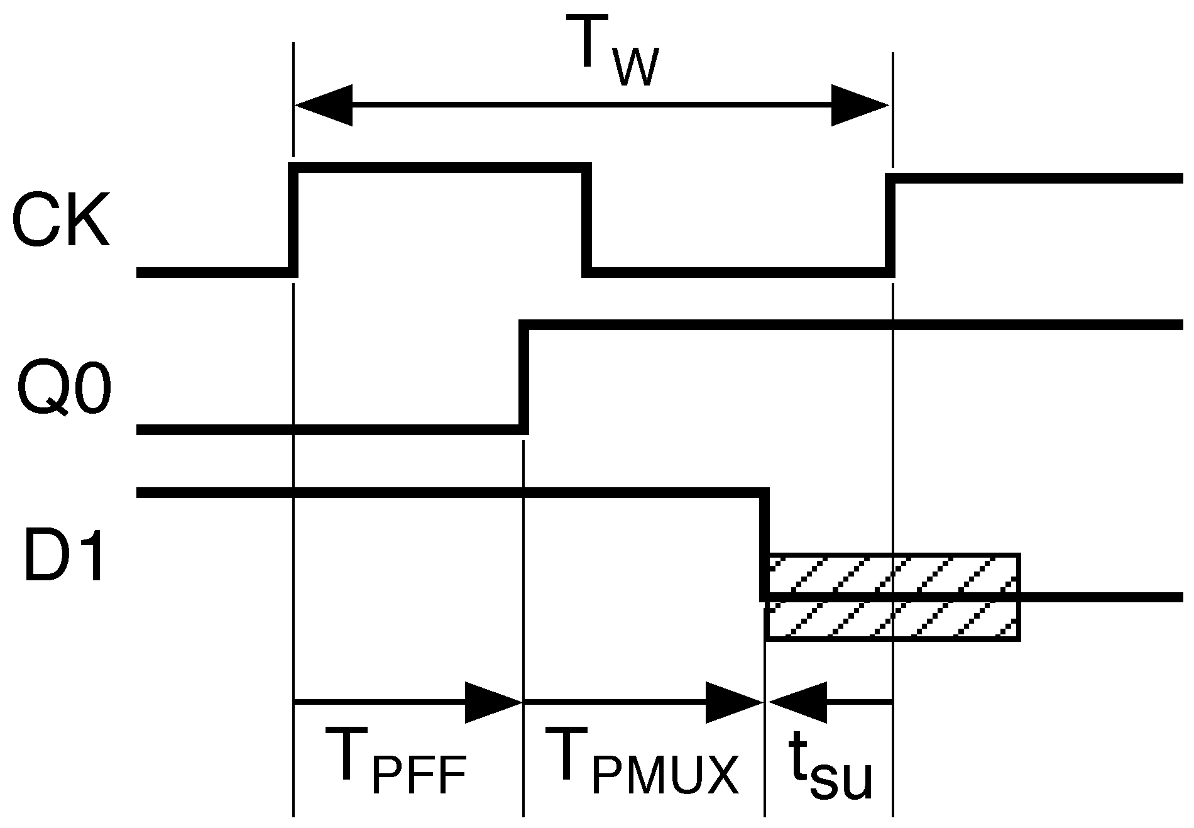
Example
T_{W} ≥ max t_{PFF} + max t_{PMUX} + t_{su}

Slide 45
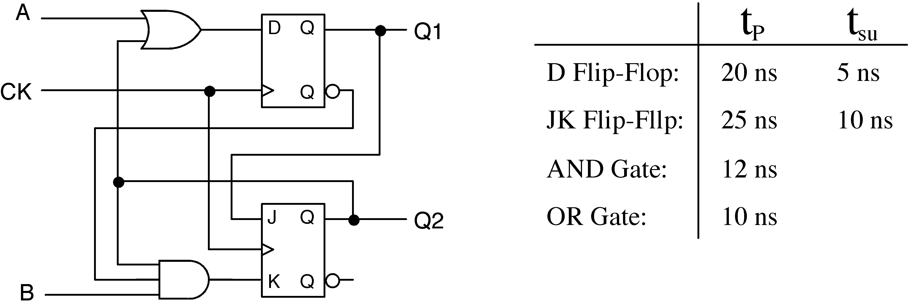
Example
Paths from Q1 to Q1:
None
Paths from Q1 to Q2:
T_{W} ≥ max t_{PDFF} +t_{JKsu} = 20 +10 = 30 ns
T_{W} ≥ max t_{PDFF} + max t_{AND} + t_{JKsu} = 20 + 12 + 10 = 42 ns
Paths from Q2 to Q1:
T_{W} ≥ max t_{PJKFF} + t_{OR} + T_{Dsu} = 25 + 10 + 5 = 40 ns
Paths from Q2 to Q2:
T_{W} ≥ max t_{PJKFF} + max t_{AND} + t_{JKsu} = 25 + 12 + 10 = 47 ns
TW ≥ 47 ns

Slide 46
Clock Skew
  If a clock edge does not arrive at different flip-flops at exactly the same time, then the clock is said to be skewed between these flip-flops. The difference between the times of arrival at the flip-flops is said to be the amount of clock skew.
  Clock skew is due to different delays on different paths from the clock generator to the various flip-flops.
    Different length wires (wires have delay)
    Gates (buffers) on the paths
    Flip-Flops that clock on different edges (need to invert clock for some flip-flops)
    Gating the clock to control loading of registers (a very bad idea)

Slide 47
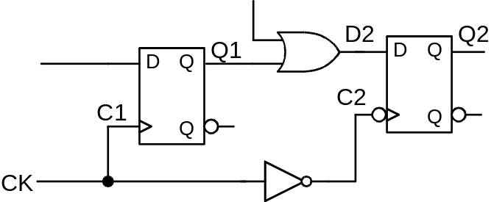
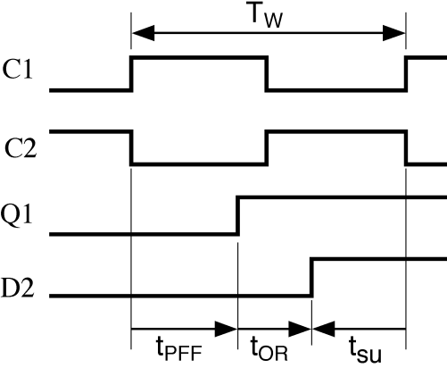
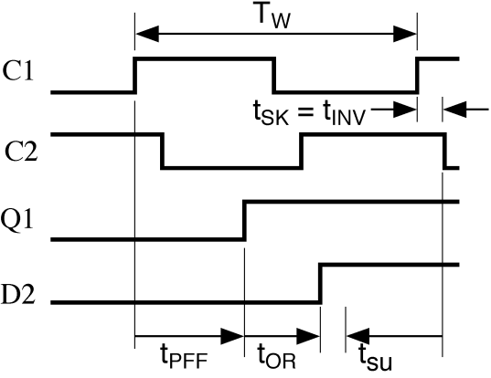
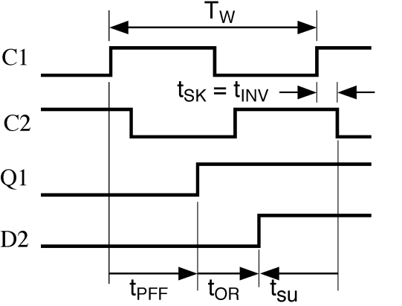
Example (Effect of clock skew on clock rate)
  Clock C2 skewed after C1
T_{W} ≥ max T_{PFF} + max t_{OR} + t_{su}
(if clock not skewed, i.e., t_{INV} = 0)
T_{W} ≥ max T_{PFF} + max t_{OR} + t_{su} - min t_{INV}
(if clock skewed, i.e., t_{INV} > 0)

Slide 48
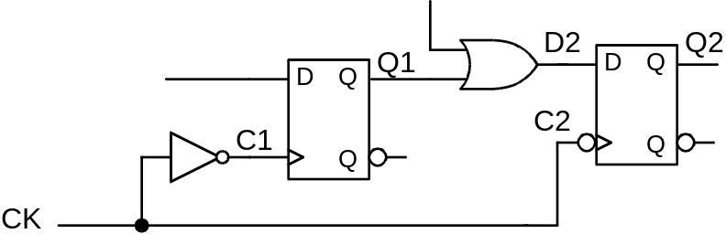
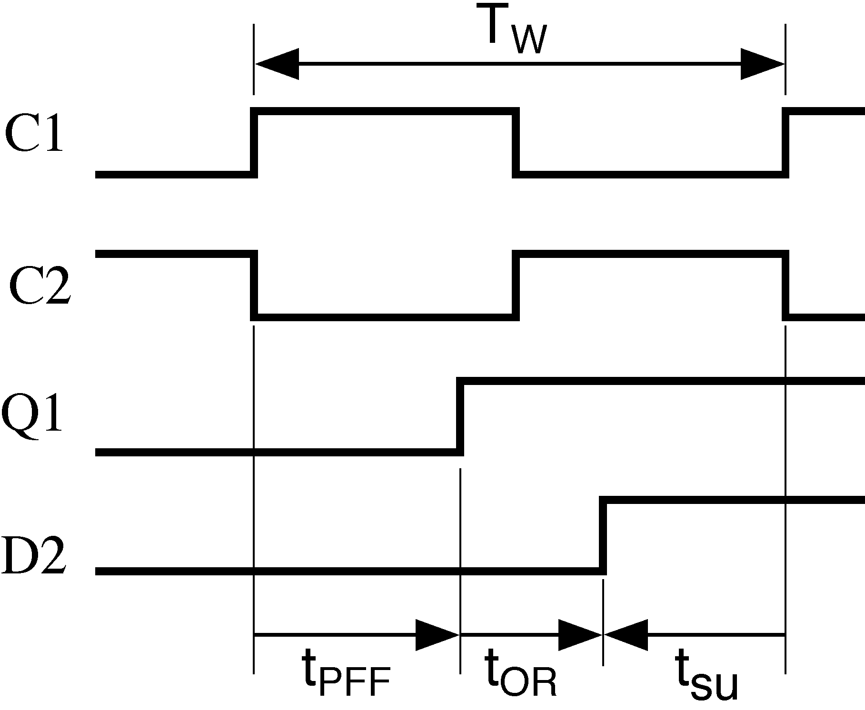
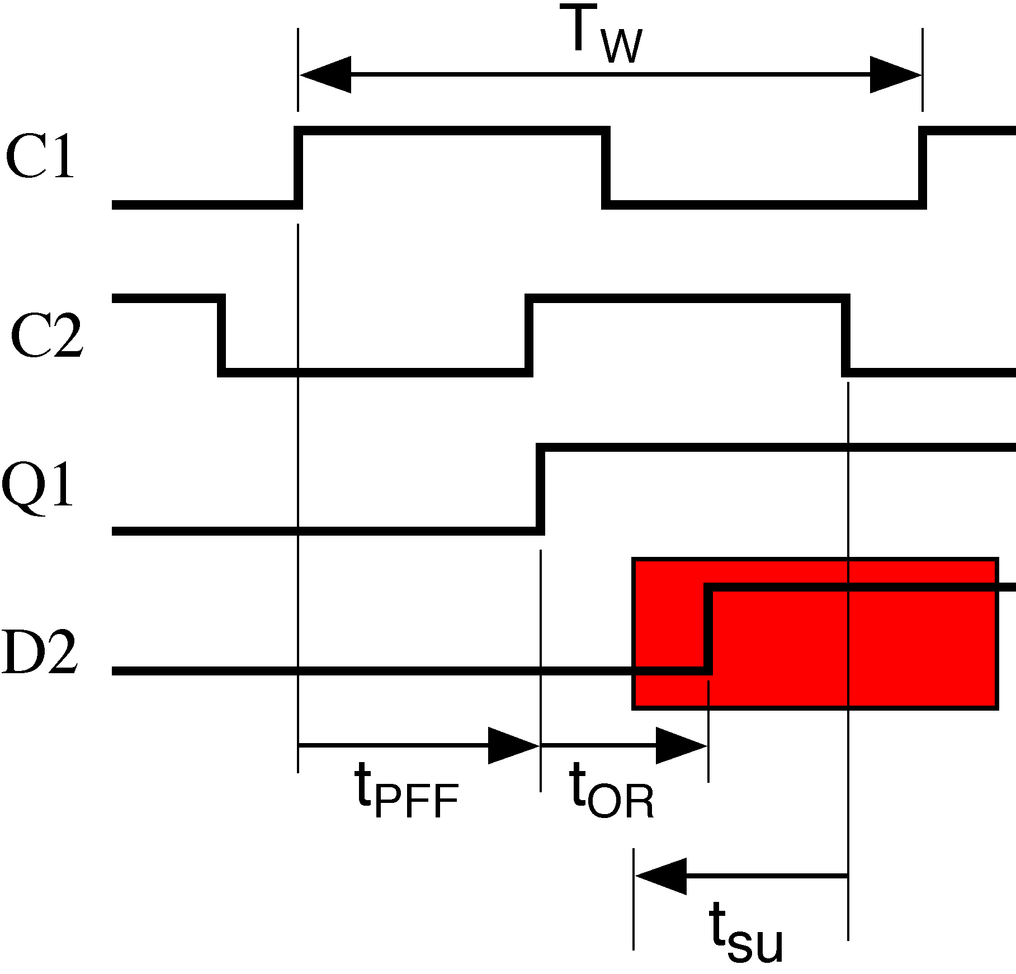
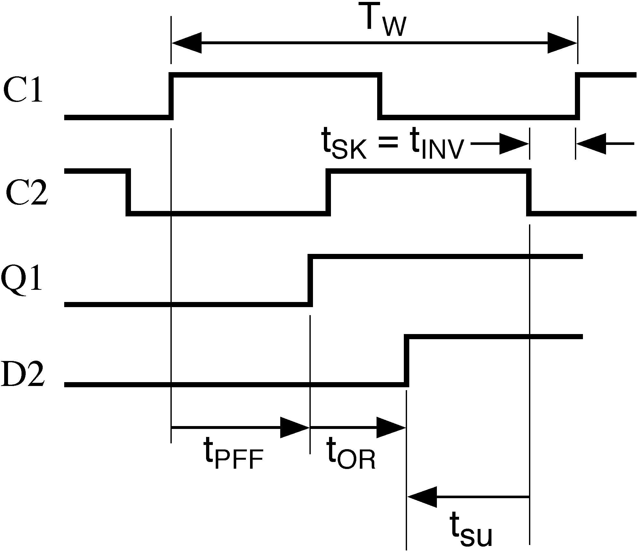
  Clock C1 skewed after C2
T_{W} ≥ max T_{PFF} + max t_{OR} + t_{su}
(if clock not skewed, i.e., t_{INV} = 0)
T_{W} ≥ max T_{PFF} + max t_{OR} + t_{su} + max t_{INV}
(if clock skewed, i.e., t_{INV} > 0)

Slide 49
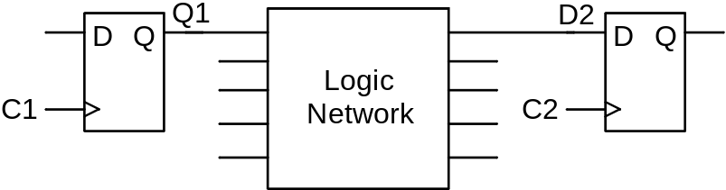
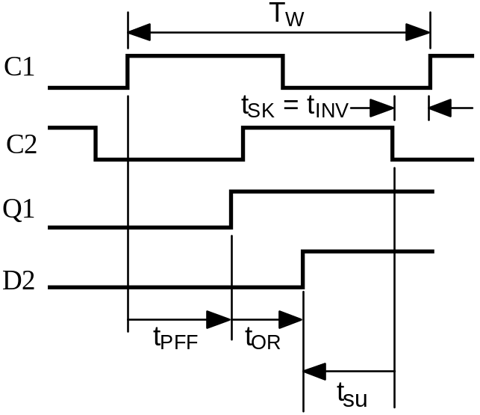
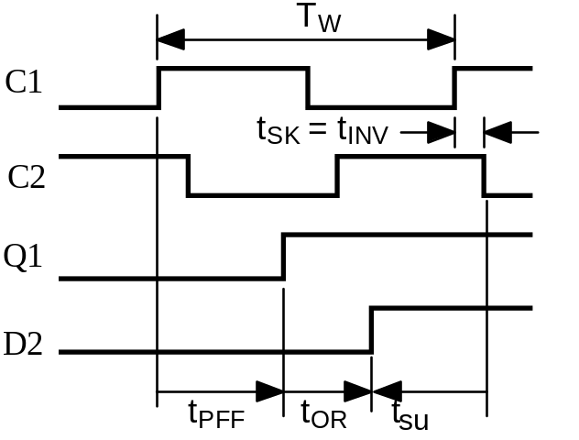
Summary of maximum clock frequency calculations
C2 skewed after C1: T_{W} ≥ max T_{PFF} + max t_{NET} + t_{su} - min t_{INV}
C2 skewed before C1: T_{W} ≥ max T_{PFF} + max t_{NET} + t_{su} + max t_{INV}

Slide 50
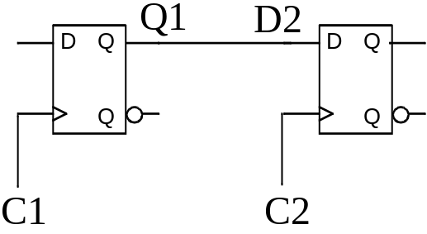
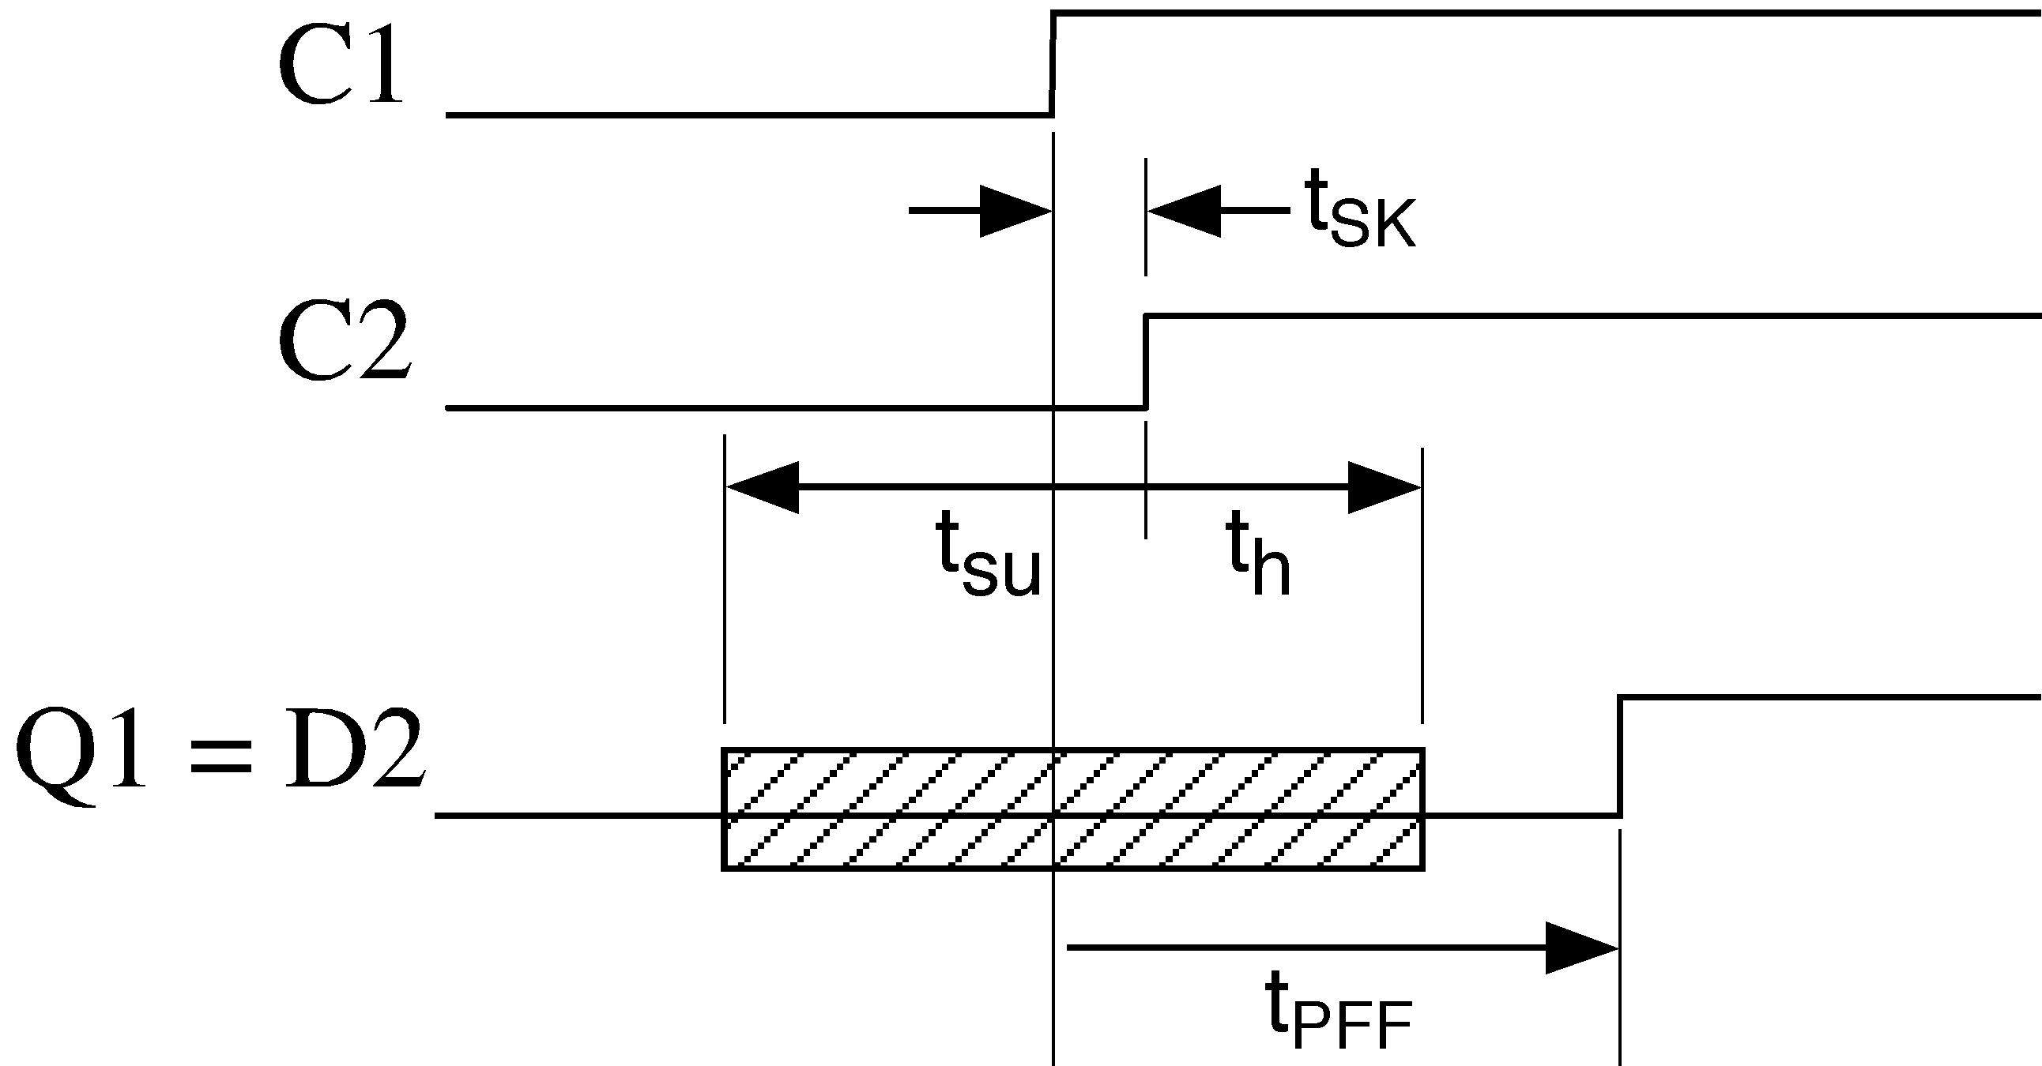
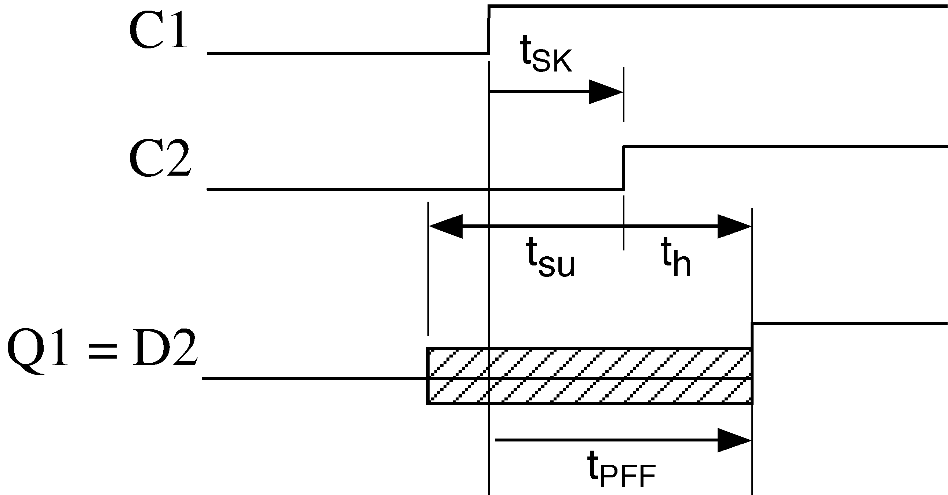

Maximum Allowable Clock Skew
How much skew between C1 and C2 can be tolerated in the following circuit?
  Case 1: C2 delayed after C1
t_{PFF} > t_{h} + t_{SK}
t_{SK} < min t_{PFF} - t_{h}

Slide 51

  Case 2: C1 delayed from C2

Slide 52




How does additional delay between the flip-flops affect the skew calculations?
t_{SK} ≤ min t_{PFF} - t_{h}
t_{sk} ≤ min t_{PFF} + min t_{MUX} - t_{h}

Slide 53


Summary of allowable clock skew calculations
t_{SK} + t_{h} ≤ t_{PFF} + t_{NET}
t_{SK} ≤ min t_{PFF} + min t_{NET} - t_{h}

Slide 54

Example: What is the minimum clock period for the following circuit under the assumption that the clock C2 is skewed after C1 (i.e., C2 is delayed from C1)?

Slide 55
  First calculate the maximum allowable clock skew.
  Next calculate the minimum clock period due to the path from Q1 to D2.
  Finally calculate the minimum clock period due to the path from Q2 to D1
t_{SK} < min t_{PFF} + min t_{N1} - t_{h}
T_{W} > max t_{PFF} + max t_{N1} + t_{su} - min t_{SK}
T_{W} > max t_{PFF} + max t_{N1} + t_{su} + max t_{SK}
T_{W} > max t_{PFF} + max t_{N2} + t_{su} + (min t_{PFF} + min t_{N1} - t_{h})
T_{W} > max t_{PFF} + min t_{PFF} + max t_{N2} + min t_{N1} + t_{su} - t_{h}

Slide 56



Global Setup Time, Hold Time and Propagation Delay
Global setup and hold times (data delayed)
T_{SU} = t_{su} + max t_{NET}
T_{H} = t_{h} - min t_{NET}

Slide 57



Global setup & hold time (clock delayed)
T_{SU} = t_{su} - min t_{C}
T_{H} = t_{h} + max t_{C}

Slide 58




Global setup & hold time (data & clock delayed)
T_{SU} = + max =-0987654321\ - min .
T_{H} = t_{h} - min t_{NET} + max t_{C}

Slide 59


Global propagation delay
T_{P} = t_{C} + t_{FF} + t_{NET}

Slide 60

Summary of global timing parameters
T_{SU} = t_{su} + max t_{PN} - min t_{PC} ≤ t_{su} + max t_{PN}
T_{H} = t_{h} + max t_{PC} - min t_{PN} ≤ t_{h} + max t_{PC}
T_{P} = t_{PFF} + t_{PN} + t_{PC}

Slide 61

Example
  Find T_{SU} and T_{H} for input signal LD relative to CLK.
T_{SU} = t_{su} +max t_{NET} - min t_{C}
= t_{su} + max t_{INV} + max t_{NAND} + max t_{NAND} - min t_{INV}
T_{H} = t_{h} - min t_{NET} + max t_{C}
= t_{h} - min t_{NAND} - min t_{NAND} + max T_{INV}

Slide 62


Register load control (gating the clock)
A very bad way to add a load control signal LD to a register that does not have one is shown below
The reason this is such a bad idea is illustrated by the following timing diagram.
The flip-flop sees two rising edges and will trigger twice. The only one we want is the second one.

Slide 63

If LD was constrained to only change when the clock was low, then the only problem would be the clock skew.

Slide 64


If gating the clock is the only way to control the loading of registers, then use the following approach:
  There is still clock skew, but at least we only have one triggering edge.

Slide 65

The best way to add a LD control signal is as follows:

Slide 66
Tips & Tricks
Use timing diagrams to determine the timing properties of sequential circuits
Using typical timing values from the data sheet (use only max and/or min values)
Gating the clock

Slide 67
Detecting timing violations – CASE 1
Hold time for clocks is 1.5 ns
Determine if there are any timing violations in this design
Delay (min) = 5 ns
DFF 2
DFF 1
Data
clk20Mhtzref
clk10Mhtz
Notes:
Min Data path delay = 5 ns
Max Clock path delay = 0 ns
Hold Slack = 5-0 ns = 5 ns
No timing violation
Hold margin = 5 –1.5 ns = +3.5 ns

Slide 68
Detecting timing violations – CASE 2
Hold time for clocks is 1.5 ns
Clock skew of 3.72 ns between clk20mref and clk10mz
Determine if there are any timing violations in this design
DFF 1
Delay (min) = 5 ns
DFF 2
Data
clk20Mhtzref
clk10Mhtz
Notes:
Min Data path delay = 5 ns
Max Clock path delay = 3.72 ns
Hold slack = 5 – [3.72+1.5] = 5 - 5.22 = -0.22 ns –ve value => timing violation
3.22 ns < 3.72 ns

Slide 69
Detecting timing violations – CASE 3
Hold time for clocks is 1.5 ns
Clock skew of 3.72 ns between clk20mref and clk10mz
DFF 1
Delay (min) = 5 ns
DFF 2
Data
clk20Mhtzref
clk10Mhtz
Notes:
Min Data path delay = 5 ns
Max Clock path delay = 3.72 ns
Hold slack = 5 – [3.72+1.5] = 5 – 5.22 = -0.2 ns hold time violation

Slide 70
Detecting timing violations – CASE 4
Consider
Clock skew of 3.72 ns between clk20mref and clk10mz
Clock network delays
DFF 1
Delay (min) = 5 ns
DFF 2
Data
clk20Mhtzref
clk10Mhtz
Propagation delay = 4 ns
(thru clock tree buffers)
Propagation delay = 2 ns
(thru clock tree buffers)
Notes:
Min Data path delay = 5+4 ns = 9 ns
Max Clock path delay = 3.72+2 ns = 5.72 ns
Hold Slack = 9 – [5.72+1.5] = 9-7.22 ns = 1.78 ns
No timing violation

Slide 71
Thank you

