Slide 1
Demonstration of types of cell division
143577
Members:
Nguyen Van Dang 20215033
Nguyen Thanh Dat 20204947
Nguyen Tien Dat 20194503
Le Anh Dat 20215025

Slide 2
01
Problem statement
Cell division:
Amitosis in prokaryotic cells
Meiosis and mitosis in eukaryotic cells
Main screen: Help button, choose type of cells, quit button
Display:
- Cell components
- Cell division processes

Slide 3
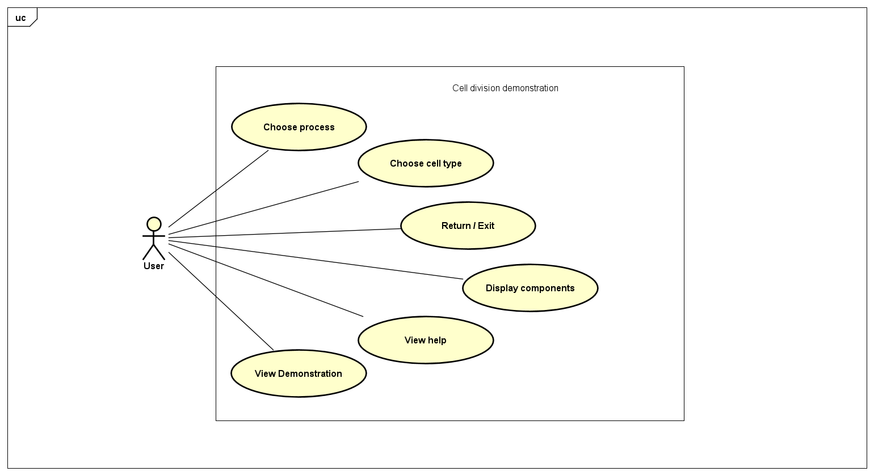
02
Use case diagram

Slide 4
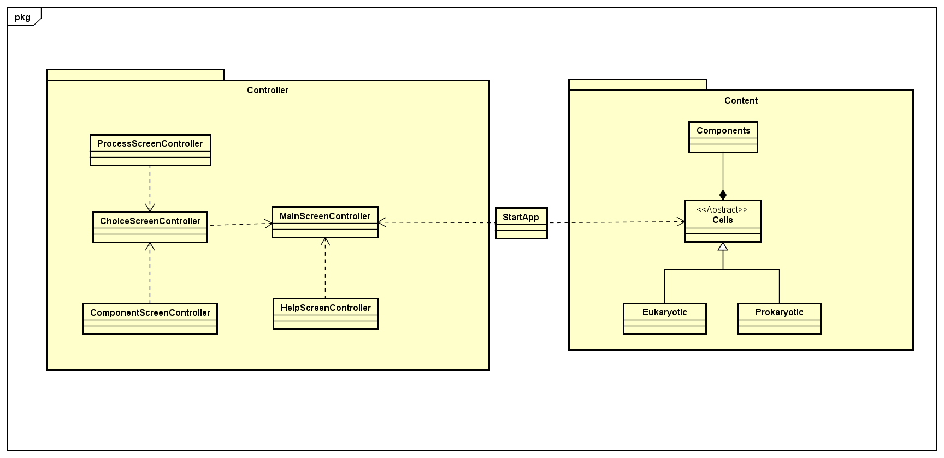
03
General class diagram

Slide 5
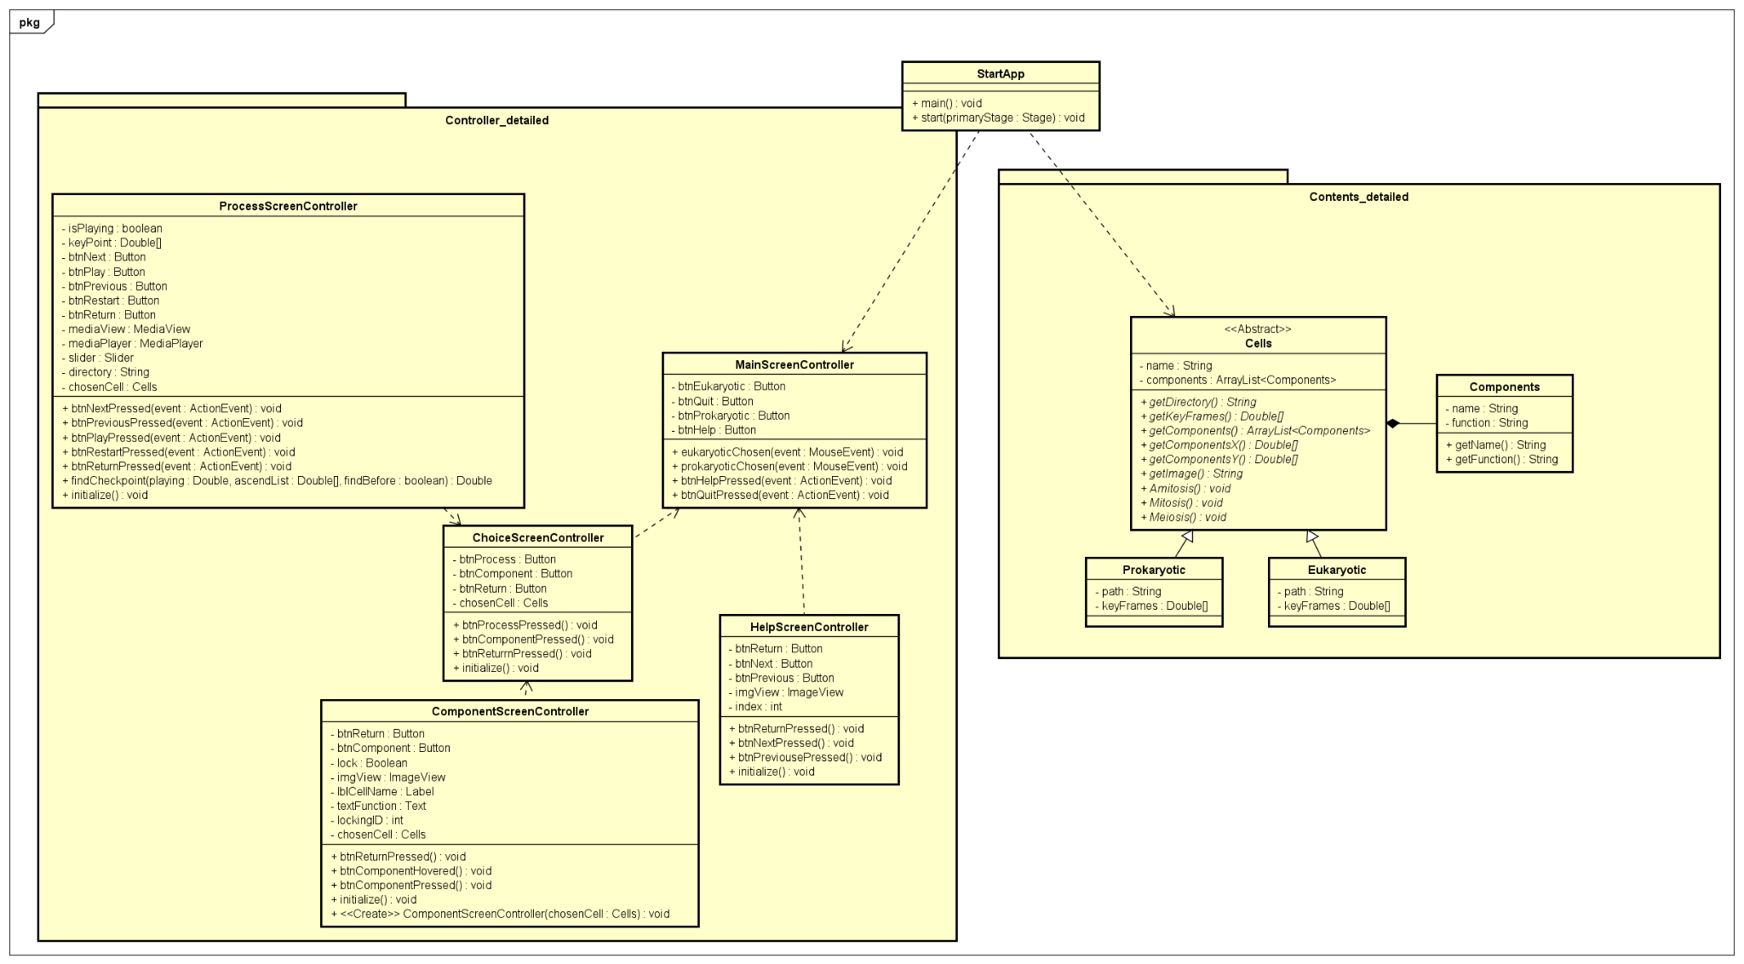
04
Detailed class diagram

Slide 6
05
OOP Programing techniques
Encapsulation
Private class attributes prevent access from outside
Methods defined in class to handle those attributes
Abstraction
Real life cells are abstracted into java classes and objects
Hiding process details from user

Slide 7
05
OOP Programing techniques
Inheritance
Classes of similar traits can generalize into parent class and vice versa
Cells are superclass of Prokaryotic and Eukaryotic
Polymorphism
Eukaryotic and Prokaryotic implements Process interface
A function of the same name behaves differently depending on the calling object

Slide 8
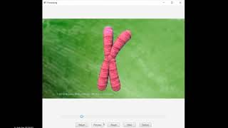
Demo
06
Link: https://www.youtube.com/watch?v=H5pNMPDcC7s

