Slide 1
L-layer Neural Network for cat recognition
By Nikita Vdovichev

Slide 2
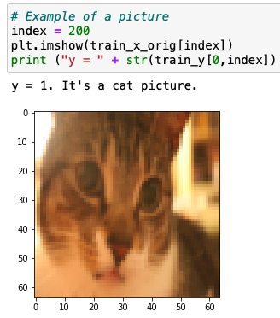
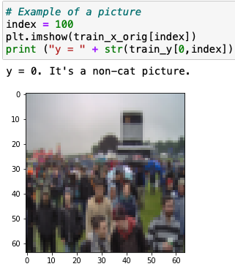
Image examples

Slide 3
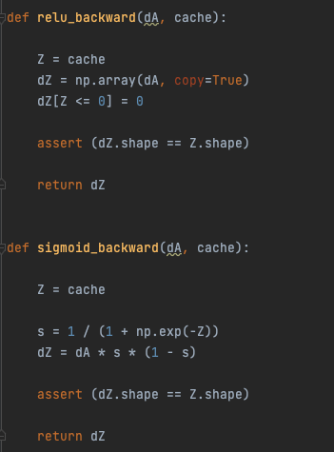
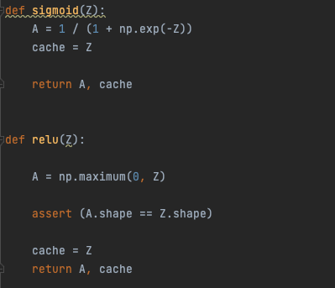
Activations

Slide 4
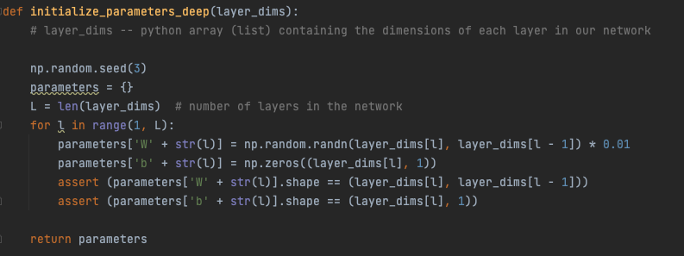
Initialize parameters

Slide 5
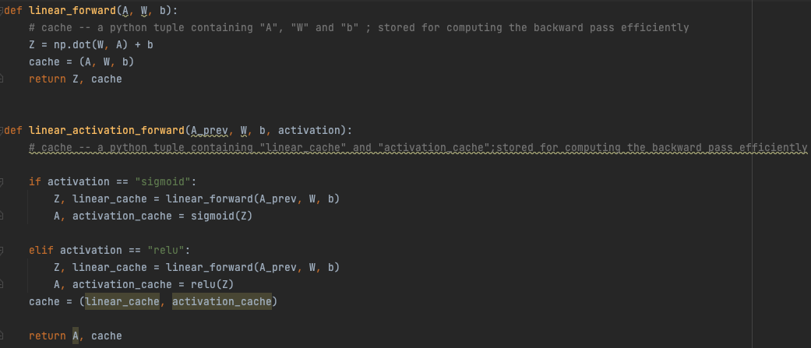
Forward prop

Slide 6
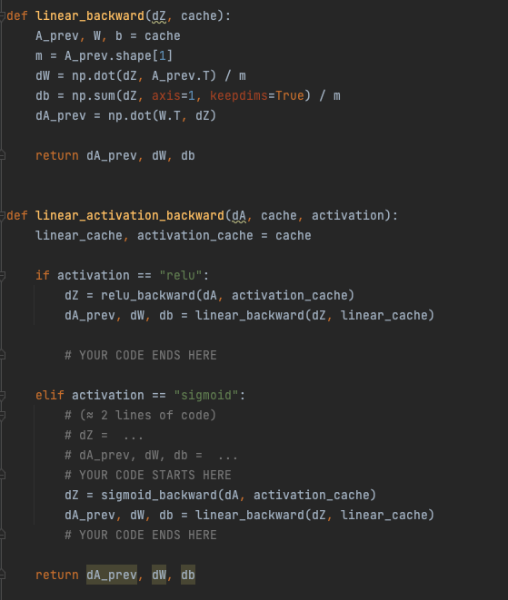
Backward prop

Slide 7


Update parameters and cost

Slide 8
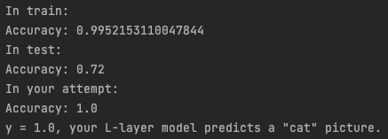

Summary
A few types of mislabaled: cat body in an unusual position, unusual cat color, camera Angle Brightness

