Slide 1
Media Compression Techniques
Duc Nguyen
Tohoku Institute of Technology
Sendai, Japan

Slide 2
Compression
The process of reducing the size of a data file
Types
Lossless compression: Preserve all information of the source data
Mainly for text, data files
Ex: zip, gzip
Lossy compression: Some information are lossed
Mainly for image, audio, video
Ex: mp3, mp4, aac

Slide 3
Lossless Compression
Compress data by exploiting statistical redundancy in the source data
Run-length coding (Huffman code)
Runs of data are stored as a single data value and count
Source data: AAABBCCCCDEFFF
Compressed data: 3A2B4C1D1E3F

Slide 4
Lossy Compression
Dropping nonessential detail to reduce data size
human eye is more sensitive to subtle variations in luminance than it is to the variations in color
Based on transform coding
Fourier Series

Slide 5
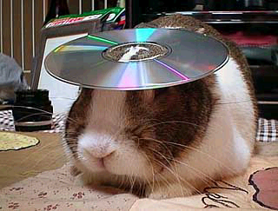

Image Compression: Basics
Human vision is insensitive to high spatial frequencies
JPEG Takes advantage of this by compressing high frequencies more coarsely and storing image as frequency data
JPEG is a “lossy” compression scheme.
Losslessly compressed image, ~150KB
JPEG compressed, ~14KB

Slide 6
Digital Image Representation
JPEG can handle arbitrary color spaces (RGB, CMYK, YC_{b}C_{r} (separates colors into grayscale components)
Luminance/Chrominance commonly used, with Chrominance subsampled due to human vision insensitivity
Uncompressed spatial color data components are stored in quantized values (8, 16, 24bit, etc).

Slide 7
Flow Chart of JPEG Compression Process
Divide image into 8x8 pixel blocks
Apply 2D Fourier Discrete Cosine Transform (FDCT) Transform
Apply coarse quantization to high spatial frequency components
Compress resulting data losslessly and store
8x8 pixel
blocks
Frequency Dependent quantization
JPEG syntax generator
FDCT
Zig-zag scan
Huffman encoding
Quantization Table
output

Slide 8
Example of Frequency Quantization with 8x8 blocks
128 | 128 | 128 | 128 | 128 | 128 | 128 | 128
118 | 111 | 112 | 117 | 120 | 123 | 123 | 122
125 | 121 | 115 | 111 | 119 | 119 | 118 | 117
120 | 121 | 113 | 113 | 125 | 124 | 115 | 108
120 | 120 | 116 | 119 | 124 | 120 | 115 | 110
117 | 113 | 111 | 122 | 120 | 110 | 116 | 119
109 | 113 | 111 | 122 | 120 | 110 | 116 | 119
111 | 121 | 124 | 118 | 115 | 121 | 117 | 113
-80 | 4 | -6 | 6 | 2 | -2 | -2 | 0
24 | -8 | 8 | 12 | 0 | 0 | 0 | 2
10 | -4 | 0 | -12 | -4 | 4 | 4 | -2
8 | 0 | -2 | -6 | 10 | 4 | -2 | 0
18 | 4 | -4 | 6 | -8 | -4 | 0 | 0
-2 | 8 | 6 | -4 | 0 | -2 | 0 | 0
12 | 0 | 6 | 0 | 0 | 0 | -2 | -2
0 | 8 | 0 | -4 | -2 | 0 | 0 | 0
Color space values (spatial data)
Color space values (spatial data)
-5 | 0 | 0 | 0 | 0 | 0 | 0 | 0
2 | -1 | 1 | 1 | 0 | 0 | 0 | 0
1 | 0 | 0 | -1 | 0 | 0 | 0 | 0
1 | 0 | 0 | 0 | 0 | 0 | 0 | 0
1 | 0 | 0 | 0 | 0 | 0 | 0 | 0
0 | 0 | 0 | 0 | 0 | 0 | 0 | 0
0 | 0 | 0 | 0 | 0 | 0 | 0 | 0
0 | 0 | 0 | 0 | 0 | 0 | 0 | 0
16 | 11 | 10 | 16 | 24 | 40 | 51 | 61
12 | 12 | 14 | 19 | 26 | 58 | 60 | 55
14 | 13 | 16 | 24 | 40 | 57 | 69 | 56
14 | 17 | 22 | 29 | 51 | 87 | 80 | 62
18 | 22 | 37 | 56 | 68 | 109 | 103 | 77
24 | 35 | 55 | 64 | 81 | 104 | 113 | 92
49 | 64 | 78 | 87 | 103 | 121 | 120 | 101
72 | 92 | 95 | 98 | 112 | 100 | 103 | 99
Quantized spatial frequency values
Quantization Matrix to divide by

Slide 9
Scanning and Huffman Encoding
Spatial Frequencies scanned in zig-zag pattern (note high frequencies mostly zero)
Huffman encoding used to losslessly record values in table
-5 | 0 | 0 | 0 | 0 | 0 | 0 | 0
2 | -1 | 1 | 1 | 0 | 0 | 0 | 0
1 | 0 | 0 | -1 | 0 | 0 | 0 | 0
1 | 0 | 0 | 0 | 0 | 0 | 0 | 0
1 | 0 | 0 | 0 | 0 | 0 | 0 | 0
0 | 0 | 0 | 0 | 0 | 0 | 0 | 0
0 | 0 | 0 | 0 | 0 | 0 | 0 | 0
0 | 0 | 0 | 0 | 0 | 0 | 0 | 0
0,2,1,-1,0,0,1,0,1,1,0,0,1,0,0,0,-1,0,0,… 0
Can be stored as:
(1,2),(0,1),(0,-1),(2,1),(1,1),(0,1),(0,1),(2,1),(3,1),EOB

Slide 10
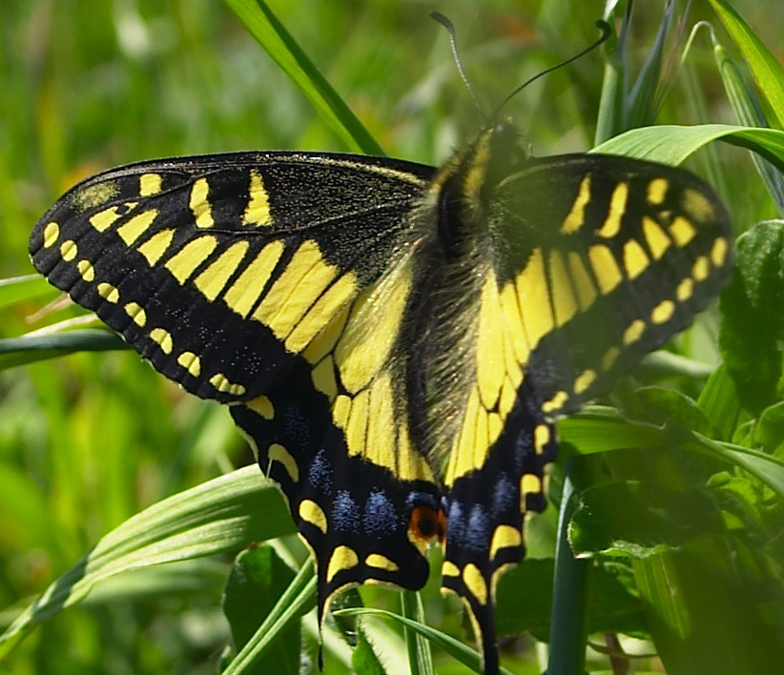
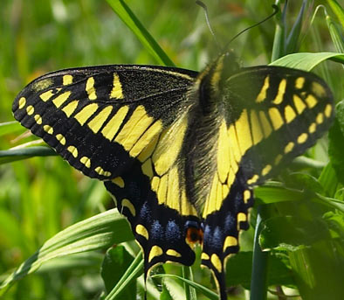

Examples of varying JPEG compression ratios
500KB image, minimum compression
40KB image, half compression
11KB image, max compression

Slide 11
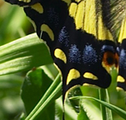


Close-up details of different JPEG compression ratios
Uncompressed image (roughness between pixels still visible)
Half compression, blurring & halos around sharp edges
Max compression, 8-pixel blocks apparent, large distortion in high-frequency areas

Slide 12
Video Compression
Using strictly spatial redundancy (JPEG) gives video compression ratios from 7:1 to 27:1
Taking advantage of temporal redundancy in video gives 20:1 to 300:1 compression for H.261, or 30:1 to 100:1 for high quality MPEG-2

Slide 13
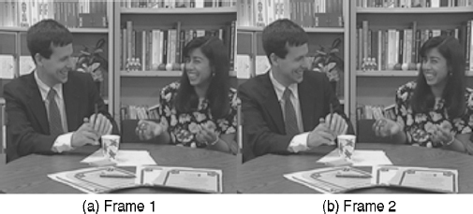
Temporal Redundancy
Two consecutive images in a video have a lot of similarities
Better to compress the “difference” images to reduce redundancy

Slide 14
Exercise: Compressing video using FFMPEG
Install FFMPEG
Download sample video and ffmpeg using HTTPClient.java program
sample video: input.mp4
ffmpeg: ffmpeg.zip
Extract ffmpeg.zip, then copy input.mp4 into bin/ folder

Slide 15
Open Command Prompt, go to ffmpeg/bin/ folder
Create raw video:
ffmpeg -i input.mp4 input.yuv

Slide 16
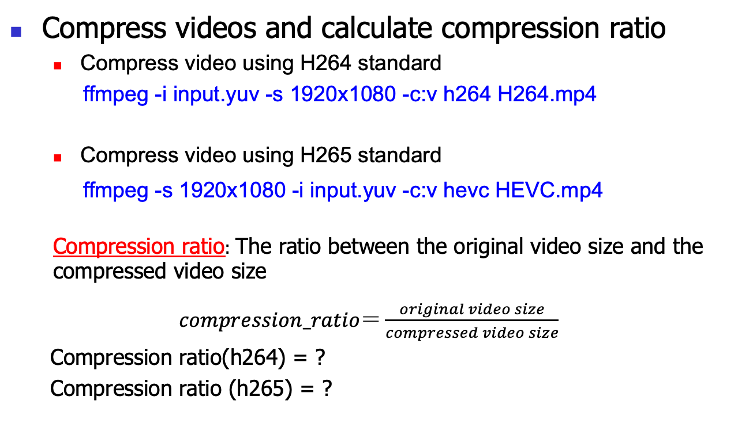
Exercise: Compressing video using FFMPEG

Slide 17
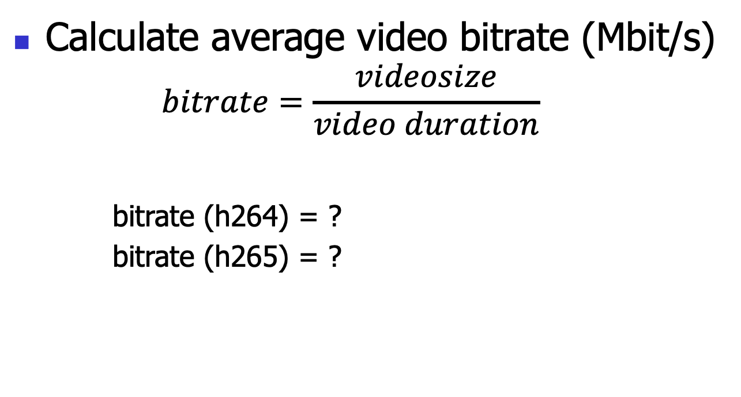
Exercise: Compressing video using FFMPEG
Calculate average video bitrate (Mbit/s)
$$bitrate=\frac{videosize}{video duration}$$
bitrate (h264) = ?
bitrate (h265) = ?

Slide 18
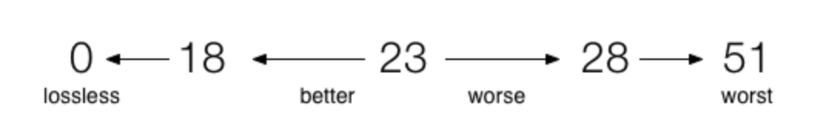
Exercise: Compressing video using FFMPEG
Adjust compressed video quality
In ffmpeg, output video quality is controlled by Constant Rate Factor (CRF) parameter, which takes value from 1-51. Default value: 23
ffmpeg -i input.mp4 -c:v h264 -crf 23 crf23.mp4

Slide 19
Exercise: Compressing video using FFMPEG
Change the value of the crf parameter and compare 1) compressed video size, 2) compressed video PSNR, and compression ratio
CRF | Compressed video size | Compressed video PSNR | Compression ratio
0
18
23
28
51

