Slide 1
LENDING CLUB CASE STUDY
GROUP MEMBERS:
YASH SARAIYA (GROUP FACILITATOR)
NAVEEN KUMAR

Slide 2
BUSINESS UNDERSTANDING
When the company receives a loan application, the company has to make a decision for loan approval based on the applicant’s profile. Two types of risks are associated with the bank’s decision:
If the applicant is likely to repay the loan, then not approving the loan results in a loss of business to the company
If the applicant is not likely to repay the loan, i.e. he/she is likely to default, then approving the loan may lead to a financial loss for the company
- We, working for a consumer finance company which specializes in lending various types of loans to urban customers have been provided with the historical data of loan applications.
- We are tasked with identifying the patterns indicating the likelihood of a borrower defaulting
- The data consists only of the accepted loan applications covering the Current, Fully Paid, Charged-off loans

Slide 3
BUSINESS OBJECTIVE
To identify risky loan applications and thereby reducing the effects of the company running into losses due to default made by borrowers.
To help the company to formulate policies based on the findings of the data analysis.
To help the company identify and understand the driving factors that leads to loan default i.e. identifying strong indicators of the loan default.

Slide 4
DATA UNDERSTANDING
To understand the various columns (variables) available in the dataset and what does they mean
To understand if some of the columns are related to each other
DATA CLEANING
Dropping columns with null values
UNIVARIATE ANALYSIS
Plotting the frequencies of loan applications against certain important variables to understand the nature of the loan applicants.
Create derived variables where needed
Converting the data types where needed
SEGMENTED UNIVARIATE ANALYSIS
Analyze variables after segmenting other variables
Create derived variables where needed
BIVARIATE ANALYSIS
Check how two or more variables affect each other
INSIGHTS & CONCLUSIONS
Gather insights
Draw conclusions
ANALYSIS APPROACH

Slide 5
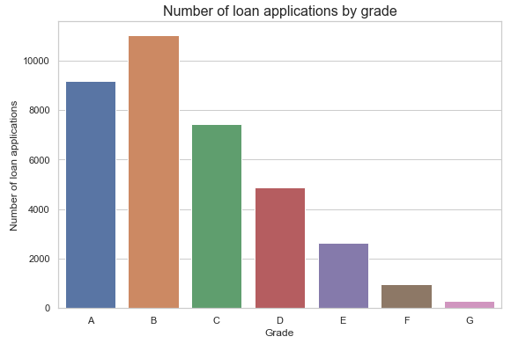
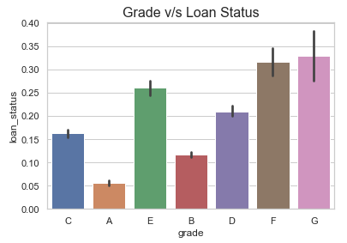
ANALYSIS
Understanding the nature of the loan applications by plotting a frequency graph for various parameters
The maximum number of loan applications are received from the borrowers falling in the Grade B
It can also be observed that the number of applications goes down as the grade goes from B to G
The default rates of Grade F and Grade G are the highest (over 30%)

Slide 6
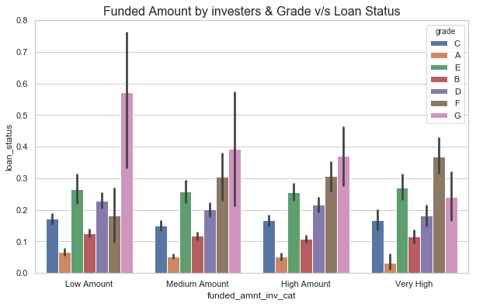
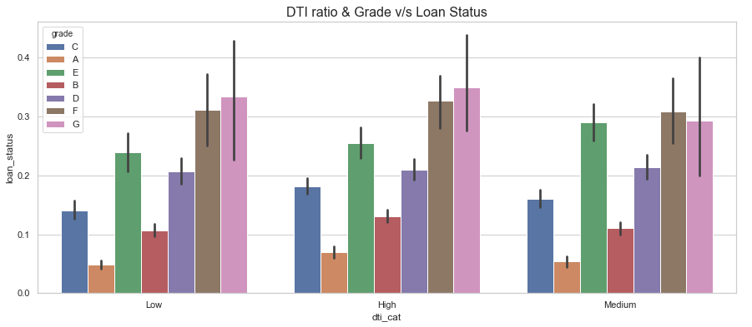
ANALYSIS
The default rate of Grade G amongst the low funded amount by investors category is the highest
Across the funded amount by investors category, Grade F and Grade G has seen the maximum loan defaults.
Also, across the funded amount by investors category, the distribution of loan defaults is more or less the same except for Grade G.
As the funded amount by investors rises, the defaults in Grade G goes down whereas defaults in Grade F rises.

Slide 7
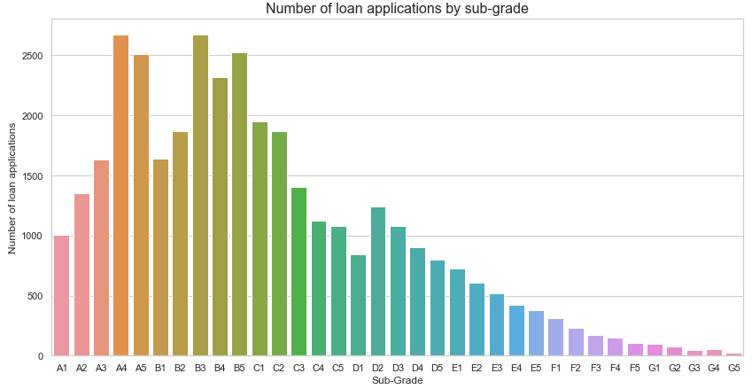
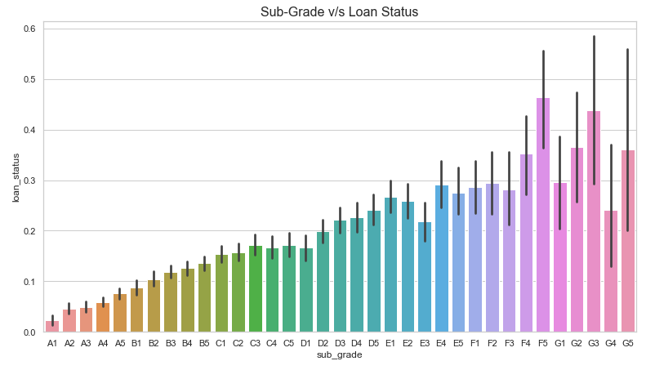
ANALYSIS
The maximum number of loan applications are made by borrowers who have been graded A and B by the Lending Clubs.
In grade A and B there is more or less a rising trend in number of loan applications in their respective sub-grades whereas from grade C to G, there is a declining trend in number of loan applications in their respective sub-grades.
Similar to grades, the default rates more or less increases for each subgrade within grades A to E whereas the default rates varies in subgrades of grade F and G

Slide 8
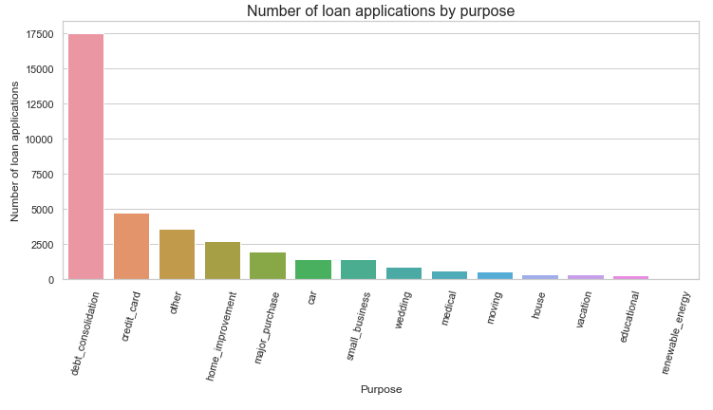
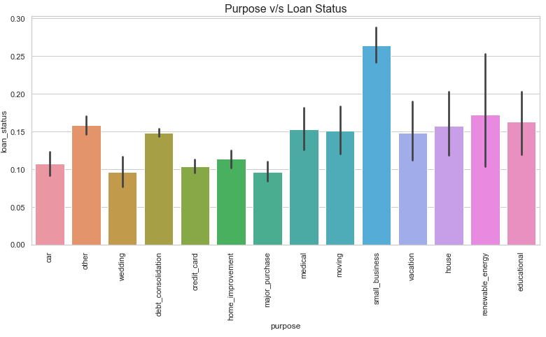
ANALYSIS
The maximum number of loan applications are made by borrowers for debt consolidation. i.e. for paying off their other debts.
The small-businesses defaults the most. It makes sense as small businesses having less capital and profits relies on loans to pay off their other debts.

Slide 9
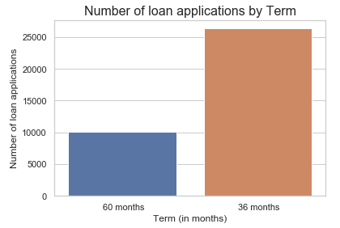
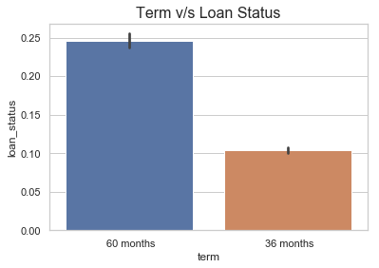
ANALYSIS
The majority of the loan applications are made for shorter term loans.
The majority of the defaults are made by the borrowers opting for long term loans

Slide 10
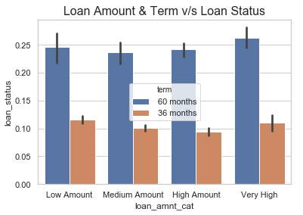
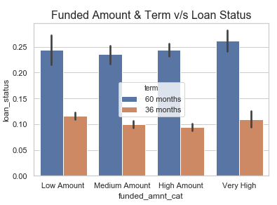
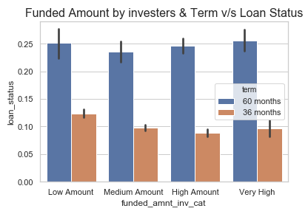
ANALYSIS
For each range of the loan amount, funded amount and funded amount by investors, the short term loans are better performing, whereas the default rates are very high for long term loans

Slide 11
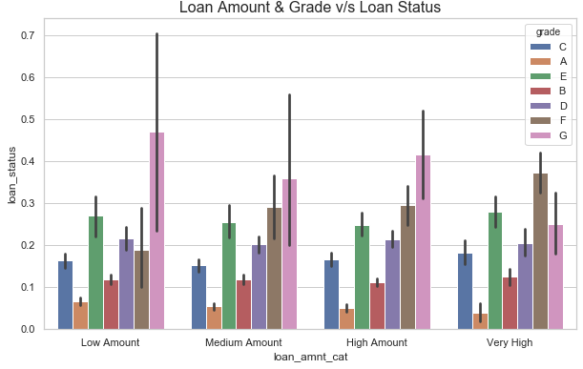
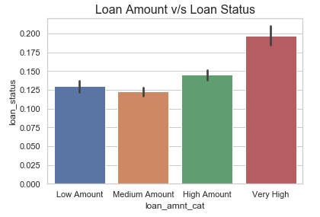
ANALYSIS
Higher the loan amount, higher the risk of default
Across the range of loan amounts, the distribution of default is more or less the same except for grade F and grade G in each of those range of loan amounts.

Slide 12
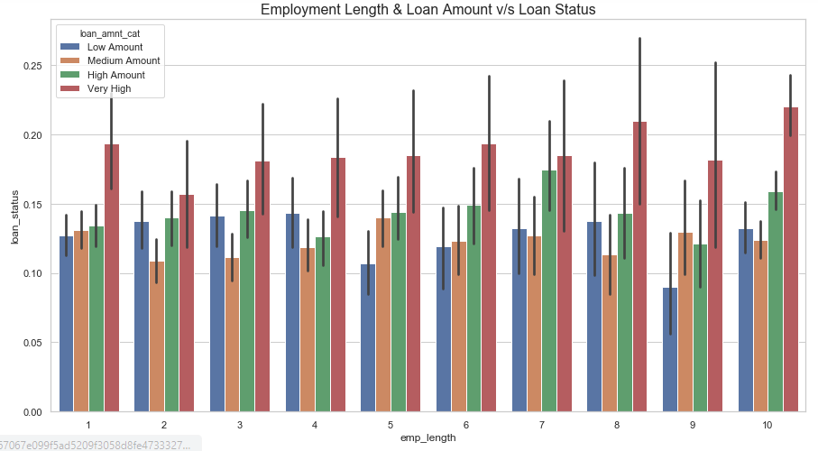
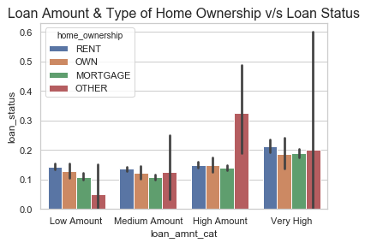
ANALYSIS
Across the experience level or the employment duration, the higher the loan amount, the higher the default rate.
The borrowers who own their house and are granted low loan amount defaults the least. Whereas the borrowers who stay on Rent and are granted higher loan amounts defaults the most.

Slide 13
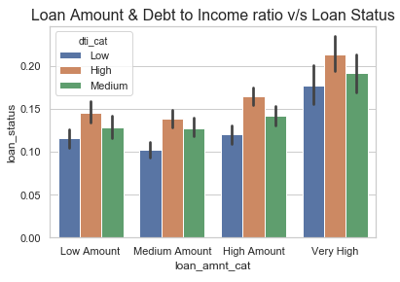
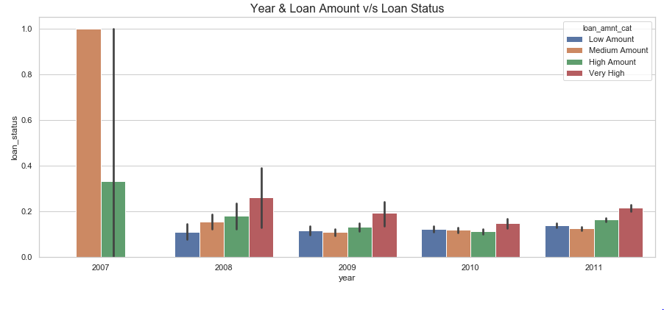
ANALYSIS
Across the range of loan amount, higher the debt to income ratio, higher the default rates.
The maximum defaults happened in 2007 (the year of inception of the lending clubs)
From 208 to 2011, the distribution is more or less the same.

Slide 14
RECOMMENDATIONS
The top driving factors identified are:
Sub-grade
Grade
Purpose
Term
Loan amount
Since the number of loan applications received by borrowers with grade F and grade G, avoid giving loans or give loans with caution to the borrowers having the least grade (grade G) and focus on borrowers assigned grade A and B as they constitute the majority of the loan applications and are the least risky borrowers.
For each grade, focus on the top sub-grades, as they are likely to default less. Focus on sub-grades A4, A5, B3, B5 as they apply for loans the most and are less likely to default.
Avoid giving loans or give loans with caution to the borrowers applying for the purpose of small-businesses. Also, look out for borrowers applying for debt consolidation. Although the default rate for borrowers applying for debt consolidation is relatively low, the number of loan applications is quite high.
Avoid giving very high amount long term loans.
Avoid giving higher loan amounts to borrowers assigned grade F and grade G
Avoid giving very high loans to borrowers whose debt to income ratio is high

