Slide 1

CREATING ENJOYABLE APPS
www.makingsense.com– hello@makingsense.com- USA -Argentina

Slide 2
Sikuli
http://www.sikuli.org/

Slide 3
What is Sikuli
Automation too based on image recognition to identify and control GUI components
Created by User Interface Design Group at MIT and now supported by Raimund Hocke
Automate Visual Workflows
I want to click to open....
I want to click and type...
I want to drag and drop
I wait until...

Slide 4
How It works?
OpenCV - an open-source BSD-licensed library that includes several hundreds of computer vision algorithms.
Template Matching: Template matching is a technique for finding areas of an image that match (are similar) to a template image (patch)

Slide 5
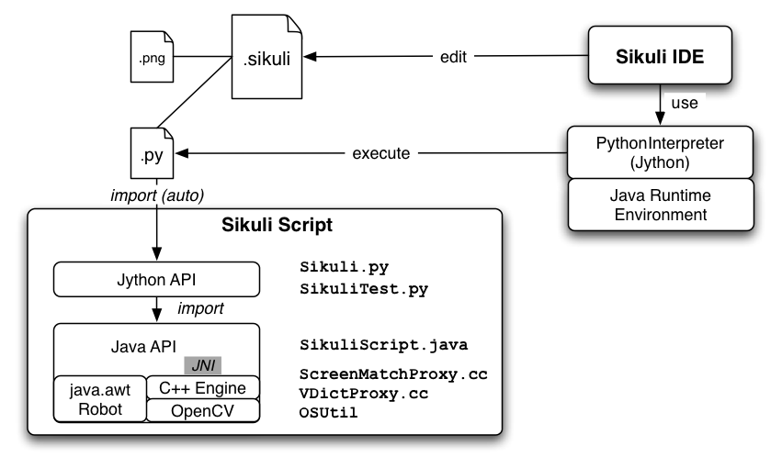
Architecture
Notes:
Sikuli Script is a Jython and Java library that automates GUI interaction using image patterns to direct keyboard/mouse events. The core of Sikuli Script is a Java library that consists of two parts: java.awt.Robot, which delivers keyboard and mouse events to appropriate locations, and a C++ engine based on OpenCV, which searches given image patterns on the screen. The C++ engine is connected to Java via JNI and needs to be compiled for each platform. On top of the Java library, a thin Jython layer is provided for end-users as a set of simple and clear commands. Therefore, it should be easy to add more thin layers for other languages running on JVM, e.g. JRuby, Scala, Javascript, etc.
The Structure of a Sikuli source folder or zipped file (.sikuli, .skl)¶
A Sikuli script (.sikuli) is a directory that contains a Python source file (.py) representing the automation workflow or the test cases and all the image files (.png) used by the source file. All images used in a Sikuli script are simply a path to the .png file in the .sikuli bundle. Therefore, the Python source file can also be edited by any text editor.
While saving a script using Sikuli IDE, an extra HTML file may optionally be created in the .sikuli directory so that users can share a visual copy of the scripts on the web easily.
A Sikuli zipped script (.skl) is simply a zipped file of all files in the .sikuli folder. It is intended for distribution via mail or web upload, can also be run from command line and reopened in the Sikuli IDE. (The previous naming as “Sikuli executable” is deprecated, since this is misleading: people most often thought, it is something like a self-contained and self-running package comparable to a Windows EXE, but it is not).

Slide 6
OS Support
Version 1.1.0+
Windows - jar file
OSX - osx app - issues on OSX 10.6+ with 1.1.0
Linux - jar file

Slide 7
Sikuli Element
Region
Location
Match
Pattern

Slide 8
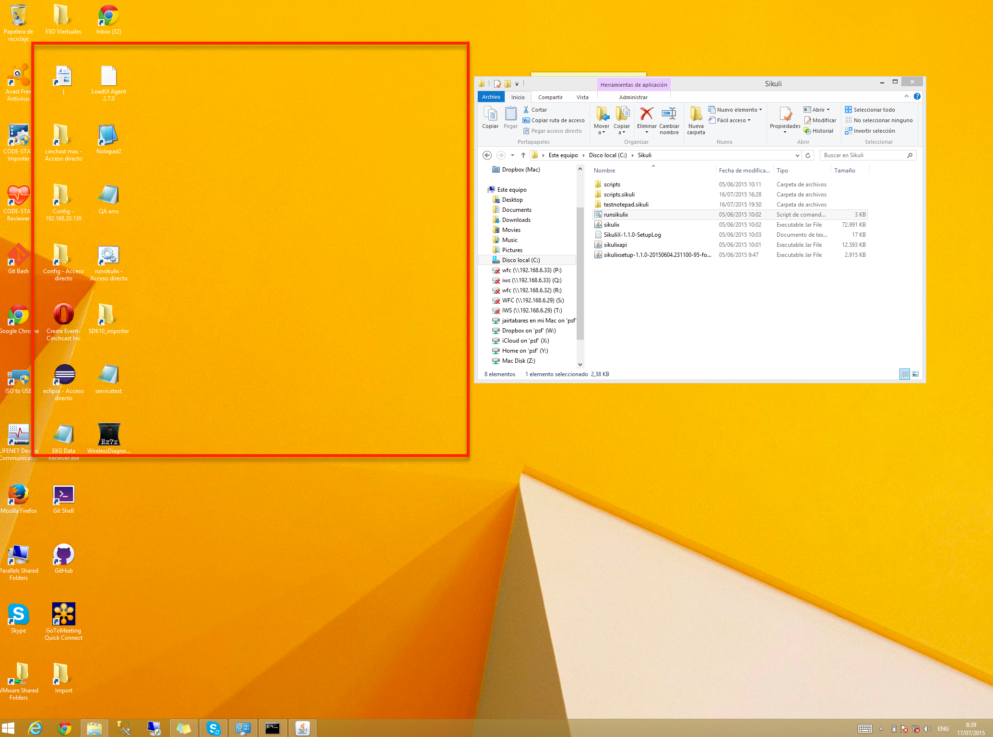
Regions
Notes:
A Region is a rectangular area on a Screen and is defined by its upper left corner (x, y) being the pixel with this offset relative to the upper left corner of the screen (usually (0, 0) ) and its dimension (w, h) as its width and height in pixels.

Slide 9
Acting on regions
click
doubleClick
rightClick
highlight
hover
dragDrop
drag
dropAt
type
paste

Slide 10
Action Parameters
PSMRL: which means, that either a Pattern object or a string (path to an image file or just plain text) or a Match or a Region or a Location can be used as parameter, in detail:
P: pattern: a Pattern object. An implicit find operation is processed first. If successful, the center of the resulting matches rectangle is the click point. If the pattern object has a target offset specified, this is used as click point instead.
S: string: a path to an image file or just plain text. An implicit find operation with the default minimum similarity 0.7 is processed first. If successful, the center of the resulting match object is the click point.
M: match: a match object from a previous find operation. If the match has a target specified it is used as the click point, otherwise the center of the match’s rectangle.
R: region: a region object whose center is used as click point.
L: location: a location object which by definition represents a point on the screen that is used as click point.

Slide 11
Location
To handle single points on the screen directly by its position (x, y). It is mainly used in the actions on a region, to directly denote the click point. It contains methods, to move a point around on the screen.
getX()
getY()
setLocation(x, y)
offset(dx, dy)
above(dy)
below(dy)
left(dx)
right(dx)

Slide 12
Match & Pattern
Match
Represents the result of a successful find operation. It has the rectangle dimension of the image, that was used to search. It knows the point of its upper left corner on an existing monitor, where it was found.
getScore: Similarity value, between 0 and 1
getTarget
Pattern A pattern is used, to associate an image file with additional attributes used in find operations and when acting on a match object.
similar
exact
targetOffset --> Pattern with the same attributes but different definition for click
getFilename
getTargetOffset --> Location

Slide 13
Sikuli Slides
Test applications by reading scripts from a slide file

Slide 14
Examples
SikuliX IDE: Notepad example
Sikuli API + Selenium + Java: Gmail
Sikuli API + Selenium + Java: Angry Birds

Slide 15
Questions?
Thanks!
Making Sense

