Slide 1

Comparative Study on Early Detection of Sepsis
By:
Nandhini Veluswamy
Chair:
Dr. Rittika Shamsuddin
Adviser:
Dr. Johnson P Thomas
Committee Members:
Dr. K. M. George
Department of Computer Science
Oklahoma State University

Slide 2
Outline
1.Introduction
• Sepsis
• Motivation
2. Problem Statement
3. Methodology
• Data Collection Processing
• Data Processing
• Modelling
• Model Performance
4. Conclusion

Slide 3
Introduction
Sepsis is a life-threatening organ dysfunction caused by a dysregulated host response to infection
Sepsis – Major concern in today’s health care industry with high mortality rate
The sepsis patient who has not been treated with antibiotics six hours from hospital admit time has 9% high mortality rate.
Sequential Organ Failure Assessment (SOFA) identifies patients at risk for poor outcomes due to sepsis.

Slide 4
Motivation
It is necessary to predict sepsis earlier to intervene with treatment
Delayed treatment would inflate the mortality rate
Accurate model for earlier prediction of sepsis is necessary as false alarms would increase in the consumption of limited hospital resources.
Imbalanced data affects the model’s prediction as most predictions would be towards majority class

Slide 5
Problem Statement
Detect sepsis earlier 1 hour, 6 hour and 12 hour before its actual onset
Analyze the existing data to preprocess it
Apply the machine learning models for the preprocessed dataset
Determine the outcomes of each model
Identify the change in efficiency of models based on the data sets
Find the Accuracy, F1score, sensitivity and specificity for each technique.

Slide 6
Methodology
Data collection
Data Preporcessing
Modelling
Performance Evaluation

Slide 7
Methodology : Data Collection
The physiological data used is extracted from the PhysioNet Computing in Cardiology Challenge 2019
Dataset comprises of 40336 patient records each represented in a psv file
Each patient records consists of 40-time subordinate components
The features observed include vital signs, laboratory observations and demographic information

Slide 8
Methodology : Data Collection
A row in psv file represents 1 hour of patient data
Patients are labeled for sepsis 0 or 1 for time t.
The sepsis label 0 denotes No sepsis at time t
The sepsis label 1 indicates the presence of sepsis at time t

Slide 9
Methodology : Data Preprocessing
Each patient file is appended with column indicating a sequential patient id
Separate patient files are grouped into single csv file
Missing Values Ratio dimensionality reduction - Filter out columns with more than 95% of the missing value
Group patients by patient ID
Fill in the missing value with the previous observation if any

Slide 10
Methodology : Data Preprocessing
Standardize the values in the dataset using stand scalar
The mean of standardized dataset should be zero and standard deviation should be the same
Shift the values in dataset using the value one greater than the minimum value in the dataset
Remaining missing values are imputed with zero

Slide 11
Methodology : Modeling
Models to predict the dataset are Naïve Bayes, Ada Boost, Random Forest and Resnet model
Input to the model is feature vector containing vital signs, laboratory observations and demographic information
Output is the predicted sepsis label
The preprocessed data set is divided into train(70%) and test data(30%)
Accuracy, F1-score, sensitivity, and specificity are calculated for each experiment

Slide 12
SMOTE
The data is skewed towards the majority non sepsis class
Bias in prediction as most values are trained for normal class
Balance the dataset using SMOTE (Synthetic Minority Oversampling Technique)
Figure1: Class Distribution for various Time shifts

Slide 13
Label Shift
The Sepsis label is shifted one row ahead to predict sepsis one hour ahead of its occurrence
Similarly, the labels are shifted 6 rows and 12 rows to predict 6 hours and 12 hours respectively
The model is trained and tested for shifted labels
Figure2: Shifted Labels plotted for time

Slide 14
Methodology : Modeling
The different experiments conducted are
The four classifier are applied on imbalanced dataset
The models are trained and tested on balanced dataset after SMOTE
The models are implemented for different time shifted datasets
So totally 32 [4(classifier) * 2(Datasets) * 4(Label shifts)] different models are implemented

Slide 15
Methodology : Naïve Bayes
Probabilistic machine learning model based on Bayes theorem with assumption of independence among predictors
The presence of a feature in class is dissimilar to any other feature
Commonly used as a benchmark to compare the performance of other models

Slide 16
Methodology : Random Forest
Decision tree-based machine learning model for classification and regression
Each individual tree in a random forest classifier predict its outcome class
The final out of random classifier is the class with the maximum votes.
The model avoids overfitting of data

Slide 17
Methodology : Ada Boost
Commonly used Machine learning classification algorithm
The Ada boost classifier combines multiple week learners into a single strong learner.
Initial weights are reassigned or recalculated at each iteration for the incorrect classification
Weights are recalculated until maximum iteration or correct classification is obtained

Slide 18
Methodology : Resnet
Deep learning model based on neural networks
Resnet-50, Resnet -101, Resnet -152 are variants to resnet model
Resnet 50 is implemeted on the preprocessed datasets
The skip function in Resnet is used to transfer the result from a previous layer to the next layer

Slide 19
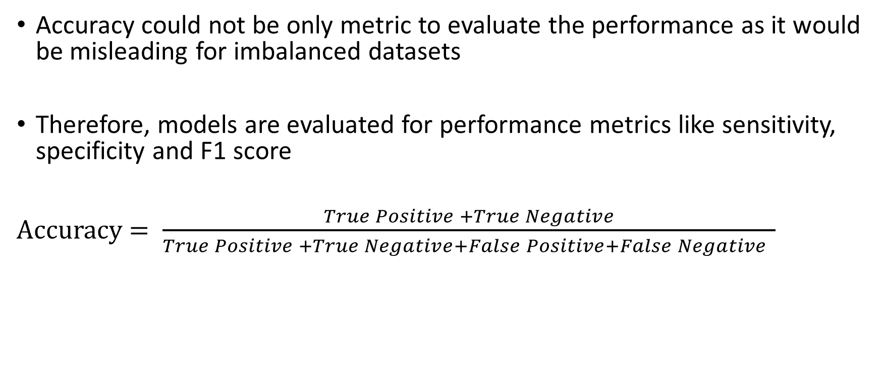
Model Performance
Accuracy could not be only metric to evaluate the performance as it would be misleading for imbalanced datasets
Therefore, models are evaluated for performance metrics like sensitivity, specificity and F1 score
Accuracy $= \frac{True Positive +True Negative}{True Positive +True Negative+False Positive+False Negative }$

Slide 20
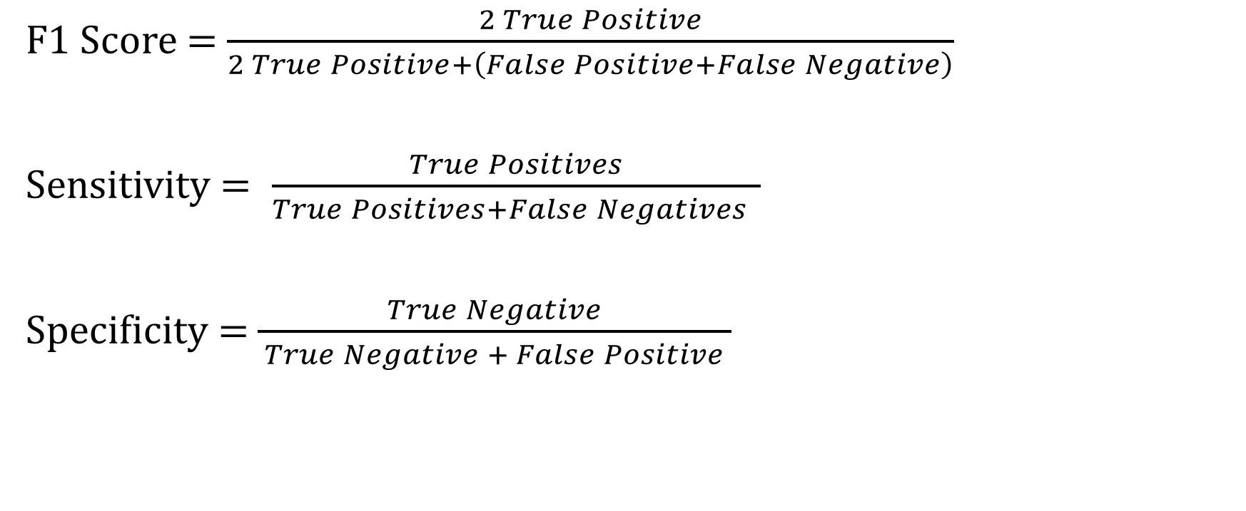
Model Performance – Contd..
F1 Score = $\frac{2 True Positive}{2 True Positive+\left(False Positive+False Negative\right)}$
Sensitivity $= \frac{True Positives}{True Positives+False Negatives }$
Specificity = $\frac{True Negative}{ True Negative + False Positive }$

Slide 21
Model Performance – No Label Shift
Label Shift | Model | SMOTE | Accuracy | Specificity | Sensitivity | F1 score
No Shift | Naïve Bayes | No | 80.44% | 0.99 | 0.94 | 0.07
 | Random Forest | No | 99.15% | 0.99 | 0.09 | 0.69
 | Ada Boost | No | 98.24% | 0.99 | 0.01 | 0.10
 | Resnet | No | 97.31% | 1.0 | 0.0 | 0.09
 | Naïve Bayes | Yes | 32.19% | 0.95 | 0.99 | 0.04
 | Random Forest | Yes | 99.19% | 0.98 | 0.44 | 0.76
 | Ada Boost | Yes | 85.32% | 0.99 | 0.93 | 0.09
 | Resnet | Yes | 98.00% | 0.99 | 0.17 | 0.29
Table 1: Performance metrics of classifiers for no shift in time

Slide 22
Model Performance – 1 Hour Shift
Label Shift | Model | SMOTE | Accuracy | Specificity | Sensitivity | F1 score
1 Hour Shift | Naïve Bayes | No | 80.57% | 0.99 | 0.94 | 0.07
 | Random Forest | No | 99.13% | 0.98 | 0.10 | 0.71
 | Ada Boost | No | 98.11% | 0.99 | 0.01 | 0.01
 | Resnet | No | 98.12% | 1.0 | 0.0 | 0.99
 | Naïve Bayes | Yes | 40.43% | 0.96 | 0.99 | 0.07
 | Random Forest | Yes | 99.18% | 0.98 | 0.47 | 0.77
 | Ada Boost | Yes | 84.35% | 0.99 | 0.93 | 0.09
 | Resnet | Yes | 22.22% | 0.99 | 0.93 | 0.03
Table 2: Performance metrics of classifiers for One hour shift in time

Slide 23
Model Performance – 6 Hour Shift
Label Shift | Model | SMOTE | Accuracy | Specificity | Sensitivity | F1 score
6 Hour Shift | Naïve Bayes | No | 75.34% | 0.98 | 0.94 | 0.10
 | Random Forest | No | 99.10% | 0.98 | 0.11 | 0.80
 | Ada Boost | No | 97.35% | 0.99 | 0.01 | 0.01
 | Resnet | No | 95.00% | 0.99 | 0.01 | 0.01
 | Naïve Bayes | Yes | 34.51% | 0.93 | 0.99 | 0.06
 | Random Forest | Yes | 99.14% | 0.97 | 0.47 | 0.83
 | Ada Boost | Yes | 83.63% | 0.98 | 0.91 | 0.12
 | Resnet | Yes | 97.11% | 0.99 | 0.01 | 0.03
Table 3: Performance metrics of classifiers for Six hour shift in time

Slide 24
Model Performance – 12 Hour Shift
Label Shift | Model | SMOTE | Accuracy | Specificity | Sensitivity | F1 score
12 Hour Shift | Naïve Bayes | No | 61.75% | 0.96 | 0.97 | 0.10
 | Random Forest | No | 99.29% | 0.97 | 0.12 | 0.87
 | Ada Boost | No | 96.86% | 0.99 | 0.01 | 0.02
 | Resnet | No | 94.35% | 0.99 | 0.01 | 0.03
 | Naïve Bayes | Yes | 61.75% | 0.96 | 0.97 | 0.10
 | Random Forest | Yes | 99.38% | 0.97 | 0.44 | 0.90
 | Ada Boost | Yes | 96.86% | 0.99 | 0.01 | 0.02
 | Resnet | Yes | 96.87% | 0.99 | 0.01 | 0.01
Table 1: Performance metrics of classifiers for Twelve-hour shift in time

Slide 25
Findings on performance Comparison
A model with high specificity, accuracy, F1 score and low sensitivity is to be chosen
From the above result Random Forest classifier outperforms other models for all the datasets
Random forest also has high accuracy, with a balanced sensitivity and specificity for the different time shifted datasets

Slide 26
Findings on performance Comparison
Feature importance results of random forest ranked Hospital Admit Time first for all the shifts
The other important features ranked top ten in all shifts are Temperate, Age, calcium, WBC, and BUN
Slight decrease in accuracy on removing the hospital admit time feature from analysis and reconducting the experiments.

Slide 27
Conclusion
Random Forest classifier with oversampling technique is chosen model for earlier detection of sepsis
The result also confirms that hospital admit time plays a major role in predicting sepsis
The accuracy of the model decreases for each of the time shifts

Slide 28

Thank You !!
Any Questions??

