Slide 1


Exploring Geometric Representational Disparities Between Multilingual and Bilingual Translation Models
Presented by: Neha Verma
In collaboration with: Kenton Murray, Kevin Duh
LREC-COLING 2024
Notes:
I’m Neha and I’m a PhD student at Johns Hopkins – this work is in collaboration with Kevin Duh and Kenton Murray

Slide 2
Outline
Motivation
Isotropy Metrics
Experiment Setup
Main Results
Notes:
This talk will go over the motivation for the work, a description of the specific metrics relevant to the work, our experimental setup, and finally results

Slide 3
Outline
Motivation
Isotropy Metrics
Experiment Setup
Main Results
Notes:
We’ll start with motivation

Slide 4
Multilingual Machine Translation
S₁
T₁
Complete parameter sharing
Improves low-resource
Zero-shot directions
Off-target output
Interference
S₂
Translation model
T₂
S_{n}
T_{m}
Notes:
This work focuses on multilingual machine translation systems, which are defined as models that translate from n source languages into m target languages
These models enjoy several benefits:
They are parameter efficient compared to an equivalent number of bilingual models via complete param sharing
Low resource languages can see performance improvements over bilingual models
Zero shot translation directions can be supported where there isn’t bitext for a specific language pair
However, there are some drawbacks of this setting too:
Sometimes, outputs can be in the wrong language despite specifying the desired target
While low resource directions can see improvement, high resource directions frequently underperform bilingual models. Especially with multiple targets

Slide 5
Motivation and Research Questions
Motivation: There are clear differences in performance patterns between bilingual and multilingual MT models.
RQ: Do these models differ in how they represent information?
More specifically, is there a difference in the geometric structure of their internal representations?
Notes:
As we can see, there are clear differences in performance patterns between these two model classes
Therefore, our research question asks if these models differ in how they represent information.
Specifically, we ask if there is a difference in the geometric structure of their internal representations

Slide 6
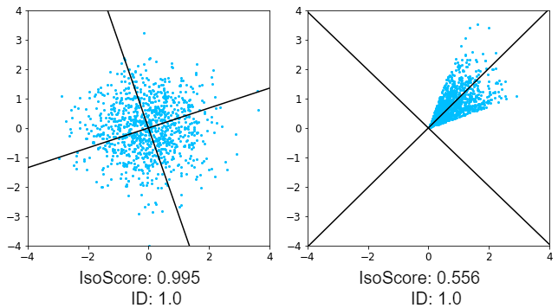
Why representational geometry?
We focus on measures of isotropy
how uniformly the variance of a dataset is spread across its vector dimensions
Representational geometry serves as an interesting tool for our RQ
“Bottlenecking”, “model capacity”
Notes:
You might be wondering why should we think about representational geometry.
[click] Before we answer this, we’ll first talk about actual geometric property we focus on, called isotropy, [click] which is defined as how uniformly the variance of a dataset is spread across its vector dimensions
[click] We use representational geometry because it serves as an interesting tool for our research question
[click] Bottleneck and model capacity are terms used to talk about potential limitations of multilingual translation. While we don’t link geometry differences directly to performance bottlenecks, information about current models geometry can help inform future modeling choices

Slide 7
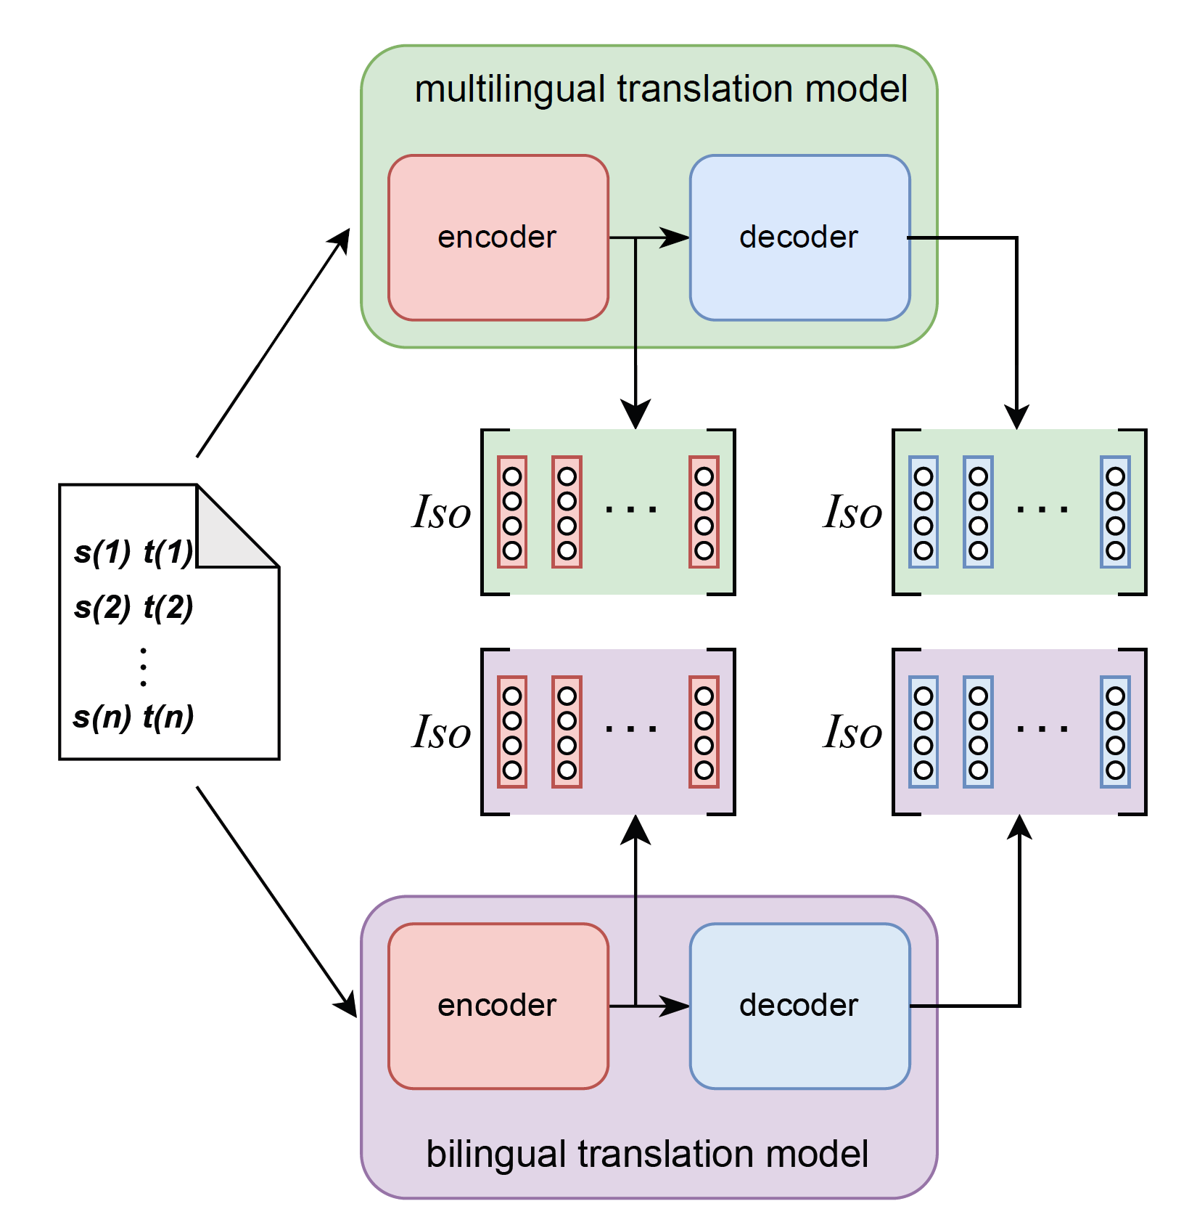
Our approach
Compute a forward pass & collect hidden states
With the same bitext (s, t)
Compute isotropy scores for each set of hiddens
Notes:
For comparison, [click] our approach starts with the same bitext, [click] computes forward passes through both a multilingual model and bilingual model, both supporting s-> t translation, and then finally, [click] computes isotropy scores for each set of hidden states. In this setup, these scores are directly comparable.

Slide 8
Outline
Motivation
Isotropy Metrics
Experiment Setup
Main Results
Notes:
Now, we will discuss how we measure isotropy

Slide 9
Isotropy Metric 1: IsoScore
Main Idea:
How far does the covariance matrix of a point cloud differ from the covariance matrix of a perfectly isotropic point cloud?
Rudman et al., 2022. IsoScore: Measuring the Uniformity of Embedding Space Utilization
Notes:
The first metric is named IsoScore, which appears in prior work. The main idea is to measure how far the covariance matrix of a point cloud differs from the covariance matrix of a perfectly isotropic point cloud.
On the left, we see that the point cloud variance spread across both dimensions is much more even than that on the right, resulting in a higher isoscore

Slide 10
Isotropy Metric 2: Intrinsic dimensionality
Main Idea:
Of the true dimension d_{orig}, how many dimensions contain variance over a certain threshold?
Fukunaga & Olsen, 1971. An algorithm for finding the intrinsic dimensionality of data.
Notes:
The second metric is named intrinsic dimension, which is an older metric. The main idea is to measure how many dimensions capture variance over a threshold.
In the example, both point clouds capture enough variance in their 2 dimension to have an ID of 1 or 2/2

Slide 11
Outline
Motivation
Isotropy Metrics
Experiment Setup
Main Results
Notes:
We will discuss experimental setup now

Slide 12
Trilingual Models
One-to-many is a “harder” multilingual setting
Controlled for language relatedness
T₁
Ru
Translation model
Uk
script + close family
En
T₂
De
distant family
Zh
unrelated
Translation model
Ru
En
Translation model
T₂
En
Notes:
We focus on trilingual models because
One to many is harder
We can directly control for language relatedness by
[clikc]
Fixing Target 1 to be russian, and select [[click] ukrainian, german, and chinese as our Target 2s. [clikc] These are selected for different language relatedness. [click] Then, for comparison, we train 2 bilingual models for each multilingual model, where only their targets differ

Slide 13
Methods: Datasets & Models
1. WMT-large
~30M-90M sentences
2. Multiparallel TED
~60k-160k sentences
3. WMT-small
~60k-160k sentences
Transformer Base architecture
Transformer Iwslt architecture
Notes:
We 3 different datasets for our experiments. WMT-large is from the 2022 WMT general taks, with filtering. IT is in the 10s of millions sentence range. Multiparallel TED is a subset of the TED talks corpus, but filtered to be 3 way parallel. This is on teh order of 60k-160k sentences. Finally, WMT-small is a subsample of WMT-large to be the same size as the ted data.
We use the transformer base architecture for our larger corpus, and the IWSLT architecture for the smaller ones, as implemented by fairseq

Slide 14
Outline
Motivation
Isotropy Metrics
Experiment Setup
Main Results
Notes:
Now, we will discuss our results

Slide 15
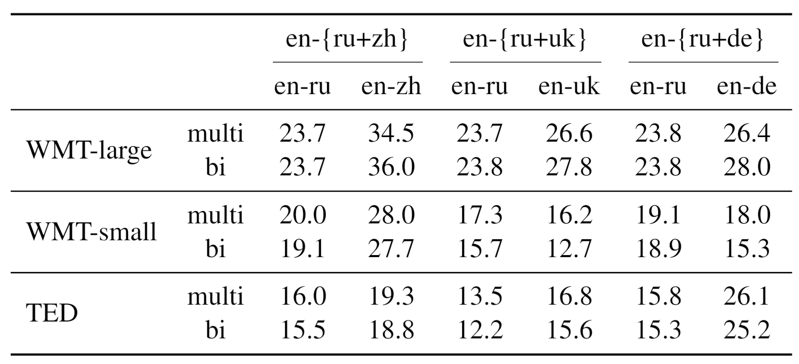
Translation performance
Interference observed
Small model size
Notes:
I’ll briefly touch on translation performance,
We observe interference in the large setting, with bilingual models outperforming multilingual ones,
[click], [click] In the small data setting, this is not observed, consistent with prior work.
Despite increased performance on small model, it may be the case that more data is just helpful despite some capacity limitations caused by multilingualism

Slide 16
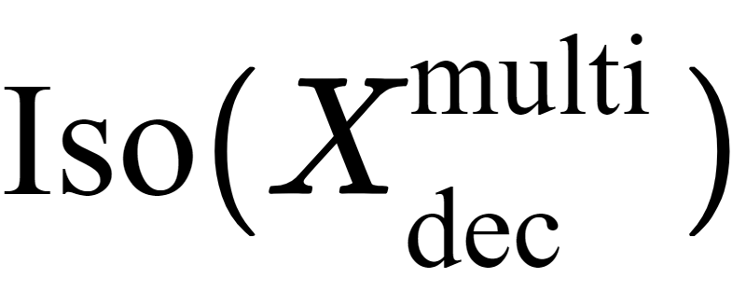
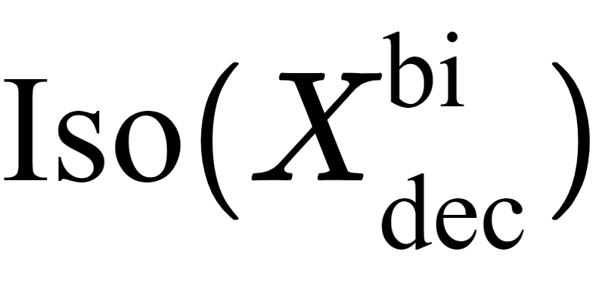
Multilingual decoder capacity reduction
Notes:
Now, we are comparing the difference between decoder states from multilingual models, and bilingual models.

Slide 17
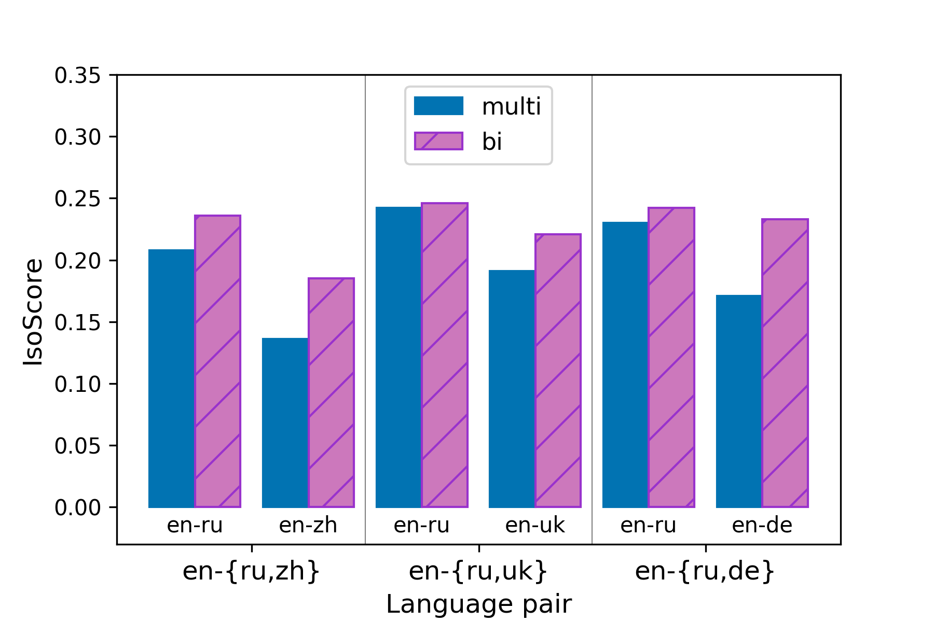
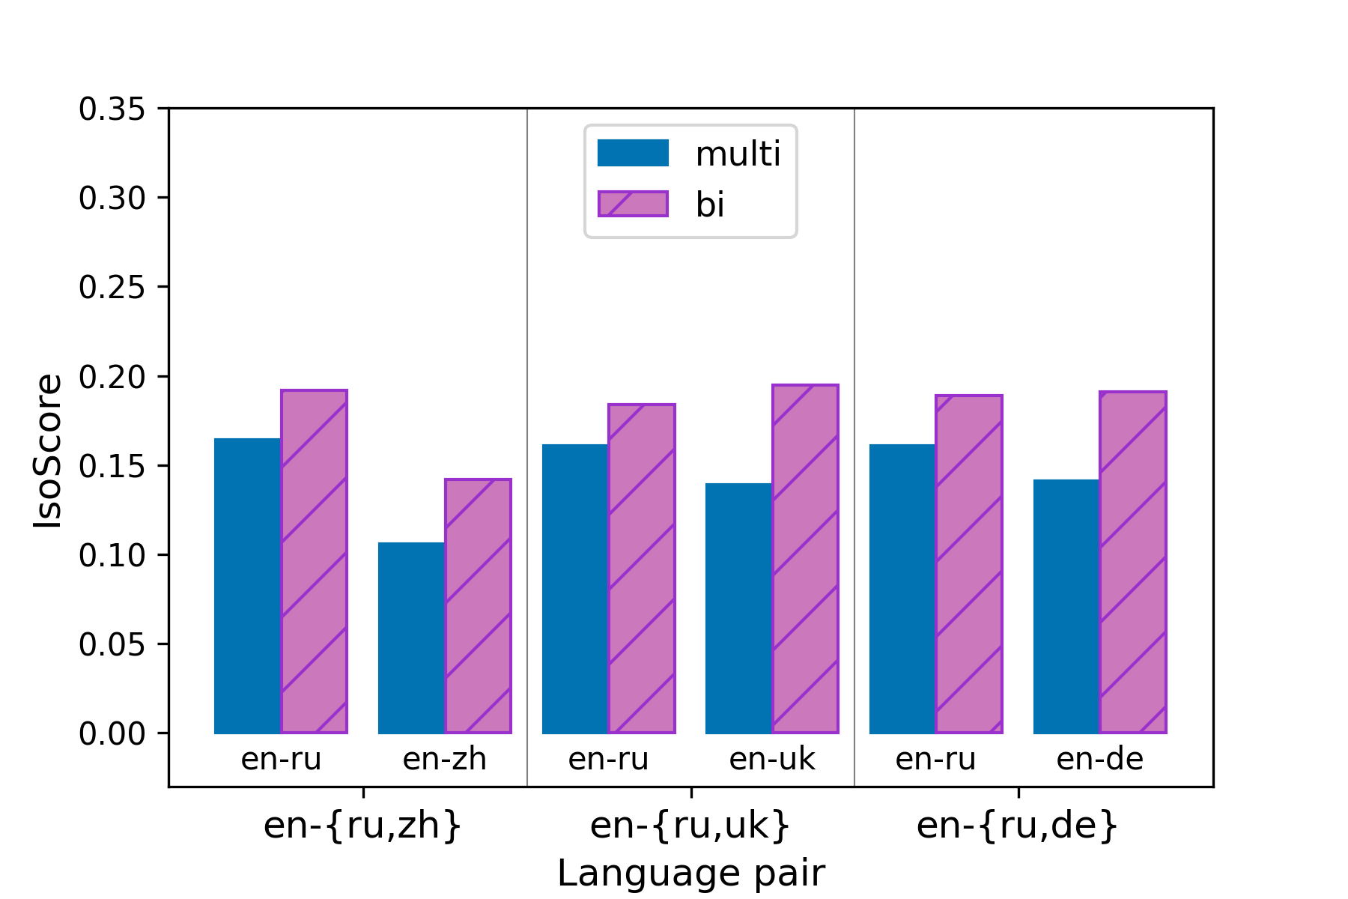
Multilingual decoder capacity reduction
Vs
WMT-small
WMT-large
Notes:
Here, we have two plots for both WMT sizes, where blue indicates IsoScores from multilingual decoder states, and pink indicates IsoScores from bilingual decoder states
We can see that across all three language pairs, and across our data sizes, bilingual decoder states are more isotropic than multilingual decoder states

Slide 18
Multilingual decoder capacity reduction (cont.)
For the same sentences, decoder states from multilingual models consistently use less available dimensionality
Accounts for any sharing across targets
Bottleneck phenomenon?
Notes:
Takeaway: [click] For the same sentences,multi decoder states consistently use less dimensionality available.
This approach Accounts for sharing across targets ( as these decoder dimensions need not be unique dimensions)
We hypothesize that this reduced isoscore may be related to the bottleneck phenomenon mentioned previously, where multiple languages may be bottlenecked by one decoder

Slide 19
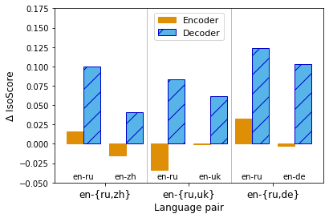
Decoder states store language specific information
Language-pair specific decoder states
Overall decoder states
Isotropy of language-pair specific decoder states is higher than the isotropy of overall decoder states
No similar pattern seen in encoder states
Some top dimensions in decoder are largely dictated by language information
Low isotropy = high variance spread across few dimensions
WMT-large
Notes:
In the next set of results, we are Trying to see how different is the isotropy of a [click] specific language in the decoder compared to [click] the isotropy of the target languages combined in the decoder. This delta shows us the difference in isotropy when separating the languages form the overall decoder states.
We see that [click] the isotropy of language pair specific decoder states is higher than the isotropy of overall decoder states, as shown by the positive delta blue bars.
From the orange bars, [clikc] we see that there is no similar pattern in encoder states.
[click], These results suggest that some top dimensions in the decoder are largely dictated by language information.
Overall decoder states have lower isotropy, meaning there is high variance in only a few dimensions. ONe such dimension is likely related to langID

Slide 20
Decoder states store language specific information
Language-pair specific decoder states
Overall decoder states
Isotropy of language-pair specific decoder states is higher than the isotropy of overall decoder states
No similar pattern seen in encoder states
Some top dimensions in decoder are largely dictated by language information
Low isotropy = high variance spread across few dimensions
T₁
T₂
Variance explained by target language
Notes:
On the left, we have a very toy example demonstrating this phenomenon that could lead to a large delta.
Considering both point clouds together, there is very high variance in one direction. But when considered separately, thye look much more locally isotropic.

Slide 21
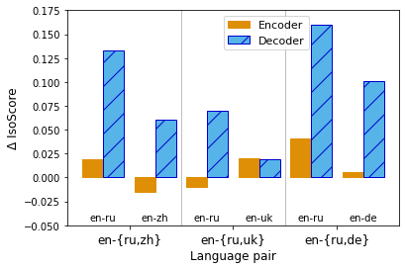
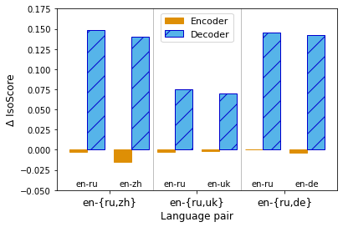
Decoder states store language specific information
Language-pair specific decoder states
All decoder states
WMT-small
TED multiparallel
Notes:
For our other two datasets, we see very similar trends of high deltas in decoders, suggesting much language specificity in decoder states

Slide 22
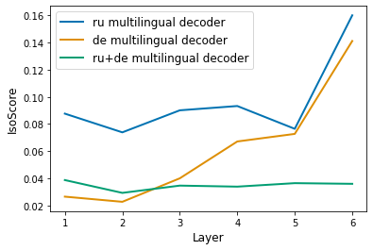
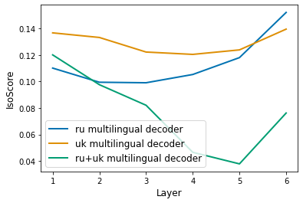
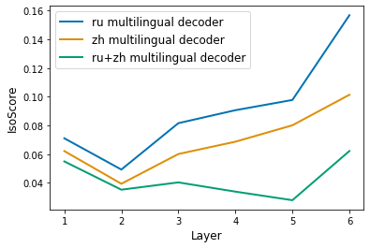
Decoder states become more language-specific by layer
Notes:
All WMT-large models

Slide 23
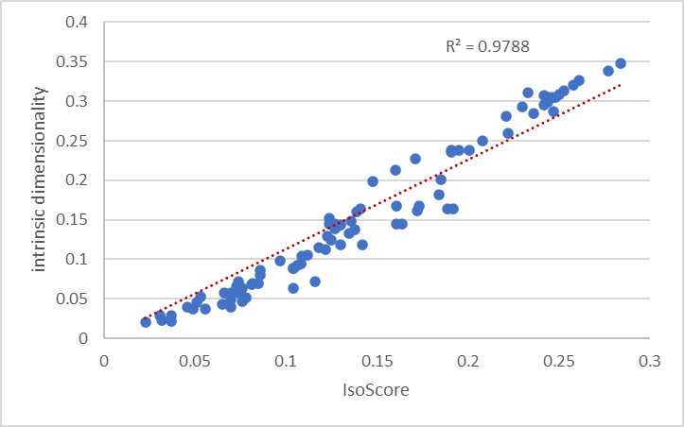
Metric consistency
All scores reported here are IsoScore
Metric agreement is high
Notes:
Briefly, I wanted to show a plot on metric consistency. Reliability of signal measured

Slide 24
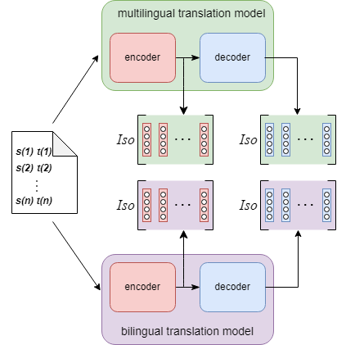
Conclusions
We study the geometric differences between representations from comparable bilingual and multilingual translation models
Consistent reduction in isotropy in multilingual decoder states
Language-specific dimensions seem to occupy a notable portion of the multilingual decoder representation space

Slide 25
Thank you!

Slide 26
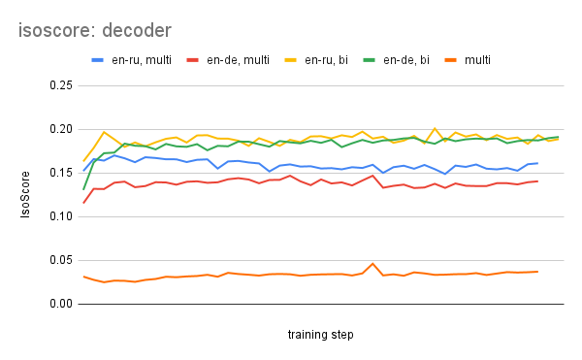
Isotropy changes little throughout training

Slide 27
Isotropy Metric 1: IsoScore details
PCA-reorient dataset X ⊆ ℝ^{n}: X^{PCA}
Compute diagonal covariance matrix of X^{PCA}: Σ_{D}
Compute distance between Σ_{D} and I, which has ideal isotropy
Rescale to compute percentage of dimensions isotropically utilized
Notes:
Sigma_d is diagonal because pca has 0 off-diagonal

Slide 28
Isotropy Metric 2: Intrinsic dimensionality details
For threshold ε (0.05) and orig dim d_{orig}
Compute PCA of dataset X ⊆ ℝ^{n}:
cov(X) = VΛV^{T}
Normalize eigenvalues:
λ_{i} ← λ_{i} / λ₁
Return intrinsic dim:
sum(λ_{i} > ε ) / d_{orig}

Slide 29
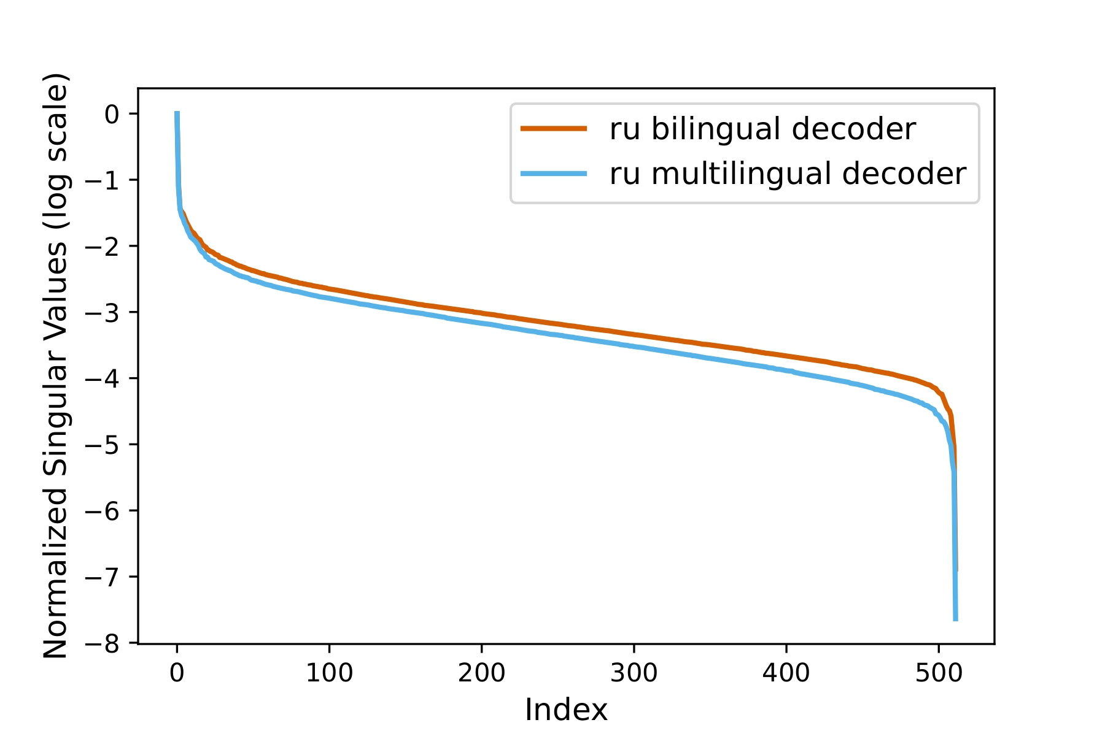
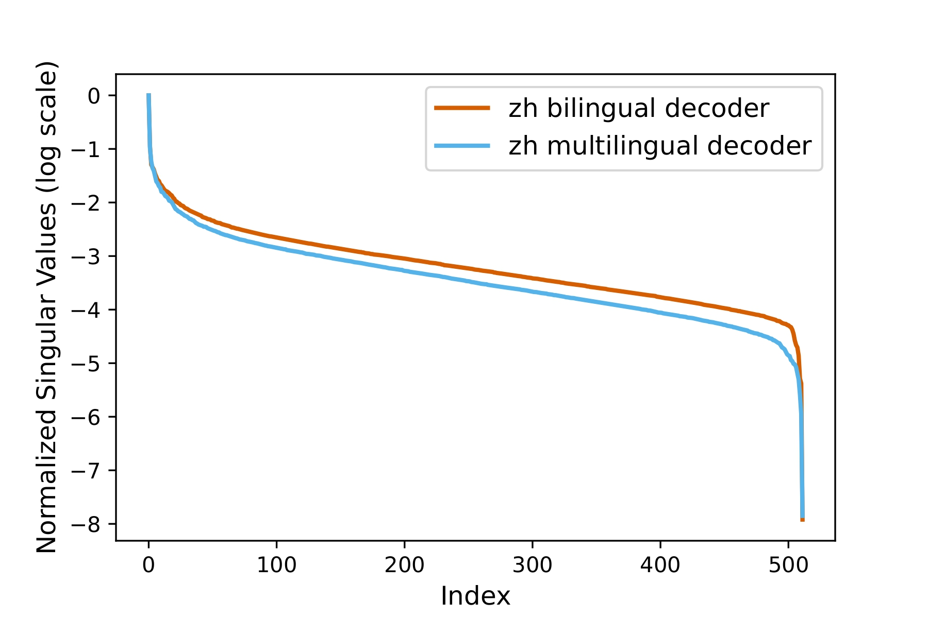
Multilingual decoder capacity reduction (cont.)
Plot log(Σ) from X_{dec} = UΣV^{T}
Higher value means more variance captured in that dimension

Slide 30
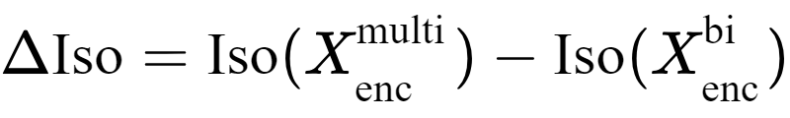
Multilingual encoder capacity increases
Notes:
Equation
Higher isoscore means …

Slide 31
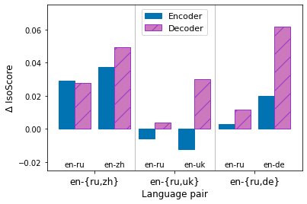
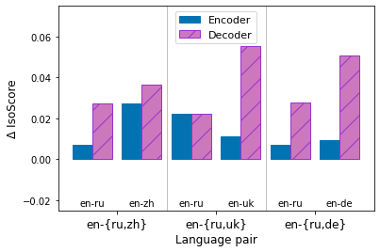
Multilingual encoder capacity increases
WMT-small
WMT-large
Notes:
Less than decoder capacity decreases,
Also consistent across scale, language. Except wmt-small ru-uk, where encoder capacity decreases

Slide 32
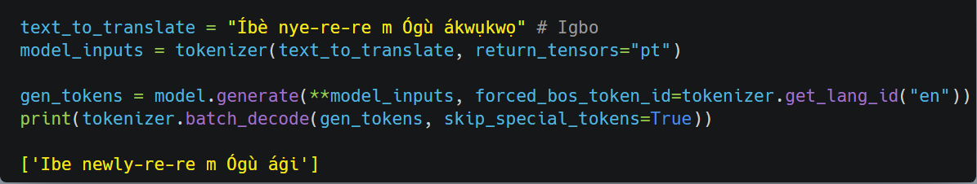
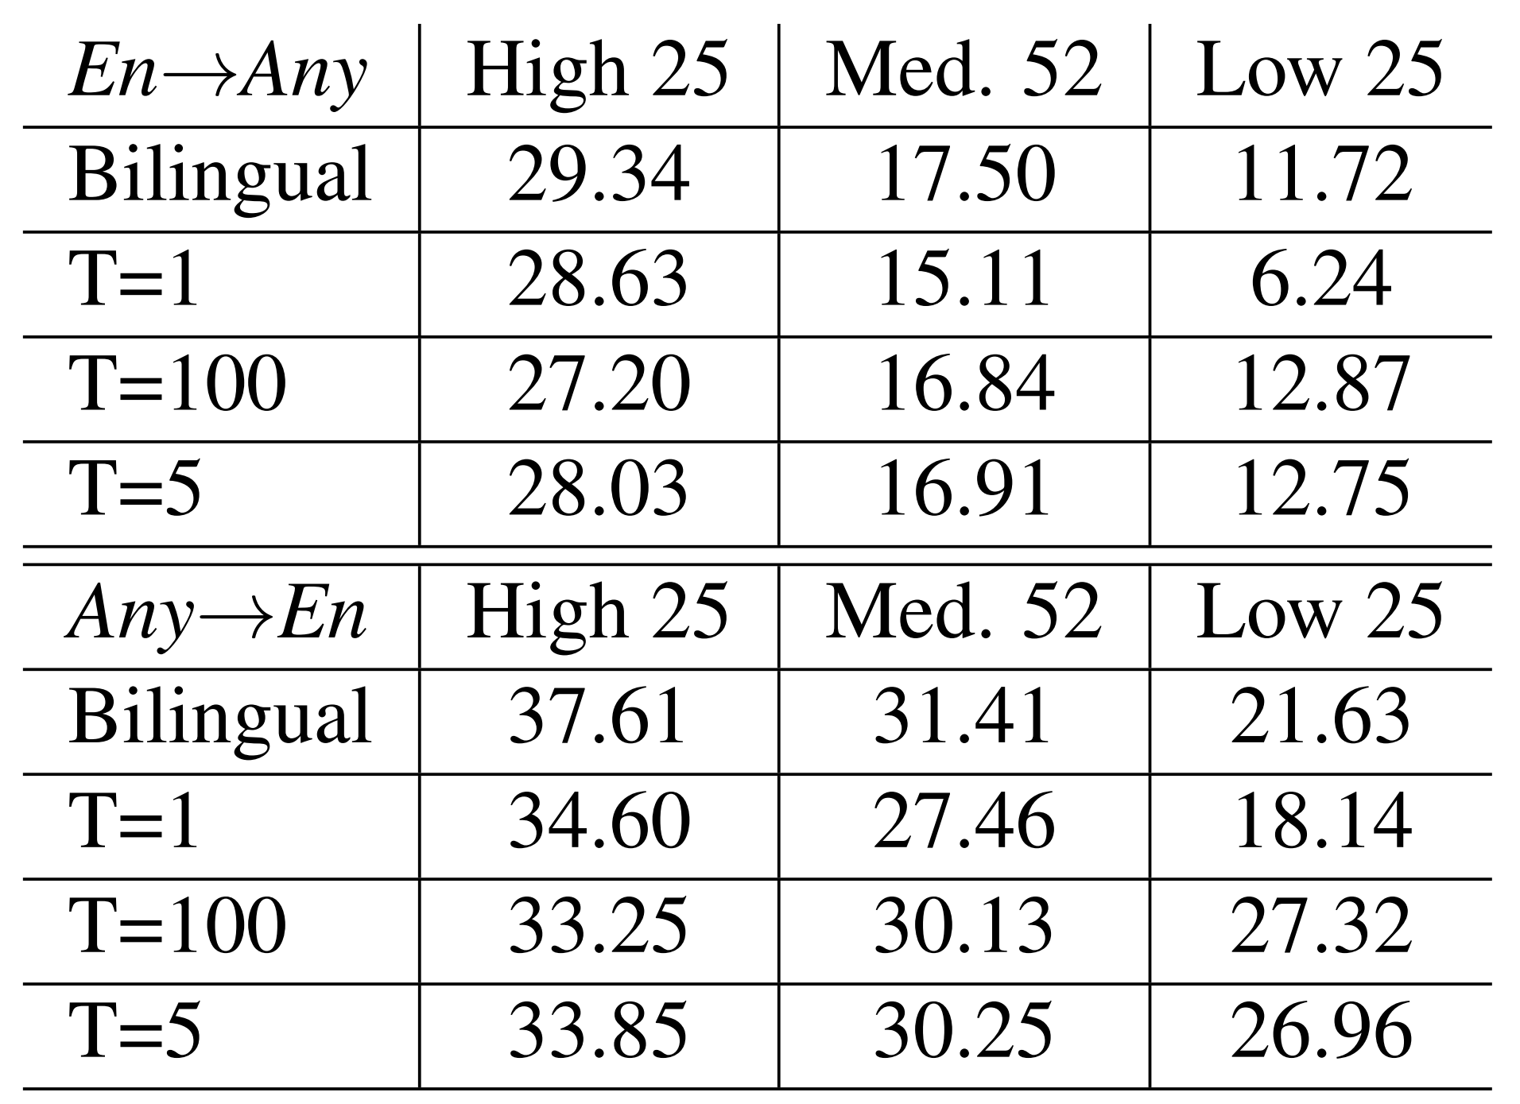
Limitations and Performance differences
Off-target translation (M2M100, Fan et al., 2020)
“Ibe gave the book to Ogu for me”
Interference (Google-103, Arivazhagan et al., 2019)
Multilingual
BLEU scores by resource level
Multilingual
Notes:
However, there are also some drawbacks.
Off target translation is a common issue, where the hypothesis language ID does not actually match the target language
In this example, we want the target to be in English, but the output is still mostly in Igbo. The target was actually
“'Ibe gave the book to Ogu for me”
Interference is also a known issue, where although low resource languages can see performance improvements, high and medium resourced languages frequently underperform bilingual baselines.
We don’t even get this bilingual baseline comparison for current sota (NLLB 200)

