Slide 1
Multi View Representation Learning
B21PV02

Slide 2
Progress
Literature review on multi view representation learning
Implementation of deep CCA i.e., two view non-linear representation learning on noisy MNIST dataset
Implementation of multi-view representation techniques on the real world problem
1
3
5
2
4
6
Understanding different CCA techniques for multi-view learning
Exploring a real-world problem that can be efficiently solved using multi-view learning
Analysis on the improvement in results upon incorporating information from multiple views

Slide 3
Problem Statement
Personalized news recommendation

Slide 4
News recommendation
Objective : To improve user experience with personalized news recommendation
News - multi view data
Title
Body
Category etc
Learn informative representations of users and news by exploiting information from the multiple views of the news data

Slide 5

Dataset
MIND Dataset -
Around 160k English news articles
Around 15 million impression logs generated by around 1 million users

Slide 6
The performance of recommendation algorithm depends on the informativeness of the news and user representations learnt

Slide 7
Attentive Multi view learning approach
To incorporate information from different views as per their importance

Slide 8
Attentive Multi-view learning framework
News Encoder
User Encoder
Click Predictor

Slide 9
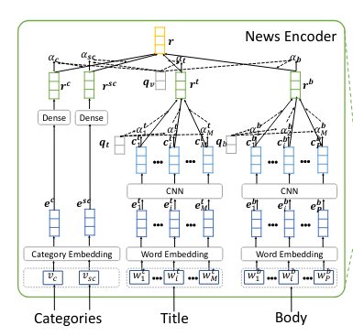
News Encoder
Four major components -
Title Encoder
Body Encoder
Category Encoder
Attentive pooling

Slide 10
Title Encoder
1. Word Embedding
Converts a word sequence into a sequence of low-dimensional semantic vectors
[w₁^{t} ,w₂^{t} , ..., w_{M}^{t}] is converted into [e₁^{t} ,e₂^{t} , ..., e_{M}^{t}]
2. CNN
Contextual word representation of the i-th word is
c_{i}^{t} = ReLU(F_{t} × e^{t}_{(i-k):(i+k)} + b_{t} )
The o/p of this layer is a sequence of contextual representations.
3. Word level attention
To select important words within the context of each news title.
Say, α_{i} is the attention weight obtained for the i-th word,
Final representation of the news title:
r^{t} = Σα_{i}c_{i}^{t} for i = 1 to M

Slide 11
Body Encoder
Three layers - word embedding, CNN and attention network similar to the title encoder
Final representation of news body is the summation of contextual word representations weighted by their attention weights
r^{b} = Σα_{i}c_{i}^{b} for i = 1 to P, where P is the number of words in the news body

Slide 12

Attentive Pooling
A view-level attention network to learn attention weights of title, body, category and sub-category
Final news representation
r = α_{c}r^{c} + α_{sc}r^{sc} + α_{t}r^{t} +α_{b}r^{b}
where α_{c},α_{sc},α_{t},α_{b} are the attention weights of each view

Slide 13
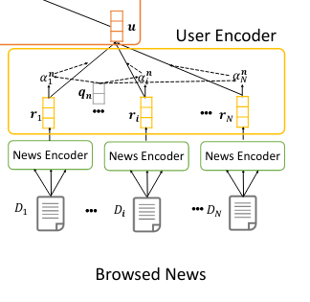
User Encoder
Learns representations of users from the representations of their browsed news

Slide 14
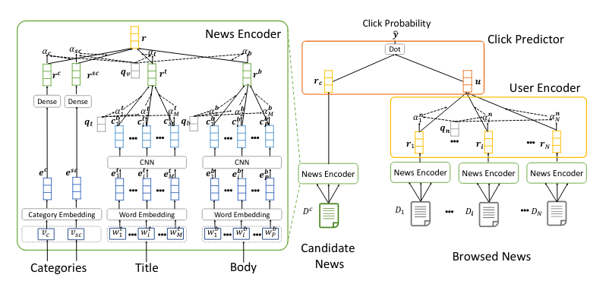
Attentive Multi-view learning framework

Slide 15
Training
Negative sampling technique - with K = 4
For each news article clicked by the user, randomly sample K articles that are presented in the same session and are not clicked by the user
Jointly predicting the click probability scores of the positive news article and the k negative news articles.
Normalize the click-probability scores using softmax
Loss function : negative log likelihood of all positive samples
L = - Σlog(p_{i}) for i ∈ S where S is the set of positive training samples

Slide 16
Results
MRR (Mean reciprocal rank) = 0.6518
AUC Area under the ROC curve = 0.3072
nDCG @ 5 = 0.3380
nDCG @ 10 = 0.4022

Slide 17
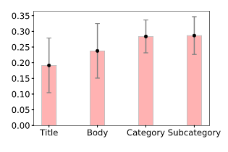
Results
Plot of the mean and standard deviation of attention weights of the views

Slide 18
Observations
The category view has the highest attention weight among all views for most samples.
Attention weights on the title and body views are small for many samples.
The over-fitting has reduced upon applying 20% drop-out to each layer.

Slide 19
Conclusion
Incorporating information from multiple views and applying attention mechanism has learnt useful representations thereby improving the performance of the news recommendation task.

Slide 20
References
[1] Li, Yingming, Ming Yang, and Zhongfei Zhang. "A survey of multi-view representation learning." IEEE transactions on knowledge and data engineering 31.10 (2018): 1863-1883.
[2] Okura, Shumpei, et al. "Embedding-based news recommendation for millions of users." Proceedings of the 23rd ACM SIGKDD International Conference on Knowledge Discovery and Data Mining. 2017.
[3] Wu, Chuhan, et al. "Neural news recommendation with attentive multi-view learning." arXiv preprint arXiv:1907.05576 (2019).
[4] Wang, Hongwei, et al. "DKN: Deep knowledge-aware network for news recommendation." Proceedings of the 2018 world wide web conference. 2018.

Slide 21
Thank You
Any Questions?

