Slide 1
Text pre-processing
Week2

Slide 2
Objective
Text mining introduction
Text Mining vs Data Mining
Text preprocessing
Text Processing tools in python

Slide 3
Text Analytic
Text analytic is the technology to gather store and mine textual information to aware the businesses for better decisions.
70% information stored in text . Documents, journals, web pages, emails...
The source can be internal or can be gathered through social media, blogs or mobile data.
It is necessary to automatically analyze, organize, summarize...

Slide 4
Text mining vs Data Mining
Data Mining Text Mining
Data Object Numerical & categorical data Textual data
Data structure Structure Un structure & semi-structure Data representation Straightforward Complex
Space dimension <tens of thousands > tens of thousands
Data analysis, Data mining
Methods machine learning , statistic, information retrieval,
Neural Network, NLP,...
Maturity Broad Implementation since Broad Implementation
1994 starting 2000
Market 10⁵ analysts at large and mid 10⁸ analysts corporate workers
size companies and individual users

Slide 5
Text-Preprocessing
Sentence and word tokenizing
Parsing
Part of speech tagging
Text stemming
Chunking
Lemmatizing

Slide 6
Text mining approaches
Sentiment analysis
Spam filtering
Text categorization
Topic detection
Keyword Frequency
Document similarity
Phrase extraction

Slide 7
Text mining-Modeling
Text representation:
Boolean Model
Vector model
Probabilistic model
Text classification:
Naïve Bayes
SVM
Neural network
Text clustering:
K nearest neighbor
Probabilistic Clustering

Slide 8
Lexicon analysis
Lexicon analysis is the first step of text processing.
Convert all the text to lower of upper case
Eliminates comma and all the punctuations [!”#$%&’()*+,-./:;<=>?@[\]^_`{|}~]
Strip the text with white space (\t)
Lexicon analysis combined with sparser transfer the text to the list of tokens.
Lexicon analysis : cleaning the digits, hyphens, punctuation marks, the case of letters,…

Slide 9
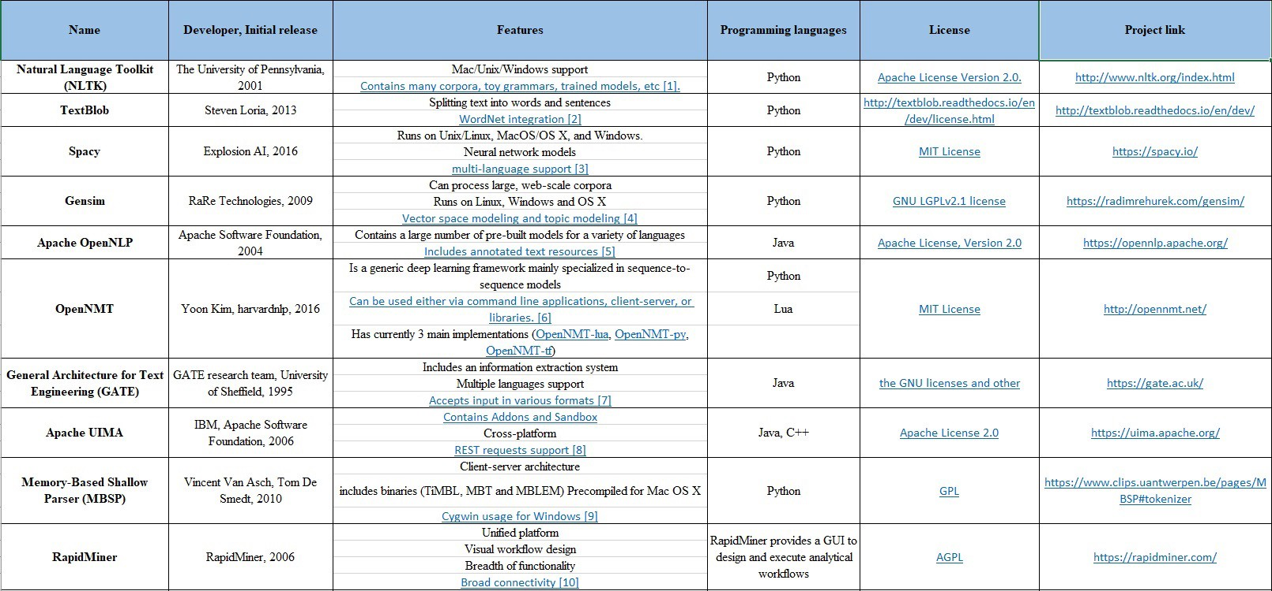
Lexicon analysis

Slide 10
Lexicon analysis
Numbers usually not good index terms because of their vagueness. They need some advanced lexical analysis procedure
ex) 510B.C. , 12/2/2000, ….
Hyphens breaking up hyphenated words
ex) state-of-the-art -> state of the art (Good!)
but, B-1 -> B 1 (???)
Punctuation:
ex) 510B.C -> 510BC.
ex) val.id -> valid (???)
The case of letters
converts all the text to either lower or upper case may affect part of the semantics.

Slide 11
Stop words
The stop words are the list of the words that we do not want to process them. Usually the words similar ‘the’, ‘is’, ‘are’ are categorized in Stop words list . There is no universal list of stop words in NLP research, however the NLTK module contains a list of stop words.
from sklearn.feature_extraction.stop_words import ENGLISH_STOP_WORDS
from spacy.lang.en.stop_words import STOP_WORDS

Slide 12
Tokenizing
Tokenizing is divide text into word units called tokens (word, sentence,..) .
Tokenizing is far more difficult than expectation.
Word tokenizer uses usually space, however we can separate words with comma, or any other punctuations.

Slide 13
Tokenizing
Sec. 15.2.3
The best sentences tokenizer is searching for ., ?, ! Or sometimes :
Problem:
The punctuation may be also used for word abbreviation and many other applications.
There are several algorithms for sentence boundary detection such as:
Heuristic
Statistical classification tree
Neural Network
Maximum entropy

Slide 14
Stemming
Stemming is the process of reducing inflection in words to their roots.
The portion of a word which is left after the removal of its affixes (i.e., prefixes and suffixes)
Laughing, Laugh, Laughs, Laughed -> Laugh
Problem:
May generate an invalid or different word .
Eg. Business->busy or saw(tool) -> See
Stemming can be useful for some queries but in some cases may end up even worse.

Slide 15
Stemming
The methods are:
Porter:
Does not follow suffix and uses just 5 rules
Lancaster
Is an iterative algorithm which use more aggressive algorithm than Lancaster.
Snowball stemmer
ISRI stemmer
RSLPS stemmer

Slide 16
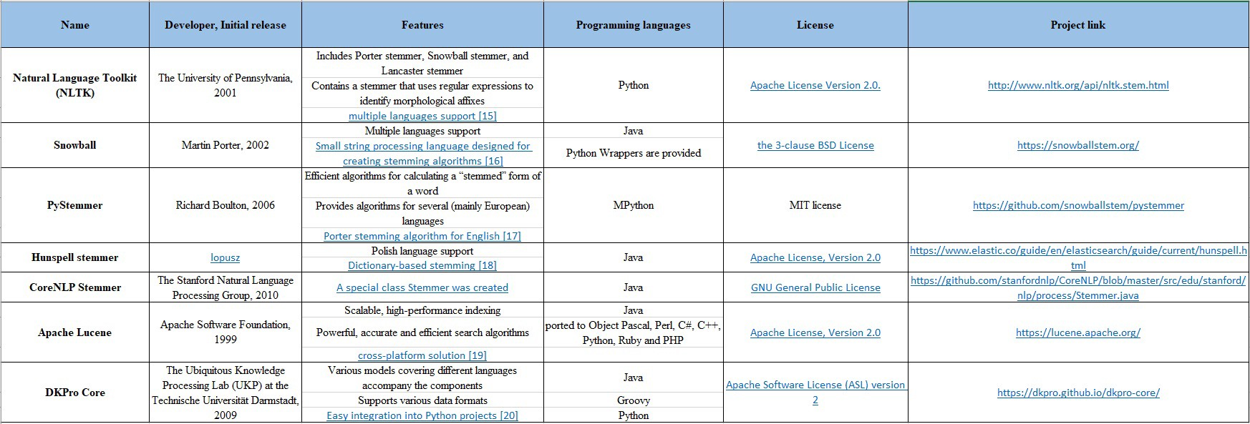
Stemming

Slide 17
Part of speech
Part of speech (POS) tagging:
The process of assigning a part of speech class marker to each word in a corpus called POS tagging where given a string of words, identify the parts of speech for each word.
here is the sample code for NLTK part of speech tagging with lots of comments and info as well:
CC coordinating conjunction
CD cardinal digit
DT determiner
EX existential there (like: "there is" ... think of it like "there exists")
FW foreign word
VB verb, base form take
Notes:
For more details in Python, you can use (https://www.analyticsvidhya.com/blog/2017/09/understaing-support-vector-machine-example-code/)

Slide 18
Part of speech
IN preposition/subordinating conjunction
JJ adjective 'big'
JJR adjective, comparative 'bigger'
JJS adjective, superlative 'biggest'
LS list marker 1)
MD modal could, will
NN noun, singular 'desk'
NNS noun plural 'desks'
NNP proper noun, singular 'Harrison'
NNPS proper noun, plural 'Americans'
PDT predeterminer 'all the kids'

Slide 19
Part of Speech
POS possessive ending parent's
PRP personal pronoun I, he, she
PRP$ possessive pronoun my, his, hers
RB adverb very, silently,
RBR adverb, comparative better
RBS adverb, superlative best
RP particle give up
TO to go 'to' the store.
VBD verb, past tense took
VBG verb, gerund/present participle taking
VBN verb, past participle taken
VBP verb, sing. present, non-3d take

Slide 20
Part of speech
There are many tools containing POS taggers including:
NLTK, spaCy, TextBlob,
Pattern, Stanford CoreNLP,
Memory-Based Shallow Parser (MBSP),
Apache OpenNLP, Apache Lucene,
General Architecture for Text Engineering
FreeLing, Illinois Part of Speech Tagger,
DKPro Core. (GATE),

Slide 21
Chunking:
After knowing the parts of speech, we can do what is called chunking, and group words into meaningful chunks.
One of the main goals of chunking is to group into what are known as "noun phrases."
These are phrases of one or more words that contain a noun, maybe some descriptive words, maybe a verb, and maybe something like an adverb.
The idea is to group nouns with the words that are in relation to them.

Slide 22
Chunking:
Example: Chunks corresponding to Noun-Phrases
[John P.] saw [a beautiful woman] with [a telescope]
Available tools:
NLTK, TreeTagger chunker, Apache OpenNLP,
General Architecture for Text Engineering (GATE), FreeLing.

Slide 23
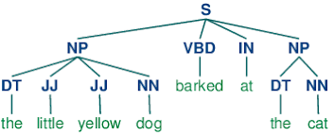
Chunking(hierarchy of ideas):
Defining a chunk grammar
Creating a chunk parser → Output will be a Tree showing all the chunks

Slide 24
Lemmatizing
Lemmatizing is very similar operation to stemming. However ,while stemming can often create non-existent words, lemmas are actual words.
The lemmatize takes a part of speech parameter, "pos." If not supplied, the default is "noun."
In Lemmatizing the attempt is to find the closest noun. For example the lemmatize of better with pos=adj. Will be good.

Slide 25
Text-Preprocessing
Available Libraries for lemmatizing:
NLTK (WordNet Lemmatizer),
spaCy, TextBlob, Pattern,
gensim, Stanford CoreNLP,
Memory-Based Shallow Parser (MBSP),
Apache OpenNLP, Apache Lucene,
General Architecture for Text Engineering (GATE),
Illinois Lemmatizer,
DKPro Core.

Slide 26
Text-Segmentation/Tokenizing
!,? Are relatively unambiguous.
Period “.” is quite ambiguous
Sentence boundary
Abbreviation like Inc. or dr.
Numbers like 0.2 or 4.3
The suggested method :
Classifier (EndOfSentence/Not EndOfSentence)
Such as decision tree, logistic regression,SVM.

Slide 27
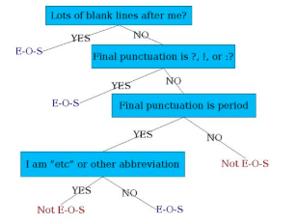
Text-Segmentation
Decision Tree
Upper case word
with “.”
Numeric word
with “.”
Length of the
sentence.

Slide 28
Decision-Tree rule
https://stuff.coffeecode.net/2016/ohiodevfest/kgdiscovery.html?
Heuristics represent an indefinite assumption, by common sense to find an optimal solution.
HR: A verb followed by a preposition such as on, in, by and to may indicate a relationship type. E.g. persons work on projects.
Heuristic weights are assigned according to the confidence level that event is true. Eg. Weight of 0.5 basically means that 50% of the time this may produce correct answer but not all the types.
Heuristic flowchart:
Part of speech tagging
Apply heuristic and assign weight
Human intervention
Attached attribute to the words
Produce final result.

Slide 29
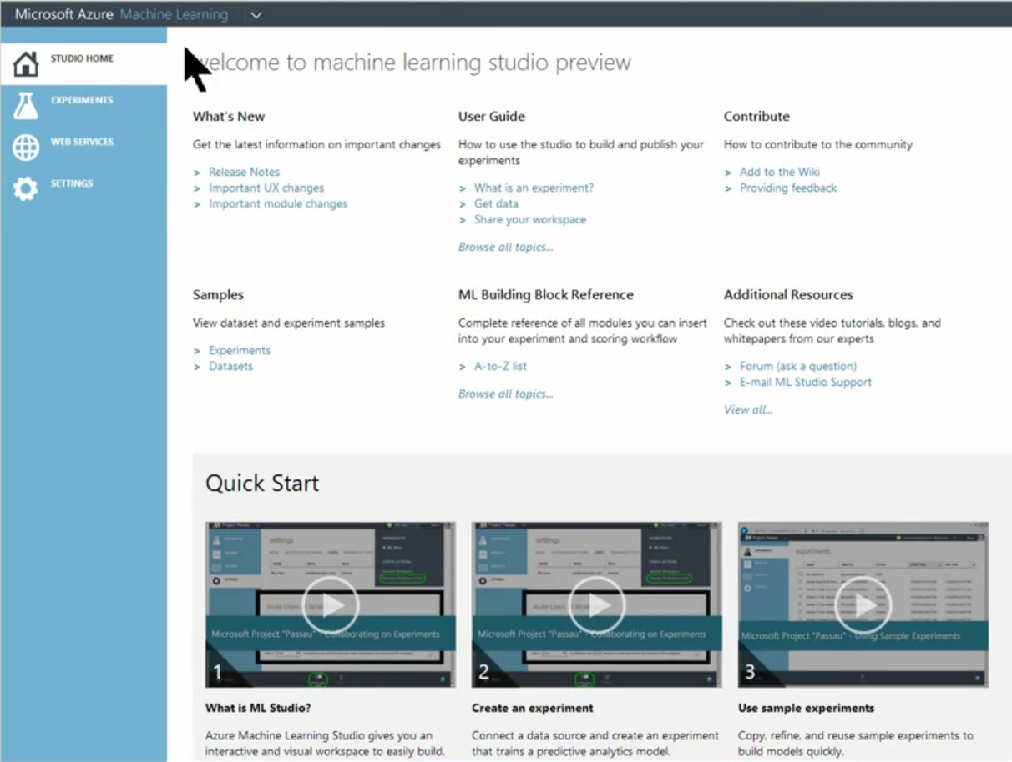



The Azure Machine Learning solution
Azure ML Studio
Browser-based
Designed for people without deep data science backgrounds
Supports deep science scenarios – R support, multiple models
Azure ML API
REST-based web service
Supports best-in-class algorithms
Reduces time from model experimentation to production
Azure Marketplace
Drag-and-deploy
Fast monetization of ML solutions and APIs
Quick source for free and third-party Azure ML APIs
Azure cloud services
No software to install or infrastructure needed
Nearly unlimited file repositories via Azure Storage
Supports Azure data-related services – HDInsight, SQL Database
Notes:
We discussed this slide in our solution overview (module one), but for those that have not seen that session, these are the key components of the Azure ML solution. At its core, Azure ML is comprised of three things:
The Azure ML Studio
The Azure ML API
The Azure Marketplace
The Azure ML Studio is a big part of what makes Azure ML so valuable because it enables people without extensive experience in data science to take full advantage of ML analysis. It is an easily accessible browser-based solution with a simple and visual interface to let mainstream business workers access their ML data repositories for deep insight into how the business is functioning.
But that is not to say that Azure ML ignores advanced functionality or data scientists. All the cutting edge features data scientists need to build complex ML models are here, including support for R and deeper ML scenarios such as multiple model operations.
Another way for data scientists to get the most from Azure ML is by using the Azure ML API to create even more complex and dynamic models. The API is a REST-based web service that lets users extend the capabilities of Azure ML Studio with customization. But here, again, we have made it relevant to general users as well as data scientists by keeping it in the web service paradigm, which means it can also be accessible as an app plug-in or even using mobile apps.
The Azure Marketplace is the last core component of the Azure ML solution and a very important one. This is a one-click web service that lets users shop for ML components useful to their business or project and also allows data scientists to immediately market their expertise as web services.
But while Azure ML Studio, the Azure ML API, and Azure Marketplace comprise the core Azure ML solution, an important part of what makes Azure ML so competitive is that it integrates easily with the rest of the Microsoft Azure cloud data services portfolio. HDInsight, SQL Database, and Azure Storage and cloud infrastructure are all positioned to directly benefit the capabilities of Azure ML, which is a key part of what makes the solution flexible enough to address such a large variety of ML scenarios.

Slide 30



Azure ML Studio
ML Studio
New enhancements
New experiment flow
Streamlined experiment page
New visualization for data tables
Browser-based environment supporting general users and data scientists
Immutable library of models including search, discover, and reuse
Wide range of features, machine learning algorithms, and modeling strategies
Ability to quickly deploy models as Azure web services to the ML API service
Notes:
The heart of the Azure ML solution is Azure ML Studio. This is a browser-based integrated development environment (IDE) that uses drag-and-drop gestures and simple data flow graphs to let users that are not expert data scientists set up ML modeling experiments. For many tasks, users will not have to write a single line of code. ML Studio also features a library of time-saving sample experiments and sophisticated algorithms that have been developed by Microsoft Research, including the same algorithms Microsoft is using right now to run our Bing and Xbox cloud services among many others.
But Azure ML Studio also pays attention to the needs of more advanced users, like data scientists. It features a number of modules with which to build comprehensive predictive models, including state of the art ML algorithms such as scalable boosted decision trees, Bayesian Recommendation systems, Deep Neural Networks, and Decision Jungles developed at Microsoft Research.
We have made recent enhancements to Azure ML Studio, including a new and more intuitive experiment flow along with a new streamlined experiment page as well as new capabilities for visualizing data tables as customers make them part of an ML experiment.
Azure ML Studio is also critically important when it comes to deploying ML models and experiments. Using the Azure ML API, which we will talk about in a moment, Azure ML Studio can deploy ML web services as an integrated part of other analytical software and dashboards as well as making such services and algorithms available on the Azure Marketplace with just a few clicks. This is important because it lets data scientist customers monetize their experience immediately by allowing them to quickly expose their intellectual property to a broad swath of potential customers.

Slide 31

Azure ML API
Azure ML API
Azure ML Software
Development Kit (SDK)
Custom data ingress and egress
Extends ML Studio with customization
Rich functionality – rules engine, R support, optimizer, simulation
Web-service and REST-based for easy creation and fast deployment
Allows general users and data scientists to run models as web services in minutes
Build apps that are easily accessible as web services, app plug-ins, or even mobile apps
Supports advanced data science, including R coding and 350 R packages included
Notes:
What gives the Azure ML solution so much flexibility is largely the Azure ML API. This API allows customers to build powerful ML solutions, customize Azure ML Studio to their particular needs, and integrate Azure ML into other data analysis solutions and software.
And just like Azure ML Studio, the Azure ML API is accessible by users who are not sophisticated when it comes to advanced data analytics, but it also supports the needs of those who are. By enabling the API as a REST-based web service, we have made using it to run and publish models very easy. But by including richer functionality, including a rules engine, R support with 350 included packages, an optimizer, and simulation tools, we have also given it depth enough to address even the most advanced scenarios.

