Slide 1
Machine Learning
Week3

Slide 2
Learning Objective
Information retrieval vs Label prediction
Binary similarity
TF
TF-IDF
Cosine similarity
LSA

Slide 3
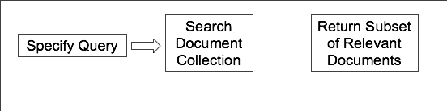
Document Ranking
Information retrieval
Information retrieval(IR) retrieves relevant documents in response to a query.
A query is examined and transformed into a vector of values to be compared with stored documents.

Slide 4
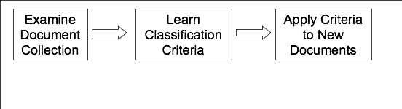
Document Classification
Prediction
The similar documents are retrieved based on their common properties.
Label will be assigned to a new document or a new query or document

Slide 5
IR vs prediction
In prediction we collect similar documents and we look at their labels
In IR we try to find out if the satisfactory response to the search query has been found out. The objective of search engine is to rank the documents and not to assign label
IR works with a global dictionary of words but in prediction we select the dictionary according to the labels

Slide 6
Similarity Measurement
The common measures used to examine how documents are similar and the output is a numerical measure of similarity:
Binary similarity
TF
TF-IDF

Slide 7
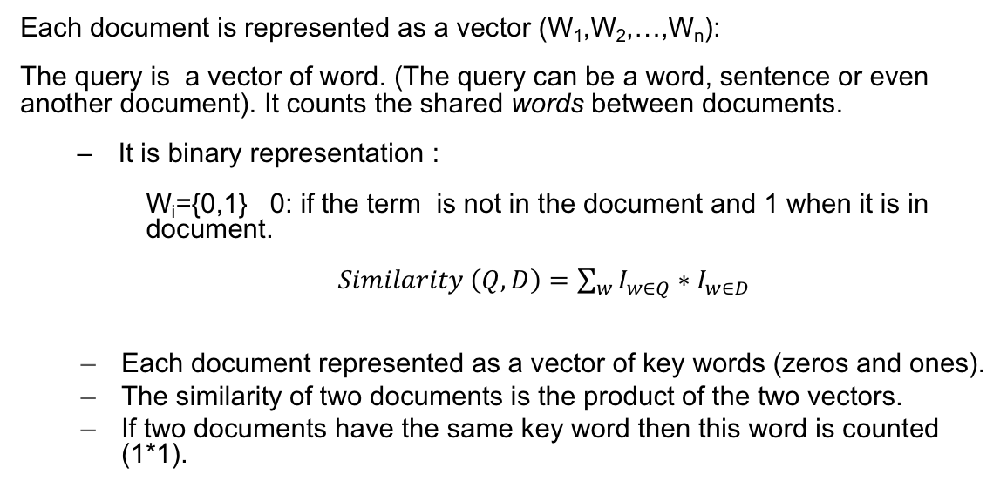
Binary similarity
Each document is represented as a vector (W₁,W₂,…,W_{n}):
The query is a vector of word. (The query can be a word, sentence or even another document). It counts the shared words between documents.
It is binary representation :
W_{i}={0,1} 0: if the term is not in the document and 1 when it is in document.
$Similarity \left(Q,D\right)=\sum_{w}{I_{w∈Q}∗I_{w∈D}}$
Each document represented as a vector of key words (zeros and ones).
The similarity of two documents is the product of the two vectors.
If two documents have the same key word then this word is counted (1*1).

Slide 8
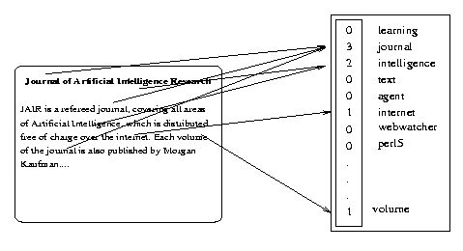
Similarity/Frequency
Represent each document by a high-dimensional vector in the space of words
0
1
0
1
0
0
1
0
0
0
0
.
.
.
1

Slide 9
Binary Algorithm
Binary algorithm looks at all words in the new document . For each document in the collection it counts if these words appear.
Pros:
The results of this measure are clearly intuitive
No one will question why a document was retrieved
The application of binary is more dictionary lookup.
Cons:
Binary is an exact search. either select or not select a document.
No weighting can be done on terms
Between two queries, we can’t specify which one is more important.
Every retrieved document are treated equally.

Slide 10
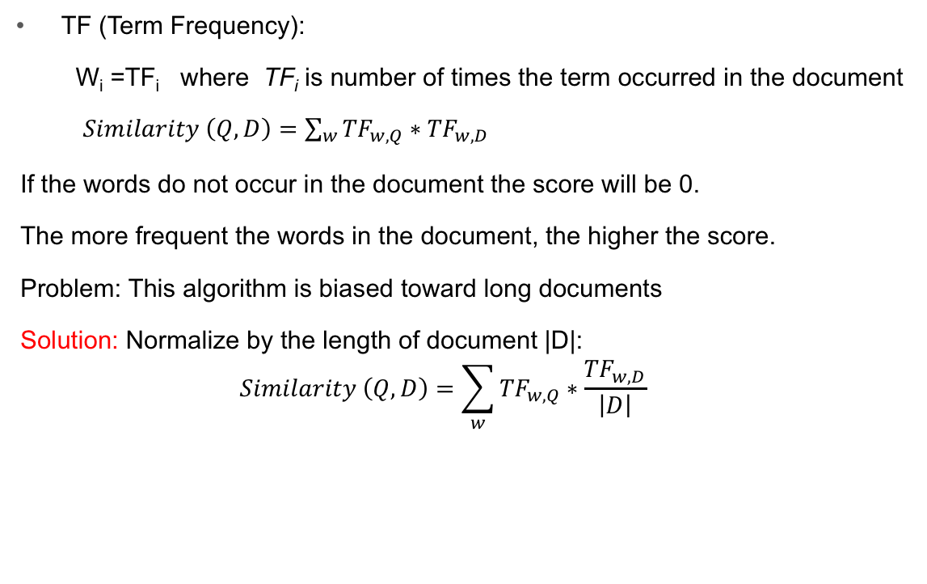
Term Frequency
TF (Term Frequency):
W_{i} =TF_{i} where TF_{i} is number of times the term occurred in the document
$Similarity \left(Q,D\right)=\sum_{w}{{TF}_{w,Q}∗{TF}_{w,D}}$
If the words do not occur in the document the score will be 0.
The more frequent the words in the document, the higher the score.
Problem: This algorithm is biased toward long documents
Solution: Normalize by the length of document |D|:
$$Similarity \left(Q,D\right)=\sum_{w}{{TF}_{w,Q}∗\frac{{TF}_{w,D}}{\left|D\right|}}$$

Slide 11
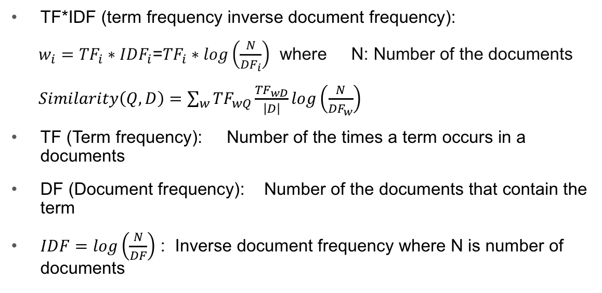
Term Freq. Inverse Doc. Freq.
TF*IDF (term frequency inverse document frequency):
$w_{i}={TF}_{i}∗{IDF}_{i}$=${TF}_{i}∗log\left(\frac{N}{{DF}_{i}}\right)$ where N: Number of the documents
$Similarity\left(Q,D\right)=\sum_{w}{{TF}_{wQ}\frac{{TF}_{wD}}{\left|D\right|}log\left(\frac{N}{{DF}_{w}}\right)}$
TF (Term frequency): Number of the times a term occurs in a documents
DF (Document frequency): Number of the documents that contain the term
$IDF=log\left(\frac{N}{DF}\right)$ : Inverse document frequency where N is number of documents

Slide 12
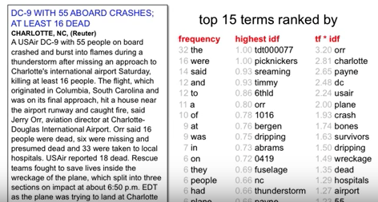
Term Freq. Inverse Doc. Freq.
Example:

Slide 13
Pros and Cons
The score increases with the number of the occurrences within a document.
The score increase with rarity of the word in the set of documents while it decrease with high frequency of the word in set of documents.
IDF is the bonus such as, if the word occurs in many documents, the bonus is small.
This measure better than Binary and TF because its discriminate among the weak and strong predictive words.

Slide 14
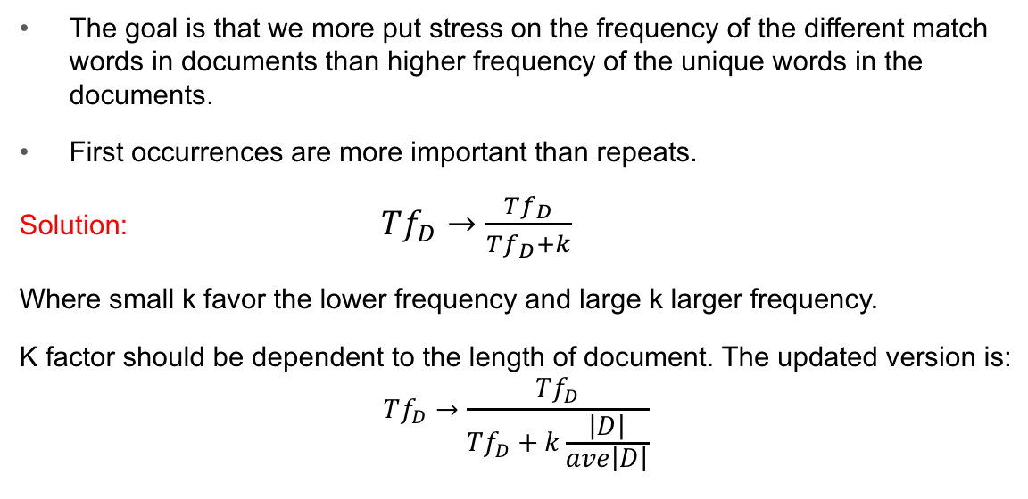
TFIDF correction coef.
The goal is that we more put stress on the frequency of the different match words in documents than higher frequency of the unique words in the documents.
First occurrences are more important than repeats.
Solution: $Tf_{D}→\frac{Tf_{D}}{Tf_{D}+k}$
Where small k favor the lower frequency and large k larger frequency.
K factor should be dependent to the length of document. The updated version is:
$$Tf_{D}→\frac{Tf_{D}}{Tf_{D}+k\frac{\left|D\right|}{ave\left|D\right|}}$$

Slide 15
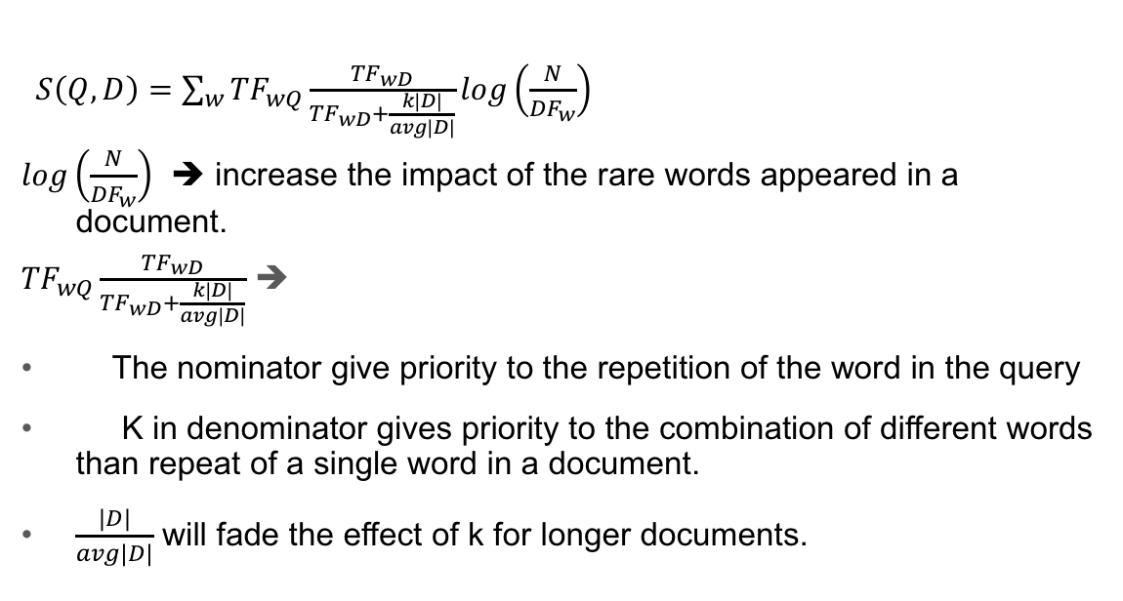
TFIDF-summary
$S\left(Q,D\right)=\sum_{w}{{TF}_{wQ}\frac{{TF}_{wD}}{{TF}_{wD}+\frac{k|D|}{avg|D|}}log\left(\frac{N}{{DF}_{w}}\right)}$
$log\left(\frac{N}{{DF}_{w}}\right)$ ➔ increase the impact of the rare words appeared in a document.
${TF}_{wQ}\frac{{TF}_{wD}}{{TF}_{wD}+\frac{k|D|}{avg|D|}}$ ➔
The nominator give priority to the repetition of the word in the query
K in denominator gives priority to the combination of different words than repeat of a single word in a document.
$\frac{|D|}{avg|D|}$ will fade the effect of k for longer documents.

Slide 16
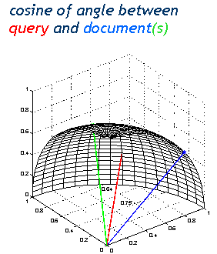

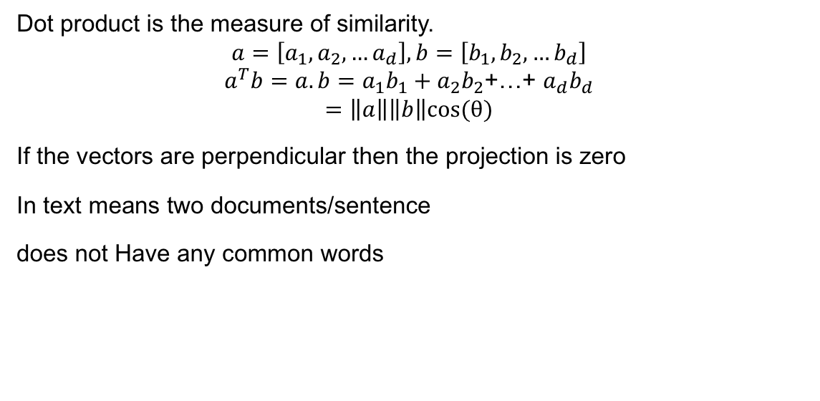
Similarity for Document to Document
Dot product is the measure of similarity.
$$a=\left[a_{1},a_{2},…a_{d}\right],b=\left[b_{1},b_{2},…b_{d}\right]$$
$$a^{T}b=a.b=a_{1}b_{1}+a_{2}b_{2}\text{+…+ }a_{d}b_{d}$$
$$=\left\|a\right\|\left\|b\right\|cos(θ)$$
If the vectors are perpendicular then the projection is zero
In text means two documents/sentence
does not Have any common words
$$θ$$

Slide 17
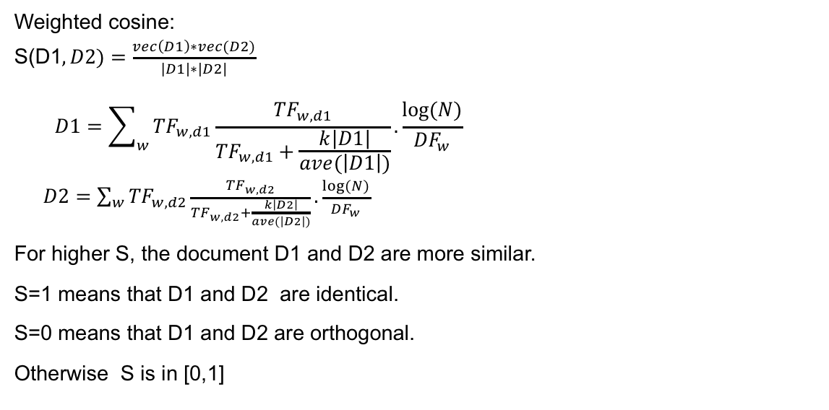
Weighted Cosine Similarity
Weighted cosine:
S(D1$,D2)=\frac{vec\left(D1\right)∗vec(D2)}{\left|D1\right|∗\left|D2\right|}$
$$D1=\sum_{w}{{TF}_{w,d1}\frac{{TF}_{w,d1}}{{TF}_{w,d1}+\frac{k\left|D1\right|}{ave(\left|D1\right|)}}.}\frac{log⁡(N)}{{DF}_{w}}$$
$D2=\sum_{w}{{TF}_{w,d2}\frac{{TF}_{w,d2}}{{TF}_{w,d2}+\frac{k\left|D2\right|}{ave(\left|D2\right|)}}.}\frac{log⁡(N)}{{DF}_{w}}$
For higher S, the document D1 and D2 are more similar.
S=1 means that D1 and D2 are identical.
S=0 means that D1 and D2 are orthogonal.
Otherwise S is in [0,1]

Slide 18
Text similarity
The goal is convert everything as a vector in the multi-dimentional space. This space can be words, sentence or document.
Step1:select the number of dimensions
Step2: project words/sentence/document to that space.
Step3:compare the vectors

Slide 19
cons
The vectorizing need the condition of orthogonality which means that the basis should be independent. How ever the words are correlated
Considering each word as a vector make huge n-dimentional matrix.
Projection on the basis does not respect the order of words.
John hits Mike
Mike hits John
John
Hits
Mike

Slide 20
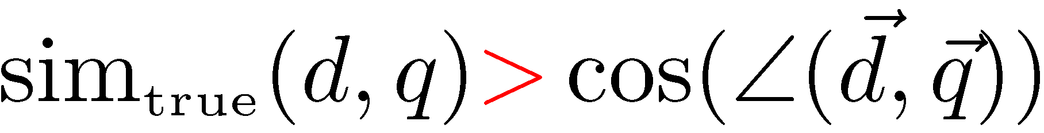
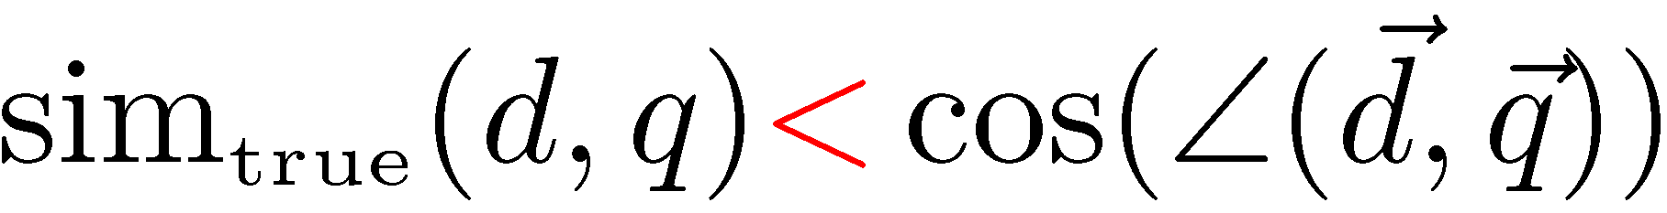
LSA
Synonyms: separate words that have the same meaning.
E.g. ‘car’ & ‘automobile’
They tend to reduce recall
Polysems: words with multiple meanings
E.g. ‘saturn’
They tend to reduce precision
→ In general: there is a disconnect between topics and words

Slide 21
Solution
Term-document matrices are very large But the number of topics that people talk about is small (in some sense)
Clothes, movies, politics, …
Can we represent the term-document space by a lower dimensional latent space?

Slide 22
LSA
LSA aims to discover something about the meaning behind the words; about the topics in the documents.
What is the difference between topics and words?
Words are observable
Topics are not. They are latent.

Slide 23

Linear Algebra review of 101-course
Eigenvectors (for a square m⋅m matrix S)
eigenvector
eigenvalue

Slide 24
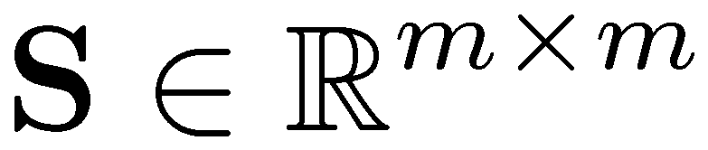
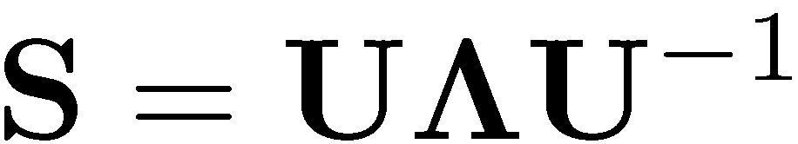
Linear Algebra review of 101-course
Let be a square matrix with m linearly independent eigenvectors (a “non-defective” matrix). There exists an eigen decomposition:
This is a mth order equation in λ which can have at most m distinct solutions (roots of the characteristic)
If is a symmetric matrix then there exists a (unique) eigen decomposition where Q is orthogonal (Q⁻¹= Q^{T})

Slide 25
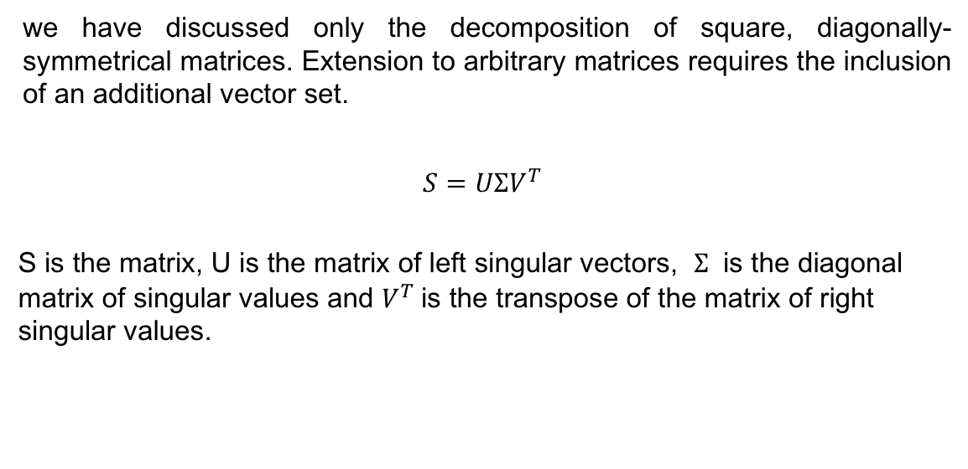
LSA-SVD
we have discussed only the decomposition of square, diagonally-symmetrical matrices. Extension to arbitrary matrices requires the inclusion of an additional vector set.
$$S=UΣV^{T}$$
S is the matrix, U is the matrix of left singular vectors, $Σ$ is the diagonal matrix of singular values and $V^{T}$is the transpose of the matrix of right singular values.

Slide 26
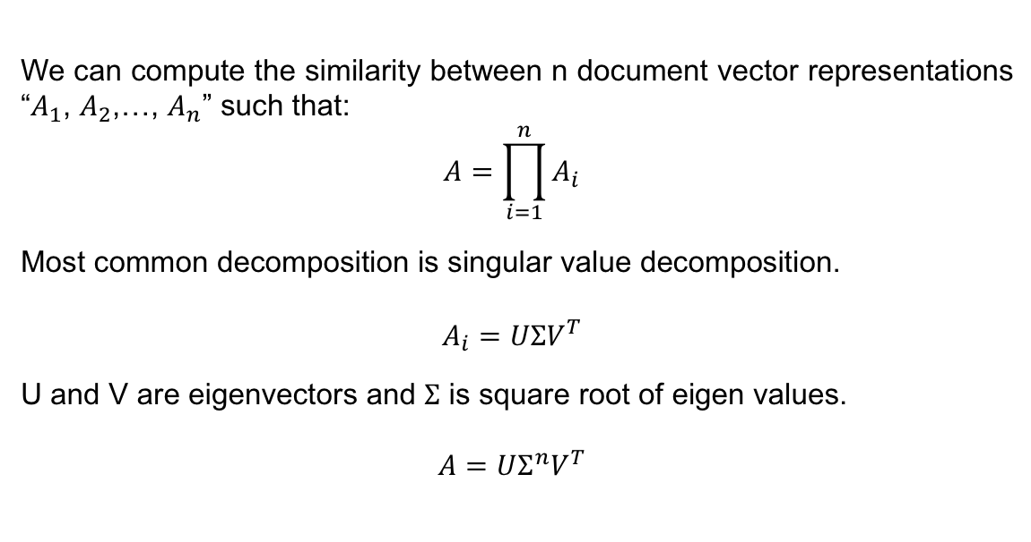
LSA-SVD
We can compute the similarity between n document vector representations “$A_{1}$, $A_{2}$,…, $A_{n}$” such that:
$$A=\prod_{i=1}^{n}{A_{i}}$$
Most common decomposition is singular value decomposition.
$$A_{i}=UΣV^{T}$$
U and V are eigenvectors and $Σ$ is square root of eigen values.
$$A=UΣ^{n}V^{T}$$

Slide 27
Similarity
A_{[n x m]} = U_{[n x r]} Λ _{[ r x r]} (V_{[m x r]})^{T}
A: n x m matrix (e.g., n documents, m terms)
U: n x r matrix (n documents, r concepts)
Λ: r x r diagonal matrix (strength of each ‘concept’) (r: rank of the matrix)- singular value are positive, and sorted in decreasing order
V: m x r matrix (m terms, r concepts)

Slide 28
LSA
Latent Semantic Analysis is a technique for creating a vector representation of a document. Dot product is the measure of similarity.
The first step in LSA is actually a separate algorithm which is TF or in more accurate form of TFIDF
LSA takes tf-idf one step further by use SVD to perform dimensionality reduction on the tf-idf vectors.

Slide 29
Similarity
We decompose the document-term matrix A into three matrices
The V matrix refers to terms
and U matrix refers to documents

Slide 30
Similarity
Example
CS-concept
data
retrieval
lung
MD-concept
inf.
brain
CS
=
x
x
MD

