Slide 1
Deep Learning
Week 9-Word embedding

Slide 2
Objective
Word Embedding
One-hot vectors
Co-occurrence Matrix
SVD
Word2Vec
Skip-gram
CBOW
Negative Sampling
Gloves
Advance topics in neural network
Image caption
Semantic segmentation

Slide 3
Introduction
Machin learning and deep learning can not accept text and we have to convert it to numeric presentation.
Document Representation:
TF
TFIDF, however the method does not consider the relationship between words.
Word Representation:
Word embedding (word2vec) embed the words to the high dimensional vector representation.
Word2Vec algorithm needs large corpus such as Wikipedia

Slide 4
One-hot Vectors
Words as discrete units.
Represent as one-hot vectors
Example Let our lexicon be: {king, queen, man, woman}
king [1, 0, 0, 0]
queen [0, 1, 0, 0]
man [0, 0, 1, 0]
woman [0, 0, 0, 1]
What would the dot product of the king vector and queen vector be?

Slide 5
One-hot vs. Embedding
Traditional Method - Bag of Words Model | Word Embeddings
Uses one hot encoding Each word in the vocabulary is represented by one bit position in a HUGE vector. For example, if we have a vocabulary of 10000 words, and “Hello” is the 4th word in the dictionary, it would be represented by: 0 0 0 1 0 0 . . . . . . . 0 0 0 0 Context information is not utilized | Stores each word in as a point in space, where it is represented by a vector of fixed number of dimensions (generally 300) Unsupervised, built just by reading huge corpus For example, “Hello” might be represented as : [0.4, -0.11, 0.55, 0.3 . . . 0.1, 0.02] Dimensions are basically projections along different axes, more of a mathematical concept.

Slide 6
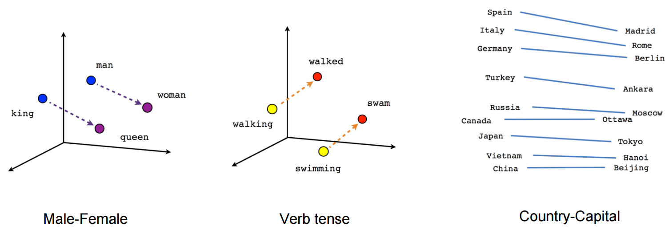
Embedding

Slide 7
How word embedding work?
Text Similarity:
Word Embedding is based on the concept of similar context have similar embedding or Similar words occur in similar contexts. They are exchangeable.
Vec(dog bites man)=(0.2,-0.3,1.5)
Sentence similar in meaning should be close to this embedding.

Slide 8
Word embedding Applications
Machine Translation
Part-of-Speech and Named Entity Recognition
Relation Extraction
Sentiment Analysis

Slide 9
Word embedding Methods
Co-occurrence Matrix
SVD
word2vec (Google)
Global Vector Representations (GloVe) (Stanford)

Slide 10
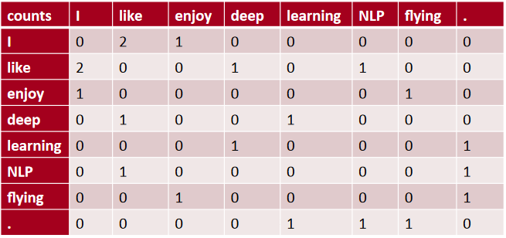
Co-occurance Matrix
Corpus = {“I like deep learning”
“I like NLP”
“I enjoy flying”}
Context = previous word and next word

Slide 11
Co-occurance Matrix
increase in size with vocabulary
very high dimensional
sparsity issues
Goal:
Store most of the information in a fixed, small number of dimensions: a dense vector.

Slide 12
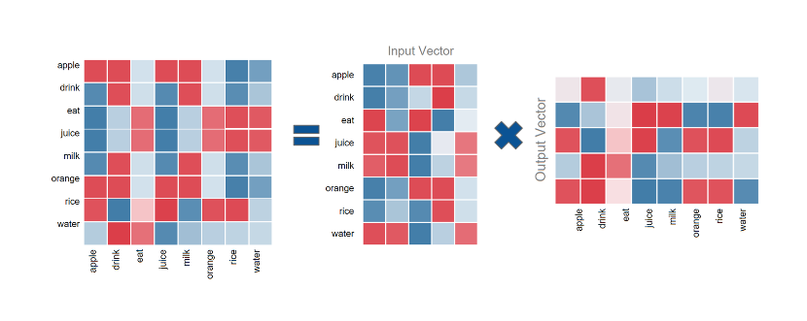
Singular Value Decomposition

Slide 13
SVD
The dimensions of the matrix change very often (new words are added very frequently and corpus changes in size).
The matrix is extremely sparse since most words do not co-occur.

Slide 14
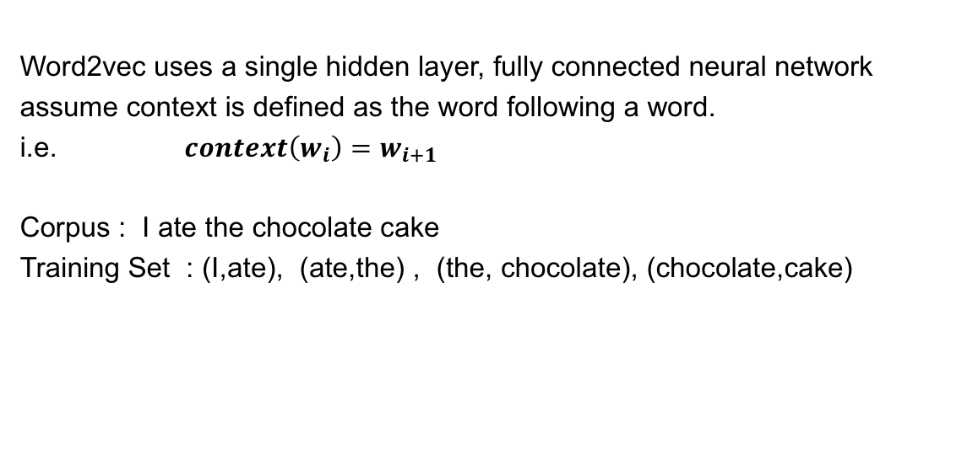
Word2Vec
Word2vec uses a single hidden layer, fully connected neural network
assume context is defined as the word following a word.
i.e. $context\left(w_{i}\right)=w_{i+1}$
Corpus : I ate the chocolate cake
Training Set : (I,ate), (ate,the) , (the, chocolate), (chocolate,cake)

Slide 15
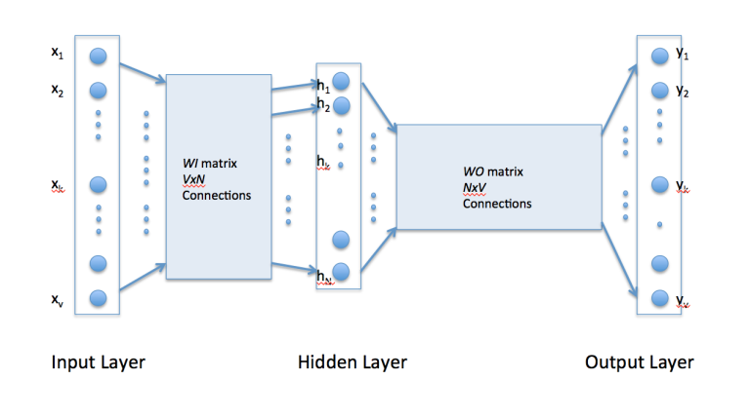
Word2Vec
The input layer is set to have as many neurons as there are words in the vocabulary for training.
The hidden layer size is set to the dimensionality of the resulting word vectors.
The size of the output layer is same as the input layer.

Slide 16
Word2Vec
Example:
“the dog saw a cat”, “the dog chased the cat”, “the cat climbed a tree”
For this example, our neural network will have eight input neurons and eight output neurons. Let us assume that we decide to use three neurons in the hidden layer.
This means that WI and WO will be 8×3and 3×8 matrices, respectively.

Slide 17
CBOW
In the continuous bag of words model, context is represented by multiple words for a given target words.
“the cat climbed a tree”
we could use “cat” and “tree” as context words for “climbed” as the target word.
The goal is to predict the center word=set

Slide 18
Architecture for the CBOW model.
inputs are the context words which are passed to an embedding layer (initialized with random weights).
The word embeddings are propagated to a layer where we average out the word embeddings (we don’t really consider the order or sequence in the context words when averaged)
At last we pass this averaged context embedding to a dense softmax layer which predicts our target word.

Slide 19
CBOW
E.g. “The cat sat on floor”
Window size = 2

Slide 20
CBOW Implementation
Build the corpus vocabulary
Build a CBOW (context, target) generator
Build the CBOW model architecture
Train the Model
Get Word Embeddings

Slide 21
CBOW
Context (X): ['old','testament','james','bible'] -> Target (Y): king
Context (X): ['first','book','called','genesis'] -> Target(Y): moses Context(X):['beginning','god','heaven','earth'] -> Target(Y):created
Context (X):['earth','without','void','darkness'] -> Target(Y): form
Context (X): ['without','form','darkness','upon'] -> Target(Y): void
Context (X): ['form', 'void', 'upon', 'face'] -> Target(Y): darkness
Context (X): ['void', 'darkness', 'face', 'deep'] -> Target(Y): upon
Context (X): ['spirit', 'god', 'upon', 'face'] -> Target (Y): moved
Context (X): ['god', 'moved', 'face', 'waters'] -> Target (Y): upon
Context (X): ['god', 'said', 'light', 'light'] -> Target (Y): let
Context (X): ['god', 'saw', 'good', 'god'] -> Target (Y): light.

Slide 22
Skip-Gram
Skip-gram model reverses the use of target and context words. In this case, the target word is fed at the input, the hidden layer remains the same, and the output layer of the neural network is replicated multiple times to accommodate the chosen number of context words.
Taking the example of “cat” and “tree” as target words and “climbed” as the context word,

Slide 23
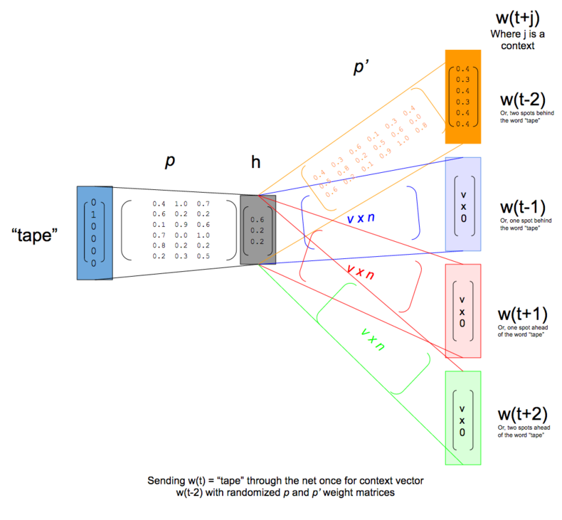
Skip-Gram

Slide 24
Optimization methods for word embedding
Softmax issue:
The computational complexity of this algorithm computed in a straightforward fashion is the size of our vocabulary, O(V).
Solution:
Hierarchical softmax
Negative sampling

Slide 25
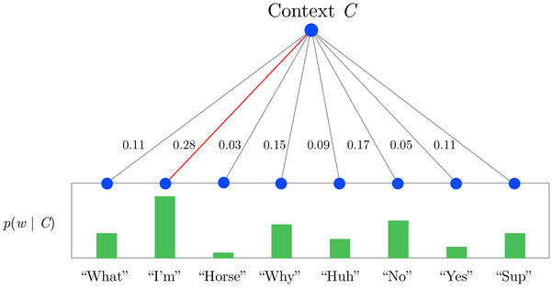
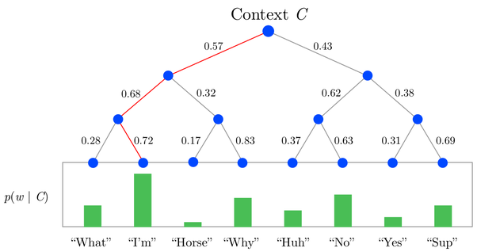
Optimization
SoftMax
Hierarchical SoftMax

Slide 26
Negative Sampling
Negative sampling addresses this by having each training sample only modify a small percentage of the weights, rather than all of them.
Assume that the output layer of the model has a weight matrix that’s 300 x 10,000. Updating the weights for just positive word, plus the weights for few (e.g 5) other words that we want to output 0. That’s a total of 6 output neurons, and 1,800 weight values total. That’s only 0.06% of the 3M weights in the output layer
With negative sampling, we select just a small number of “negative” words (let’s say 5) to update the weights for.
selecting 5-20 words works well for smaller datasets, and you can get away with only 2-5 words for large datasets

Slide 27
Transfer learning in word embedding
Learn word embedding from a larger external corpus such as fast text
download pre-trained embedding and transfer it to the new smaller training set.
It can be fine tuned by new data

Slide 28
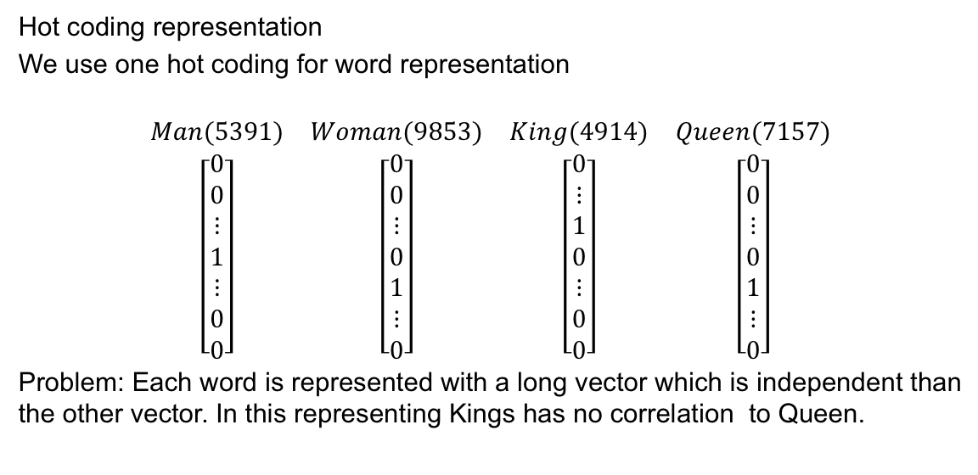
Transfer Learning
Hot coding representation
We use one hot coding for word representation
$$\begin{matrix}\begin{matrix}Man(5391) & Woman(9853) \\ \left[\begin{aligned}0 \\ 0 \\ ⋮ \\ 1 \\ ⋮ \\ 0 \\ 0\end{aligned}\right] & \left[\begin{aligned}0 \\ 0 \\ ⋮ \\ 0 \\ 1 \\ ⋮ \\ 0\end{aligned}\right]\end{matrix} & \begin{matrix}King(4914) & Queen(7157) \\ \left[\begin{aligned}0 \\ ⋮ \\ 1 \\ 0 \\ ⋮ \\ 0 \\ 0\end{aligned}\right] & \left[\begin{aligned}0 \\ 0 \\ ⋮ \\ 0 \\ 1 \\ ⋮ \\ 0\end{aligned}\right]\end{matrix}\end{matrix}$$
Problem: Each word is represented with a long vector which is independent than the other vector. In this representing Kings has no correlation to Queen.
Length of vocabulary

Slide 29
Word representation
Word embedding.
In this representation we can easy find out the correlation between Man and king or woman and queen
 | Man (5391) | Woman (9853) | King (4914) | Queen (7157) | Apple (456) | Orange (6257)
Gender | -1 | 1 | -0.95 | 0.97 | 0.00 | 0.01
Royal | 0.01 | 0.02 | 0.95 | 0.92 | -0.01 | 0.00
… | … | … | … | … | … | …
Food | 0.04 | 0.01 | 0.02 | 0.01 | 0.95 | 0.97

Slide 30
Word representation
Word embedding can be visualized on the n-diagram matrix where the n is number of the features.
The association for each words can be
found using k-neighbor method.
Man
King
Woman
Queen

Slide 31

Word embedding-Analogy
Word embedding is powerful in analogy. Where:
$$e_{man}−e_{woman}≈e_{king}−e_{Queen}$$
 | Man (5391) | Woman (9853) | King (4914) | Queen (7157)
Gender | -1 | 1 | -0.95 | 0.97
Royal | 0.01 | 0.02 | 0.95 | 0.92
… | … | … | … | …
Hobby | 0.3 | 0.4 | 0.8 | 0.6
Man
King
Woman
Queen

Slide 32


Word embedding-similarity
$$similarity(\overset{U}{\overbrace{E_{woman}+E_{king}−{ E}_{man}}},\overset{V}{\overbrace{{ E}_{Queen}}})$$
$$Cosine similarity(U,V)=\frac{U^{T}V}{\left\|U\right\|.\left\|V\right\|}$$
$$θ$$

Slide 33

Embedding-Matrix
$$\begin{matrix}\begin{matrix}⋯ & king & ⋯\end{matrix} & \begin{matrix}O_{4914} & E_{4914}\end{matrix} \\ \left[\begin{matrix}\begin{matrix}⋯ & e_{4914,1}\end{matrix} & ⋯ \\ \begin{matrix}\begin{matrix}\begin{matrix}⋮ \\ ⋮ \\ ⋮\end{matrix} \\ ⋯\end{matrix} & \begin{matrix}\begin{matrix}e_{4914,2} \\ ⋮ \\ e_{4914,n−1}\end{matrix} \\ e_{4914,n}\end{matrix}\end{matrix} & \begin{matrix}\begin{matrix}⋮ \\ ⋮ \\ ⋮\end{matrix} \\ ⋯\end{matrix}\end{matrix}\right]∗ & \left[\begin{matrix}\begin{matrix}0 \\ \begin{matrix}0 \\ ⋮\end{matrix}\end{matrix} \\ 1 \\ \begin{matrix}\begin{matrix}⋮ \\ 0\end{matrix} \\ 0\end{matrix}\end{matrix}\right]=\left[\begin{matrix}\begin{matrix}e_{4914,1} \\ e_{4914,2}\end{matrix} \\ ⋮ \\ \begin{matrix}e_{4914,n−1} \\ e_{4914,n}\end{matrix}\end{matrix}\right]\end{matrix}$$
Feature size
Corpus size

Slide 34

Embedding-Matrix
I want to drink orange ---------.
$$\begin{matrix}\begin{matrix}\begin{matrix}\begin{matrix}I & → & O_{4343}\end{matrix} \\ \begin{matrix}want & → & O_{9665}\end{matrix}\end{matrix} \\ \begin{matrix}to & → & O_{6754}\end{matrix} \\ \begin{matrix}\begin{matrix}drink & → & O_{2356}\end{matrix} \\ \begin{matrix}orange & → & O_{0734}\end{matrix}\end{matrix}\end{matrix} & \begin{matrix} & & \end{matrix} & \begin{matrix}\begin{matrix}\begin{matrix}→ & E_{4343}\end{matrix} \\ \begin{matrix}→ & E_{9665}\end{matrix}\end{matrix} \\ \begin{matrix}→ & E_{6754}\end{matrix} \\ \begin{matrix}\begin{matrix}→ & E_{2356}\end{matrix} \\ \begin{matrix}→ & E_{0734}\end{matrix}\end{matrix}\end{matrix}\end{matrix}$$
Embedding Matrix
Neural network
Softmax
Loss Calculation
W1,b1

Slide 35
Global vector words representation
Problem:
More computationally efficient (soft max is computationally difficult)
Idea:
Uses ratios of co-occurrence probabilities, rather than the co-occurrence probabilities themselves
Two major method in this domain are:
1-Global matrix factorization
2-Local context window methods

Slide 36
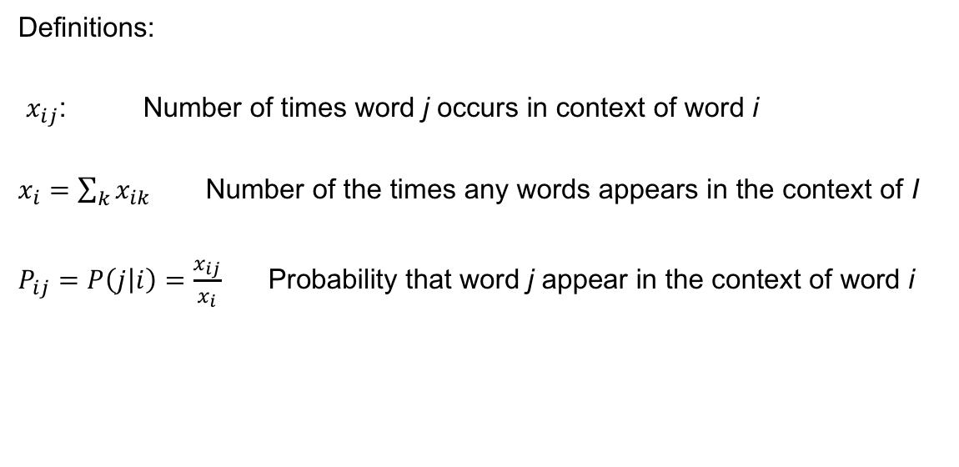
Global vector words representation
Definitions:
$x_{ij}$: Number of times word j occurs in context of word i
$x_{i}=\sum_{k}{x_{ik}}$ Number of the times any words appears in the context of I
$P_{ij}=P\left(j | i\right)=\frac{x_{ij}}{x_{i}}$ Probability that word j appear in the context of word i

Slide 37
Co- occurrence probability
Selected co-occurrence probabilities from a 6 billion token corpus :
For words k related to i but not j P_{ik} /P_{jk} is very large
For words k related to j but not i P_{ik} /P_{jk} is very small
For word k related to i,j P_{ik} /P_{jk} is close to 1
Probabilities and Ratios | k=solid | k=gas | k=water | k=fashion
P(k|ice) | 1.9x10⁻⁴ | 6.6x10⁻⁵ | 3.0x10⁻³ | 1.7x10⁻⁵
P(k|steam) | 2.2x10⁻⁵ | 7.8x10⁻⁴ | 2.2x10⁻³ | 1.8x10⁻⁵
P(k|ice)/P(k|steam) | 8.9 | 8.5x10⁻² | 1.36 | 0.96

Slide 38
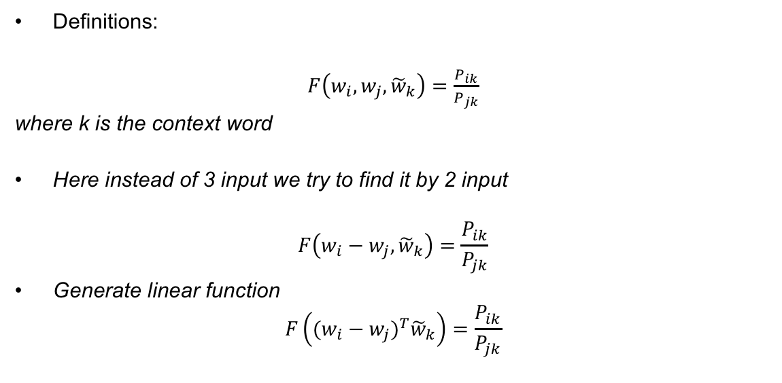
Model Design
Definitions:
$F\left(w_{i},w_{j},{\tilde{w}}_{k}\right)=\frac{P_{ik}}{P_{jk}}$
where k is the context word
Here instead of 3 input we try to find it by 2 input
$$F\left(w_{i}−w_{j},{\tilde{w}}_{k}\right)=\frac{P_{ik}}{P_{jk}}$$
Generate linear function
$$F\left({(w_{i}−w_{j})}^{T}{\tilde{w}}_{k}\right)=\frac{P_{ik}}{P_{jk}}$$

Slide 39
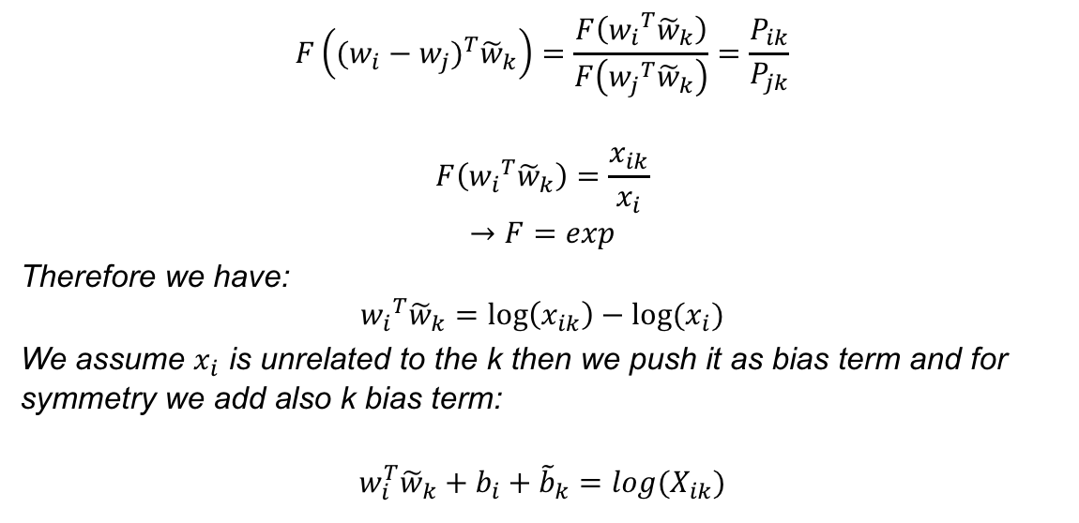
Model Design
$$F\left({(w_{i}−w_{j})}^{T}{\tilde{w}}_{k}\right)=\frac{F\left({w_{i}}^{T}{\tilde{w}}_{k}\right)}{F\left({w_{j}}^{T}{\tilde{w}}_{k}\right)}=\frac{P_{ik}}{P_{jk}}$$
$$F\left({w_{i}}^{T}{\tilde{w}}_{k}\right)=\frac{x_{ik}}{x_{i}}$$
$$→F=exp$$
Therefore we have:
$${w_{i}}^{T}{\tilde{w}}_{k}=\log\left(x_{ik}\right)−log⁡(x_{i})$$
We assume $x_{i}$ is unrelated to the k then we push it as bias term and for symmetry we add also k bias term:
$$w_{i}^{T}{\tilde{w}}_{k}+b_{i}+{\tilde{b}}_{k}=log{(X}_{ik})$$

Slide 40
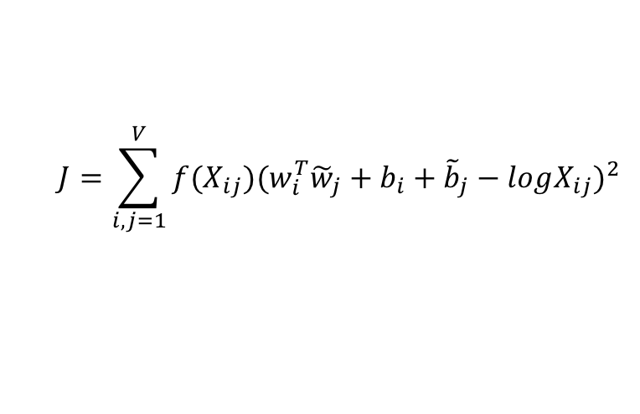

Model Design
To solve the impact of the large co-occurrence we use following weight in our function.
$$f\left(x\right)=\left\{\begin{matrix}0 & x=0 \\ {(\frac{x}{100})}^{3/4} & ≤100 \\ 1 & >100\end{matrix}\right.$$
Final model
$$J=\sum_{i,j=1}^{V}{f(X_{ij}){(w_{i}^{T}{\tilde{w}}_{j}+b_{i}+{\tilde{b}}_{j}−logX_{ij})}^{2}}$$

Slide 41
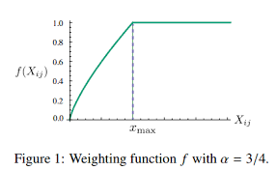
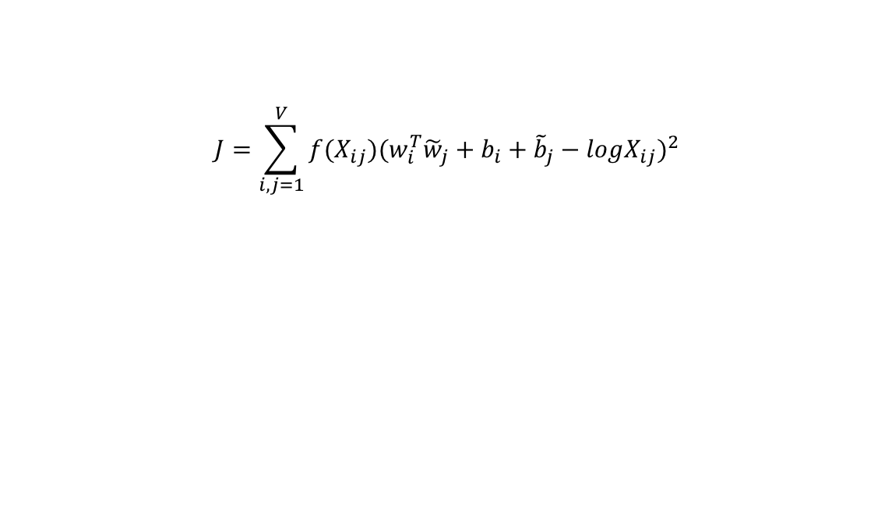
Global cost function
$$J=\sum_{i,j=1}^{V}{f(X_{ij}){(w_{i}^{T}{\tilde{w}}_{j}+b_{i}+{\tilde{b}}_{j}−logX_{ij})}^{2}}$$

