Slide 1

SONG ANALYSIS
NOOR HABIB | LEI SABARRE | MAVERICK SANCHEZ | SAM STRUTHERS
Notes:
Noor Habib
We wanted to have fun!
Music was a fun topic to analyze with a lot of tools and sources available.
Wanted to see more stats about songs and what goes behind the features of a song that contribute to the song’s statistics and predict how audiences will respond to a song without having heard it.

Slide 2
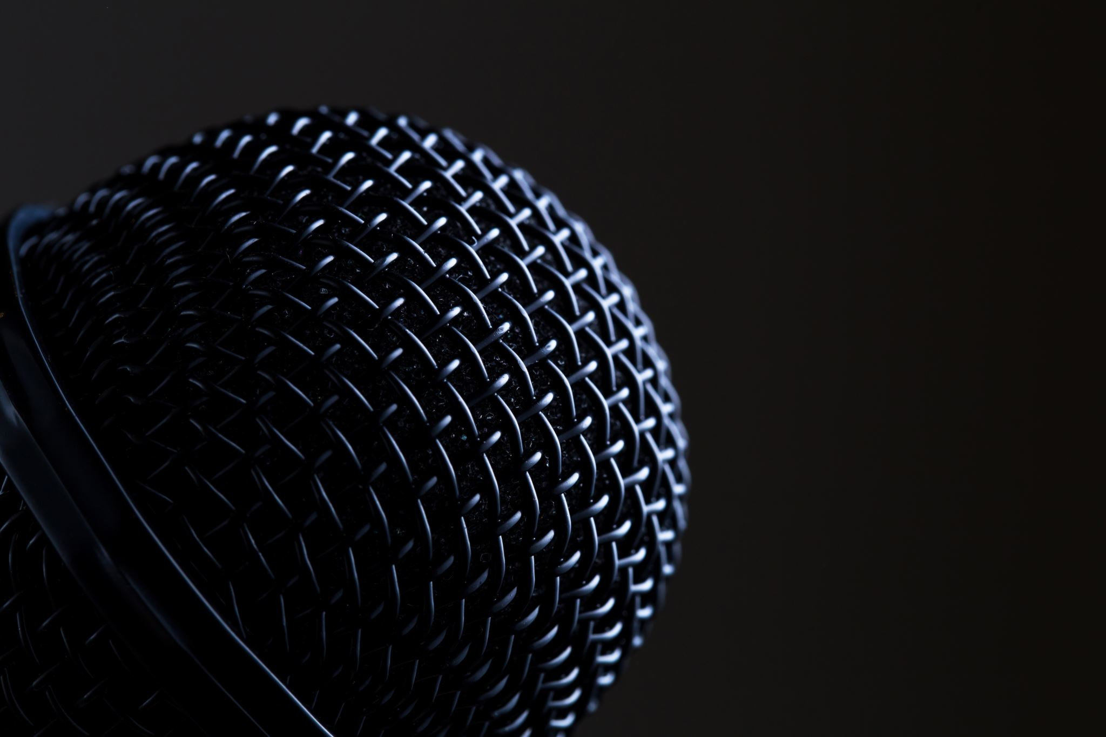
Heroku App & Data Sources
Song Search
Auto-complete suggestions
Song & Album Info
Discography – LyricsGenius
Album Cover – LyricsGenius
Lyrics – LyricsGenius
Training Data – Spotify, LastFM, Million Songs
Song Sample – Spotify
Notes:
Mav Sanchez

Slide 3
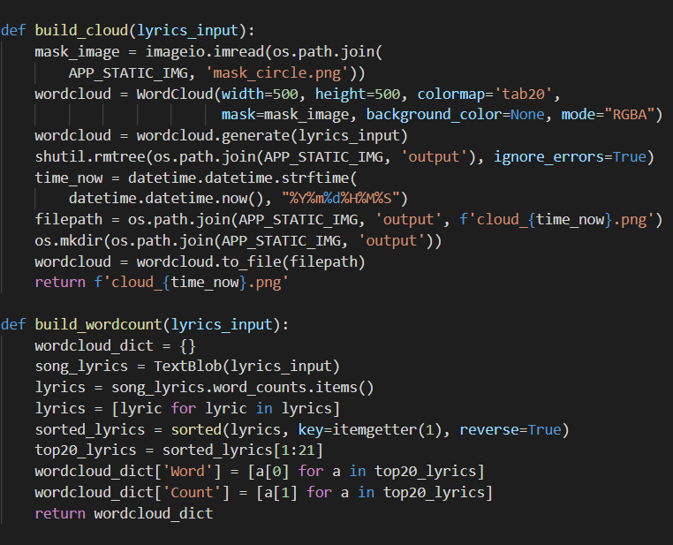
LYRIC NLP
Lyric Handling
Lowercase
Stopwords
Explicit Content
Stemming – Snowball
Collocation of words
TextBlob
WordCloud
Plotly BarChart
Notes:
Noor Habib
Lowercased
Filtered out stopwords – not enough for the bargraph but not applied for the wordcloud
Filtered out explicit content
Stemming words – ensured the root word is what was displayed. Conjugation didn’t play a factor
Found textblob was naturally collocating words – turned off this feature

Slide 4
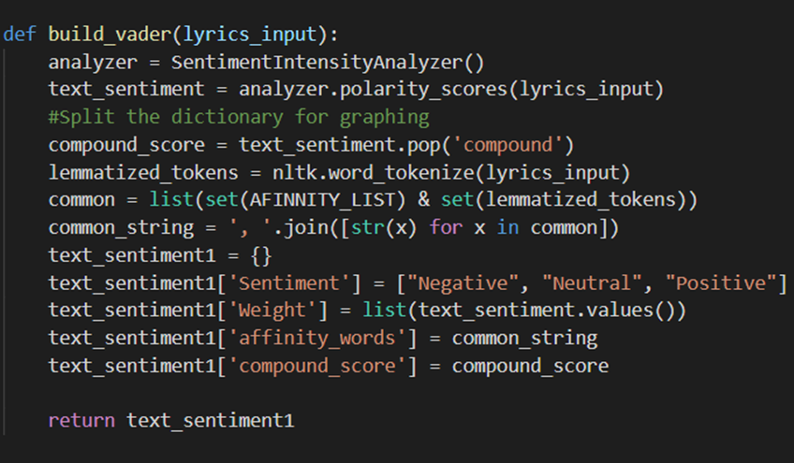
LYRIC SENTIMENT ANALYSIS
Use of natural language processing/computation analysis to determine understand tone or emotion behind text
Lexical-based approaches using pre-built libraries such as: TextBlob, VADER, AFINN, NLTK
VADER - Valence Aware Dictionary and SEntiment Reasoner
Positive/Negative/Neutral
Compound score
AFinn - lexicon rated for valence
Notes:
Lei Sabarre

Slide 5
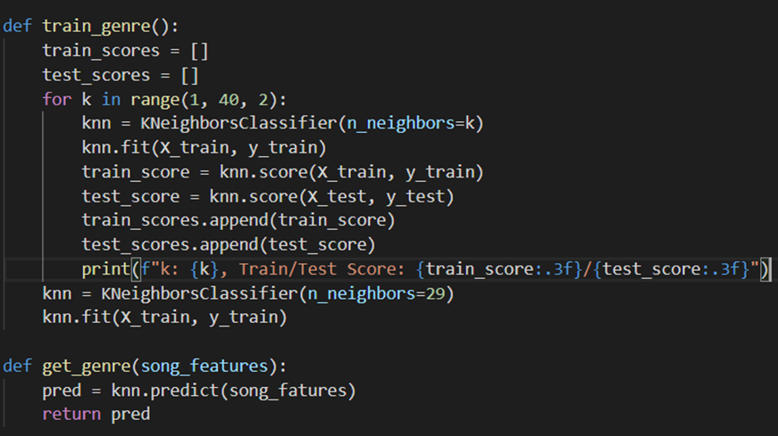
LYRIC GENRE TRAINING & PREDICTIONS
Pulled spotify audio analysis on songs with Genre to create Dataset
Ran KNN Machine learning to begin classifications of the Data
Using spotify song id we pull audio data from spotify api and have knn predict the Genre
KNN > most accurate model
30%-32% Accuracy
LAST.FM user tags, using their API, that have been written by users as a comparison to the predicted genre
Notes:
Sam Struthers

Slide 6
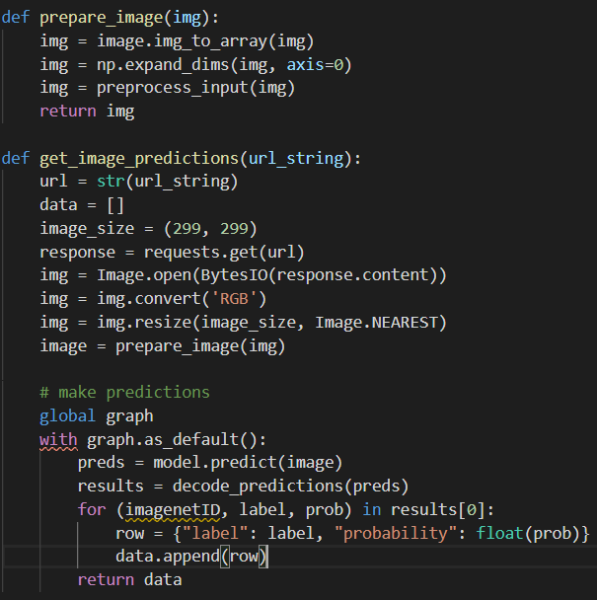
ALBUM COVER IMAGE ANALYSIS
Uses Keras Xception ImageNet to classify image and get probability level
Image passed is from the song's cover art pulled from Genius API
Notes:
Mav Sanchez

Slide 7

THANK YOU
DEMO_APP

