Slide 1

SONG ANALYSIS
NOOR HABIB | LEI SABARRE | MAVERICK SANCHEZ | SAM STRUTHERS

Slide 2
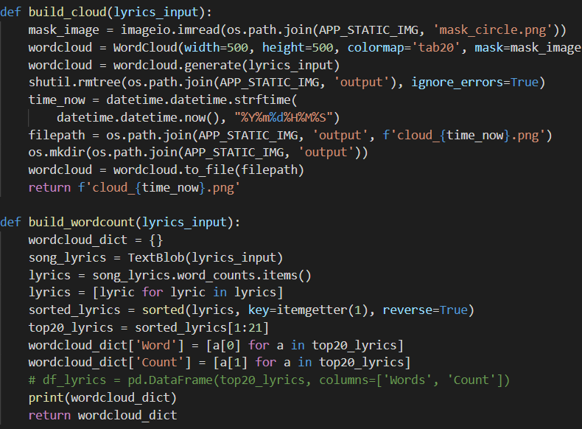
TEXTBLOB
Stopwords
Explicit content
Textblob – timestamp png

Slide 3
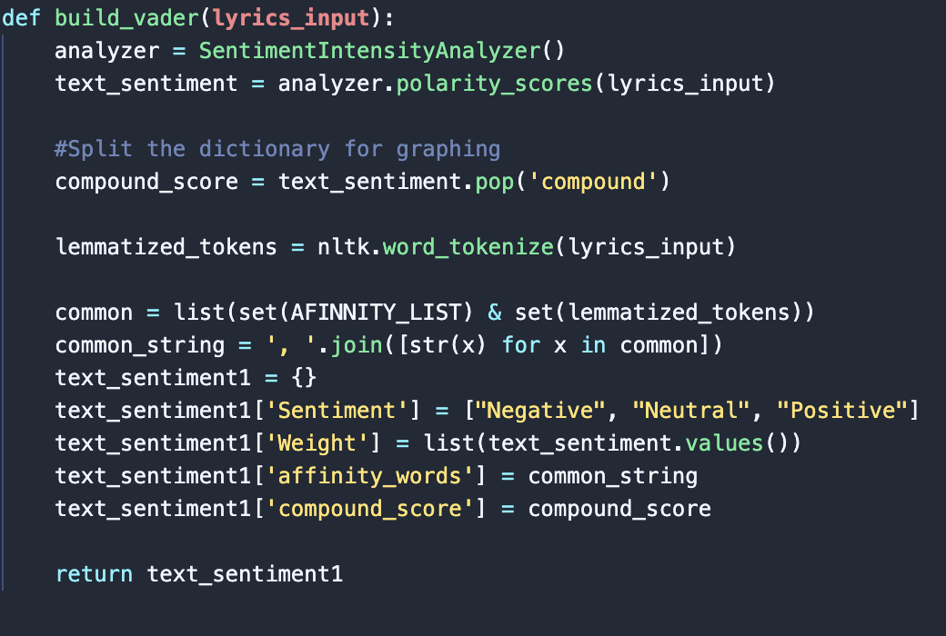
SENTIMENT ANALYSIS
Use of natural language processing/computation analysis to determine understand tone or emotion behind text
Lexical-based approaches using pre-built libraries such as: TextBlob, VADER, AFINN, NLTK
VADER - Valence Aware Dictionary and SEntiment Reasoner
Positive/Negative/Neutral
Compound score
AFinn - lexicon rated for valence

Slide 4

THANK YOU
DEMO_APP

Slide 5



OTHER SLIDE FORMAT OPTION
Network
Satellite
Link

Slide 6

OTHER SLIDE FORMAT OPTION
Cloud
Local
Hybrid

