Slide 1

Song Analysis
Noor Habib | Lei Sabarre | Maverick Sanchez | Sam Struthers

Slide 2
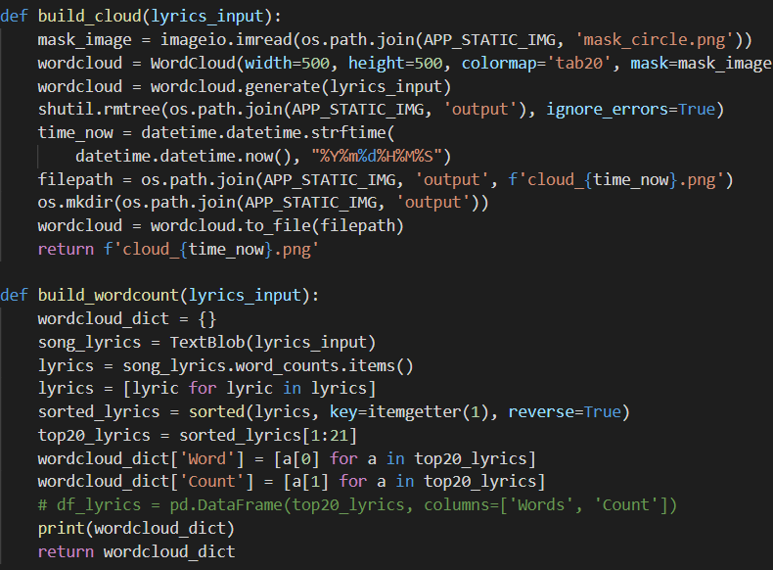
WordCloud
Stopwords
Explicit content
Textblob vs d3

Slide 3

Thank You
Demo_App

Slide 4
OTHER SLIDE format option
Network
Satellite
Link

Slide 5

OTHER SLIDE format option
Cloud
Local
Hybrid

