Slide 1

Pong Project
Nguyen Viet Hoang Nam_ITITIU19162
Huynh Duc Phat_ITITIU19177

Slide 2
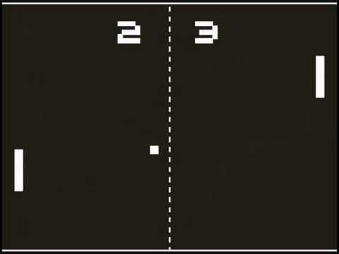
In 1972, Atari introduced Pong to the arcades and It became the first truly successful commercial arcade video game.

Slide 3
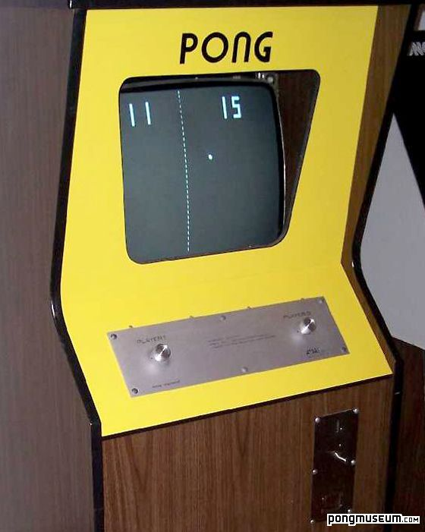
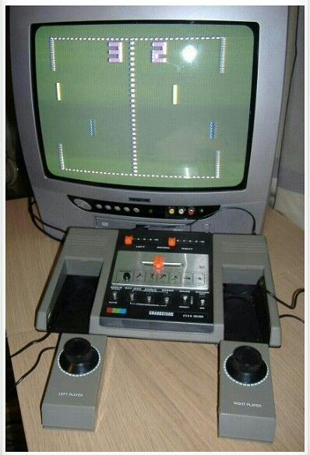
Pong is a 2-D sports game that simulates table tennis .The player controls an in-game paddle by moving it vertically across the left or right side of the screen.
The player will earn 1 point when their opponent let the ball hit their backwall.

Slide 4
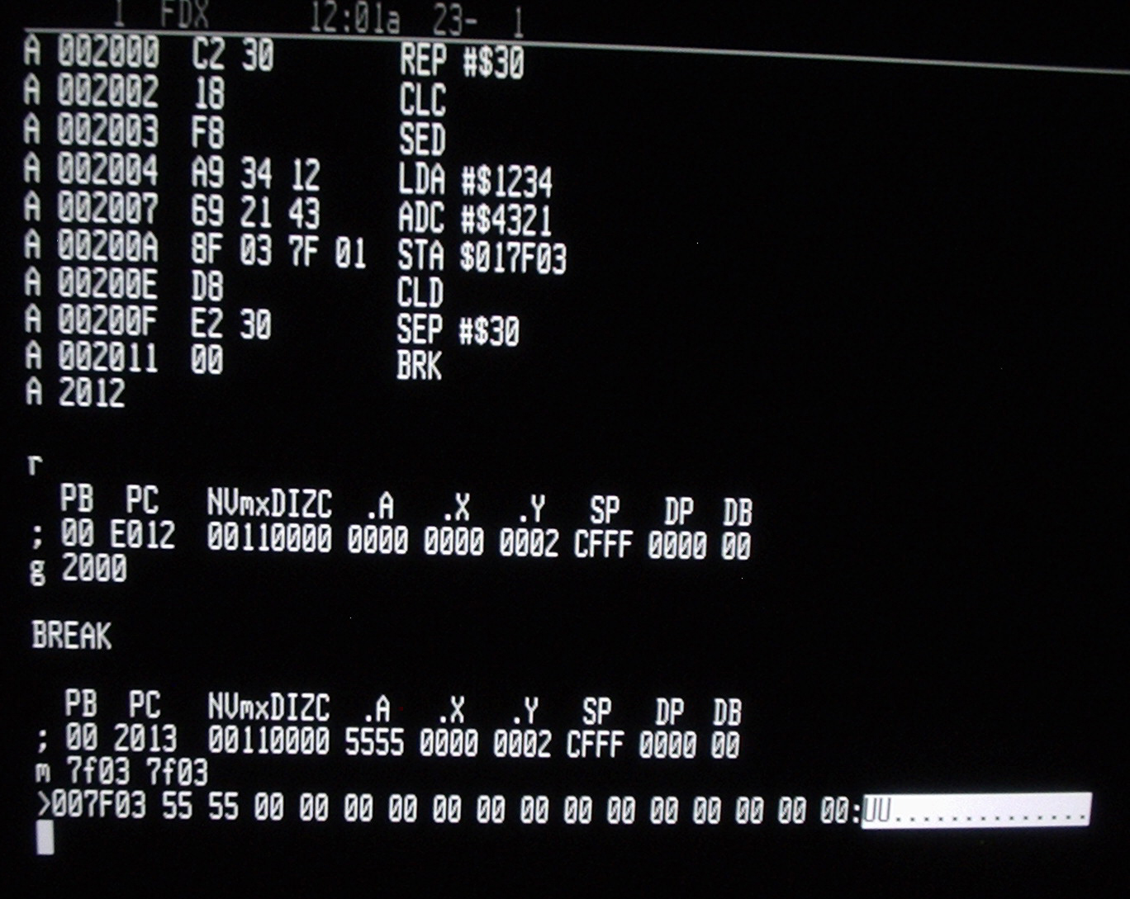
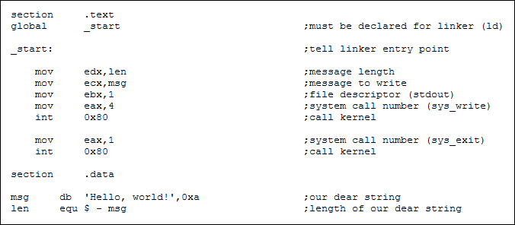
This game was originally programmed by using Assembly language code or raw machine code

Slide 5
Game classes
Our project have 7 separate class

Slide 6
The Window class:
The Game class:
It contains all the game objects and uses seperated thread to manage, update the game physics.
It has JFrame and adds the Game Canvas to it.

Slide 7
The Ball class:
Properties for the ball to bounce.
The Paddle class:
Properties for 2 paddles to move and properties for the Game score.

Slide 8
The KeyInput class:
It takes intput from the keyboards to make both paddles moving.
The Menu class:
It will aske the user "Play" or "Quit" at the start of the game.
The Test class:
It will run the Game

Slide 9
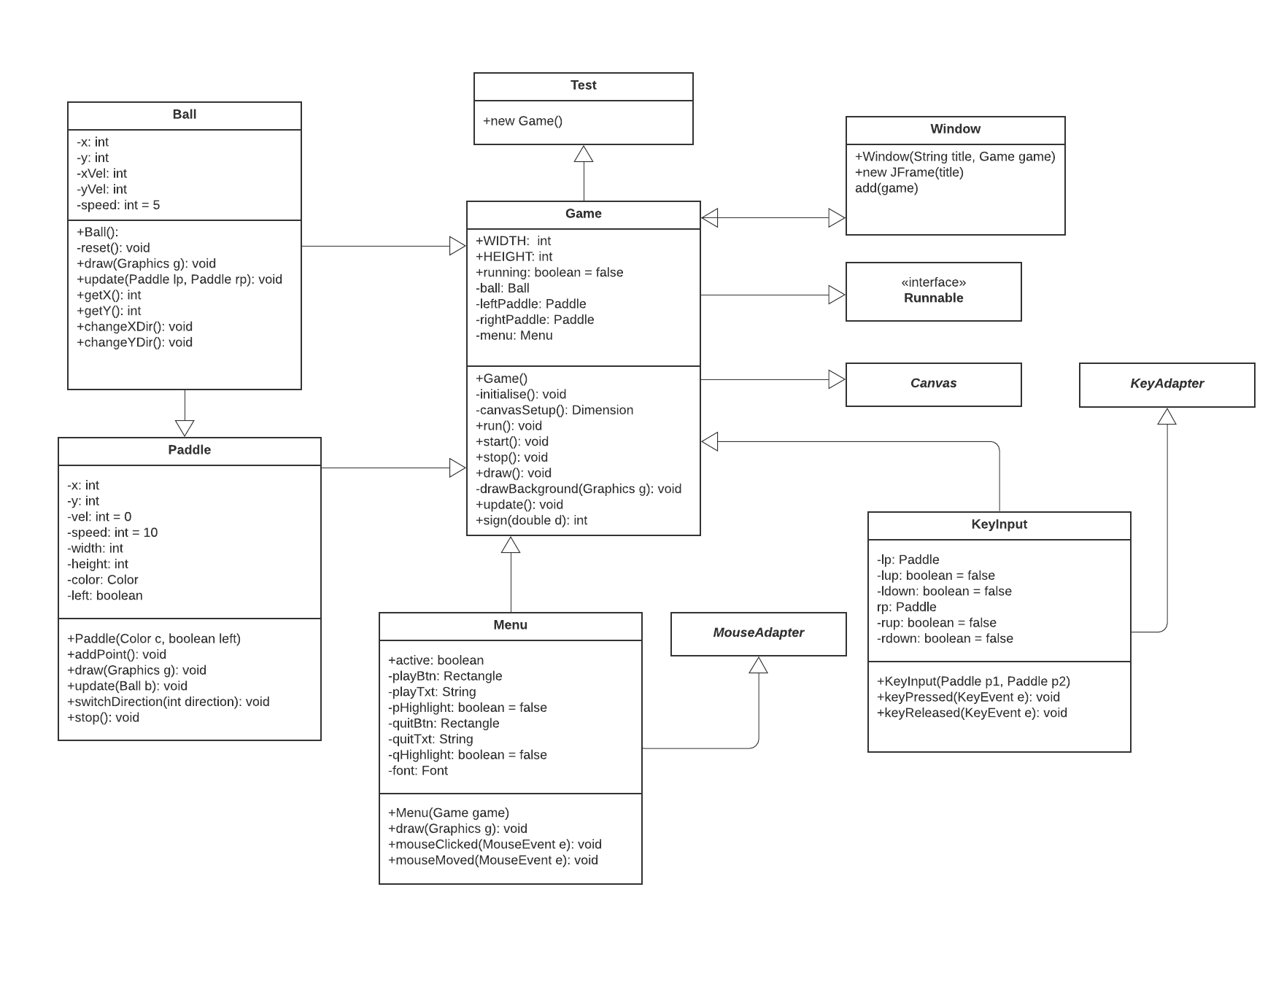

Slide 10
References:
http://nifty.stanford.edu/2003/pong/student/pongLab.html
https://electronics.howstuffworks.com/video-game2.htm
https://www.raspberrypi.org/blog/the-history-of-pong-code-the-classics/
https://codereview.stackexchange.com/questions/27197/pong-game-in-java
https://creately.com/

Slide 11
Thank you for listening

