Slide 1
Computational Approaches to Argumentation Mining in Natural Language Text
Topic 2

Slide 2
Outline
Introduction to argumentation
Argumentation mining the problem
Argumentation v. discourse
Annotation and corpora
Annotator issue
Computational models
Applications of argumentation in AI systems

Slide 3
Introduction to argumentation
Process of forming reasons, justifying beliefs and drawing conclusions with the aim of influencing the thoughts and actions of others (Mochales Palau & Moens 2009)
Acceptability of statements
Validity of structures
More operational: process whereby arguments are constructed, exchanged and evaluated in light of their interaction with other arguments
Arguments as building blocks

Slide 4
Argument & Argumentation scheme
Argument: elementary unit of an argumentation
Formed by premises and a conclusion
Premises and conclusion can be implicit (i.e. enthymemes)
Sentence level or smaller text spans?
Argumentation scheme: reasoning pattern
Structures of templates for forms of argument
Along with critical questions to evaluated argument
Offers one way of processing any real world argument

Slide 5
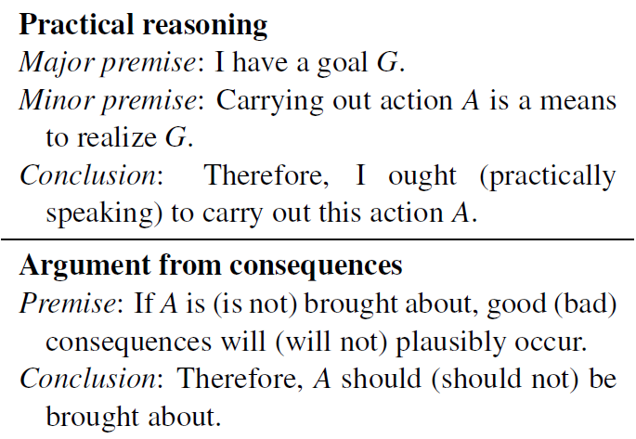
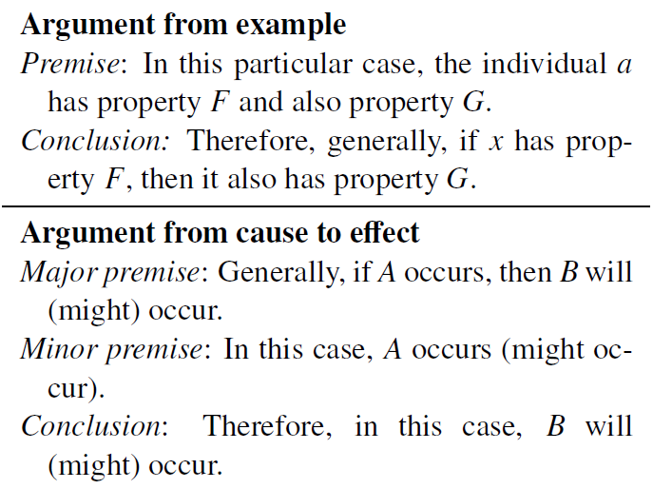
Scheme examples
(Feng & Hirst 2011)
If we stop the free creation of art, we will stop the free viewing of art.

Slide 6
Argumentation in natural language text
Argumentation based on informal logic
Natural language arguments
Reviews
Scientific articles
Legal documents
Political debates

Slide 7
the problem
Mining a document (collection) for arguments
Relations between arguments (argumentation structures)
Internal structure of each individual arguments (schemes)
New research area
In correspondence with information retrieval, information extraction, opinion mining
Proposed applications
Improve information retrieval/extraction
Natural extension to opinion mining
Public deliberation

Slide 8
More applications
(Call for papers, First Workshop on Argumentation Mining, ACL 2014)
Instructional context
Mines written and diagrammed arguments of students for purposes of assessment and instruction
Importance
Computer-supported peer reviews
Automated essay assessment
Large-scale online courses/MOOCs

Slide 9

Argumentation v. Discourse
Argumentation structures are based on discourse structures
Discourse for coherence but argument for acceptability
Peen Discourse Treebank (PDTB)
Discourse relation between two text spans (mostly adjacent)
Exhibits connection between discourse relations and argumentation schemes (Cabrio et al. 2013)
E.g. Scheme <Argument from Cause to Effect> = PDTB relation <CONTINGENCY:cause>

Slide 10
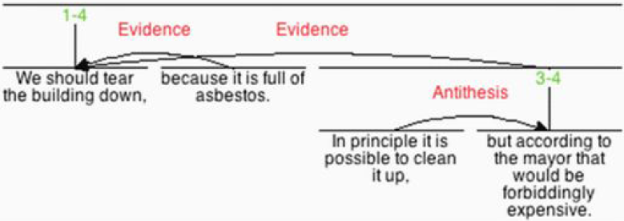
Argumentation v. Discourse (2)
Rhetorical Structure Theory (RST)
Underlying intentions of the speaker or writer
Adequate framework for representing argumentation structure (Peldszus & Stede 2013)

Slide 11
Annotation and corpora
Not too many results reported
Lack of data (Peldszus & Stede 2013)
Annotated data of arguments/schemes
AraucariaDB argument corpus
European Court of Human Rights (ECHR)
►Limited in terms of size and domain
Not really about argumentation
Scientific articles (writing structure convention): argumentative zones, core science concepts
Discourse Treebank: PDTB and RST
►More available but how to support argumentation mining?

Slide 12
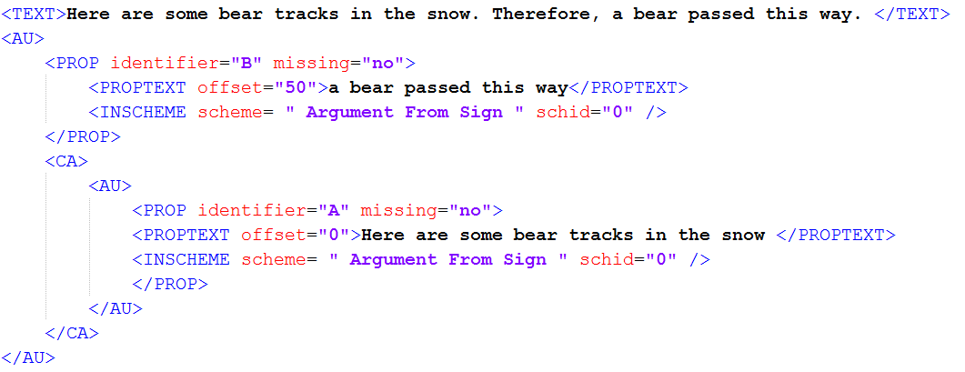
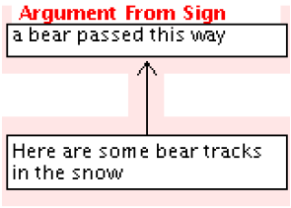
AraucariaDB
Argumentative examples of diverse sources and different regions (Reed et al. 2008)
Argument consists of argument units (AU)
Conclusion followed by optional premises
Identified with argumentation scheme

Slide 13
Argumentative Zones
Rhetorical-level analysis of scientific articles (Teufel et al. 1999, Teufel & Moens 2002)
Rhetorical status of single, important sentences w.r.t the communicative function of the whole paper
7 argumentative zone types
A zones is formed of adjacent sentences of the same status
Variants
AZ-II, Core Science Concepts (CoreSC) (Liakata et al. 2010)
►Do not lay in argumentation theory
Mines the role of each proposition towards the overall goal of the author (v. role of propositions towards the others)
Role-sequence patterns can reveal argumentation strategy

Slide 14
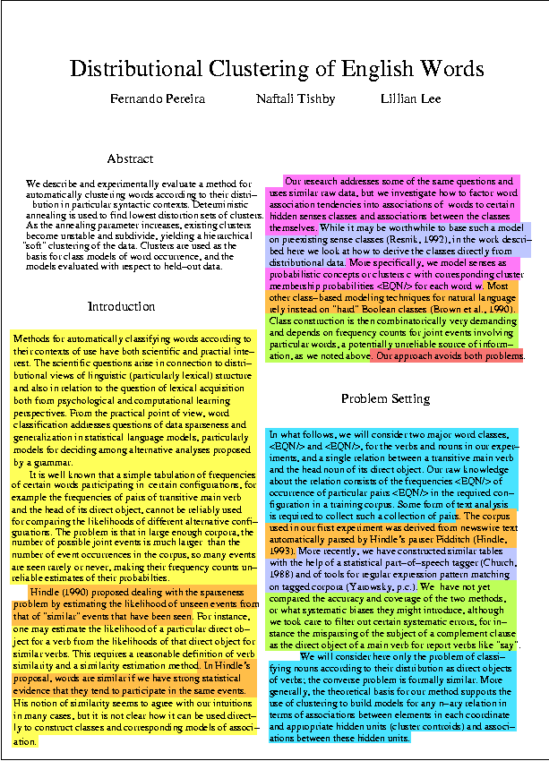
AZ Snapshots
7 zone types
Background (yellow)
Other (orange)
Own (blue)
Aim (pink)
Textual (red)
Contrast (green)
Basic (purple)

Slide 15
Discourse corpora
►Discourse relation has been used for essay grading
Signs of coherent writing (thesis, evidence)
Far from signs of correct writing (validity and acceptability of statements)
Peen Discourse Treebank (Prasad et al. 2008)
Closely related to argumentation schemes (Cabrio et al. 2013)
►Good indicators for argument extraction, as the first step towards argument validation
RST Discourse Treebank (Carlson et al. 2003)
Explain well the overall argumentation structure (Peldszus & Stede 2013)
►To mine argumentation patterns/strategies

Slide 16
Opinion and argumentation
Annotated corpus of news editorials (Bal & Saint-Dizier 2010)
Argumentation = claim + justification
Argumentation
Argument types, rhetoric relations
Opinion
Orientation, support/oppose
Persuasion
Direct strength, relative strength
►The first (only) available corpus for mining impact of argumentation and opinion in persuasion

Slide 17
Annotator issue
Annotation task (Peldszus & Stede 2013b)
Identify central claim, choose dialectical role for other text segment, determine argumentative function of each segment
26 students with minimal training (~35 min.)
Show moderate agreement
Annotator ranking and clustering for identifying reliable subgroups
Achieve good agreement
►Opens a direction for more effective annotation
Using minimal expert-generated labels to rank non-expert annotators
Less training effort

Slide 18
Computational models
Argument detection (Moens et al. 2007, Mochales Palau & Moens 2009, Araucaria and ECHR corpora)
Classifies (legal) text sentences: argumentative v. not
Linguistic features: ngrams, POS, parse, keywords
Argument classification (Feng & Hirst 2011, Araucaria corpus)
Classifies arguments regarding schemes (argument components available)
Identifying coherence relation (Madnani et al. 2012, student writing) ►First step towards argument parsing
Classifies content language v. shell language based on rules
E.g. There is a possibility that they were a third kind of bear apart from black and grizzly bears.

Slide 19
Computational Models (2)
Classifying segment status (Teufel & Moens 2002, Guo et al. 2010)
Sentence classification regarding scientific text discourse
Semi-automated argumentative analysis (Wyner et al. 2012)
Discourse indicators, sentiment lexicon, domain lexicon
Helps instantiate Consumer Argumentation Scheme (CAS)
Online debates
Debate-side classification: mines opinion + target (Somasundaran & Wiebe 2009)
Debate argument acceptability using textual entailment + abstract argumentation theory (Cabrio & Villata 2012)

Slide 20
good & bad about models
First steps towards argumentation mining
Different in terms of tasks, data, granularities
Tasks seem to supplement each other but the data says no
Legal text, scientific articles, student writing
Strict experimental settings make models less practical
Argument components available, scientific discourse
Application is still limited (if not possible)

Slide 21
Tools & Applications
Carneades (Gordon & Walton 2006)
Argumentation Framework to determine the defensibility of arguments, and acceptability of statements
RST parser (Feng & Hirst 2012)
PDTB parser (Lin et al. 2014)
Automated essay assessment (Burstein et al. 2002)
Recommendation (Chesnevar et al. 2009)
Spoken dialogue system (Andrews et al. 2008, Riley et al. 2012)
Automated persuasion
►Still discourse relations or abstract argumentation

Slide 22
Conclusions
►The available
Formal argumentation proving systems
Annotated data
Discourse parsers
►The TODO’s
Better exploit discourse relations to work on free-text (student writing, news articles)
Go beyond legal documents and scientific articles
Get along with opinion mining
Need more attention from NLP community

