Slide 1
Deep learning and applications to Natural language processing
Topic 3

Slide 2
outline
Deep learning overview
Deep v. shallow architectures
Representation learning
Breakthroughs
Learning principle: greedy layer-wise training
Tera scale: data, model, resource
Deep learning success
Deep learning in NLP
Neural network language models
POS, NER, parsing, sentiment, paraphrase
Concerns

Slide 3
Deep v. shallow overview
(Bengio 2009, Bengio et al. 2013)
Human information processing mechanisms suggest deep architectures (e.g. vision, speech, audition, language understanding)
Input percept is represented in multiple-level abstraction
Most machine learning techniques exploit shallow architectures (e.g. GMM, HMM, CRF, MaxEnt, SVM, Logistic)
Linear models cannot capture the complexity
Kernel tricks is still not deep enough
Unsuccessful attempts to train multi-layer neural networks for decades (before 2006)
Feed-forward neural nets with back-propagation
Non-convex loss function, local optima

Slide 4
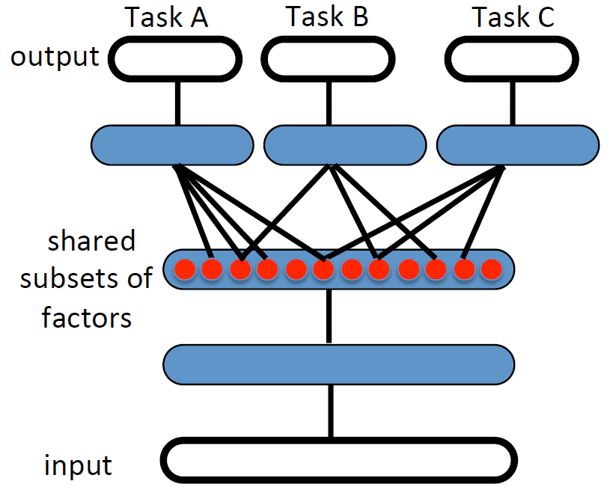
Deep learning and Advantages
Wide class of machine learning techniques and architectures
Hierarchical in nature
Multi-stage processing through multiple non-linear layers
Feature re-use for multi-task learning
Distributed representation (information is not localized in a particular parameter likes in one-hot representation)
Multiple levels of representation
Abstraction and invariance
More abstract concepts is constructed from less abstract ones
More abstract representation is invariant to most local changes of input

Slide 5
Representation learning
Representation learning (feature learning)
Learning transformation of the data that make it useful information for classifiers or other predictors
Traditional machine learning algorithm deployment
Hand-crafted features extractor + “simple” trainable classifier
Inability to extract/organize the discriminative info. from data
End-to-end learning (less dependent on feature engineering)
Trainable feature extractor + trainable classifier
Hierarchical representation for invariance and feature re-use
Deep learning is to learn the intermediate representation
Its success belongs to unsupervised representation learning

Slide 6
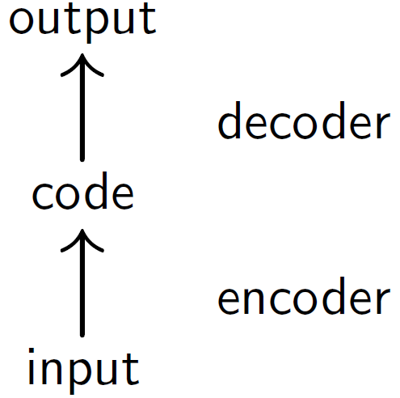
Encoder – decoder
A representation is complete if it is possible to reconstruct the input from it
Unsupervised learning for feature/representation extractions
An encoder followed by a decoder
Encoder encodes input vector to code vector
Decoder decodes code vector to reconstruction
Minimizes loss function from input to reconstruction

Slide 7
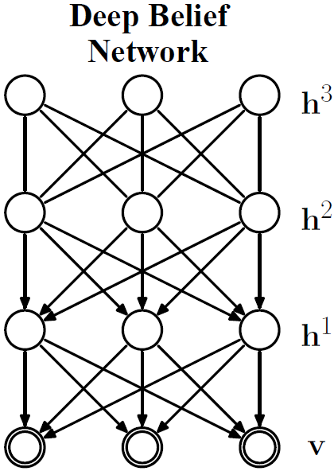
Breakthroughs
Deep architectures are desired but difficult to learn
Non-convex loss function, local optima
2006: breakthrough initiated by Hinton et al. (2006)
3 hidden-layer Deep belief network (DBN)
Greedy layer-wise unsupervised pre-training
Fine-tuning up-down algorithm
MNIST digits dataset error rate
DBN:1.25%, SVM:1.4%, NN:1.51%

Slide 8
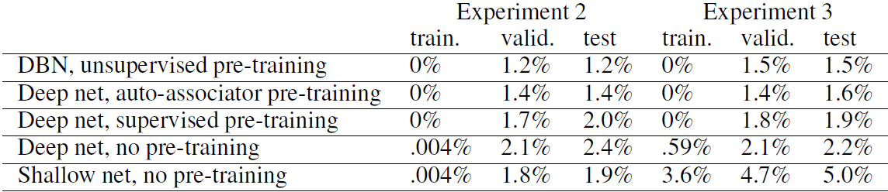
Greedy layer-wise training
Need of good training algorithm for deep architectures
Greedy layer-wise unsupervised pre-training helps to optimize deep networks
Supervised training to fine-tune all the layers
A general principle applies beyond DBNs (Bengio et al. 2007)

Slide 9
Why greedy layer-wise training works
(Bengio 2009, Erhan et al. 2010)
Regularization Hypothesis
Pre-training is “constraining” parameters in a region relevant to unsupervised dataset
Representations that better describe unlabeled data are more discriminative for labeled data (better generalization)
Optimization Hypothesis
Unsupervised training initializes lower level parameters near localities of better minima than random initialization can

Slide 10
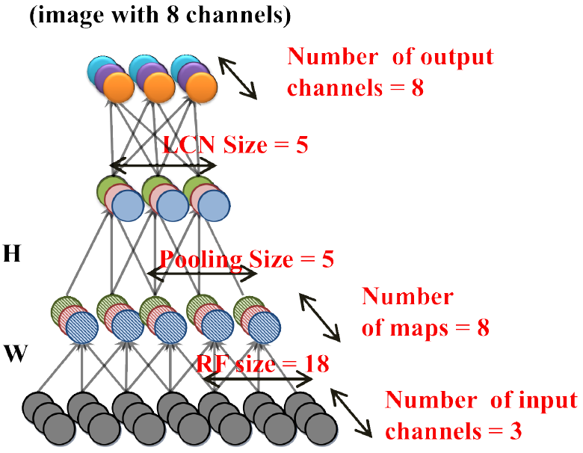
Tera-scale deep learning
(Le et al. 2011)
Trains 10M 200x200 unlabeled images from YouTube
1K machines (16K cores) in 3 days
9-layer network with 3 sparse auto-encoders
1.15B parameters
ImageNet dataset for testing
14M images, 22K categories
State-of-the-art: 9.3% (accuracy)
Proposed: 15.8% (accuracy)
► Scales-up the dataset, the model and the computational resources

Slide 11
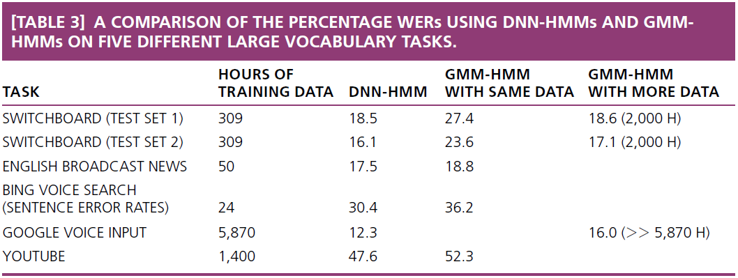
Deep learning success
So far, examples of deep learning in vision: achieve state-of-the-art
Deep learning has even more impressive impact in speech
Shared view of 4 research groups: U. Toronto, Microsoft Research, Google, and IBM Research
Commercialized!
(Hinton et al. 2012)

Slide 12
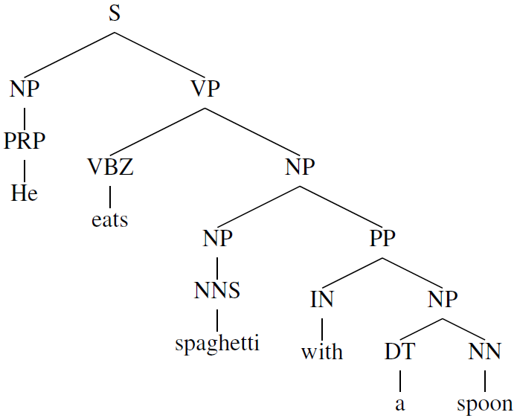
Deep learning in NLP
The current obstacles of NLP systems:
Handcrafting features is time-consuming, and usually difficult
Symbolic representation (grammar rules) makes NLP system fragile
Advantages by deep learning
Distributed representation is more (computationally) efficient than one-hot vector representation (usually used in NLP)
Learn from unlabeled data
Learn multiple levels of abstraction: word – phrase – sentence

Slide 13
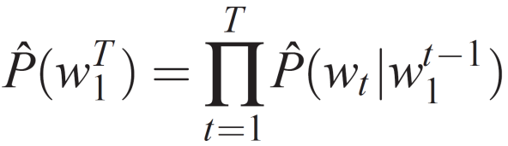
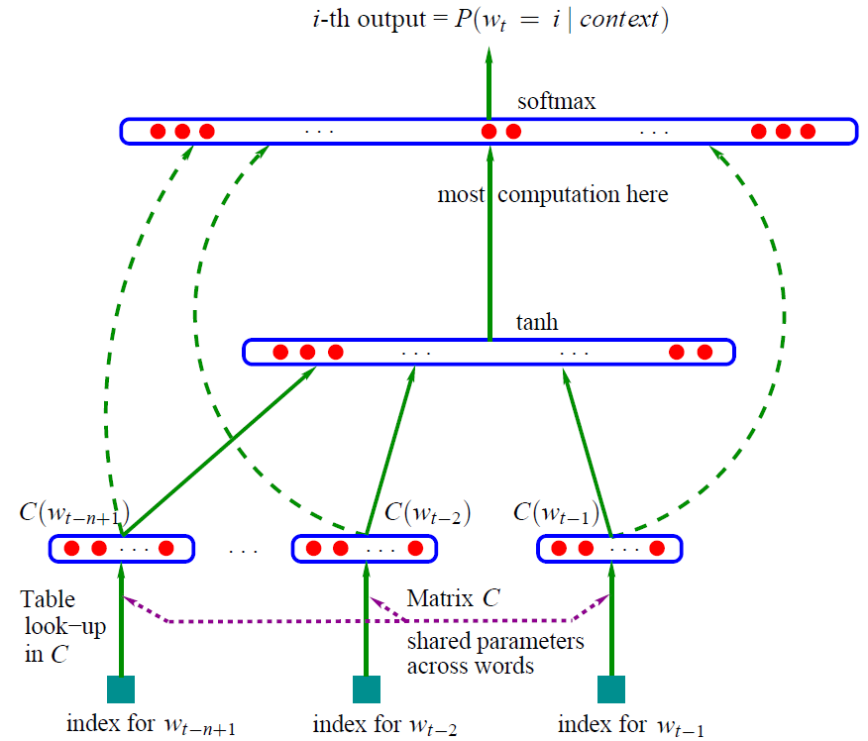
Neural network language models
Learns distributed representation for each word – word embedding – to solve the curse of dimensionality
Firstly proposed in (Bengio et al. 2003)
2 hidden-layer NN
Back-propagation
►Jointly learn language model and word representation
The latter is even more useful

Slide 14
Neural network language models
Factored restricted Boltzmann machine (Mnih & Hinton 2007)
Convolutional architecture (Collobert & Weston 2008)
Recurrent neural network (Mikolov et al. 2010)
Compare different word representations via NLP tasks (chunking and NER) (Turian et al. 2010)
Word embedding helps improve available supervised models
►The proven-efficient setting
Semi-supervised learning with task-specific information that jointly inducing word representation and learning class labels

Slide 15
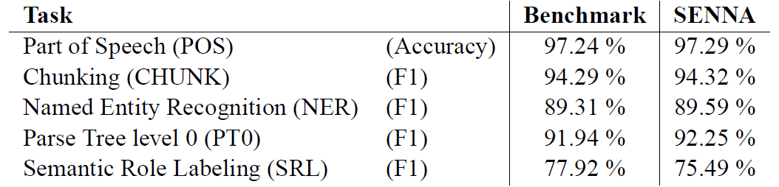
NNLM for Basic tasks
SENNA (Collobert & Weston 2011)
Convolutional neural network with feature sharing for multi-task learning
POS, Chunking, NER, SRL
Performs faster (16x to 122x) for less memory (25x)

Slide 16
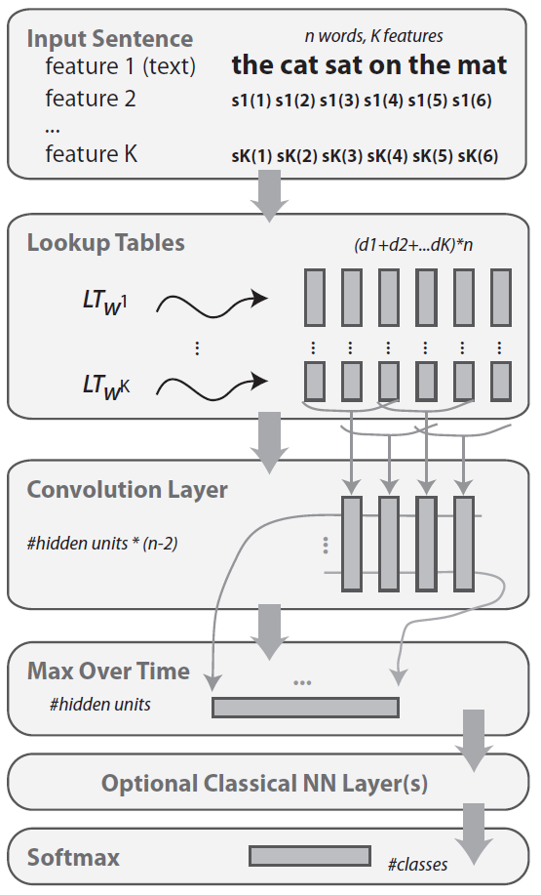
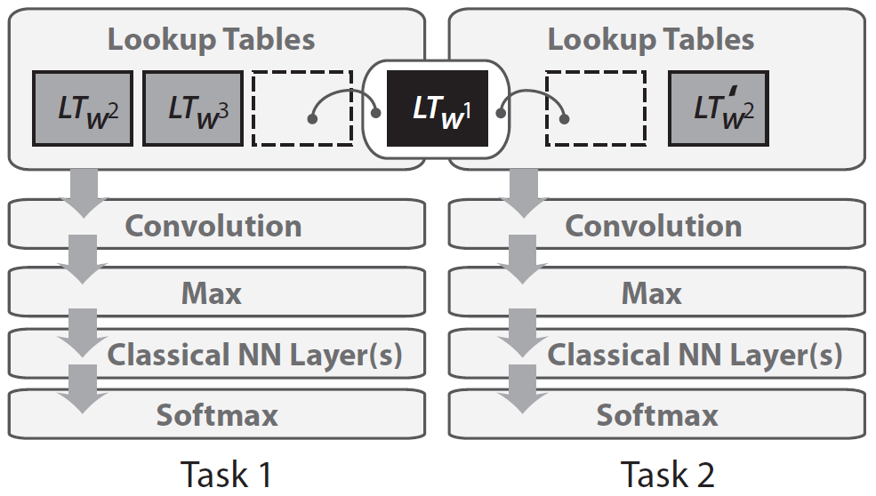
Basic Tasks (2)
SENNA’s architecture

Slide 17
Basic Tasks (3)
Syntactic and semantic regularities (Mikolov et al. 2013)
<x> is the learned vector representation of word x
<apple> - <apples> ≈ <car> - <cars>
<man> - <woman> ≈ <king> - <queen>
►Word representation not only helps NLP tasks but also has semantic inside
The representation is distributed in vector-form
Natural input of computational system
? Computational semantic

Slide 18
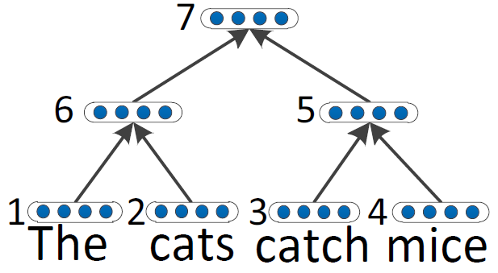
Beyond word representation
Word representation is not the only thing we need
It is the first layer towards building NLP systems
We need a deep architecture on-top to take care of NLP tasks
Recursive neural network (RNN) is a good fit
Works with variable-size input
Has tree structure can be learned (greedy) from data
Each node is an auto-encoder to learn inner representation
Paraphrase detection (Socher et al. 2011)
Sentiment distribution (Socher et al. 2011b)
Parsing (Socher et al. 2013)

Slide 19
Deep learning in NLP: the concerns
Great variety of not-really-dependent tasks
Many deep architectures, algorithms, and variants
Competitive performance, but not state-of-the-art
Not obvious how to combine with existing NLP
Not easy to encode prior knowledge of language structure
No longer symbolic, not easy to make sense from results
Neural language models are difficult to train and time-consuming
►Open to more research, deep learning in NLP is future?
Very promising results, unsupervised, big data, across domains, languages, tasks

Slide 20
Conclusions
Deep learning = Learning hierarchical representation
Unsupervised greedy layer-wise pre-training followed by fine-tuning algorithm
Promising results in many applications
Vision, audition, natural language understanding
Neural network language models play crucial roles in NLP tasks
Jointly learn word representation and classification tasks
Different tasks take advantage from different deep architectures
NLP: Recursive neural networks and convolutional networks
What is the best RNN given an NLP task is an open question

