Slide 1
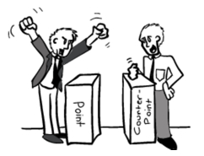



Extracting argument and domain words for identifying argument components in texts
The 2nd Workshop on Argumentation Mining
NAACL 2015 Workshops
June 4th 2015, Denver, CO
Huy Nguyen¹ Diane Litman^{1,2}
¹Computer Science Department
²Learning Research & Development Center
University of Pittsburgh
This research is supported by NSF Grant 1122504

Slide 2
Outline
Argument mining in texts
Motivation of our approach
Our approach
Evaluation
Data
Baseline vs. proposed models
Experiment results
Conclusions and future work

Slide 3
Argument mining in texts
Automatically identify argument elements and argumentative relations between them
Argument mining as classification tasks
Argument detection, i.e., argumentative sentence vs. none (Moens et al. 2007)
Sentence’s rhetorical status, e.g., aim, background, contrast (Teufel & Moens 2002)
Argumentative discourse structures, i.e., major claim, claim, premise (Stab & Gurevych 2014ab)

Slide 4
Motivation
Student essays
E.g., persuasive essays, academic writings
Optional title/topic but no section heading
Lack of evidence, substantiated by personal experience rather than cited resources
Specialized (useful) features, e.g., section heading, citation (Teufel & Moens 2002), are not available
Ngrams and syntactic rules (e.g., VP → VBG NP) are commonly used (Burstein et al. 2003, Moens et al. 2007, Stab & Gurevych 2014b, Park & Cardie 2014)
But have limitations
Large and sparse feature space
Feature selection helps with over-fitting but not efficiently

Slide 5

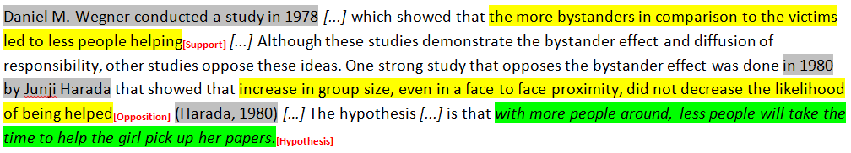
Example essays
Persuasive essay
Academic essay

Slide 6
A novel feature design
Separate argument words from domain words
Argument words: argument indicators and commonly used in different argument topics, e.g., reason, opinion, believe
Domain words: specific terminologies commonly used within the topic’s domain, e.g., art, education, children
Post-process topic model output using seeding
Seeding requires human knowledge but minimal
Unannotated data
Derive novel features to replace ngrams and syntactic rules
Feature reduction
Topic-independence

Slide 7
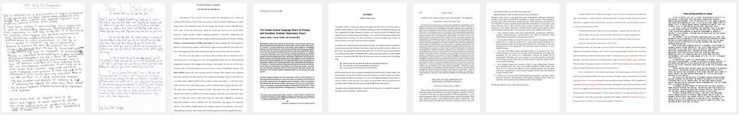
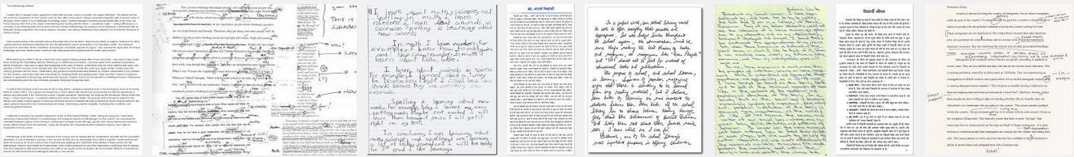
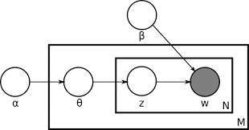
Topic model
Latent Dirichlet Allocation (Blei et al. 2003)

Slide 8
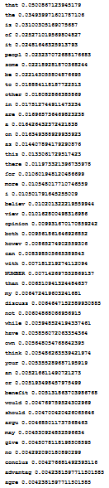
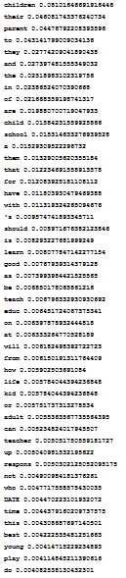
LDA topics vs. essay topics
LDA topics approximate writing topics
but not completely
believe
children
music
view
parent
art
How can we identify the LDA topic of argument words and maximize its difference from the others (LDA topics) ?
…
opinion
school
creative
however
learn
talent
discuss
teach
idea

Slide 9
Argument and domain word extraction
Identification step
Pre-defined argument keywords: most frequent argument words in essay titles, e.g., opinion, agree
Domain seed words: title words but not argument keywords or stop words
3 weights of a LDA topic (LDA word lists)
(1) Argument weight
Count of argument keywords in the list
(2) Domain weight
Sum of domain seeds’ occurrence frequency (f)
(3) Combined weight
Argument weight – Domain weight
AW=3:
opinion
believe
think
DW=
f(art) +
f(music) +
f(creative)
+ …
CW = AW – DW

Slide 10
Argument and domain word extraction (2)
Maximization step (aka the best number of LDA topics)
Given number of LDA topics K
Discrimination ratio: s_{K} = [CW(T₁) – CW(T₂)] / CW(T₂)
Get T₁ the topic with largest combined weight
Get T₂ the topic with second largest combined weight
Vary K and select K* with the largest discrimination ratio
Argument word list = LDA topic w. largest combined weight
K=9
K=10
K=40
T₁
T_{K}
…
…
…
…
…

Slide 11

Data
90 annotated persuasive essays (Stab & Gurevych 2014a, collected from www.essayforum.com)
Sentences were coded for possible argument components: major claim, claim, premise

Slide 12
Development data to learn argument and domain words
> 6000 essays from www.essayforum.com, not in the corpus
10 argument keywords
agree, disagree, reason, support, advantage, disadvantage, think, conclusion, result, opinion
Learned 263 argument words
Keyword variants: think, believe, viewpoint, opinion, argument, claim…
Connectives: therefore, however, despite…
Stop words

Slide 13
Prediction models
Baseline (Stab & Gurevych 2014b)
Proposed model
1-, 2-, 3-grams
Verbs, adverbs
Presence of model verb
Discourse connectives
First person pronouns
Argument words (unigrams)
1-, 2-, 3-grams
Lexical
Same
>5000 features
956 features
Syntactic rules
Tense of main verb
#sub-clauses, depth of parse tree
Dependency pairs (subject-main verb)
do not contain domain words
Syntactic rules
Syntactic
#tokens, #punctuation
Sentence position
First/last paragraph
First/last sentence of paragraph
Structural
Same
#tokens, #punctuation, #sub-clauses, modal verb of preceding and following sentences
Contextual

Slide 14
Our model outperforms the baseline
10-fold cross validation following (Stab & Gurevych 2014b)
Top features in training folds, calculated by InfoGain algorithm
LibLINEAR learning algorithm with default parameters
 | #feat. | Acc. | Kappa | F1 | Prec. | Recall
Baseline | 100 | 0.78 | 0.63 | 0.71 | 0.76 | 0.69
Proposed | 100 | 0.79+ | 0.65* | 0.72 | 0.76 | 0.70
75-essay training set, 15-essay test set
Estimate best #features with cross-validation in training set
 | #feat. | Acc. | Kappa | F1 | Prec. | Recall
Baseline | 130 | 0.80 | 0.64 | 0.71 | 0.76 | 0.68
Proposed | 70 | 0.83* | 0.69* | 0.76+ | 0.79 | 0.74
With less features!
* Significant higher (p < 0.05)
+ Trending higher (p < 0.1)

Slide 15
Argument words learned from different domain Can they be used?
Alternative argument word list
254 academic essays from college Psychology classes
5 argument keywords taken from the writing assignment
hypothesis, support, opposition, finding, study
Extract 429 argument words
Replace the 263 argument words of the persuasive set
10-fold cross validation
 | #feat. | Acc. | Kappa | F1
Baseline | 100 | 0.78 | 0.63 | 0.71
Proposed | 100 | 0.79+ | 0.65* | 0.72
Alternative | 100 | 0.78 | 0.62 | 0.71
Quantitatively worse!

Slide 16
… and qualitatively different
Alternative model’s top 100 feature
(argument words of academic set)
Proposed model’s top 100 feature
(argument words of persuasive set)
140 words ≡ Academic ∩ Persuasive
30 of common argument words
22 of common argument words
Transferable part: mostly function words
5 content words: conclusion, topic, analyze, show, reason
3 content words: conclusion, topic, analyze
20 of unique argument words
15 of unique argument words
Non-transferable part: genre-dependent
19 content words: believe, agree, discuss, view…
6 content words: university, value…
Most of popular terms in academic writings were not selected: research, hypothesis, variable…

Slide 17
Conclusions and future work
Novel algorithm to post-process LDA output to extract argument and domain words
Minimal seeding, unannotated data
Features derived from extracted argument words
Efficiently replace ngrams and syntactic rules
Argument words extracted from different data domain
Non-transferable part are genre-dependent and needed for the best performance
Our next study is argumentative relation classification, i.e. support vs. attack

Slide 18

Thank you!
Questions
and
Comments

Slide 19
In comparison with prior studies
Our argument words are subsets of generic unigrams
We emphasize the topic-independence of features
Argument and domain word notion is similar to argument shell and content in (Madnani et al. 2012)
We have no requirement of physical boundaries between the two aspects
Our idea of using seed words to guide the word separation is similar to (Louis and Nenkova, 2013)
We need much less prior knowledge
We identify the best number of topics that maximize topic discrimination

Slide 20
Feature analysis
Baseline (top 130 features)
Proposed model (top 70 features)
34 unigrams
31 bigrams
13 trigrams
31 argument words
6 not in baseline analyze, controversial, could, debate, discuss, ordinal
5 dependency pairs:
I.agree, I.believe, I.conclude, I.think, people.believe
21 syntactic rules

Slide 21
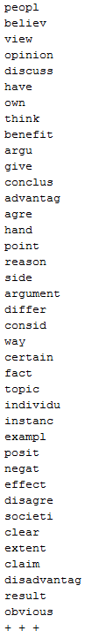

Two argument word lists overlap
Persuasive
Academic
result experi signific support idea topic oppos reason conclus mention analyz consider
72 content
words
142 words
in common
70 discourse
connectives and stop-words
whether however therefore despite instead although though regardless moreover should would still

Slide 22
Academic set
270 not selected to top 100. Most are popular terms of academic writing: research, hypothesis, variable…

Slide 23
Data
1673 sentences
1552 argument components
327 non-argumentative sentences
36 LDA topics
1804 domain words

Slide 24
Prediction performance
10-fold cross validation
 | #feat. | Acc. | Kappa | F1 | Prec. | Recall | F1: major Claim | F1: Claim | F1: Premise | F1: None
Baseline | 100 | 0.78 | 0.63 | 0.71 | 0.76 | 0.69 | 0.54 | 0.47 | 0.84 | 1.00
Proposed | 100 | 0.79+ | 0.65* | 0.72 | 0.76 | 0.70 | 0.51 | 0.53* | 0.84 | 1.00
Estimate best #features and train in 75-essay set, test in 15-essay set
 | #feat. | Acc. | Kappa | F1 | Prec. | Recall | F1: major Claim | F1: Claim | F1: Premise | F1: None
Baseline | 130 | 0.80 | 0.64 | 0.71 | 0.76 | 0.68 | 0.48 | 0.49 | 0.86 | 1.00
Proposed | 70 | 0.83* | 0.69* | 0.76+ | 0.79 | 0.74 | 0.59 | 0.56* | 0.88* | 1.00
Top features in training folds, calculated by InfoGain algorithm (Stab & Gurevych 2014b)
* Significant higher (p < 0.05)
+ Trending higher (p < 0.1)

Slide 25
Alternative argument word list
Can argument words be learned from different genre?
College students’ essays in introductory Psychology classes
254 essays, 5 argument keywords taken from the writing assignment
hypothesis, support, opposition, finding, study
Return 14 LDA topics, 429 argument words, 1497 domain words
Replace the 285 argument words of the persuasive set
10-fold cross validation
 | #feat. | Acc. | Kappa | F1: major Claim | F1: Claim | F1: Premise | F1: None
Proposed | 100 | 0.79+ | 0.65* | 0.51 | 0.53* | 0.84* | 1.00
Alternative | 100 | 0.78 | 0.62 | 0.56 | 0.47 | 0.83 | 1.00

Slide 26
Argument and domain words
Lexical signals of argumentative content and argument topic
Argument shell and content
The argument states that based on the result of the recent research, there probably were grizzly bears in Labrador (cf. Madnani et al. 2012)
result
research
probably
My view is that the government should give priorities to invest more money on the basic social welfares such as education and housing instead of subsidizing arts relative programs (cf. persuasive essay corpus, Stab & Gurevych 2014a)
should
instead of

Slide 27

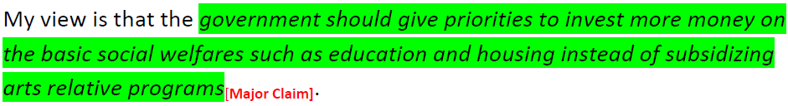
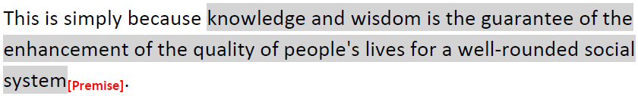
Sample essay

Slide 28
Refercence
online review (Park & Cardie 2014)
online debate (Boltužic & Šnajder 2014)

Slide 29
Stab14 (Stab & Gurevych 2014b)
wLDA (Nguyen & Litman 2015)
wLDA+5 (this study)
1-, 2-, 3-grams
Argument words as unigrams
Same as wLDA
Numbers of argument & domain word
Numbers of common words with title and preceding sentence
Comparative & superlative adverbs and POS
Discourse relation labels
Plural first personal pronouns
Lexical
Verbs, adverbs, presence of model verb
Discourse connectives,
Singular first person pronouns
Same as Stab14
Production rules
LDA-enabled subject-main verb pairs
Parse
Tense of main verb
#sub-clauses, depth of parse tree
Same as Stab14
#tokens, #punctuation, sentence position
First/last paragraph
First/last sentence of paragraph
Same as Stab14
Structure
Context
#tokens, #punctuation, #sub-clauses, modal verb in preceding/following sentences

