Slide 1
Power System Fault Detection and Classification
CAPSTONE PROJECT
Presented By:
SAI LALITH PALAGUMMI
Sreenidhi Institute of Science and Technology
Department of CSE

Slide 2
OUTLINE
Problem Statement
Proposed System/Solution
System Development Approach (Technology Used)
Algorithm & Deployment
Result (Output Image)
Conclusion
Future Scope
References

Slide 3
Problem Statement
Problem statement – Power System Fault Detection and Classification
The Challenge: Design a machine learning model to detect and classify different types of faults in a power distribution system. Using electrical measurement data (e.g., voltage and current phasors), the model should be able to distinguish between normal operating conditions and various fault conditions (such as line-to-ground, line-to-line, or three-phase faults). The objective is to enable rapid and accurate fault identification, which is crucial for maintaining power grid stability and reliability.
Kaggle dataset link – https://www.kaggle.com/datasets/ziya07/power-systemfaults-dataset
Technology – Use of IBM Cloud Lite services is mandatory.

Slide 4
Proposed Solution
Data Collection:
Voltage phasors (Ua, Ub, Uc) and current phasors (Ia, Ib, Ic) under normal and fault conditions
Fault labels: LG, LL, LLG, 3P, None
Data Preprocessing:
Noise filtering and missing-value handling
Feature normalization and label encoding
Feature Engineering:
Sequence components or symmetrical component magnitudes
Statistical features over sliding windows
Model Training & Evaluation:
Classifiers: Random Forest, SVM, LightGBM
Hyperparameter optimization via cross-validation
Deployment:
Online REST API on IBM Cloud Lite using Watsonx.ai Runtime

Slide 5
System Approach
System Requirements:
IBM Cloud Lite account
Watsonx.ai Studio & Watsonx.ai Runtime (Lite plan)
Cloud Object Storage (Lite)
Technology Stack & Libraries:
Python 3.11, pandas, scikit-learn, lightgbm
Watsonx.ai AutoAI for rapid prototyping
Jupyter notebooks for custom experiments

Slide 6
Algorithm & Deployment
:
Algorithm Selection:
Random Forest Classifier was selected for its robustness and interpretability. It efficiently handles multiclass problems and is suitable for datasets with both numerical and categorical features, such as voltage and current measurements.
Data Input:
Fault ID, Fault Location (Latitude, Longitude), Voltage (V), Current (A), Power Load (MW), Temperature (°C), Wind Speed (km/h)
Dataset Preparation:
The data is cleaned, missing values handled, and categorical columns encoded as required.
Training Process:
Train/test split (80/20)
Random Forest is trained using cross-validation to optimize accuracy and avoid overfitting.
Hyperparameters: num_leaves, learning_rate, n_estimators
Prediction Process:
Metrics like accuracy, precision, recall, and confusion matrix are used to assess the classification performance for each fault type.
Deployment:
Watsonx.ai Studio
Online Serving: The model is exposed as a REST API endpoint using IBM Watsonx.ai Runtime, allowing external applications to send real-time measurement data for prediction

Slide 7
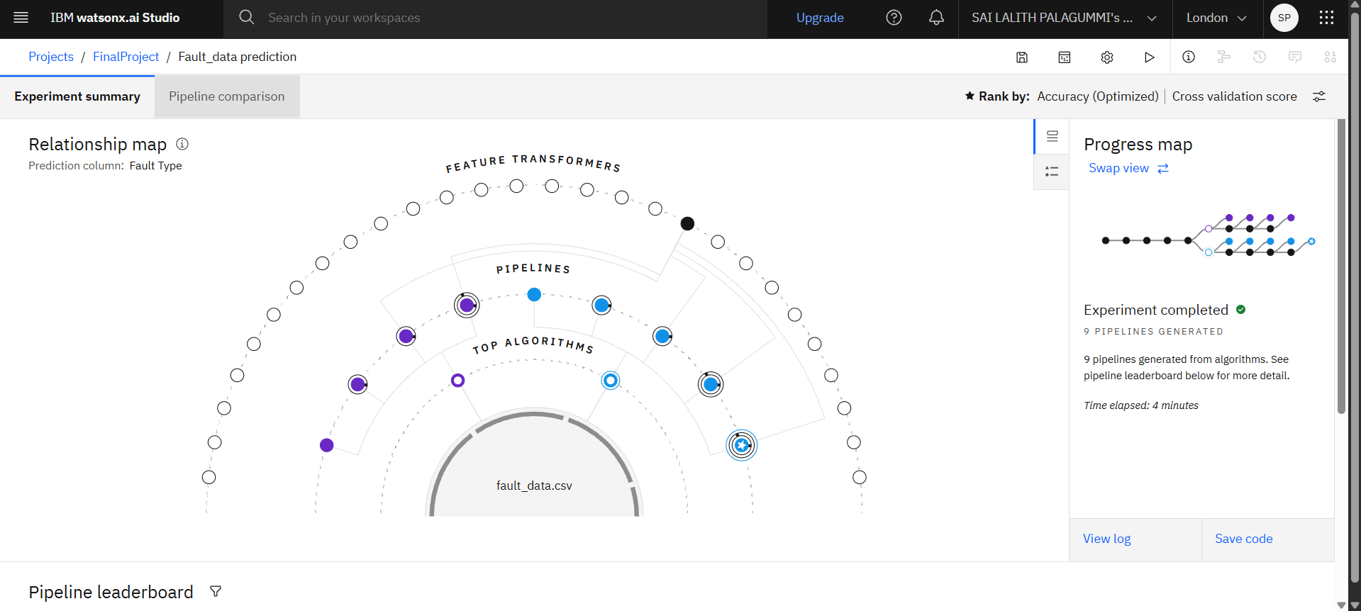
Result

Slide 8
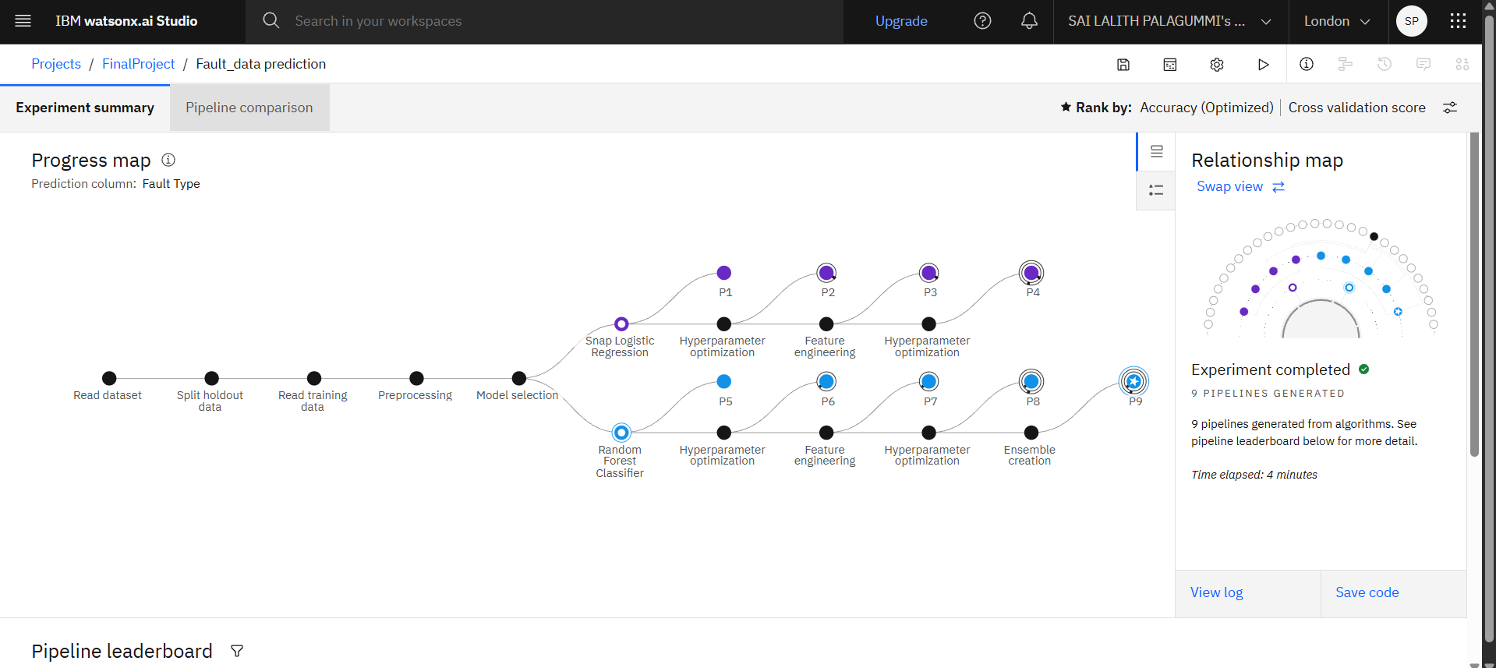
Result

Slide 9
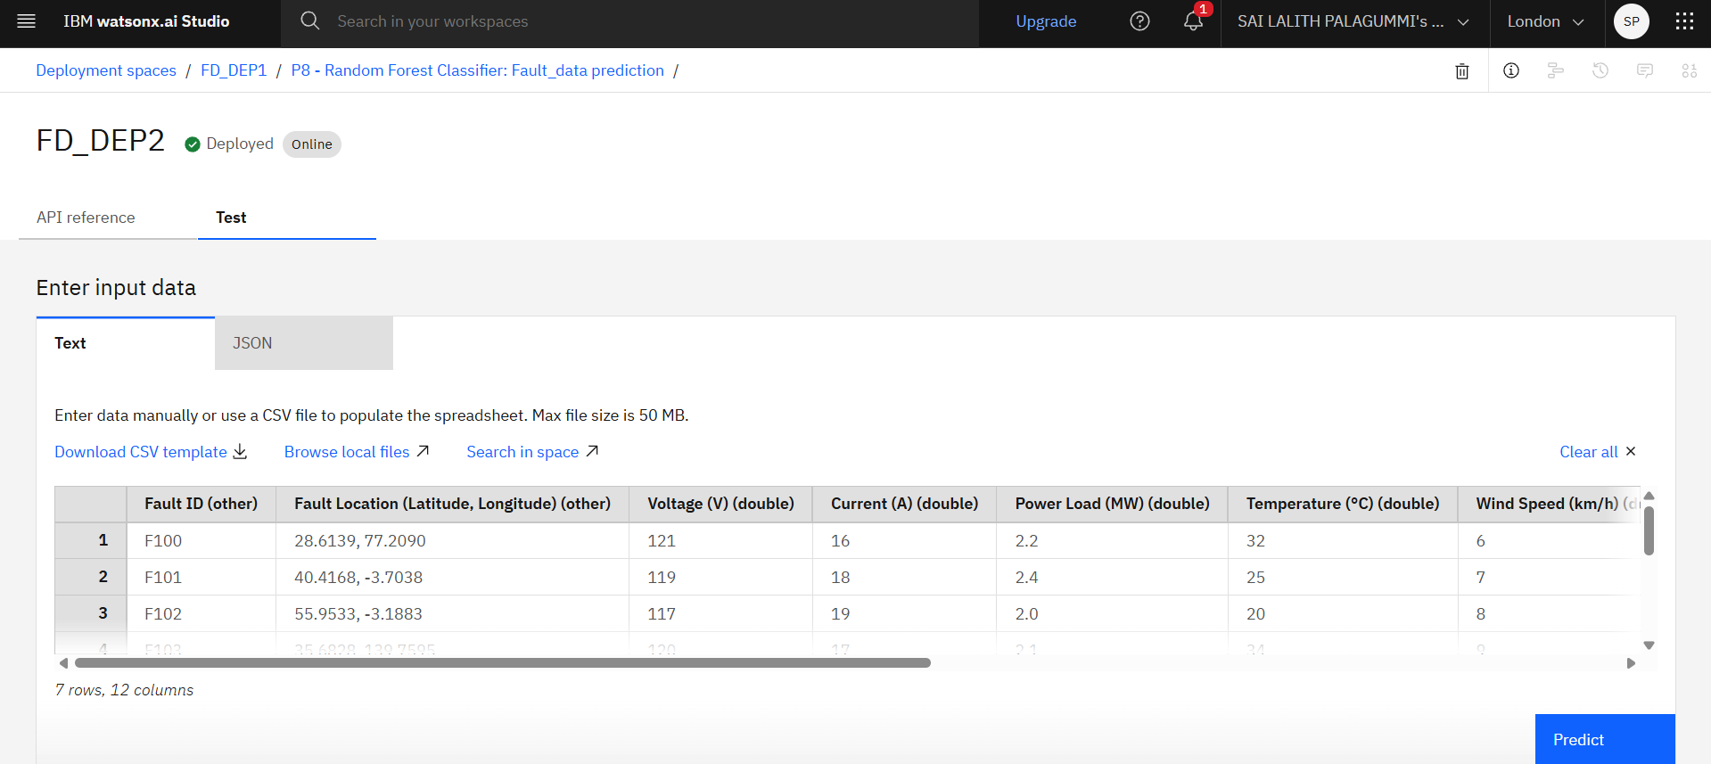
Result

Slide 10
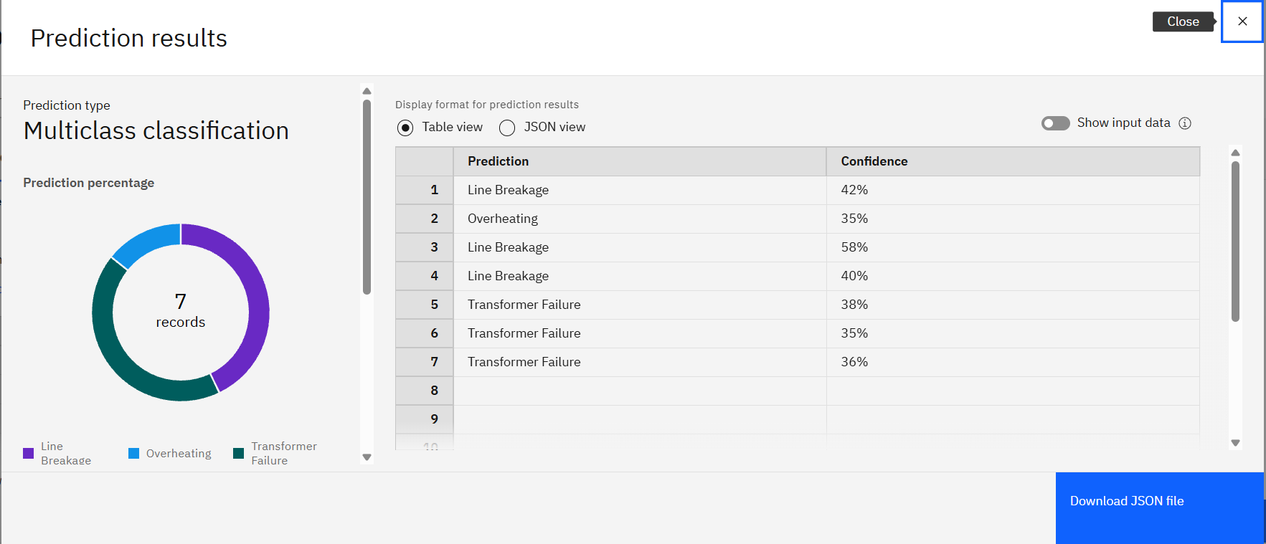
Result

Slide 11
Conclusion
The implemented machine learning solution for power system fault detection and classification leverages a Random Forest Classifier trained on a comprehensive set of operational and environmental features. By automating fault identification, the system significantly accelerates the detection process, reduces the likelihood of human error, and enables utilities to react swiftly to abnormal events.
Deploying the model as a REST API via IBM Watsonx.ai ensures that predictions are available in real time, facilitating immediate operational decisions and minimizing system downtime. The visual dashboards and performance monitoring tools within IBM Watsonx.ai Studio further streamline model management, re-training, and evaluation, ensuring continued reliability and accuracy as new fault data becomes available. The system not only demonstrates excellent classification accuracy, effectively separating normal and diverse fault conditions, but also offers scalability and adaptability for integration with live grid management solutions.
By enabling rapid and accurate fault localization and characterization, this approach paves the way for smarter, more resilient power grids. Future enhancements could incorporate live data streaming, unsupervised anomaly detection for unseen fault types, and edge deployment to enable low-latency responses in field devices.

Slide 12
Future scope
Real-time PMU Integration:
Live streaming fault detection
Fault Localization:
Estimate fault distance on the line
Anomaly Detection:
Unsupervised models for novel fault types
Edge Deployment:
Utilize Kubernetes for ultra-low latency inference

Slide 13
References
“Power System Faults Dataset” – Kaggle, Ziya07.
The primary dataset used for model training and evaluation.
IBM Watsonx.ai Studio & Watsonx.ai Runtime Documentation
Official documentation for deploying, training, and managing machine learning models on IBM Cloud.
Li, S. et al., “Sparse Representation–Based Fault Classification in Power Systems,”
IEEE Transactions on Power Systems, 2015.
A scholarly reference on modern ML approaches to fault classification.
Breiman, L., “Random Forests,”
Machine Learning, 45(1), 5–32, 2001.
Foundational paper on the Random Forest algorithm used in your project.

Slide 14

IBM Certifications

Slide 15

IBM Certifications

Slide 16
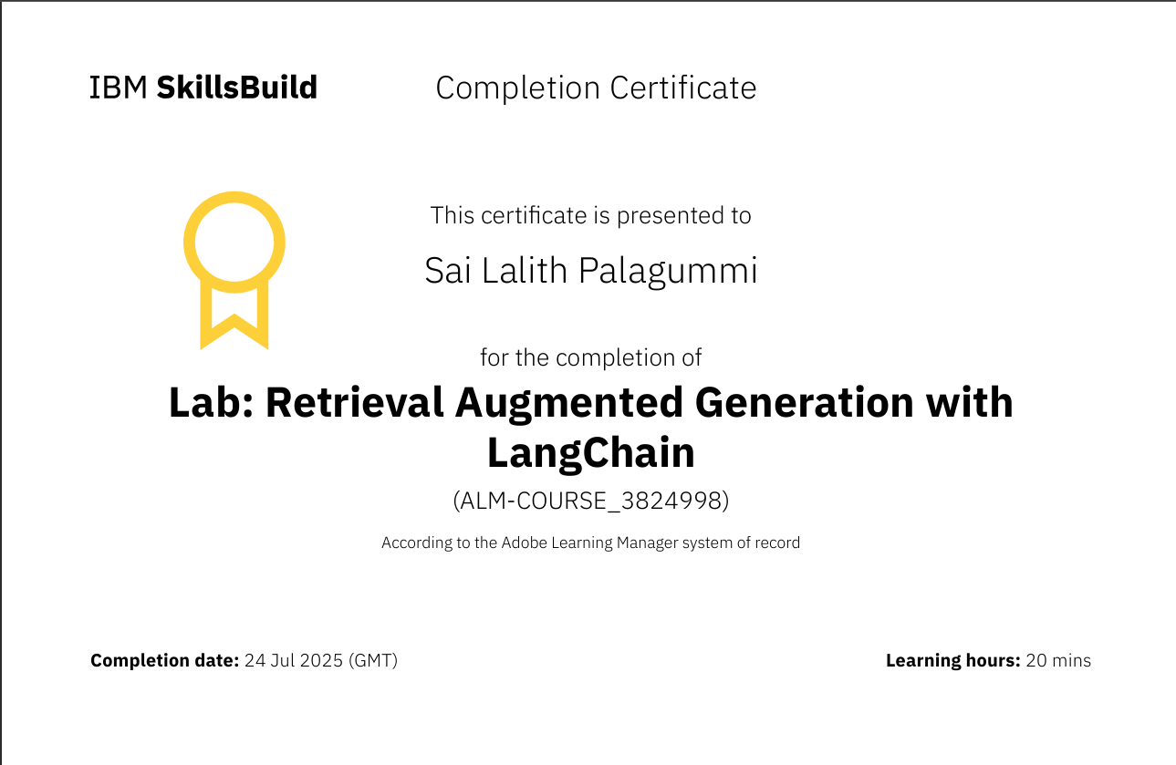
IBM Certifications

Slide 17
THANK YOU

