Slide 1
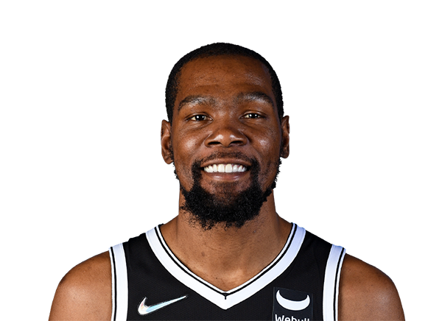


Kevin Durant vs Twitter
Nick Videtti
IST-652 Final Project
Summer 2022

Slide 2
Background on Kevin Durant
Career Accolades:
Professional basketball player that is recognized as one of the most talented scorers in NBA history
Drafted #2 overall in the 2007 NBA Draft
Led the NBA in scoring in 4 different seasons
Has won the NBA Finals twice and was Finals MVP both times
NBA MVP of the 2013-2014 season
Much more…
Fan Critique:
Joined Golden State Warriors in July 2016
Durant’s team was eliminated by the Warriors just weeks earlier
Warriors were coming off the best regular season in NBA history and barely lost the Finals
Requests Trade from Nets in 2022
At one point gave the team an ultimatum
Responds to critics on Twitter
Many think his focus in the game has suffered from this
Has created a narrative amongst some than Durant is mentally weak and easily flustered

Slide 3
Project Goals
Collect CSV files containing stats for Durant’s regular season and postseason games from SportsReference (https://www.basketball-reference.com/players/d/duranke01.html)
Collect number of tweets per day from Kevin Durant
Merge all data into one pandas DataFrame and only use days where Durant has both played a game and sent a tweet
Use PyPlot from MatPlotLib to create scatter plots and look for trends between tweet frequency and game performance

Slide 4
Disclaimers
There is a near-consensus belief that Durant has “burner” accounts that are his attempt to tweet at critics from an account that is not confirmed to be his. This project only uses only tweets from his main account @KDTrey5.
I was unable to scrape tweets due to Internet Security issues, so the Twitter data came from https://www.trackalytics.com/twitter/profile/kdtrey5/, this means that the accuracy of the Twitter data will only be as accurate as the data found in this link.

Slide 5
Code
Read in 15 CSV files for game stats as pandas DataFrames and concatenate them into one pandas DataFrame
Data cleaning
Read in Twitter data to its own pandas DataFrame
More data cleaning
Join the two pandas DataFrames on date (day of game played / day of tweets)
Visualize results with PyPlot

Slide 6
Results…

Slide 7
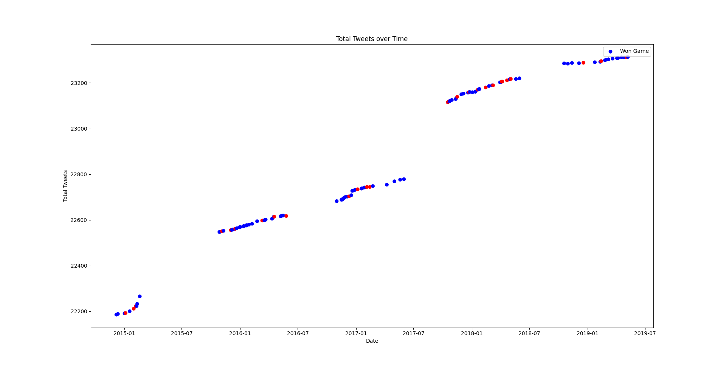

Slide 8
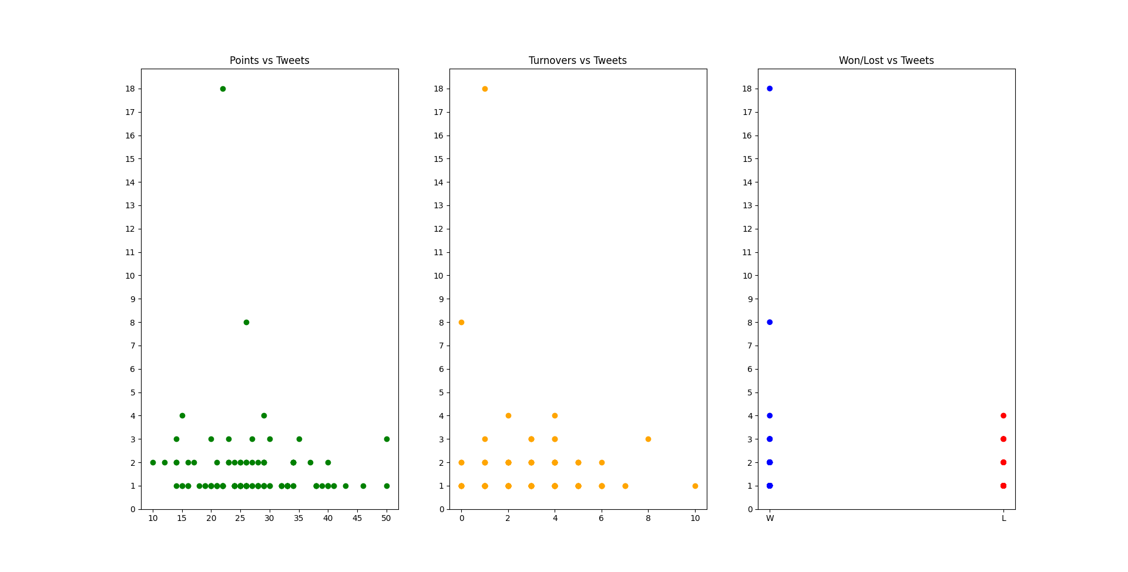

Slide 9
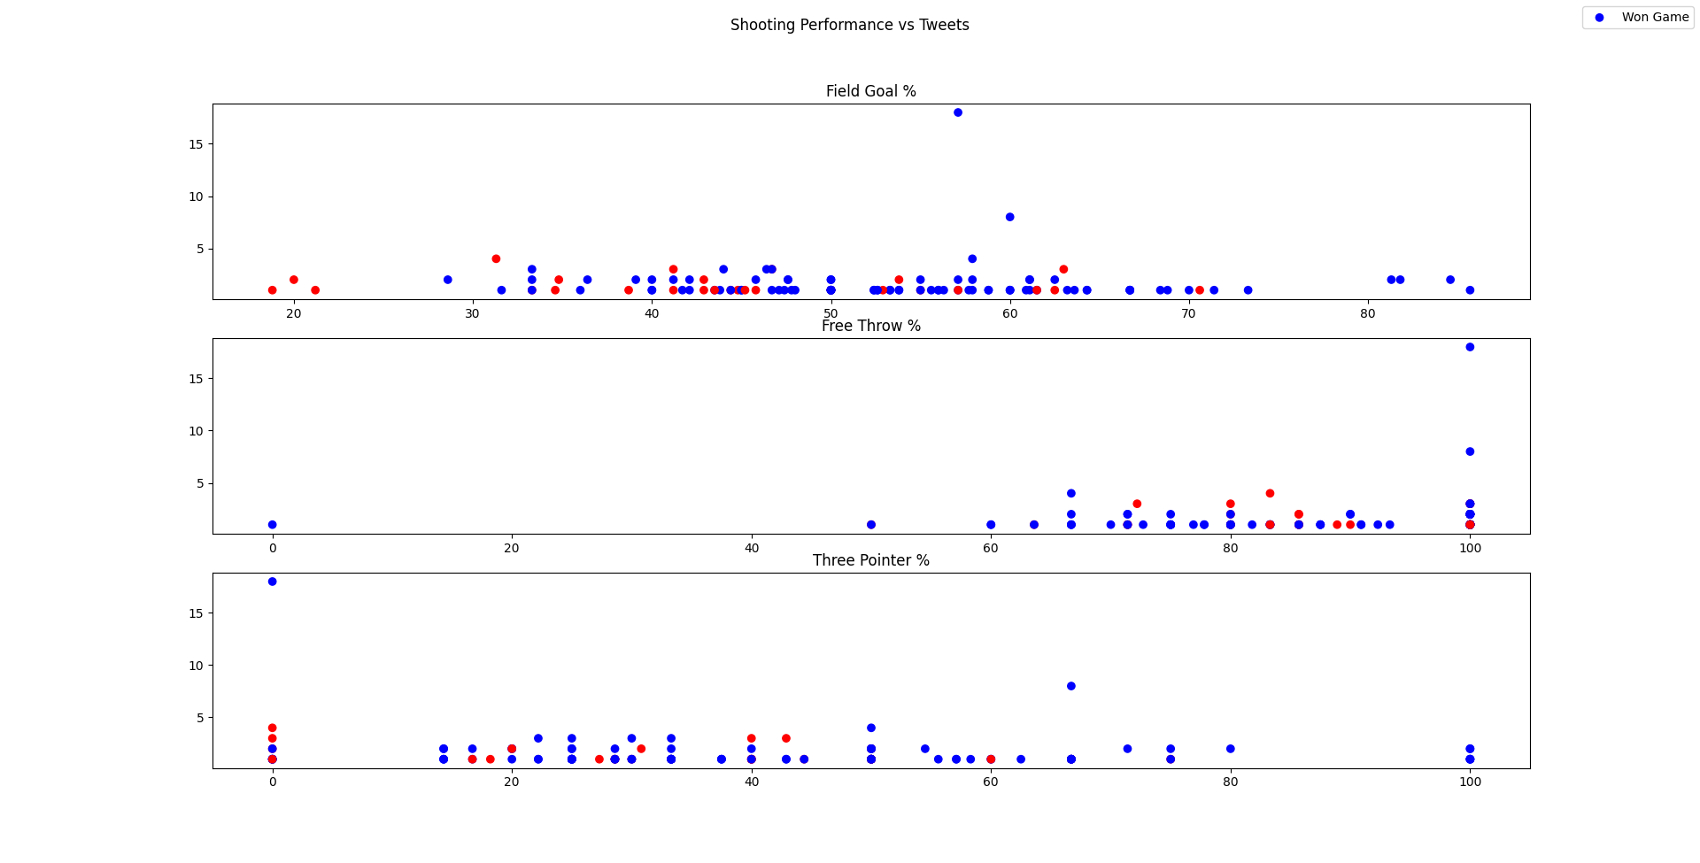

Slide 10
Thank You!
Q&A

