Slide 1



Categorization of the Brown Corpus
with the
Natural Language Toolkit (NLTK)
Nick Videtti
Final Project
IST 664 - Natural Language Processing
Winter 2023

Slide 2
About the Brown Corpus (Information from the NLTK book Chapter 2 Section 1.3
Created in 1961 at Brown University
Was the first million-word electronic corpus of English words
Contains corpora from 500 sources, each of which are categorized by genre
Some of the categories include news, editorial, humor, science fiction, adventure
Available in NLTK (nltk.corpus.brown)

Slide 3
Summary of Processing and Experiments
Tokenize words and sentences, put results into pandas DataFrame
Create feature sets, put results into pandas DataFrame
Create NLTK Naive Bayes classifiers and find accuracy via cross validation
Find most informative features
Alter sentence feature sets and compare results with originals
Analysis of sentence lengths

Slide 4
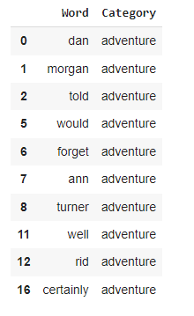
Pandas DataFrame of Tokenized Words
(Lowercase, Alphabetical Phrases, No Stopwords)

Slide 5
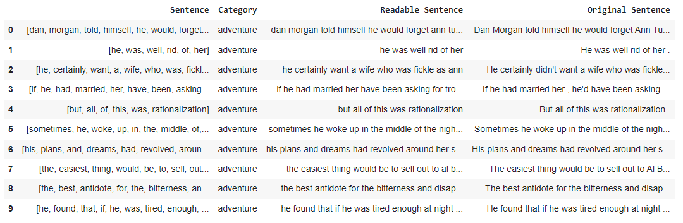
Pandas DataFrames of Tokenized Sentences
(Lowercase, Alphabetical Phrases, Stopwords Included)

Slide 6
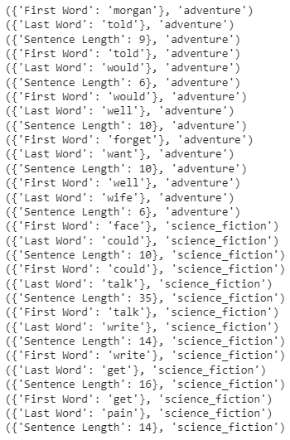
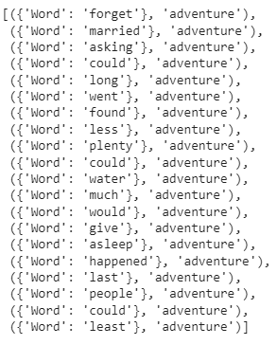
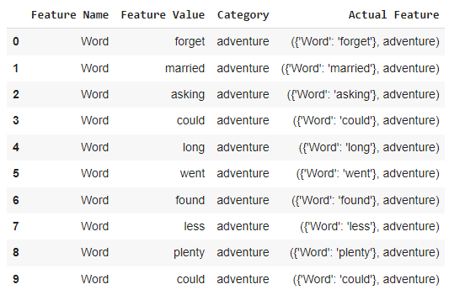
Initial Feature Sets
First Non-Stopword of Sentence
Last Non-Stopword of Sentence
Sentence Length (including stopwords)
Words
First 10 rows of Feature Set DataFrame

Slide 7
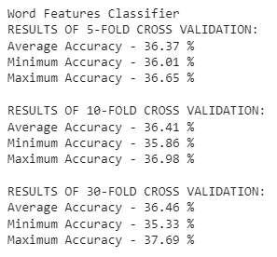
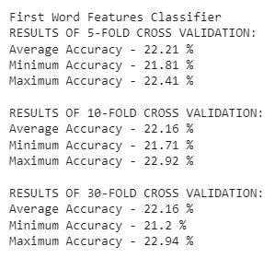
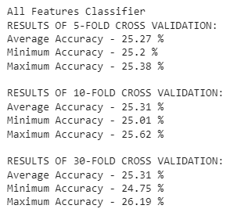
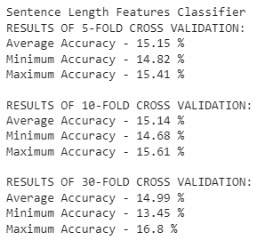
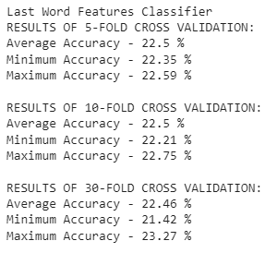
Cross Validation of Initial NLTK Naive Bayes Classifiers

Slide 8
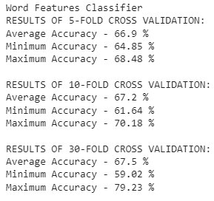
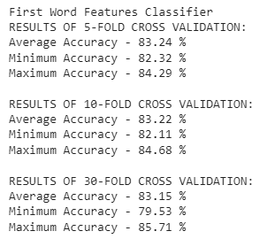
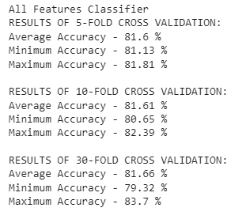
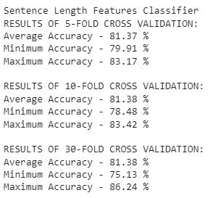
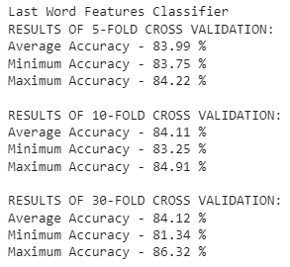
Cross Validation of Updated NLTK Naive Bayes Classifiers
(Only “News” and “Humor” Categories)

Slide 9
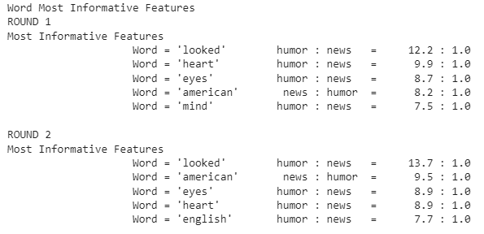
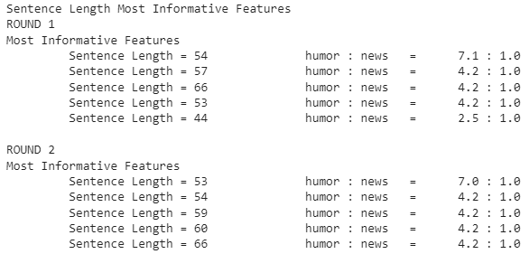
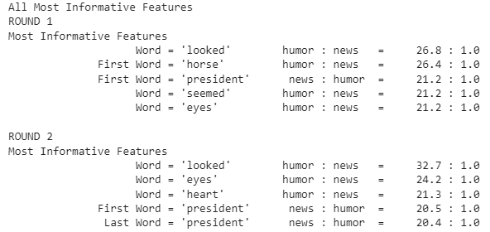
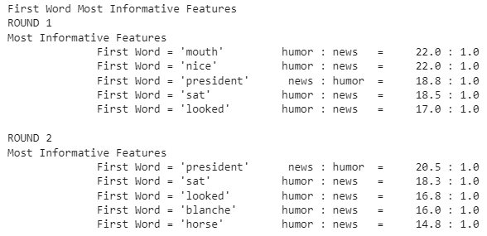
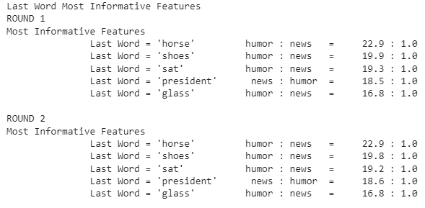
Updated Most Informative Features (Humor or News)

Slide 10
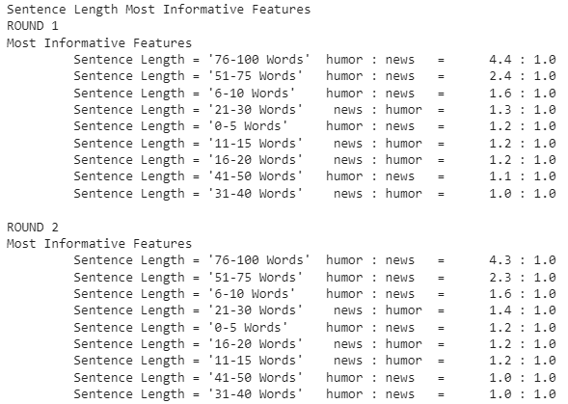
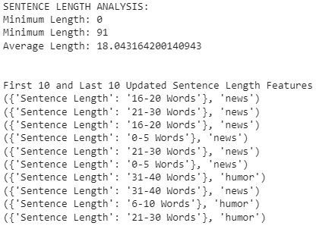
Sentence Length Range Features

Slide 11
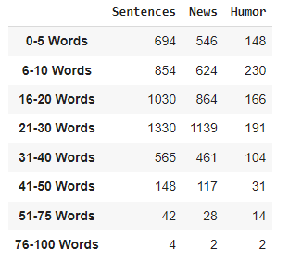
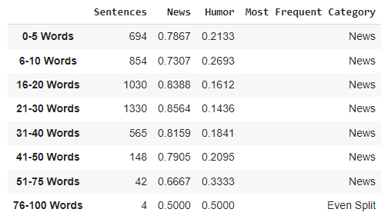
Sentence Length Range Categorization
Frequency
Normalized Frequency

Slide 12
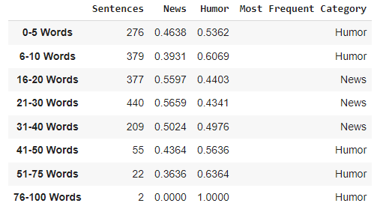

Updated Sentence Length Range Categorization
(Using Feature Set with Same Number of News and Humor Sentences)
Test Set
Train Set - All Sentence Length range Features for News and Humor Categories

Slide 13
Thank You!
Q&A

