Slide 1

StatMuse
“The elephant of sports and financial information”
Presentation by: Nick Videtti
IST - 644 Natural Language Processing
Winter 2023

Slide 2
What is StatMuse?
StatMuse, an artificial intelligence company, is the leader in conversational search for sports stats and information.
Search stats, scores, schedules, standings, odds, fantasy, bios, recaps and more — from live games all the way back to the inaugural seasons — for the NBA, NFL, NHL, MLB and PGA.
StatMuse Search provides instant answers to trillions of sports questions, while turning every result into a piece of personalized content on all your favorite devices.
The company was founded in 2014 and is backed by Disney, Google, Techstars Ventures, Greycroft, the NFL Players Association, Russell Okung and Tracy McGrady.
“Sports is, by itself, the international language, but StatMuse has taken a giant leap forward, transforming sports statistics into meaningful, storytelling prose.”
- David J. Stern, NBA Commissioner 1984-2014
Source: statmuse.com/company/about

Slide 3




Where is StatMuse?
Internet Browser (statmuse.com)
Alexa Devices
Google Assistant
iOS (App Store)
Facebook Messenger
Slack
Source: statmuse.com/company/products

Slide 4
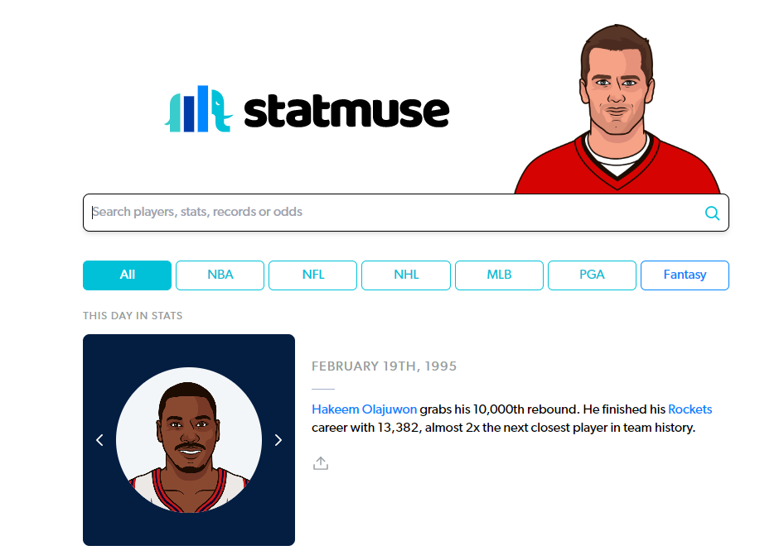

Major Features
Natural Language Querying
Natural Language Results
Automated Data Visualization
Player Gallery
Featured Searches and Trending Searches
Speech to Text processing for voice querying
Text to speech processing for voice-based results
Authentic Player Voices
Search Examples
Beta for Stocks and Crypto

Slide 5
Data Coverage
NFL
Game by game official statistics dating back to 1960
Season by season official statistics dating back to 1932
Game results and team standings dating back to 1920
NBA
Game by game official statistics dating back to 1984
Season by season official statistics dating back to 1946
Game results and team standings dating back to 1946
MLB
Game by game official statistics dating back to 1908
Season by season official statistics dating back to 1876
Game results and team standings dating back to 1876
NHL
Game by game official statistics dating back to 1917
Season by season official statistics dating back to 1917
Game results and team standings dating back to 1917
PGA
Season by season official statistics dating back to 1979
(All of the Above)
Real-time scores and stats powered by sports technology company sportradar
Source: statmuse.com/product/data

Slide 6
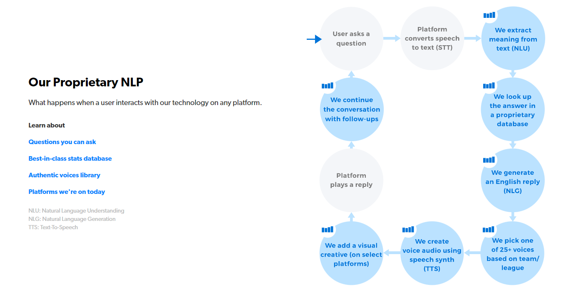
The StatMuse Model
(statmuse.com/company/about)

Slide 7
Demonstration of StatMuse on Google Chrome
statmuse.com

Slide 8
Thank You!

