Slide 1
IBM Data Science Final Capstone Project
Prepared By Vijayaragavan

Slide 2
Introduction
The aim of this project is predicting the traffic delay duration with given weather condition in United states. This model will be useful for who are new comers on the state for safe journey. A model to predict accident severity is built using these predictors as input vectors. Once the model is validated using a Machine Learning algorithm approach, we can be confident in predicting accident severity. In this proactive approach, the results of the analysis would be useful to various Entities like the Police and Insurance Companies. The goal is to reduce the fatalities and economic losses from accidents.
Approximately 1.35 million people die each year as a result of road traffic crashes. The 2030 Agenda for Sustainable Development has set an ambitious target of halving the global number of deaths and injuries from road traffic crashes by 2020. Road traffic crashes cost most countries 3% of their gross domestic product. More than half of all road traffic deaths are among vulnerable road users: pedestrians, cyclists, and motorcyclists. 93% of the world's fatalities on the roads occur in low- and middle-income countries, even though these countries have approximately 60% of the world's vehicles. Road traffic injuries are the leading cause of death for children and young adults aged 5-29 years.

Slide 3
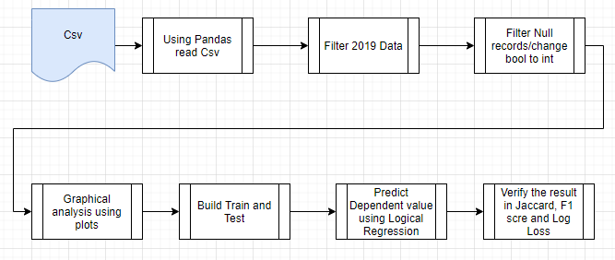
Process Flow

Slide 4
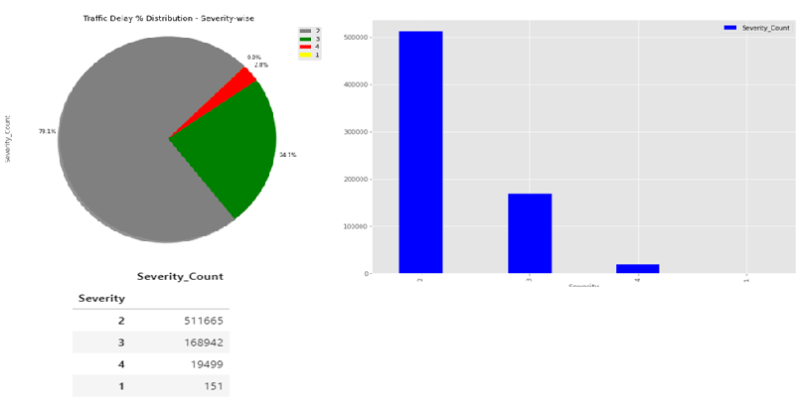
Severity Count Analysis – USA 2019 data

Slide 5
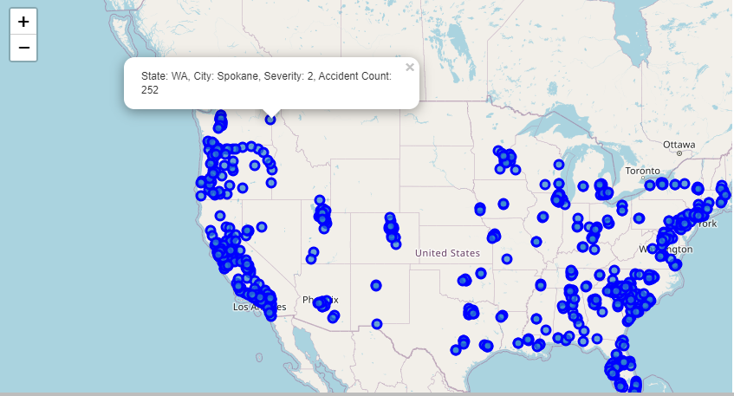
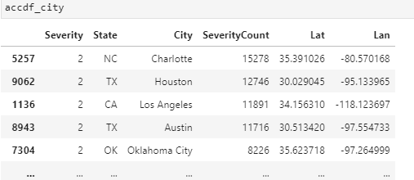
Accident counts with State/City Analysis

Slide 6
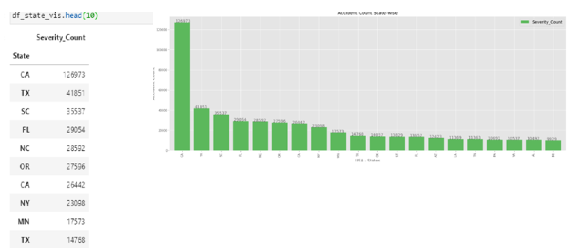
Below Bar chart indicates Accident count analysis for statewise

Slide 7
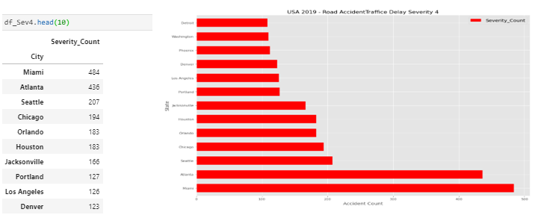
Below Bar chart indicates Severity4 count analysis for Citywise

Slide 8
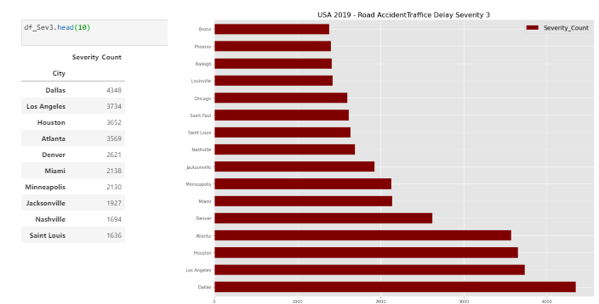
Below Bar chart indicates Severity3 count analysis for Citywise

Slide 9
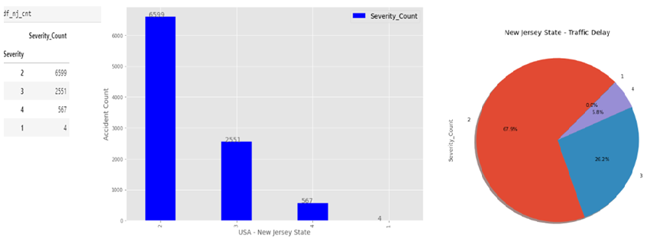
Below Bar/Pie chart indicates Severity count analysis for New Jersey

Slide 10
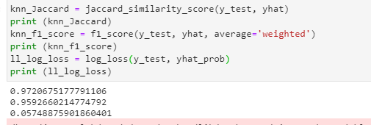

Conclusion
Conclusion:
Built useful models to predict traffic delays and plan for travel in.
Below is the final score in Logical Regression model.

