Slide 1

STOPPING TB WORLDWIDE
From Latin America to the World
A GCSO Immersion project
STOPPING TB WORLDWIDE

Slide 2
Why TB?
Why the Americas?
Why does it matter
for the region?
STOPPING TB WORLDWIDE

Slide 3

TB is the last
priority of WHO.
Most affected are
largely invisible.
STOPPING TB WORLDWIDE

Slide 4
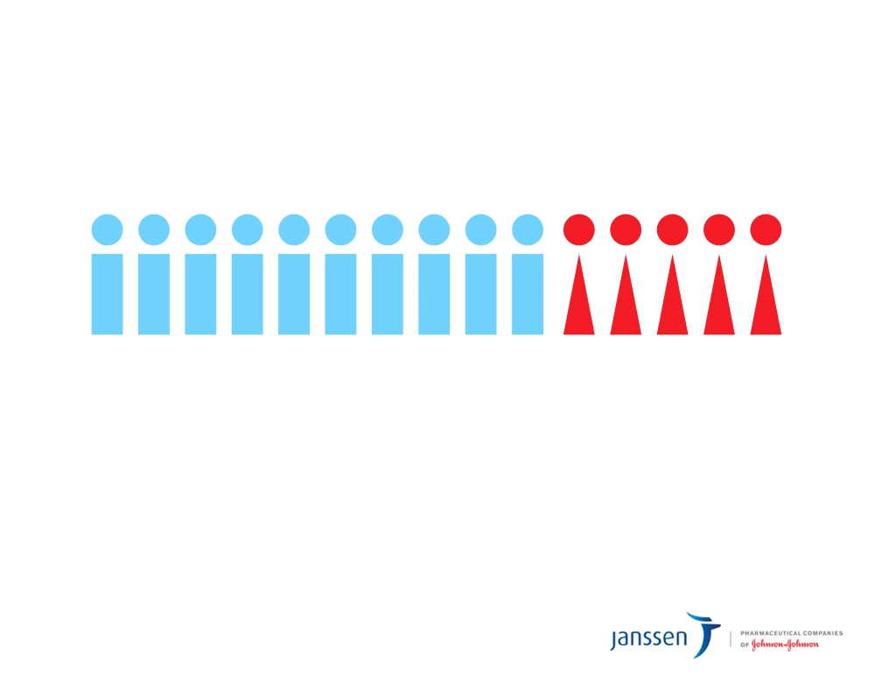
More than 1.5 million people die each year from TB. 1/3 of those are women.
TB is the #3 cause of death among women of childbearing age.
10 million children worldwide have been orphaned because a parent died of TB.
Over 18,000 die each year from TB in Latin America.
STOPPING TB WORLDWIDE

Slide 5
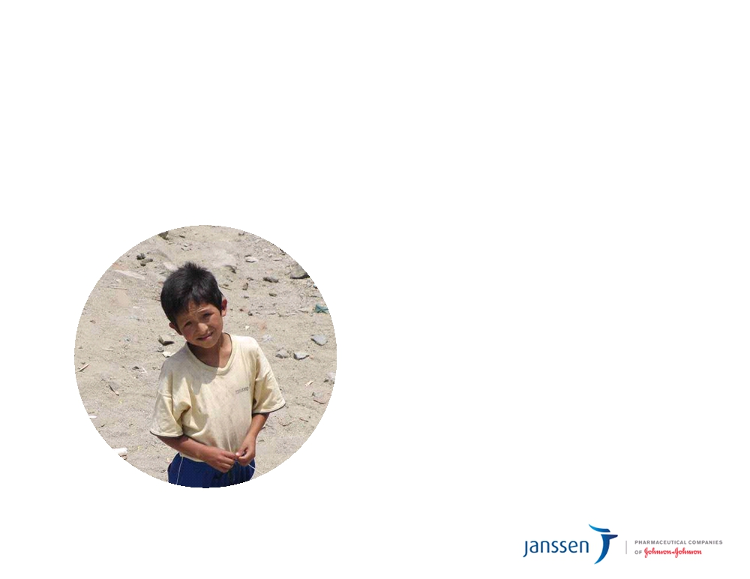
“Being poor is sad. Being poor and sick is infernal.”
- Sonia Goldenberg
STOPPING TB WORLDWIDE

Slide 6

Large unmet need + novel drug = partial solution
Sirturo
TM
Origination > Diagnosis > Treatment > Fulfillment > Compliance
Health partnerships across stakeholders can
fully address the problem
STOPPING TB WORLDWIDE

Slide 7
Sirturo
TM
“I’m pleased that another weapon
has been added to the arsenal for
What they’re saying
fighting this deadly, contagious disease.” - Margaret A. Hamburg, MD, FDA Commissioner
“The accelerated approval of Sirturo is a significant step in the fight against MDR-TB.” - Dr. Paul Stoffels
“This is the first time a new drug is being introduced
specifically for MDR-TB, for which the current needs are so great. - Lee Reichman, MD
STOPPING TB WORLDWIDE

Slide 8
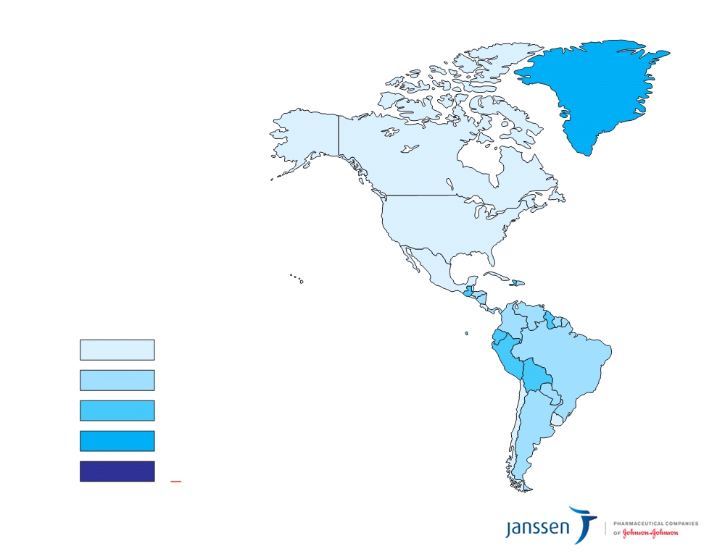
Estimated TB Incidence Rates, 2011
Estimated new TB cases (all forms)
per 100,000 population
0-24
25-49 50-149 150-299 > 300
STOPPING TB WORLDWIDE

Slide 9
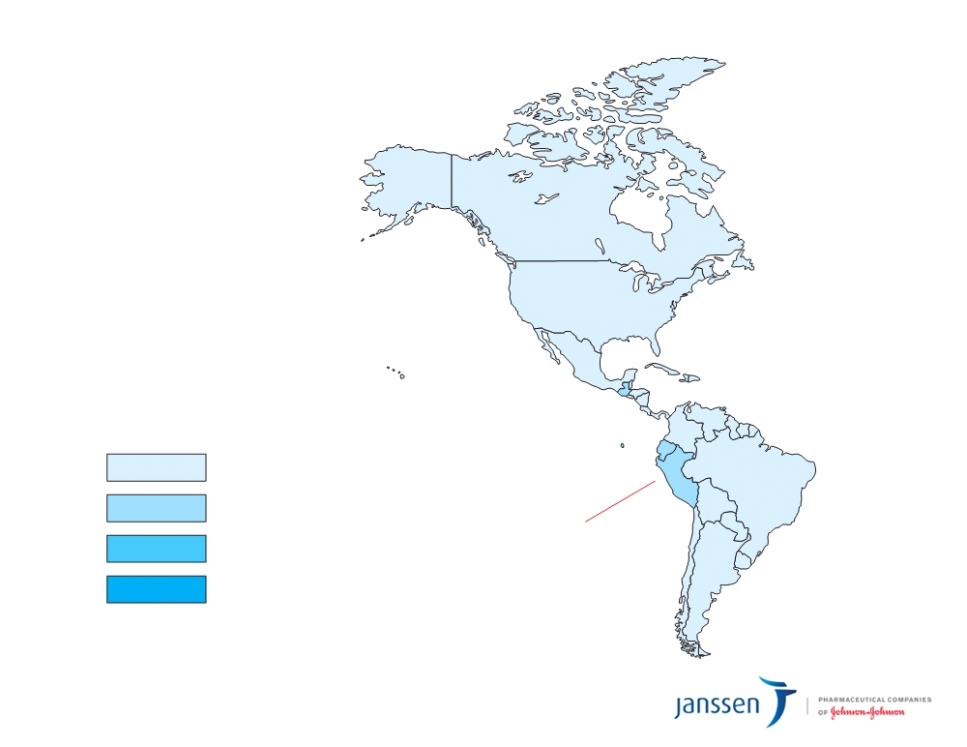
New MDR-TB Cases, 2011
Percentage
of cases
0-2.9
3-5.9 6-11.9 12-17.9
Peru has the highest incidence
STOPPING TB WORLDWIDE

Slide 10
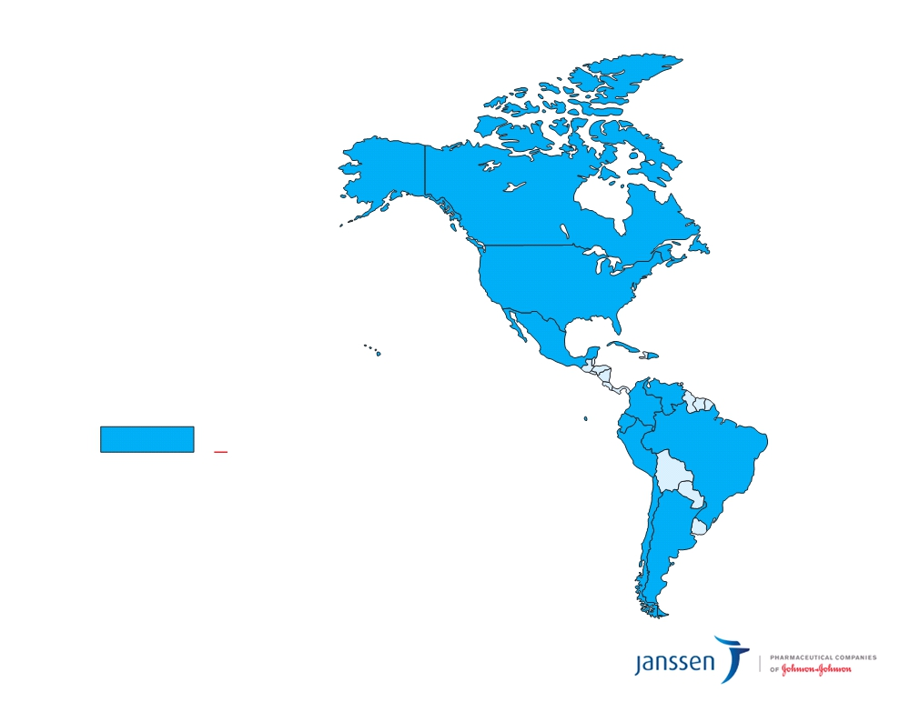
XDR Cases Reported, 2011
Number of
cases reported
> 1
Resistance is
advancing everywhere
STOPPING TB WORLDWIDE

Slide 11
Relevance to LA Team
External
Internal
Engagement with local key stakeholders > reshaping JnJ Pharma perceptions,
LA as learning pilot for JnJ and Health Partnerships > to export to other regions
strengthening relationships
Internal/External
JnJ recruitment point of differentiation: socially committed, bringing innovative solutions
STOPPING TB WORLDWIDE

Slide 12

Work to date
Draft
Proof of Concepts
Meetings w/ local stake-
Partner with
FDA holders in
approval Peru - input
Socios
of Sirturo key ideas
Meetings w/
Q1 2013
local stake- holders in Peru
Action plan
defined
Meetings
Team w/ int’l.
formed orgs.
Q4 2012
STOPPING TB WORLDWIDE

Slide 13

Action
Plan
Digital Adherence System
Electronically link TB patients, promotoras, nurses, and physicians for rapid communication and support during treatment, via mobile device
Focus
Concepts to target improvements in MDR treatment adherence
Treatment Completion Incentive
Specific treatment milestones will be established for both the patient and the promotora; “incentives” are earned when these milestones are achieved
STOPPING TB WORLDWIDE

Slide 14

What’s next?
Continue building concepts to address treatment adherence in Peru
Landscape assessments
Local enrollment
Engagement with gov’t. affairs/ patient advocates
STOPPING TB WORLDWIDE

Slide 15
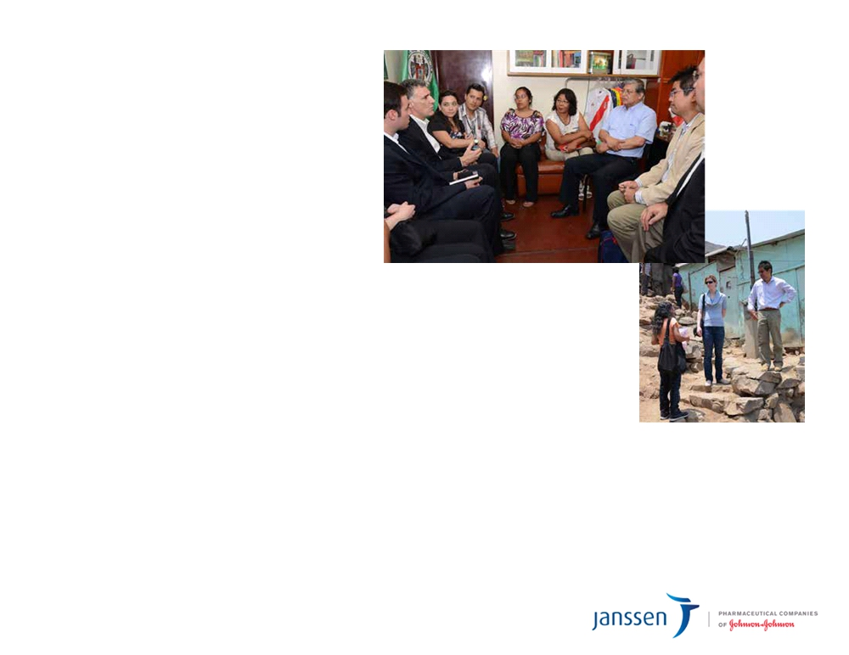
Ross Underwood
Global Access,
Commercial Leader
Debbie Nicholl
Market Access
Jami Taylor
Pharm Access Policy
Derek Fetzer
Carolina Kellstein
Business Analytics
Business Analytics
Steve Ruhmel
Carlo Crisostomo
Information Technology
Marketing IDP (Mexico)
Grace Normandin
Tacho Valencia
Infectious Diseases & Vaccines
Market Access (Mexico)
STOPPING TB WORLDWIDE

Slide 16
Our Request
Access insight from local gov’t. affairs teams
Access insight/collab from patient advocacy groups
Collab from local team members on a volunteer basis
STOPPING TB WORLDWIDE

Slide 17
Comments? Questions?
STOPPING TB WORLDWIDE

Slide 18
Stop TB
Working
deaths in
pilot in Peru
by 2013
the Americas
by 2025
Stop all
TB deaths by 2050
STOPPING TB WORLDWIDE

Slide 19
Todo Bien
It’s time to make the invisible visible. Time to be the beacon on the hill.
Our passion is changing the playing field; our commitment is changing lives.
Simply put, we’re stopping all TB deaths. That’s not a pipe dream. That’s a promise. By going well beyond the pill, we’re
responding to needs, not logistics - inspiring our industry in the process.
And we won’t stop until poverty becomes priority. Until fear turns to hope.
Until the world is well.
STOPPING TB WORLDWIDE

