Slide 1
Adversarial self-supervised learning for semi-supervised 3D action recognition(ECCV 2020)
From Image Collections to Point Clouds with Self-supervised Shape and Pose Networks(CVPR 2020)
Self-Supervised Learning of Video-Induced Visual Invariances(CVPR 2020)

Slide 2
Adversarial self-supervised learning for semi-supervised 3D action recognition
Problems:
  previous methods heavily rely on the available manual annotations that are costly to acquire
  directly applying SSL for semi-supervised learning suffers from misalignment of representations learned from self-supervised and supervised learning tasks
Solutions:
self-supervised semi-supervised learning (S4L), that couples self-supervision with a semi-supervised learning algorithm
an Adversarial Self-Supervised Learning (ASSL) Network for semi-supervised 3D action recognition

Slide 3
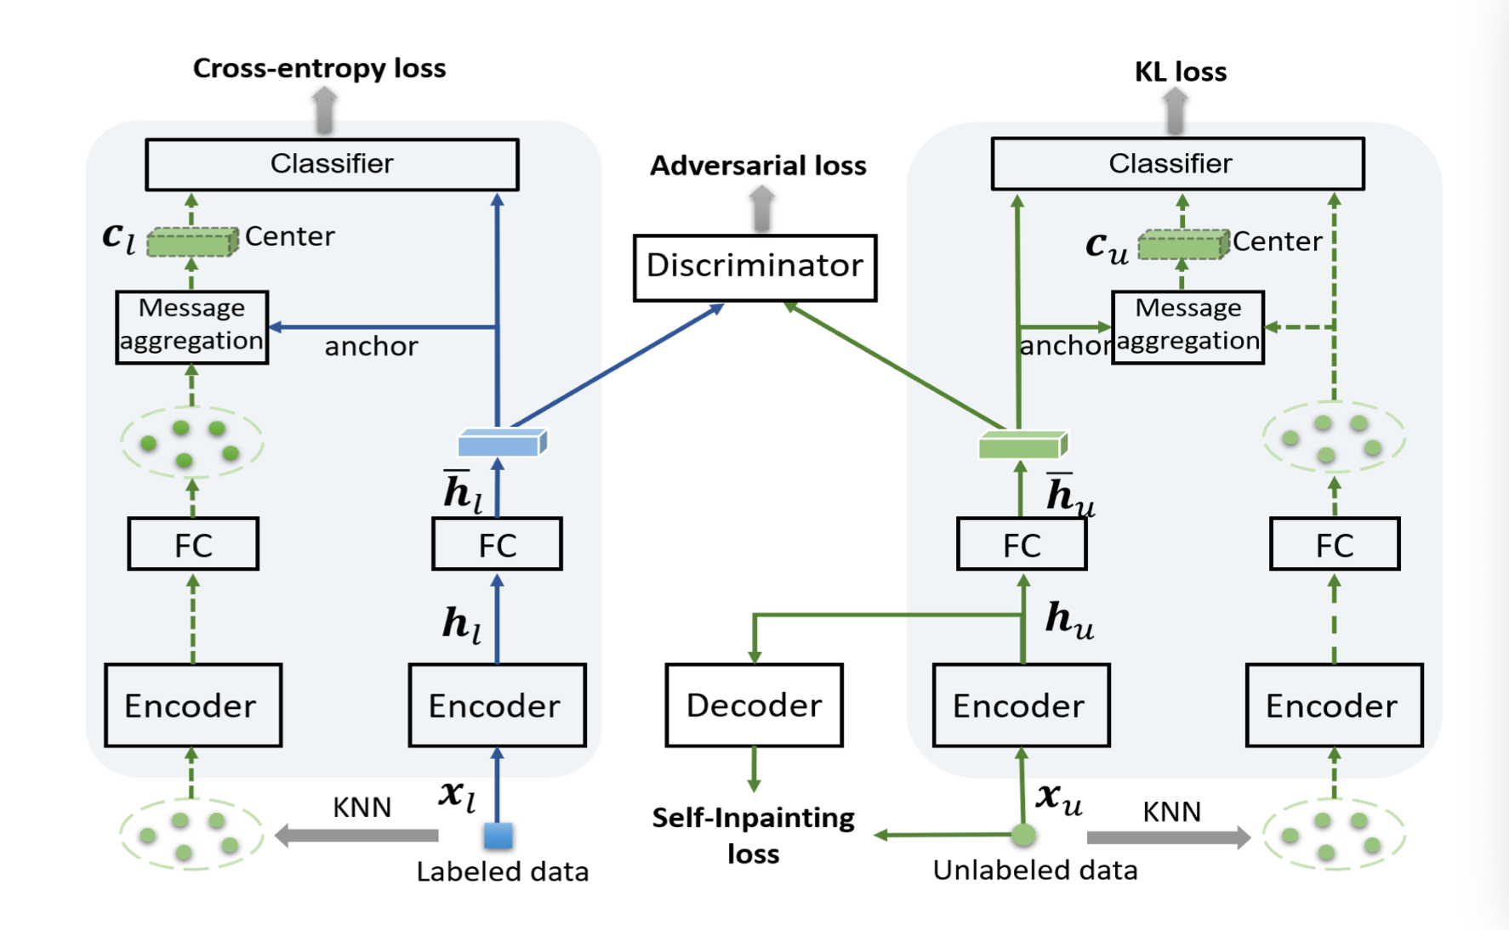
Model Architecture

Slide 4
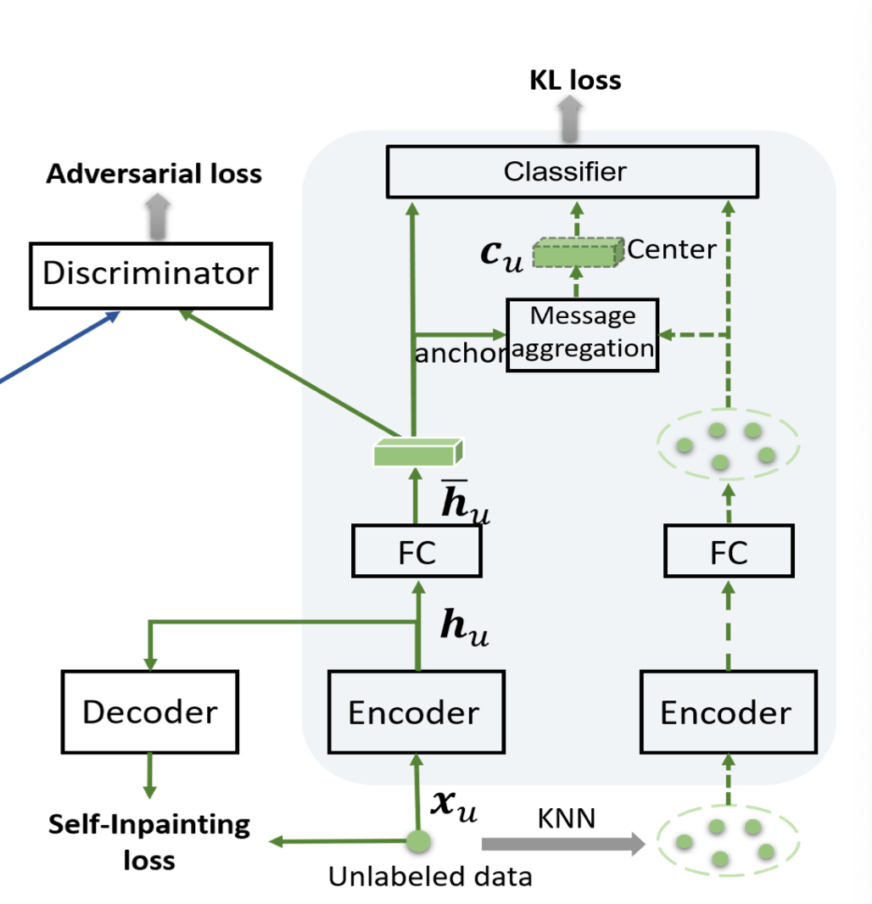
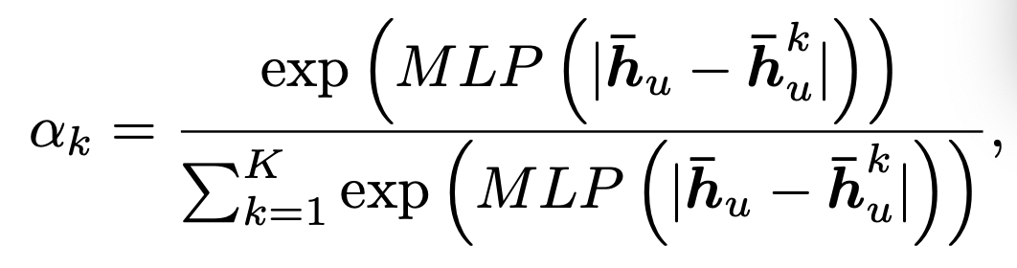
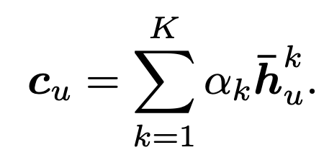
Self-Supervised
Self-Inpainting: learn temporal information for each
unlabeled sequence
Encoder: takes an input skeleton sequence x from
training set and produces a vector
as the temporal features h
Decoder: aims to fill the masked regions in the input sequence
FC: bridge the gap between the feature spaces of action classification
and skeleton inpainting
K-nearest neighbor: select K nearest neighbors from
unlabeled training set
message aggregation module: produce the local center vector

Slide 5
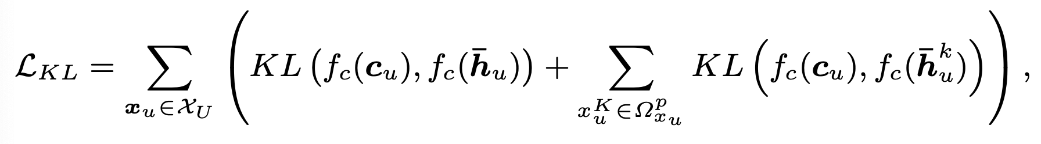
Self-Supervised
KL-Loss:
KL(·) denotes Kullback- Leibler divergence.

Slide 6
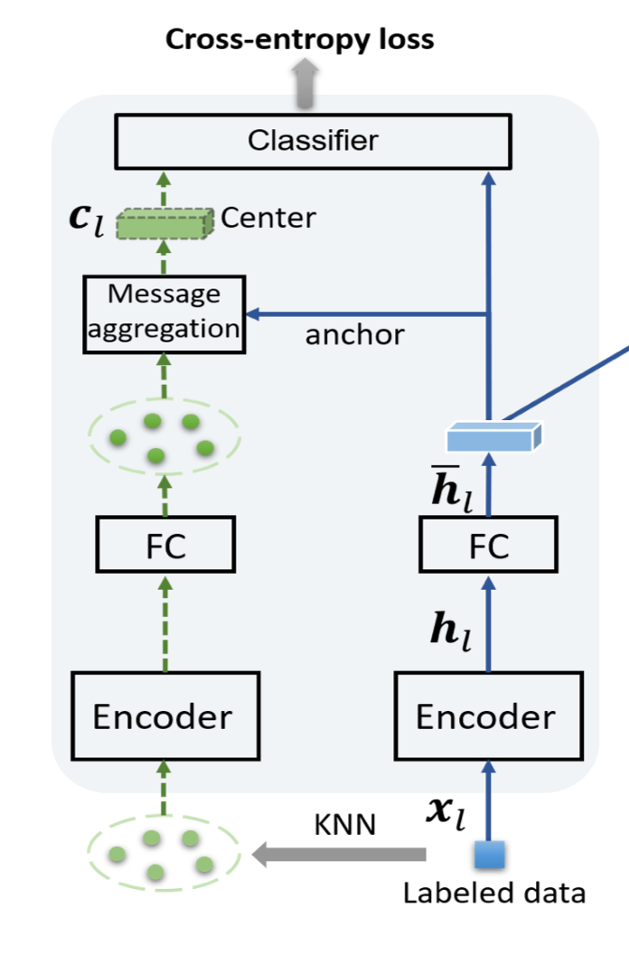
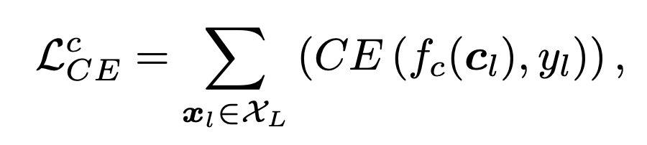
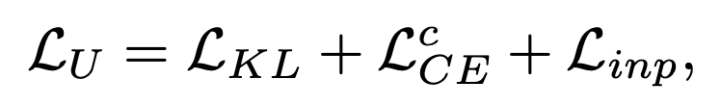
Semi-Supervised
Total Loss Function

Slide 7
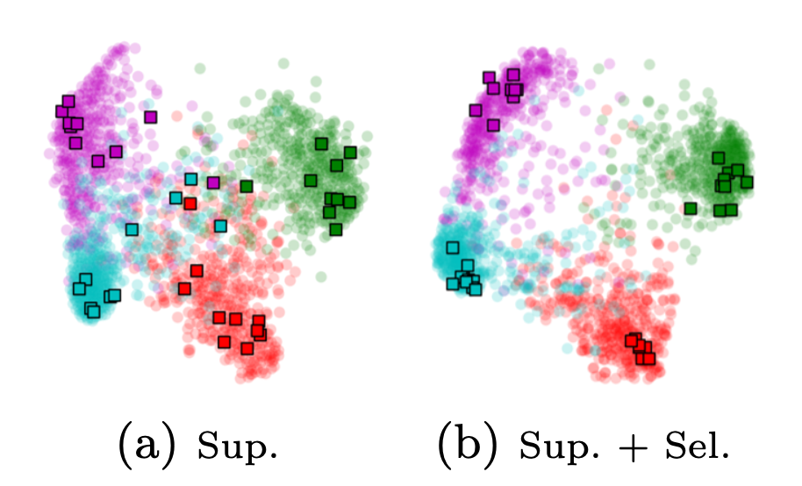
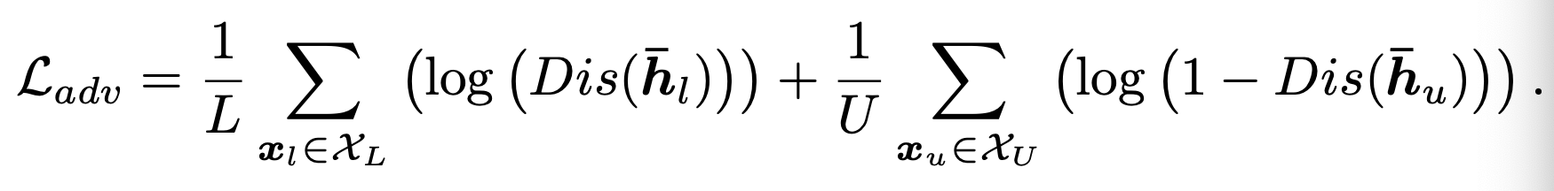
Adversarial Learning for Aligning Self-Supervised and Semi-Supervised Representations
A discriminator D is trained to distinguish the unlabeled features from the labeled features. And the model is trained simultaneously to confuse the discriminator D

Slide 8
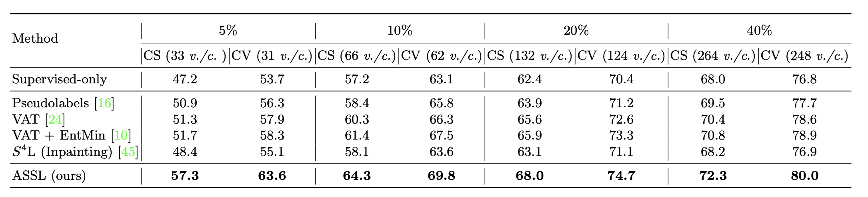
Result
Self-Supervised Pretext
Neighborhood Consistency

Slide 9
From Image Collections to Point Clouds with Self-supervised Shape and Pose Networks
Problems:
Early works on single image based 3D reconstruction utilize full 3D supervision in the form of 3D voxels, meshes or point clouds. However, such approaches re- quire large amounts of 3D data for training
Several recent works have focused on utilizing multi-view 2D supervision in the form of color images and object silhouettes as an effective alternative training protocol, however, most of these approaches require multiple 2D view of the same 3D model along with the associated camera pose information in the training stage.
Solution:
learning 3D object reconstructions from image and corresponding silhouette collections

Slide 10
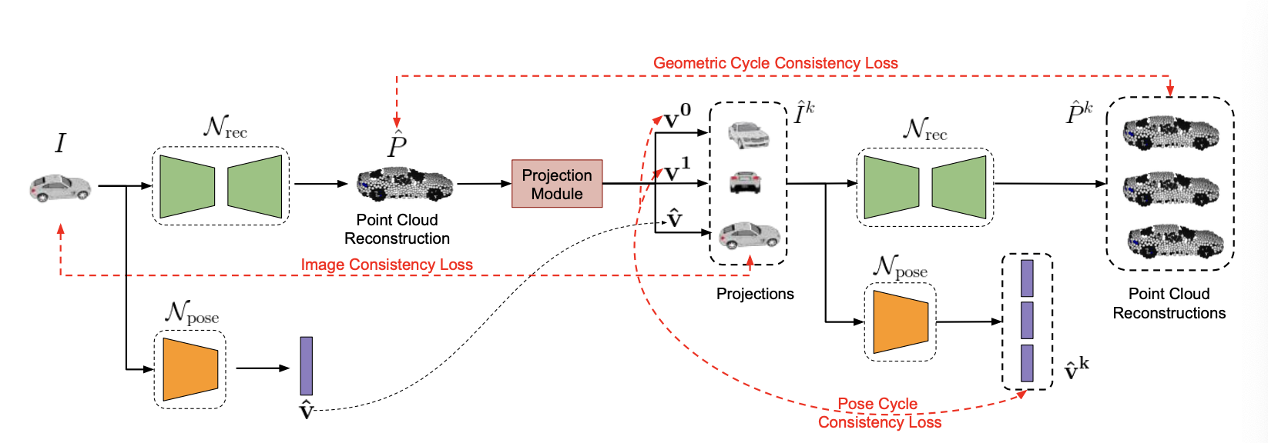
Model Architecture

Slide 11
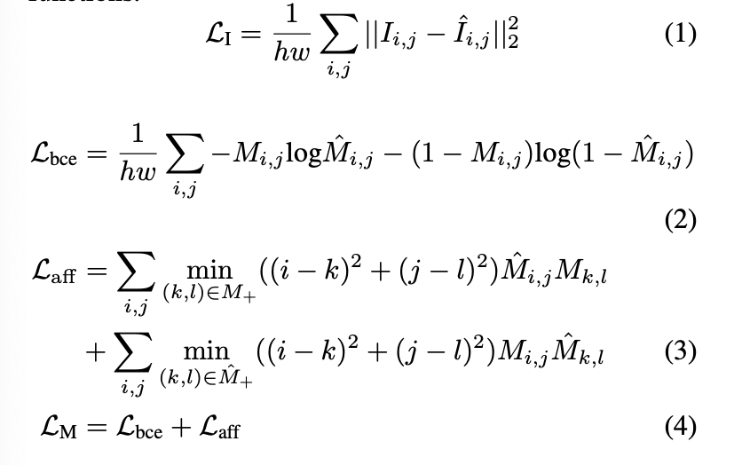
Projection Module: proposed in DIFFER and CAPNet; If the predicted viewpoint and reconstructions are correct,
the 2D projections will match the input image

Slide 12
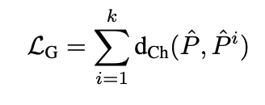
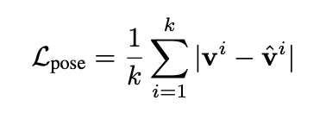


Since the predicted viewpoint is used in projection, the reconstruction network can predict correct 3D models that consistently match the input image only if the pose predictions are accurate. Similarly, since the pose network parameters are optimized using projection losses, the predicted pose values will be correct only if the reconstructions are reasonable. In such a situation, the network can collapse to degenerate solutions.
Geometric Cycle Consistency Loss
Pose Cycle Consistency Loss
dCh(·,·) denotes the Chamfer distance between two point clouds.

Slide 13
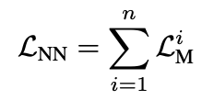




Nearest Neighbours Consistency Loss
During training, nearest neighbours of the input image are utilized as additional supervision. The neighbour images are passed through Npose to obtain the corresponding poses.
Symmetry Loss
Since all the object categories we consider in our experiments have a minimum of one plane of symmetry,
we further regularize the network to obtain symmetric reconstructions with respect to a pre-defined plane.
Inference Stage Optimization
To ensure that the reconstructions are not degraded in the regions occluded in the input image, we employ
additional regularization.

Slide 14
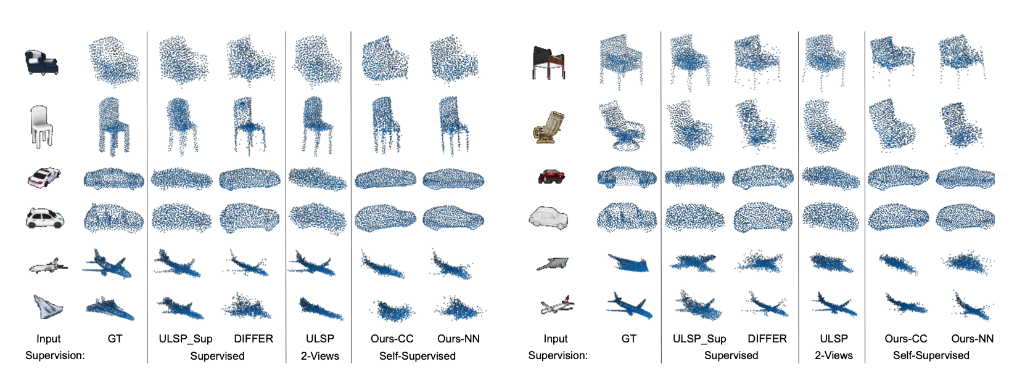
Result

Slide 15
Self-Supervised Learning of Video-Induced Visual Invariances
Video-Induced Visual Invariances
  (i) frame-level invariances (e.g. stability to color and contrast perturbations)
  (ii) shot/clip-level invariances (e.g. robustness to changes in object orientation and lighting conditions)
  (iii) video-level invariances (semantic relation- ships of scenes across shots/clips)

Slide 16
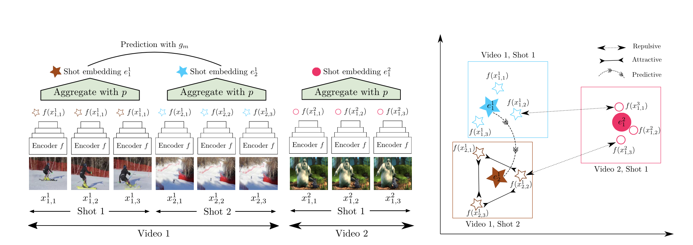



Overview
a frame-encoder f, a frame embedding pooling function p, and one or multiple shot-level prediction functions gm
Shot-level prediction functions are trained to predict pretext (label-free) targets from shot embeddings.
the frame/shot-level loss, where y are shot-level pretext labels
the video-level loss, where the y are video-level pretext labels

Slide 17
Learning shot-level invariances
For learning shot-induced invariances, one can take two approaches:
apply the image-based SSL loss independently to each frame so that the shot-induced invariances are learned implicitly through the combination of pooling function and video-level prediction task
explicitly ensure that the embeddings of the frames from the same shot are similar by adding a triplet or a contrastive loss to the image-based SSL loss.
Solution:
we consider SSL by rotation prediction without additional explicit shot-level loss.
where each image is associated with a different class, and a feature extractor is trained to classify each image into its own
class after heavily augmenting it (random cropping, rotation, contrast, and color shifts). we employ a triplet loss
encouraging augmentations of the same image to be close and augmentations of different images to be far apart.

Slide 18
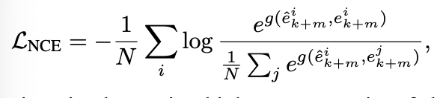
Learning video-level invariances
For shot order prediction
randomly reverse the order of the shot embeddings and train a prediction function g to predict the shot order from concatenated shot embeddings
LV in (1) is the cross-entropy loss and ymi is 1 if the sequence of shot embeddings is reversed and 0 otherwise
For predicting future shot embeddings
noise-contrastive estimation

Slide 19
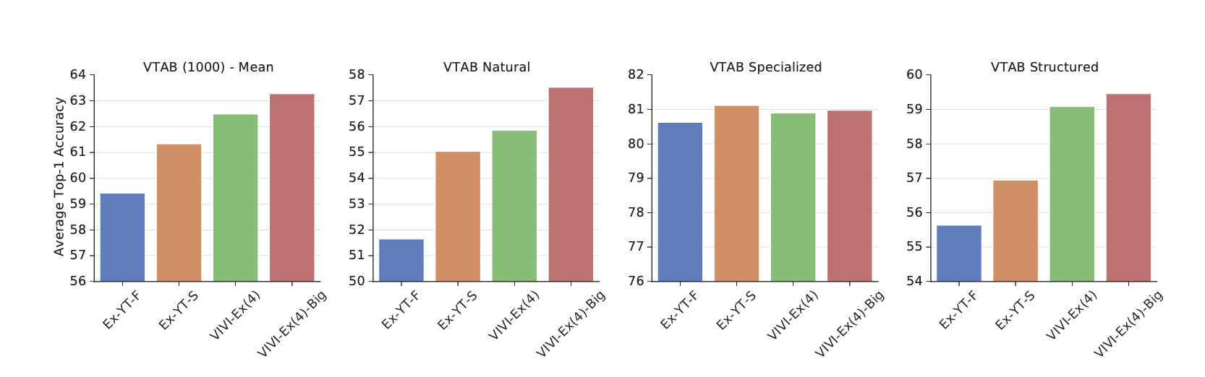
Co-training with ImageNet
Combining image- based SSL losses with a supervised loss applied to a subset of the images
we additionally apply f followed by a linear classifier to mini-batches of labeled images and compute the cross-entropy loss LSUP between the predictions and the image labels. The total loss is then computed as LSSL + γLSUP
Result

