Slide 1

Vertex Marketing
Campaign
Presented By:
Aishani Sood | Neha Vipperla | Steve Essi
Himani Chauhan

Slide 2
Objectives
➼ Is the customer eligible for a housing loan?
➼ Will the customer subscribe to a term deposit?
➼ What is the annual balance of a customer?
➼ Number of calls to be made to get customers
subscribe for a term deposit?

Slide 3
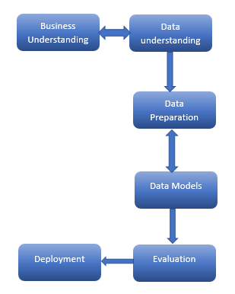
Where are we?

Slide 4
What factors are important in determining customer’s eligibility for home loan?
False Positive: Customers who are not eligible for loan will be classified as eligible
*False Negative *: Customers who are eligible for home loan will be classified as ineligible.
Significance:
Targeting potential customers
Models Used:
Decision trees
KNN

Slide 5
K-NN results
Settings | Misclassification Rate (%) | False Positive (%) | False Negative (%)
Default | 45.25 | 62.89 | 29.81
Feature Selection | 42.58 | 46.16 | 39.44
PCA | 45.17 | 46.13 | 39.47

Slide 6
Decision tree results
Settings | Misclassification Rate (%) | False Positive (%) | False Negative (%)
Default (Branches=2 Depth=6) | 41.71 | 61.14 | 25.16
Auto Tune (Branches=2 Depth=5 | 39.75 | 35.51 | 43.36
Branches=3 Depth=4 | 39.59 | 38.06 | 40.90

Slide 7
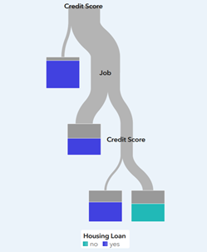
Best model
Variables Used: Credit Score, Job
Settings | Misclassification rate(%) | False positive(%) | False Negative(%)
Branches=2 Levels=6 | 41.71 | 61.14 | 25.16

Slide 8
The most common path Is:
If the credit score is less than 770 and job is blue collar, housemaid, retired, self-employed, student, technician there is 50 percent chances that customers will be eligible for loan.
The most desired path Is:
If the credit score is greater than 770, then there are 90 percent chances that the customers will be eligible for home loan.

Slide 9
Will the customer subscribe to a term deposit?
False Positive: Customers who will not subscribe for term deposit will be classified as they will subscribe.
*False Negative *: Customers who are likely to subscribe for term deposit are classified as they will not subscribe.
Significance:
Targeting potential customers
Direct Marketing strategies
Models Used:
Decision trees
KNN

Slide 10
K-NN results
Settings | Misclassification Rate (%) | False Positive (%) | False Negative (%)
Default | 9.94 | 2.61 | 67.78
Feature Selection | 10.1 | 2.74 | 71.65
PCA | 10.04 | 2.10 | 72.61

Slide 11
Decision tree results
Settings | Misclassification Rate (%) | False Positive (%) | False Negative (%)
Default (Branches=2 Depth=6) | 9.07 | 3 | 54.8
Auto Tune (Branches=2 Depth=6) | 9.45 | 3.5 | 55
Branches=2 Depth=8 | 8.59 | 2.3 | 50.03

Slide 12
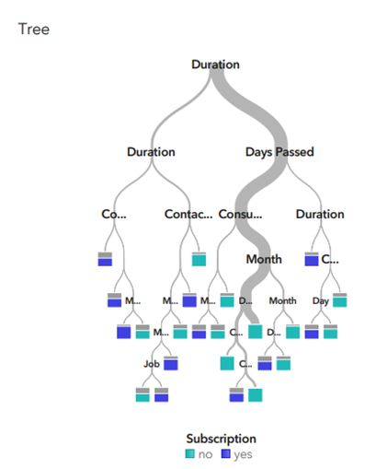
Best model
Variables used: Duration, Days passed,Month CCI, Contact Type, Job, POutcome, Age Group and Annual Balance group
Settings | Misclassification rate(%) | False positive(%) | False Negative(%)
Branches=2 Levels=8 | 8.59 | 2.3 | 50.3

Slide 13
The Most common path Is:
If we make promotional calls are made during Jul, June, May and
If Consumer confidence index is as low as -35 and
If we make a call back after 50 days and
Duration of the call is less than 245 seconds
then subscription=’No’
The Most desirable path is:
If Contact type is Telephone and
Promotional calls are made during Aug, Dec, Nov, Oct, Sep and
Duration of the call is less than 1200 seconds then subscription=’yes’
Notes:
Recommendation: Best time to make calls are during the months of Aug, Dec, Nov, Oct, Sep
Duration of the call better be crisp i.e., between 4 minutes to 20 minutes
Phone calls are to be made to their home telephone rather than cellular to increase the chances of customer subscribing to term deposit.

Slide 14
What is the annual balance of a customer ?
Significance:
Target Campaign, Up-selling and Cross-selling
Models Used:
Linear regression
Decision trees
Linear Regression
Settings | Model p-value | Adj R² | RMSE
5 Variables | <.00001 | 0.0022 | 3,247
Y = 1,783.14 +0.1453X_{Consumer confidence index}
Notes:
The Business scenario is to see if we can predict customers annual balance on the average. This will be used for target campaign, cross selling and upselling of new and existing customers.
Linear Regression: We did not have good output from this model as the Adj R² variability was just 0.22% and RMSE $3,240 away from the mean ($1,550).
Approach/modelling Experience: We used several settings while doing the linear regression. For Decision tree, we used settings ranging from (2 branch, 6 dept) to Autotune with settings (3 branches, 10 dept).

Slide 15
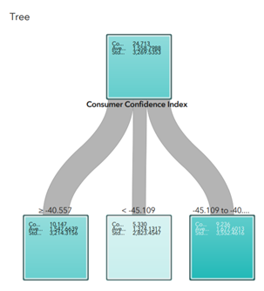
Best model
Variables used: Consumer Confidence Index,
Job, Credit Score.
Settings | ASE
Branches=3 Depth=10 | 3,168

Slide 16
The most common path Is:
If consumer confidence index (CCI) is between -46.25 and 32.59
then we can predict that the annual balance on the average would be $1,552
The Most desirable path is:
If consumer confidence index (CCI) is >= -32.59
then we can predict that the annual balance on the average would be $1,862.
Recommendation: We recommend that output from this prediction using consumer confidence index should be made available to our Sales and Customer service representatives for effective campaign, cross-selling and upselling.
Notes:
The Major predictor of customers annual balance using this dataset is consumer confidence index. Customers will save more if the are pessimistic and do not have confidence that the economy will improve. This impacts on their annual balance in their bank accounts.
Part of our motivation and major interest in predicting customers annual balance is to use it for more investigation on whether the customer saves his income with the bank and how we could encourage them to save more with our bank. We need to device a means of getting a good share of their savings as we believe they may have other options of investing or saving their money with competitors. As part of our campaign strategy, we will encourage them to take advantage of our various product and services which will incentivize them and bring valuable returns on their investment with the bank.

Slide 17
Number of calls to be made to get customers to subscribe to a term deposit?
Significance:
Targeting potential customers
Optimizing efforts
Models Used:
Decision trees
Linear regression
Linear Regression
Settings | Model p-value | Adj R² | RMSE
2 Variables | <.00001 | 0.0245 | 1.716
Y = 2.18 - 0.528X_{Contact type} + 0.0004X_{Days Passed}

Slide 18
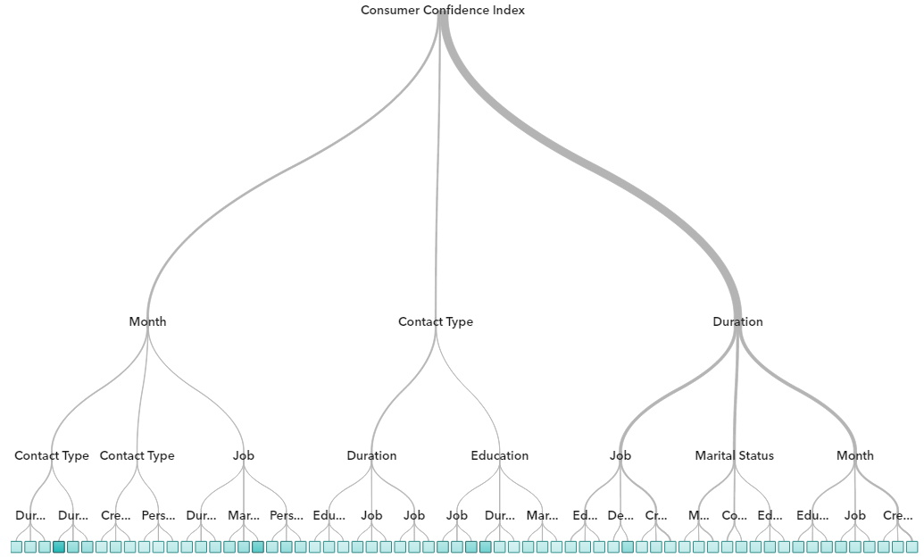
Best model
Variables used: Default Credit, Month, Consumer Confidence Index, Credit Score, Duration, Contact type, education, job, marital status, personal loan.
Settings | ASE
Branches=3 Depth=4 | 2.52

Slide 19
The Most common path Is:
If credit score is more than 800
Consumer confidence index (CCI) between -28 to -48
Called in March, April, June, July, September, October, November or December
Duration of the call is less than 7 minutes
then average calls made is 1.82
The Most desirable path is:
If the client is a technician and has no default credit
Consumer confidence index (CCI) between -28 to -48
Duration of the call is between 230 to 430 seconds
then average calls made is 1.5
Notes:
Recommendation: Our recommendations based on this model are to engage with customers on an average of 1.5 times.
Contact customer that are have a credit score of more than 800 and a consumer confidence index between -28 to -48. Engage with customers during spring and fall months i.e. March, April, June, July, September, October, November or December. The duration of the calls should be less than 7 minutes.

Slide 20

Conclusion:
Effective and target campaign is key in marketing and rendering good customer service. This will save cost and increase productivity.
To preserve the relationship with customer, we need to optimize number of calls made to a customer, duration of the phone call, contact method, time of contact and hence balance the effort to reward ratio.

Slide 21
Thank You

