Slide 1
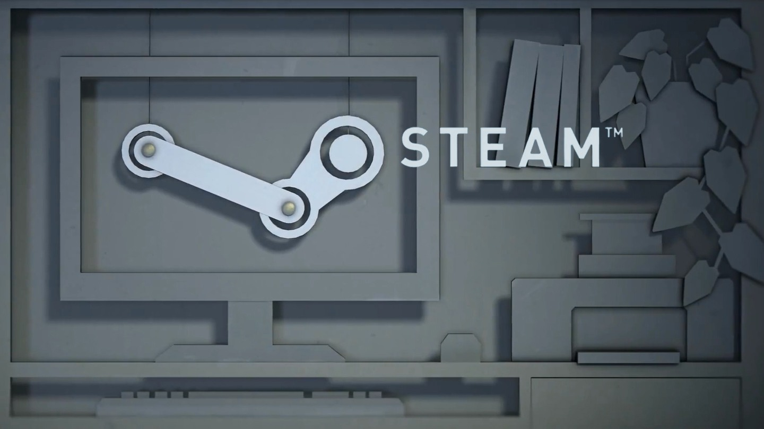
Final Presentation
By
Aishani Sood
Himani Chauhan
Steve Essi
Neha Vipperla

Slide 2

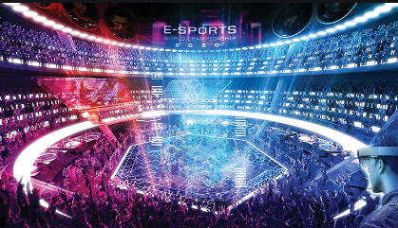
Paradigm Shift in Video Game Industry
Notes:
Games have moved from Rooms to Arenas.

Slide 3
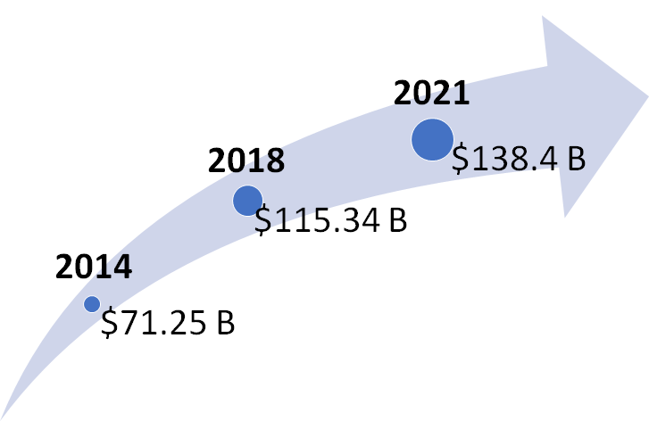
Tapping into the Growth
Tap into potential market
Remain competitive
Know the customer pulse
Increase revenue
Notes:
How video game industry is growing? Impacts? Todays market? Customers madness

Slide 4
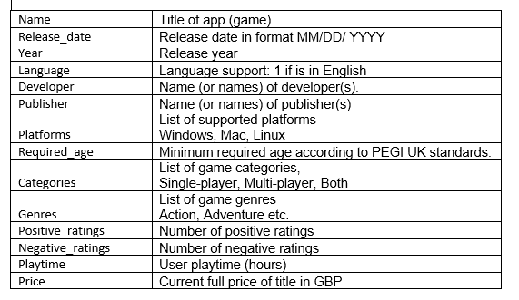
Data Dictionary
5 year data from 2014-2018.
11 columns and 898 rows.
7 qualitative, 4 quantitative
variables.
Notes:
Name variables which we are using

Slide 5
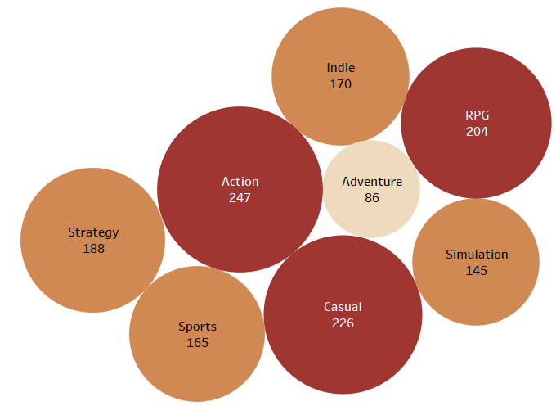


Which genres are more popular among customers?
Notes:
Different genres ppl prefered
We filtered our data to top 8 genre
And out of that Action is most played genre
ANOVA results are not significant difference
Decided not to keep in best model

Slide 6
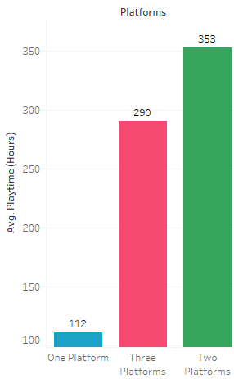
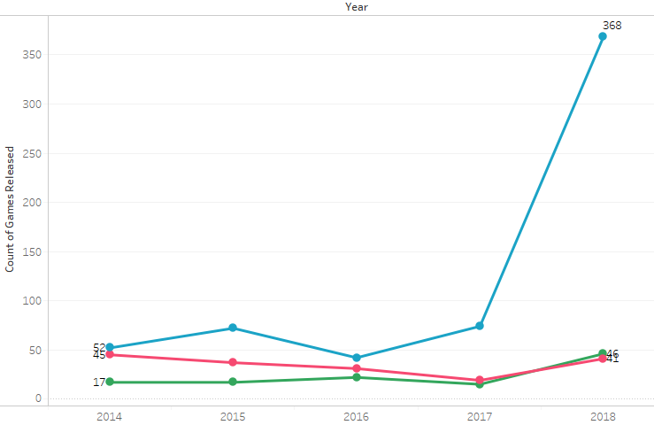

Should we release games on multiple platforms?
Notes:
No of games released over years
More games in one platform
Huge difference in avg playtime for two platforms and one

Slide 7
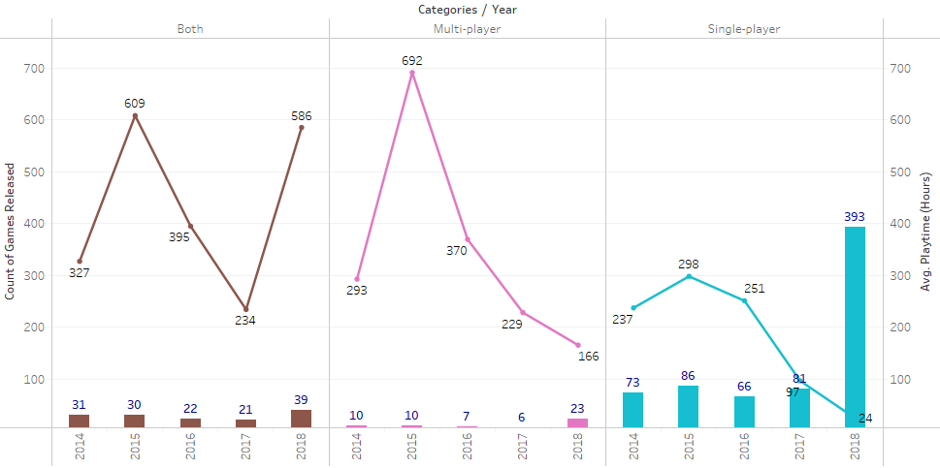

Which games are better? Single Player vs Multiplayer
Notes:
We found
No of games release is more for single
But sharp inCrease in playtime for Both
People like to have competitive ness but single player has its own fanbase
So suggest more flexibility to customer by providing both single and multi player options

Slide 8
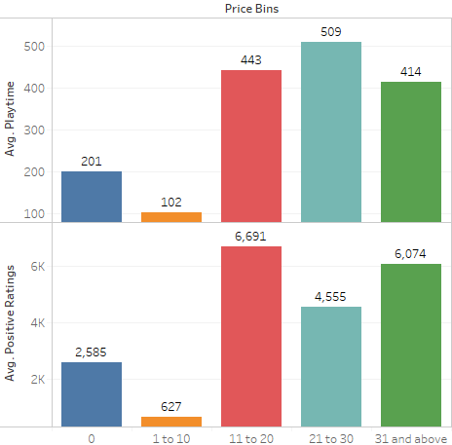
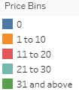
Does the price of games influence the playing time?
Notes:
If a customer
Avg playtimes high for highr price bins and -- series games versions pay more for that
examples
Price doesnt make any difference and customer preference

Slide 9
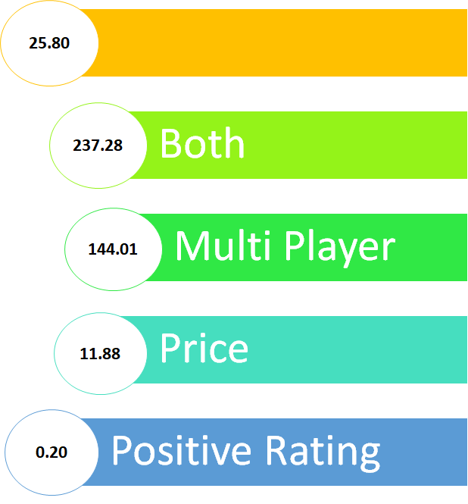

Best Model
Adjusted R² = 0.23

Slide 10
Conclusion
Develop more games in top 8 genres.
Focus more on releasing games on two platforms.
Provide both single player and multiplayer categories for a game.
Further Analysis
Social media impact
Youtube influencers
Preferred features in games

Slide 11
Thank You

