Slide 1
Command Design Pattern
Nidhi V Kulkarni
Priyanka V Rao

Slide 2
What is Command design pattern?
- An object encapsulates all information needed to perform an action.
- Issue requests to objects without knowing -
The operation being requested
The receiver of the request.
Information-
Method name
The object that owns the method
Values for the method parameters.

Slide 3
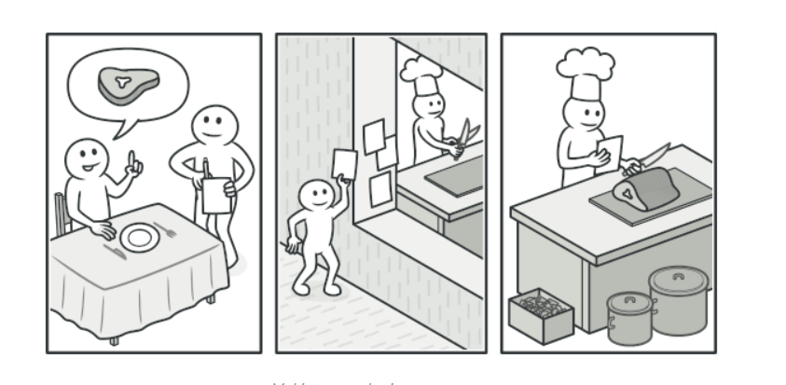
Real time example

Slide 4
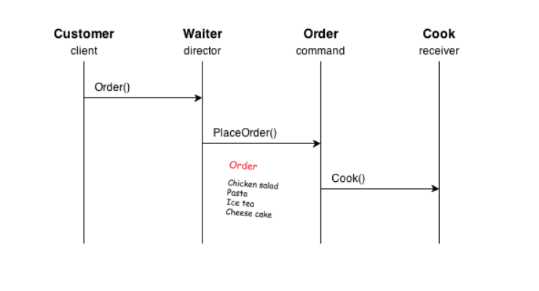

Slide 5
Four terms-
Client
Command
Invoker
Receiver

Slide 6
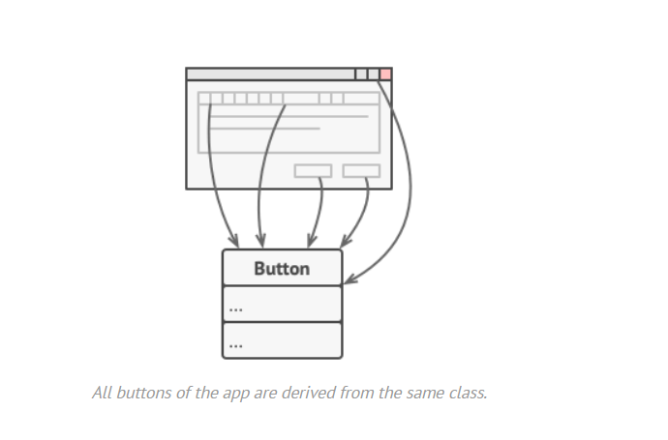
Technical example
Text editor app-> Create toolbar -> Many buttons
Button - Base class
Buttons look similar, but different operations
Code for the various click handlers of these buttons?
Create subclasses for each button.
Subclasses contain code for the button click.

Slide 7
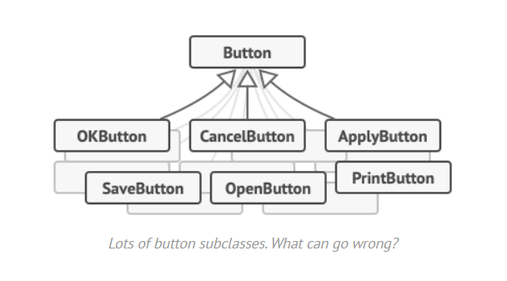
Flaw 1
Many number of classes
Risk breaking the code in subclasses - Button class
GUI code is dependent on business logic code

Slide 8
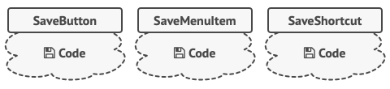
Flaw 2
Copy, paste, print or save would need to be invoked from multiple places.
Print button -
Toolbar
The context menu,
Hit Ctrl+P on the keyboard- shortcut
Solution?
Duplicate the operation’s code in many classes
Make menus dependent on buttons.

Slide 9
Solution?
Good software design - Principle of separation of concerns
Breaking an app into layers.
Example - a layer for the GUI and another layer for the business logic.
A GUI object calls a method of a business logic object
This is done by passing it some arguments.
This process is usually described as one object sending another a request.

Slide 10
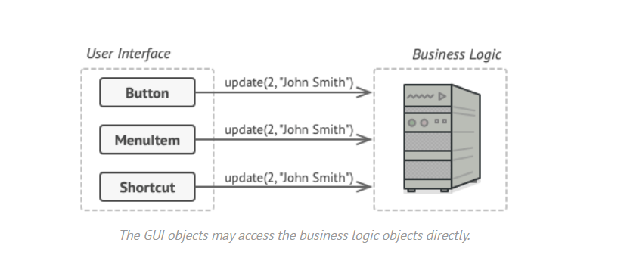

Slide 11
Ideal approach
The Command pattern- GUI objects shouldn’t send these requests directly.
Instead, you should extract all of the request details-
The object being called
The name of the method
Arguments in a command class with a method that triggers the request.
Object called- Business logic
Name of the method - Update
Arguments- 2, “John Smith”

Slide 12
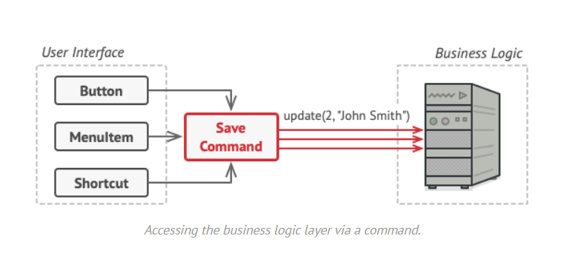
Command objects- links between various GUI and business logic objects.
The GUI object doesn’t need to know -
What business logic object
What request and how it’ll be processed.
The GUI object just triggers the command, which handles all the details.

Slide 13
After we apply the Command pattern-
No longer need all those button subclasses
Put a single field into the base Button class
Stores a reference to a command object
The button execute that command on a click.
Commands -
Middle layer
Reduces coupling between the GUI and business logic layers

Slide 14
Real world applications
GUI buttons and Menu items
Multi-level Undo/Redo
Remote Control Devices
Transactional behavior

Slide 15
Pros and Cons
Pros
Encapsulation
Decoupling
Undo/Redo functionality
Sequencing of commands
Logging
Cons
Increased complexity
Increased memory usage
Performance overhead
Notes:
Pros:
Encapsulation: The Command pattern encapsulates commands as objects, making it easy to modify or extend functionality without affecting other parts of the system. This makes it easier to maintain and extend the codebase over time.
Decoupling: The Command pattern decouples the requester of an action from the object that performs the action, making it easier to modify or replace either component without affecting the other. This promotes modularity and flexibility in the codebase.
Undo/Redo functionality: The Command pattern can be used to implement undo/redo functionality, which is a common requirement in many software applications. This functionality can be achieved by simply storing the command objects in a stack and reversing or replaying them as needed.
Logging: The Command pattern provides a natural way to log actions taken by the system, since each action is encapsulated as a command object.
Cons:
Increased complexity: The Command pattern adds some additional complexity to the codebase, since it requires creating additional classes to encapsulate commands as objects. This can make the codebase more difficult to understand and maintain.
Increased memory usage: The Command pattern requires storing each command as an object, which can consume additional memory compared to a simpler implementation that just executes commands directly.
Performance overhead: The Command pattern can introduce additional performance overhead compared to a simpler implementation that executes commands directly. This is due to the additional overhead of creating and executing command objects.

Slide 16
References
https://refactoring.guru/design-patterns/command
https://www.tutorialspoint.com/design_pattern/command_pattern.htm
https://en.wikipedia.org/wiki/Command_pattern#:~:text=In%20object%2Doriented%20programming%2C%20the,values%20for%20the%20method%20parameters.
https://sourcemaking.com/design_patterns/command

