Slide 1


Slide 2
tmux
Many-in-one
Various layouts
Session separate from emulator
Scriptable
Notes:
- no GUI, no browser – just basic command line stuff
- “releases” are simply snapshots
- Generally latest stable packages
- Generally vanilla. Other distros apply various patches (Ubuntu and fonts).

Slide 3
wat?

Slide 4
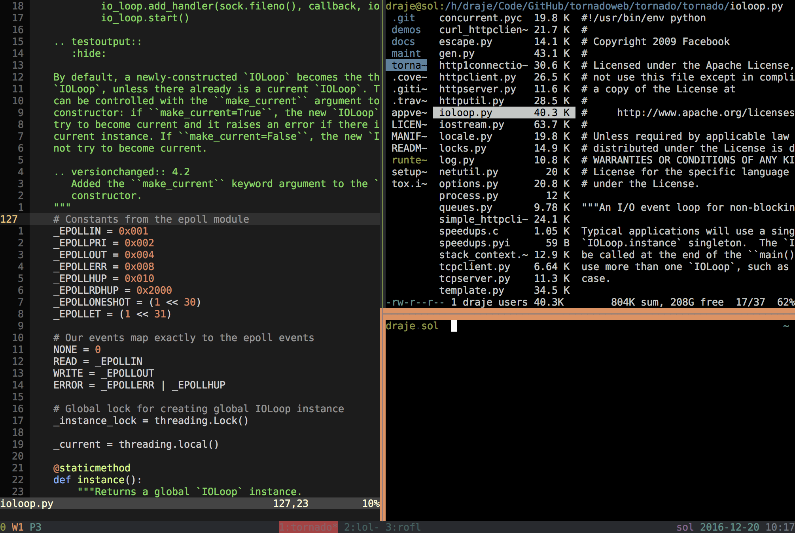

Slide 5
panes
windows
sessions
Notes:
- no GUI, no browser – just basic command line stuff
- “releases” are simply snapshots
- Generally latest stable packages
- Generally vanilla. Other distros apply various patches (Ubuntu and fonts).

Slide 6
Status Bar
Active Window
Hostname
Pane
Window
Date & Time
Window
List
Session

Slide 7
The Prefix
Entered before tmux shortcuts
  Creating new window
  Switching panes
  Etc.
Typically Control+b
Often remapped to Control+a
Notes:
- no GUI, no browser – just basic command line stuff
- “releases” are simply snapshots
- Generally latest stable packages
- Generally vanilla. Other distros apply various patches (Ubuntu and fonts).

Slide 8
begin

Slide 9

nvllsvm

