Slide 1
Technologies for Distributed Applications
Service-oriented Architecture

Slide 2
Contents
Socket
Java Socket
Remote Procedure Call
Java Remote Method Invocation

Slide 3
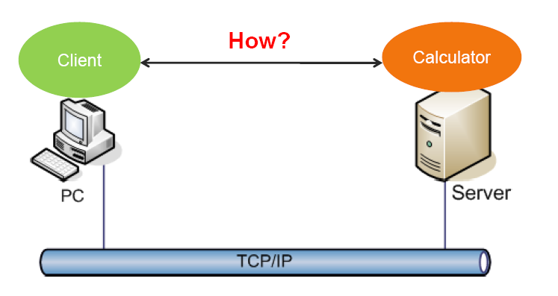
Interprocess communication

Slide 4
What is a socket?
Socket
The combination of an IP address and a port number. (RFC 793, original TCP specification)
The name of the Berkeley-derived application programming interfaces (APIs) for applications using TCP/IP protocols.
Two types
Stream socket (TCP)
Datagram socket (UDP)
Socket pair
Specified the two end points that uniquely identifies each TCP connection in an internet.
4-tuple: (client IP address, client port number, server IP address, server port number)
Notes:
TLI ( Transport Layer Interface )

Slide 5
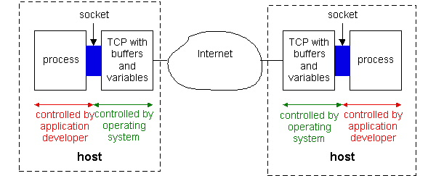
Socket Programming with TCP
Processes communicating through TCP sockets
The application developer has the ability to fix a few TCP parameters, such as maximum buffer and maximum segment sizes.

Slide 6
Client-Server Paradigm
Server waits for client to request a connection.
Client contacts server to establish a connection.
Client sends request.
Server sends reply.
Client and/or server terminate connection.

Slide 7
Sockets for server and client
Server
Welcoming socket
Welcomes some initial contact from a client.
Connection socket
Is created at initial contact of client.
New socket that is dedicated to the particular client.
Client
Client socket
Initiate a TCP connection to the server by creating a socket object. (Three-way handshake)
Specify the address of the server process, namely, the IP address of the server and the port number of the process.

Slide 8
Socket functional calls
socket (): Create a socket
bind(): bind a socket to a local IP address and port #
listen(): passively waiting for connections
connect(): initiating connection to another socket
accept(): accept a new connection
write(): write data to a socket
read(): read data from a socket
sendto(): send a datagram to another UDP socket
recvfrom(): read a datagram from a UDP socket
close(): close a socket (tear down the connection)

Slide 9
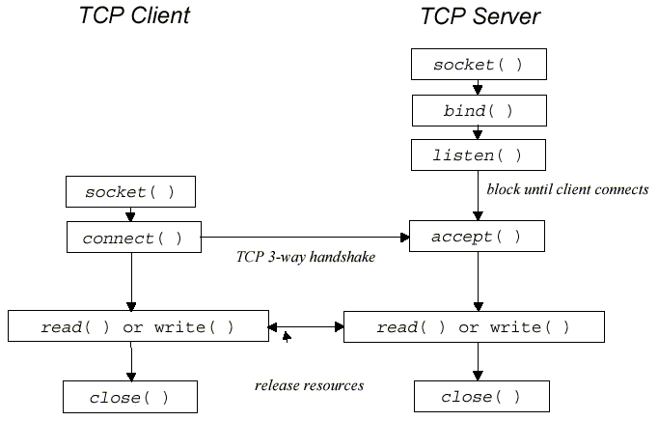

Slide 10
JAVA TCP Sockets
In Package java.net
java.net.Socket
Implements client sockets (also called just “sockets”).
An endpoint for communication between two machines.
Constructor and Methods
Socket(String host, int port): Creates a stream socket and connects it to the specified port number on the named host.
InputStream getInputStream()
OutputStream getOutputStream()
close()
java.net.ServerSocket
Implements server sockets.
Waits for requests to come in over the network.
Performs some operation based on the request.
Constructor and Methods
ServerSocket(int port)
Socket Accept(): Listens for a connection to be made to this socket and accepts it. This method blocks until a connection is made.

Slide 11
TCPClient.java
import java.io.*;
import java.net.*;
class TCPClient {
public static void main(String argv[]) throws Exception
{
String sentence;
String modifiedSentence;
BufferedReader inFromUser = new
BufferedReader(new InputStreamReader(System.in));
Socket clientSocket = new Socket(“localhost", 6789);
DataOutputStream outToServer = new
DataOutputStream(clientSocket.getOutputStream());

Slide 12
TCPClient.java
BufferedReader inFromServer = new BufferedReader(
new InputStreamReader(
clientSocket.getInputStream()));
sentence = inFromUser.readLine();
outToServer.writeBytes(sentence + '\n');
modifiedSentence = inFromServer.readLine();
System.out.println("FROM SERVER: " + modifiedSentence);
clientSocket.close(); }
}

Slide 13
TCPServer.java
import java.io.*;
import java.net.*;
class TCPServer {
public static void main(String argv[]) throws Exception{ String clientSentence; String capitalizedSentence;
ServerSocket welcomeSocket = new ServerSocket(6789);
while(true) {
Socket connectionSocket = welcomeSocket.accept();
BufferedReader inFromClient = new BufferedReader(
new InputStreamReader(
connectionSocket.getInputStream()));

Slide 14
TCPServer.java
DataOutputStream outToClient = new DataOutputStream(
connectionSocket.getOutputStream());
clientSentence = inFromClient.readLine();
capSentence = clientSentence.toUpperCase()+ '\n';
outToClient.writeBytes(capSentence);
}
}
}

Slide 15
Socket Programming with UDP
UDP
Connectionless and unreliable service.
There isn’t an initial handshaking phase.
Doesn’t have a pipe.
transmitted data may be received out of order, or lost
Socket Programming with UDP
No need for a welcoming socket.
No streams are attached to the sockets.
the sending hosts creates “packets” by attaching the IP destination address and port number to each batch of bytes.
The receiving process must unravel to received packet to obtain the packet’s information bytes.

Slide 16
Client/server socket interaction: UDP
Server (running on hostid)
Client
create socket,
port=x, for
incoming request:
create socket,
clientSocket =
DatagramSocket()
serverSocket =
DatagramSocket()
Create, address (hostid, port=x,
send datagram request
using clientSocket
read request from
serverSocket
write reply to
serverSocket
specifying client
host address,
port umber
read reply from
clientSocket
close
clientSocket

Slide 17
JAVA UDP Sockets
In Package java.net
java.net.DatagramSocket
A socket for sending and receiving datagram packets.
Constructor and Methods
DatagramSocket(int port): Constructs a datagram socket and binds it to the specified port on the local host machine.
void receive( DatagramPacket p)
void send( DatagramPacket p)
void close()

Slide 18
UDPClient.java
import java.io.*;
import java.net.*; class UDPClient { public static void main(String args[]) throws Exception { BufferedReader inFromUser = new BufferedReader(
new InputStreamReader(System.in));
DatagramSocket clientSocket = new DatagramSocket(); InetAddress IPAddress = InetAddress.getByName(
"hostname");
byte[] sendData = new byte[1024]; byte[] receiveData = new byte[1024]; String sentence = inFromUser.readLine(); sendData = sentence.getBytes();

Slide 19
UDPClient.java
DatagramPacket sendPacket = new DatagramPacket(
sendData, sendData.length, IPAddress, 9876);
clientSocket.send(sendPacket); DatagramPacket receivePacket = new DatagramPacket(
receiveData, receiveData.length);
clientSocket.receive(receivePacket); String modifiedSentence = new String(
receivePacket.getData());
System.out.println("FROM SERVER:" + modifiedSentence);
clientSocket.close(); }
}

Slide 20
UDPServer.java
import java.io.*;
import java.net.*;
class UDPServer { public static void main(String args[]) throws Exception { DatagramSocket serverSocket = new DatagramSocket(
9876);
byte[] receiveData = new byte[1024]; byte[] sendData = new byte[1024]; while(true){ DatagramPacket receivePacket = new DatagramPacket(
receiveData, receiveData.length);
serverSocket.receive(receivePacket); String sentence = new String(
receivePacket.getData());

Slide 21
UDPServer.java
InetAddress IPAddress = receivePacket.getAddress(); int port = receivePacket.getPort(); String capitalizedSentence = sentence.toUpperCase();
sendData = capitalizedSentence.getBytes(); DatagramPacket sendPacket = new DatagramPacket(
sendData, sendData.length, IPAddress, port);
serverSocket.send(sendPacket);
}
}
}

Slide 22
Question
What are the difficulties that programmers face when programming with sockets?

Slide 23
Remote Procedure Calls (RPC)
Avoid explicit message exchange between processes
Basic idea is to allow a process on a machine to call procedures on a remote machine
Make a remote procedure possibly look like a local one
Original paper on RPC:
A. Birrell, B Nelson, “Implementing Remote Procedure Calls”, ACM Symposium on Operating System Principles, 1984

Slide 24
RPC: The basic mechanism
Client process
Server process
Client calls a local procedure on the client stub
The client stub acts as a proxy and marshalls the call and the args.
The client stub send this to the remote system (via TCP/UDP)
The server stub unmarshalls the call and args from the client
The server stub calls the actual procedure on the server
The server stub marshalls the reply and sends it back to the client
Client
routines
Server
routines
1
5
Client stub
Server
stub
2
4
RPC
runtime
RPC
runtime
Process
Process
3
kernel
kernel
6
Network
routines
Network
routines
Source: R. Stevens, Unix Network Programming (IPC) Vol 2, 1998

Slide 25
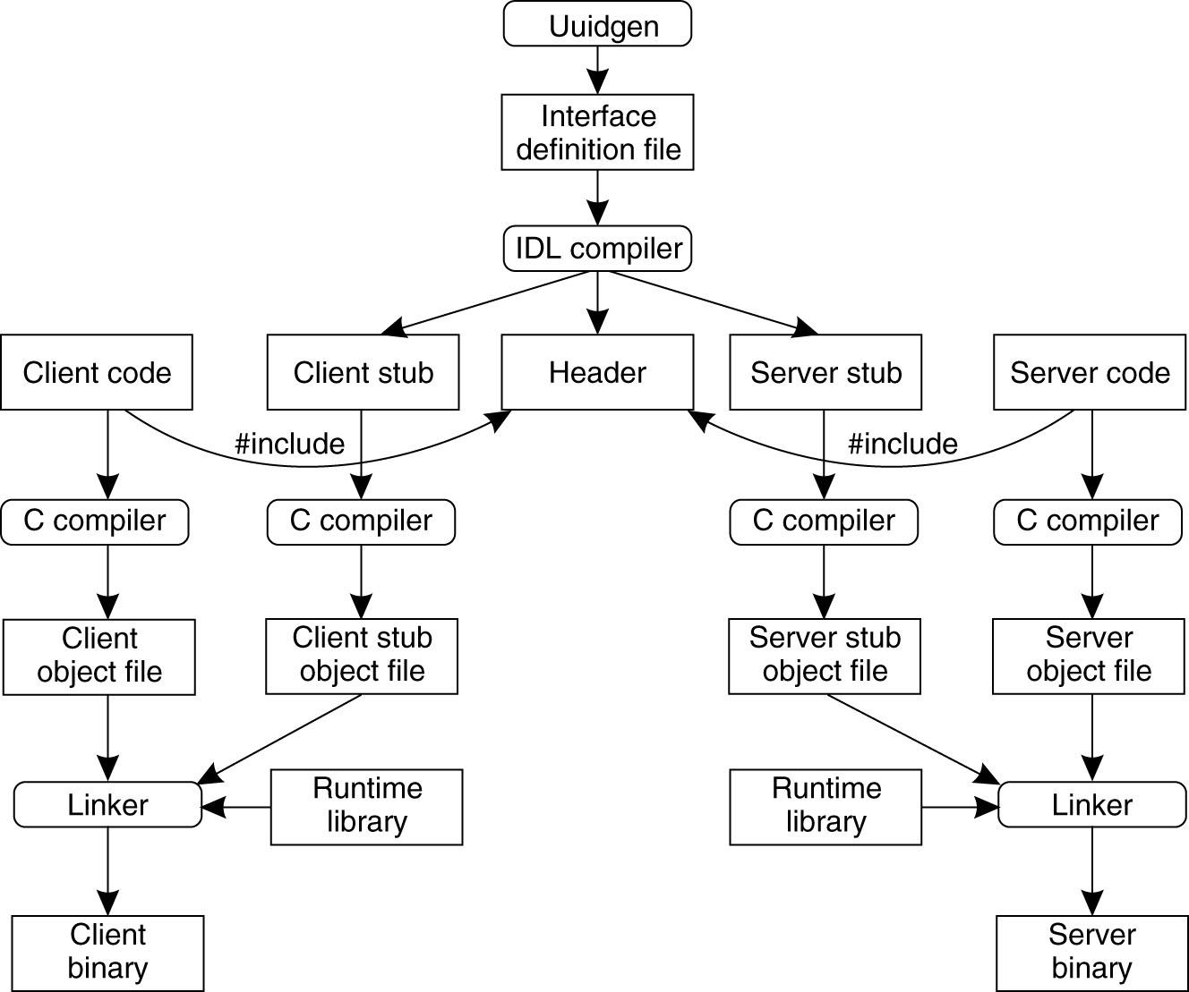
The steps in writing a client and a server in DCE RPC
Notes:
DCE was developed by the Open Group to allow applications to be built across heterogeneous platforms in a network. DCE includes security, directory naming, time synchronization, file sharing, RPCs and multithreading services.
A Universal Unique Identifier (UUID) is used to uniquely identify an interface. Its uniqueness is ensured by encoding in it the location and time of creation.
IDL: interface definition language

Slide 26
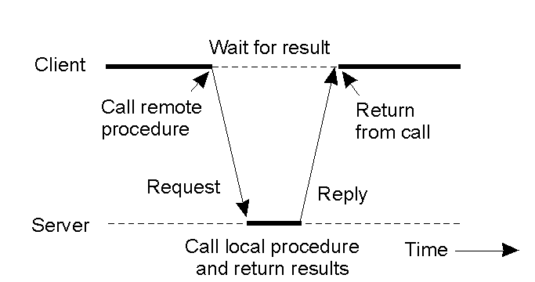
Synchoronous RPC

Slide 27
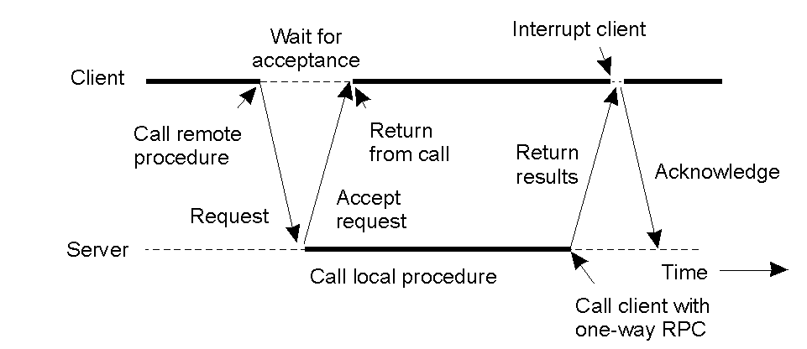
Asynchronous RPC
A client and server interacting through two asynchronous RPCs
2-13
Notes:
One-Way RPC: The client invokes a remote procedure but it does not block or wait until it receives a return.

Slide 28
When Things Go Wrong
Semantics of remote procedure calls
Local procedure call: exactly once
How many times a remote procedure call may be called?
A remote procedure call may be called:
0 time: server crashed or server process died before executing server code
1 time: everything worked well
1 or more: due to excess latency or lost reply from server, client retransmitted
Exactly once may be difficult to achieve with RPC

Slide 29
RPC Semantics
Most RPC systems will offer either:
at least once semantics
or at most once semantics
Understand application:
Illustrate some applications that “at least once” is suitable?
Idempotent functions: may be run any number of times without harm
Illustrate some applications that “at most once” is suitable?
Notes:
At-most-once call semantics are for those RPC applications which require a guarantee that multiple invocations of the same RPC call by a client will not be processed on the server. An example of such an application is inventory control. Consider several point-of-sale (POS) workstations and a server which maintains inventory records. Each POS workstation makes an RPC call to the server when an item is sold. The call causes a count of the number of items left in the inventory to be decremented on the server. If a call indicating that five of the item X was sold is processed on the server more than once, then the inventory record for item X will be in error.

Slide 30
Java RMI
Implementation of RPC in Java
sayHello()
Hello Server
Hello Client
“Hello, world”
Computer A
Computer B

Slide 31
Terminology
A remote object is an object on another computer
The client object is the object making the request (sending a message to the other object)
The server object is the object receiving the request
As usual, “client” and “server” can easily trade roles (each can make requests of the other)
The rmiregistry is a special server that looks up objects by name
rmic is a special compiler for creating stub (client) and skeleton (server) classes

Slide 32
What is needed for RMI
To send a message to a remote “server object,”
The “client object” has to find the object
Do this by looking it up in a registry
The client object then has to marshal the parameters (prepare them for transmission)
Java requires Serializable parameters
The server object has to unmarshal its parameters, do its computation, and marshal its response
The client object has to unmarshal the response

Slide 33
Processes
For RMI, you need to be running three processes
The Client
The Server
The Object Registry, rmiregistry, which is like a DNS service for objects

Slide 34
Interfaces
Interfaces define behavior
Classes define implementation
Therefore,
In order to use a remote object, the client must know its behavior (interface), but does not need to know its implementation (class)
In order to provide an object, the server must know both its interface (behavior) and its class (implementation)
In short,
The interface must be available to both client and server
The class of any transmitted object must be available to both client and server
The class whose method is being used should only be on the server

Slide 35
Serializability
If an object is to be serialized:
The class must be declared as public
The class must implement Serializable
However, Serializable does not declare any methods
The class must have a no-argument constructor
All fields of the class must be serializable: either primitive types or Serializable objects

Slide 36
Remote interfaces and class
A Remote class has two parts:
The interface (used by both client and server):
Must be public
Must extend the interface java.rmi.Remote
Every method in the interface must declare that it throws java.rmi.RemoteException (other exceptions may also be thrown)
The class itself (used only by the server):
Must implement the Remote interface
Should extend java.rmi.server.UnicastRemoteObject
May have locally accessible methods that are not in its Remote interface

Slide 37
Hello Interface
package hello;
import java.rmi.Remote;
import java.rmi.RemoteException;
public interface Hello extends Remote {
String sayHello() throws RemoteException;
}

Slide 38
Server
package server;
import hello.Hello;
…
import java.rmi.server.*;
public class HelloServer implements Hello {
public HelloServer(){};
public String sayHello(){
return "Hello, world";
}
public static void main(String[] args) {
HelloServer obj = new HelloServer();
Hello stub = (Hello)UnicastRemoteObject.exportObject(obj, 0);
Registry registry = LocateRegistry.getRegistry();
registry.bind("Hello", stub);
}

Slide 39
Client
import java.rmi.registry.LocateRegistry;
import java.rmi.registry.Registry;
import hello.Hello;
public class HelloClient {
private HelloClient() {};
public static void main(String[] args) {
Registry registry = LocateRegistry.getRegistry();
Hello stub = (Hello) registry.lookup("Hello");
String response = stub.sayHello();
System.out.println("response: " + response);
}
}

Slide 40
Run
Start registry: start rmiregistry
Assume that HelloServer.jar is located at D:\Workshop\Server; HelloClient.jar is located at D:\Workshop\Client
Start server: java -cp D:\workshop\rmi\server.jar server.HelloServer
Start client: java -cp d:/workshop/rmi/client.jar client.HelloClient

Slide 41
Codebase
2. Lookup
RMI Registry
1. Server registers a remote obj
3. Instance of stub
RMI Server
RMI Client
6. Invoke
4. Request stub class
Stub class location
5. Stub class
Djava.rmi.server.codebase=
Notes:
Question: Is there any case that RMI Server consults codebase for classes?

Slide 42
Summary
Process communication with sockets
Disadvantages of sockets
Socket programming with Java
Remote Procedure Call
Programming with Java RMI

