Slide 1
SQL-History
The origins of the SQL take us back to the 1970s, when in the IBM laboratories, new database software was created - System R. And to manage the data stored in System R, the SQL language was created.
At first it was called SEQUEL, a name which is still used as an alternative pronunciation for SQL, but was later renamed to just SQL.
In 1979, a company called Relational Software, which later became Oracle, saw the commercial potential of SQL and released its own modified version, named Oracle V2.
Now into its third decade of existence, SQL offers great flexibility to users by supporting distributed databases, i.e. databases that can be run on several computer networks at a time. Certified by ANSI and ISO, SQL has become a database query language standard, lying in the basis of a variety of well established database applications on the Internet today.
It serves both industry-level and academic needs and is used on both individual computers and corporate servers. With the progress in database technology SQL-based applications have become increasingly affordable for the regular user. This is due to the introduction of various open-source SQL database solutions such as MySQL, PostgreSQL, SQLite, Firebird, and many more.

Slide 2
SQL-Language Elements
The SQL language is based on several elements. For the convenience of SQL developers all necessary language commands in the corresponding database management systems are usually executed through a specific SQL command-line interface (CLI).
Clauses - the clauses are components of the statements and the queries
Expressions - the expressions can produce scalar values or tables, which consist of columns and rows of data
Predicates - they specify conditions, which are used to limit the effects of the statements and the queries, or to change the program flow
Queries - a query will retrieve data, based on a given criteria
Statements - with the statements one can control transactions, program flow, connections, sessions, or diagnostics. In database systems the SQL statements are used for sending queries from a client program to a server where the databases are stored. In response, the server processes the SQL statements and returns replies to the client program. This allows users to execute a wide range of amazingly fast data manipulation operations from simple data inputs to complicated queries.

Slide 3
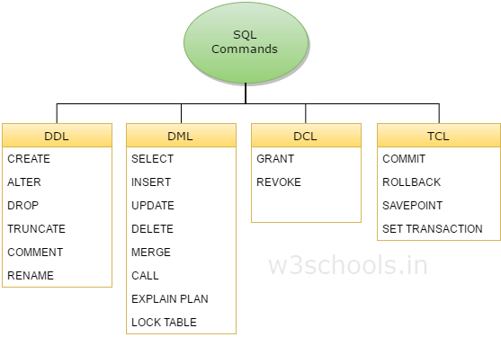
SQL- Statements
DDL – Data Definition Language
it is used to define data structures.
eg: Insert, Update, Delete
DML – Data Manipulation Language
it is used to manipulate data itself
eg: Create, Alter, Drop
DCL – Data Control Language
TCL – Transaction Control Language
DDL statements are used for creating and defining the Database structure.
DML statements are used for managing data within Database.

Slide 4
SQL- Syntax
SQL keywords are NOT case sensitive: select is the same as SELECT
A database most often contains one or more tables. Each table is identified by a name (e.g. "Customers" or "Orders").
Semicolon after each sql statements
CREATE TABLE Persons
( PersonID int, LastName varchar(255), Server Side(DML) FirstName varchar(255), Address varchar(255), -------- nvarchar?? City varchar(255) );

Slide 5
SQL-Statements
Select
From
Where
The AND and OR operators are used to filter records based on more than one condition:
The AND operator displays a record if all the conditions separated by AND is TRUE.
The OR operator displays a record if any of the conditions separated by OR is TRUE.
Eg:
SELECT * FROM Customers WHERE Country='Germany' AND/OR City='Berlin';
The NOT operator displays a record if the condition(s) is NOT TRUE.
SELECT * FROM Customers WHERE NOT Country='Germany';
AND,OR & NOT
SELECT * FROM Customers WHERE Country='Germany' AND (City='Berlin' OR City='München');

Slide 6
SQL Statements
COUNT(*) – counts all rows
COUNT(Column_Name) -- counts non-NULLs only
SELECT column_name(s) FROM table_name WHERE condition GROUP BY column_name(s) HAVING condition ORDER BY column_name(s);
The GROUP BY statement is often used with aggregate functions (COUNT, MAX, MIN, SUM, AVG) to group the result-set by one or more columns.
Eg:

