Slide 1
SAP BODS 4.2
SAP Data Services is a certified ETL (Extraction, Transformation and Loading) tool from SAP to perform batch loading into SAP HANA.
Suppose you are working in an organization where data is stored in various disparate databases like Oracle, DB2 and other legacy systems. You are asked to recommend the best application for consolidating and replicating data into SAP HANA from SAP and Non SAP sources using the ETL method.
Data integration and transformations can be performed using database programming languages like SQL and PLSQL however it will be expensive to manage/maintain the landscape.
This is where ETL (Extraction, Transformation and Loading) tools place major role in the industry.
These tools are specifically designed to have single platform where developers can build the logic for transformations and administrators also can easily maintain the system.

Slide 2
SAP BODS 4.2
SAP Data Services delivers a single enterprise-class solution for data integration, data quality, data profiling, and text data processing that allows you to integrate, transform, improve, and deliver trusted data to critical business processes.
You must have access to a local repository to log into the software. Typically, you create a repository during installation.
However, you can create a repository at any time using the Repository Manager, and configure access rights within the Central Management Server.
Additionally, each repository must be associated with at least one Job Server before you can run repository jobs from within the Designer.
Typically, you define a Job Server and associate it with a repository during installation. However, you can define or edit Job Servers or the links between repositories and Job Servers at any time using the Server Manager.
When you log in to the Designer, you must log in as a user defined in the Central Management Server (CMS).

Slide 3
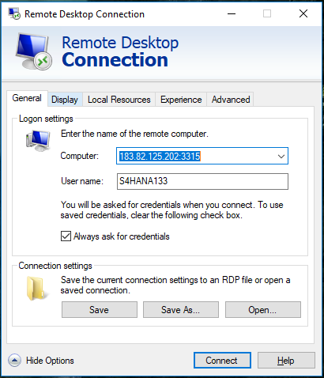

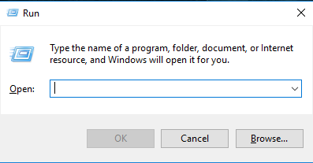
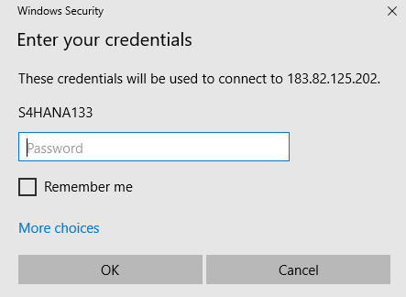
Logging into the Designer
Get acces to (RDC)Remote Desktop Connection.
Steps to connect to RDC
type run in search & press enter.
type mstsc
Microsoft Terminal Services Client, mstsc or tsclient.

Slide 4
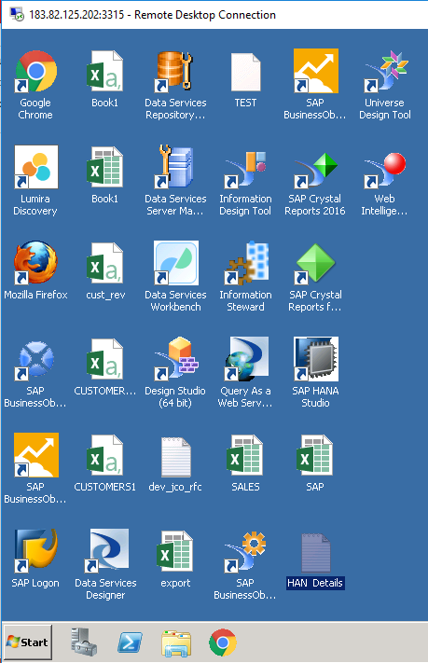
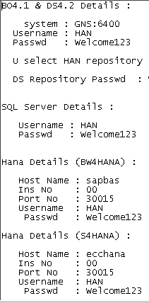
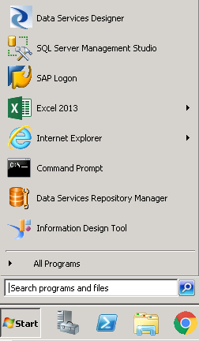
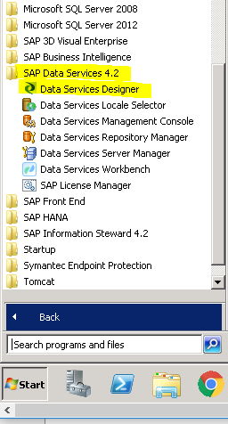
Logging into the Designer
The following screen opens, through which we can access SAP DS, SAP HANA.
The credentials of all the SAP Applications, SQL & ECC will present in notepad (HAN Details).

Slide 5
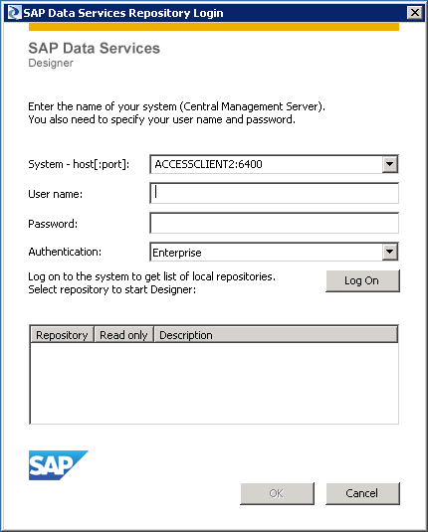
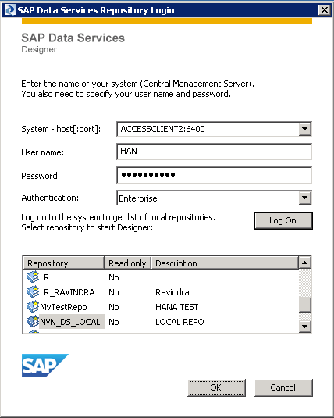
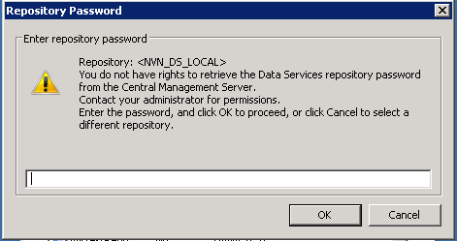
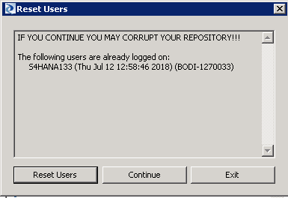
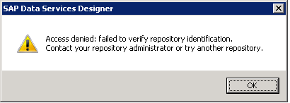
SAP DS Repository Login
The following screen appears after clicking on DS Designer.

Slide 6
Transformations
There are four categories of Transform available in SAP BODS namely Data Integrator, Data Quality, Platform and Text Data Processing.
Data Integrator- when you are dealing with Rows & Columns Data_Transfer Map_CDC_Operation Key_Generation Date_Generation Pivot History_Preserving Effective_Date Reverse Pivot XML Pipeline Hierarchy_Flattening Table_Comparison
Data Quality- Cleansing bad data Associate, Country ID, Data Cleanse, DSF2 Walk Sequencer, Geocoder, Global Address Cleanse, Global Suggestion Lists, Match, USA Regulatory Address Cleanse, User-Defined.
Platform-Tables Case, Map_Operation, Merge, Query, Row_Generation, SQL, Validation.
Text Data Processing- Unstructured data to Structured data Entity_Extraction

Slide 7
Date Generation
Date_Generation:
Date Generation Transformation is used to produces a series of dates incremented that you specify in a separate column. This transform generates a column which holds the date values based on the start & end dates provided as an input to the transform by considering the increment provided to it.
When we use: To create Time Dimension fields and Table.
Prerequisite: Before implementing Date_Generation transform, please find below the input & output values of Date_Generation transform.
Options for input data:
Start date: Provide a start date value in the format yyyy.mm.dd. It also accepts variables; instead of passing static values one can pass values through variables.
End date: Provide an end date value in the format yyyy.mm.dd. It also accepts variables; instead of passing static values one can pass values through variables.
Increment: User can specify date intervals between start date and end date. Date can be incremented daily, weekly or monthly.
Join rank: While constructing the joins, sources will be joined based on their ranks.
Cache: The data set will be cached in the memory to be used in later transform.
Output data from Date Generation transform:
The return type of this transform is a data set with a single column named DI_GENERATED_DATE containing the date sequence.

Slide 8
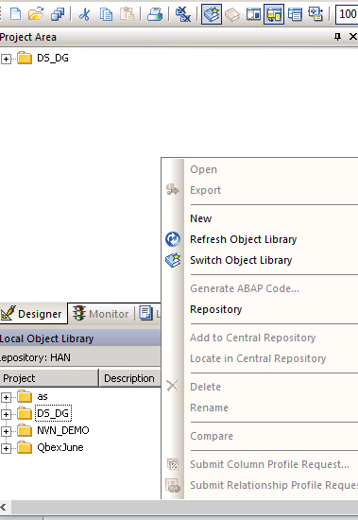
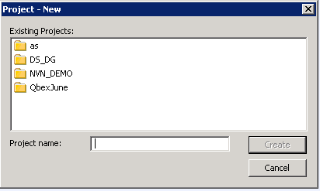
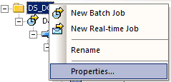

Date Generation
Create a project- 3 ways
ctrl+N
click on blue rectangular file like symbol
local object library
DS_DG
sequence is important
project Batch Job Work Flow Data Flow Transformaions

Slide 9


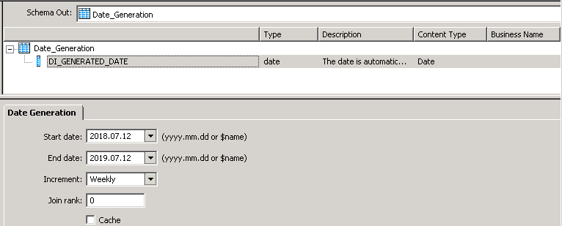
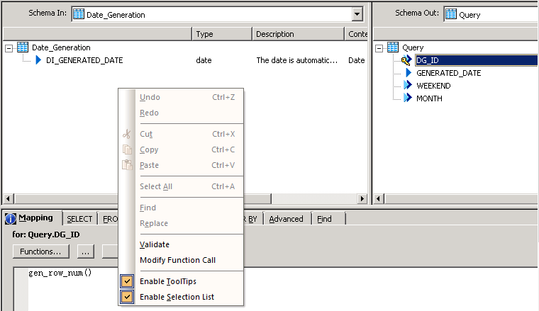
Date Generation
Drag and drop Date Generation Transformation.

Slide 10
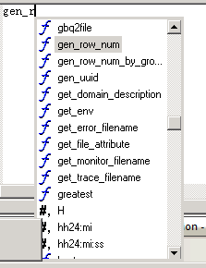
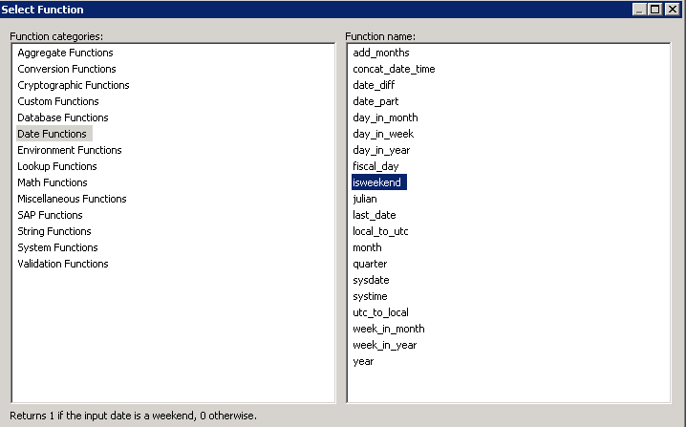
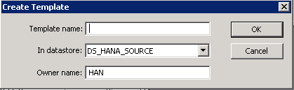
Date Generation
isweekend(DI_GENERATED_DATE)
month( Date_Generation.DI_GENERATED_DATE)
Data Types Play major role(adding column in Schema out)

Slide 11
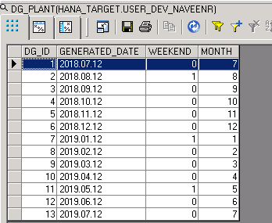
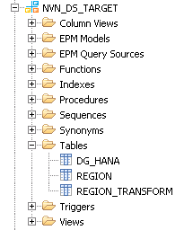
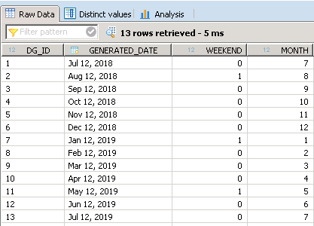
Date Generation
Check results

