Slide 1
House Price Prediction Creative and Innovative Project
by Umapathi C & Naveen Kumar M

Slide 2
INTRODUCTION
Machine learning develops algorithms and builds models from data, and uses them to predict on new data.
How to use machine learning algorithms to predict house price?
It is a challenge to get as closely as possible result based on the model built.
For a specific house price it is determined by location, size, house type, city, country, tax rules, economic cycle, population movement, interest rate, and many other factors which could affect demand and supply.
PROBLEM STATEMENT
1.First-time home-buyers are finally making purchase decisions for homes that meet their budgets.
2.It might seem strange that massive demand and massive unsold residential inventory can co-exist, but this is the result of pricing mismatch
3. This works as an advantage to the agents and they manipulate the price and increase their own profits.
4.Hence a great market is turned into a bad market because of the inappropriate pricing of the houses and the greed of the middleman that is agents.

Slide 3
LITERATURE SURVEY
S.NO | AUTHOR, PUBLICATION, YEAR | METHODOLOGY | ADVANTAGES | LIMITATIONS
1 | A Hybrid Regression Technique for House Prices Prediction Sifei Lu, Zengxiang Li, Zheng Qin, Xulei Yang, Rick Siow Mong Goh 2017 | Logistic Regression | good accuracy | uncertain results
2 | Street-based Local Area and measuring its effect on house price using a hedonic price approach Stephen Law FEB 2017 | Hedonic pricing model | high variance and high bias | low accuracy
3 | Financial position and house price determination: An empirical study of income and wealth effects Joep Steegmans, Wolter Hassink JUNE 2017 | repeat-sales method | high variance | low accuracy
4 | SVR Based Forecasting Approach for Real Estate Price Prediction Da-Ying Li, Wei Xu, Hong Zha 2009 | support vector regression (SVR) | good prediction capability | low variance on increasing data

Slide 4
S.NO | AUTHOR, PUBLICATION, YEAR | METHODOLOGY | ADVANTAGES | LIMITATIONS
5 | On the Relation between Local Amenities and House Price Dynamics Eli Beracha, Ben T Gilbert, Tyler. Aug 2016 | ANN | suitable for all type of data and good accuracy | High runtime
6 | Explaining house price dynamics: Isolating the role of nonfundamentals David C. Ling April 2015 | Regression | Feature Inclusion | uncertain results
7 | Applied Machine Learning Project 4 Prediction of real estate property prices in Montreal Nissan Pow, Emil Janulewicz 2016 | Random Forest Regression | good accuracy in small features count | low variance
8 | Prediction of Real Estate Price Variation Based on Economic Parameters L.Li, K.-H. Chu, 2017 | back propagation neural network | high accuracy | Not suitable for all kind of data types

Slide 5
ISSUES IDENTIFIED FROM SURVEY
Lack of standard selection techniques may fail to include some influential attributes in the function.
Fails to utilize the full information in real estate market, which may affect the results.
Choosing a metrices for analysing performance is vital.
4. Simple Classification of training and testing data's yeild uncertain results.

Slide 6
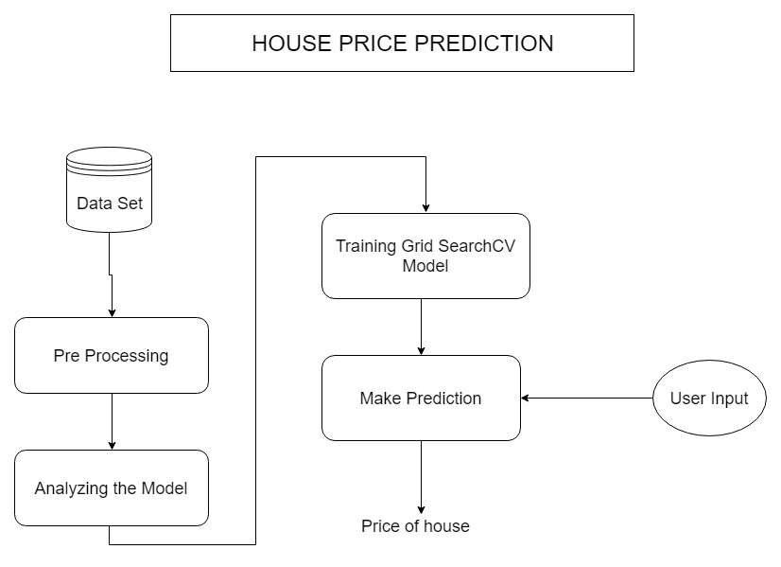
BLOCK DIAGRAM
Training Grid SearchCV
Model
Make Prediction

Slide 7
MODULE DESCRIPTION
DATA PREPROCESSING
INPUT : Dataset(boston.csv)
OUTPUT : PreProcessed data
PSEUDO CODE :
Explore the features in graphical form.
Analyse the graph.
Found Outlier values.
Remove the outlier values
ANALYZING THE MODEL
INPUT : Features and Prices
OUTPUT : Learning performance and
Complexity performance graphs.
PSEUDO CODE :
Define Function for Model Performance.
Define Function for Complexity Perfromance.
Using Matplot draw graphs.

Slide 8
TRAINING MODEL
INPUT : Train Data OUTPUT : Optimal Model
PSEUDO CODE :
1.Use DecisionTreeRegressor from sklearn.tree
2.Assign this object to the 'regressor' variable.
3.Create a dictionary for 'max_depth' with the values from 1 to 10,
4.Use make_scorer from sklearn.metrics
5.Use GridSearchCV from sklearn.grid_search
6.Pass the variables 'regressor', 'params', 'scoring_fnc', and 'cv_sets' as parameters to the object.
7.Assign the GridSearchCV object to the 'grid' variable

Slide 9
Output Prediction
Input :
user values
Output :
price of house
Explanation:
The input values will be given as a input to a trained model and the output will be displayed. The whole application is designed with web UI.

Slide 10
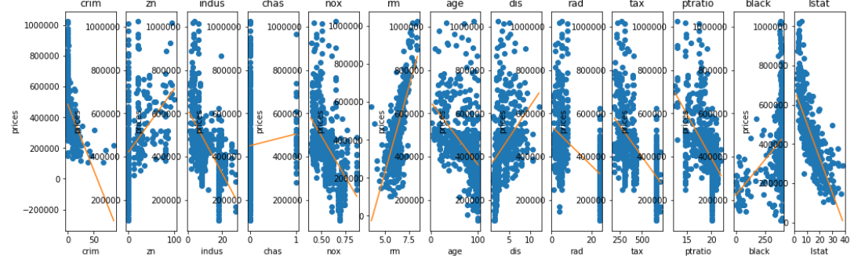
Pre Processing Output

Slide 11
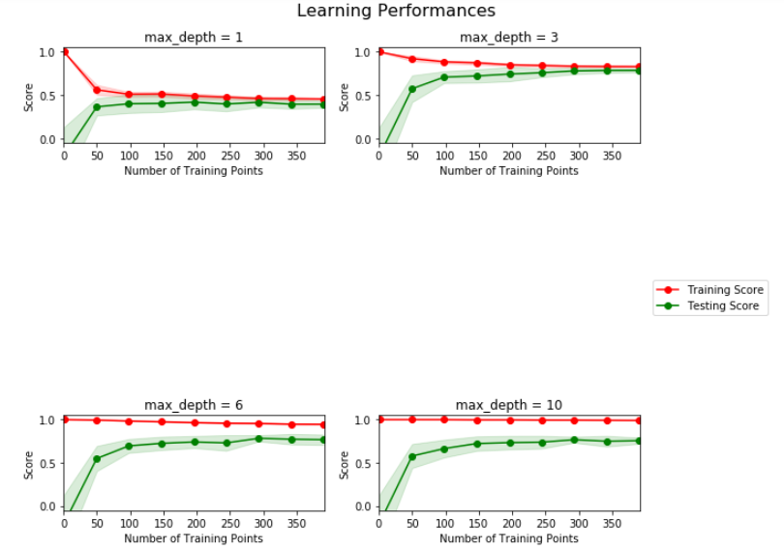
Model Analyzing

Slide 12
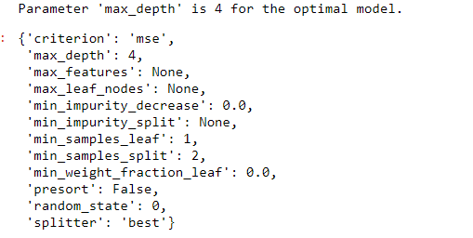
Model Training

Slide 13
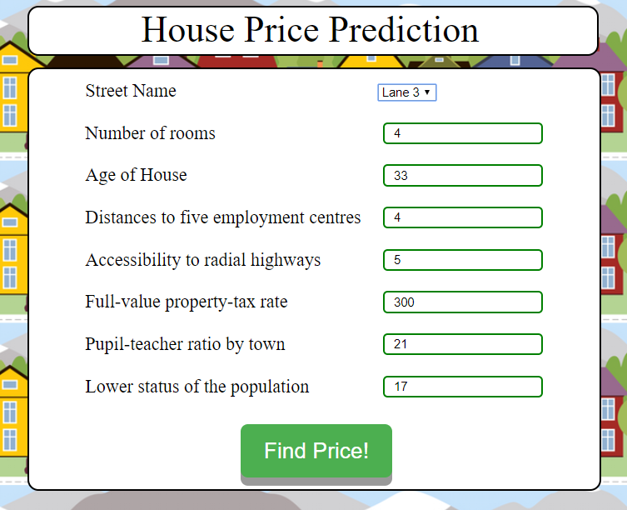
INPUT

Slide 14
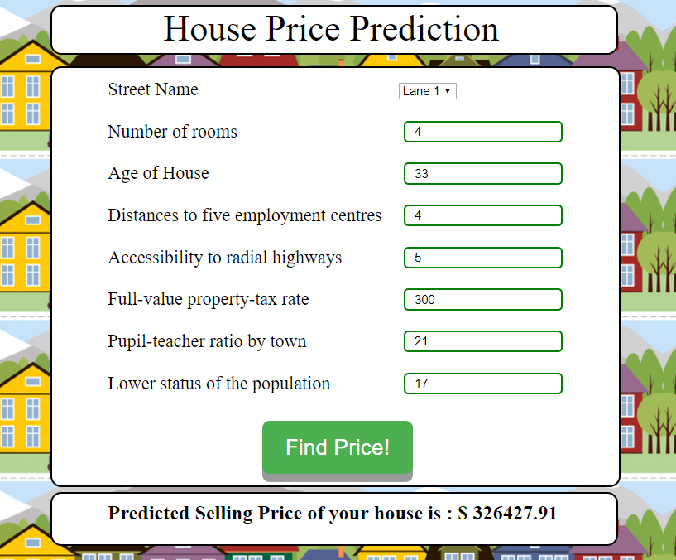
OUTPUT

Slide 15
Evaluation Metrics
R-squared is a statistical measure of how close the data are to the fitted regression line.
It is also known as the coefficient of determination, or the coefficient of multiple determination for multipleregression.
R-squared is always between 0 and 100%
The R-squared Score of our built model is achieved more than 85 %.
The accurate value found by valueis 0.8567784606316289.

Slide 16
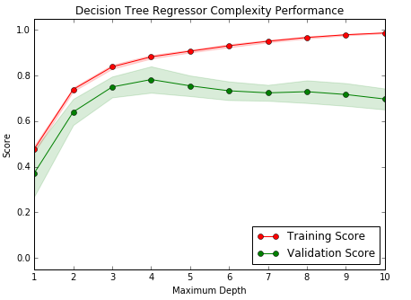
Graphs

Slide 17
Conclusion
As a result, Regularized regression, which is to fix these issues, will improve the model by a rather limited level.
Even though these improvements are kind of small,the proposed regularized regression model is still meaningful
it did provide better modeling results.
It may yield significant improved results for other problem in the field of real estate.

Slide 18
REFERENCES
[1]Yu, Jiafu Wu.. Real Estate Price Prediction with Regression and Classification, CS 229 Autumn 2016 Project Final Report, Stanford University, 2016.
[2]Y.-C.Wang,R.Huang, C.-C.Nieh,H.-K. Ou,andM.Chi,.Integration between realestatemarket and the stock market: Evidence from Taiwan, International Conference on Applied System Innovation (ICASI),2017.
[3]L.Li, K.-H. Chu, Prediction of real estate price variation based on economic parameters, International Conferenceon Applied System Innovation (ICASI), 2017
[4] Nissan Pow, Emil Janulewicz, Liu (Dave) Liu, Applied Machine Learning Project 4 Prediction of real estate property prices in Montreal: An application of Random Forest, McGillUniversity, 2016
[5] B. Trawinski, Z. Telec, J. Krasnoborski, M. Piwowarczyk, M. Talaga, T. Lasota, and E. Sawilow. Comparison of expert algorithms with machine learning models for real estate appraisal, 2017 IEEE International Conference on Innovations in Intelligent Systems and Applications (INISTA),2017
[6]E. Antipov and E. Pokryshevskaya, Mass Appraisal of Residential Apartments: An Application of Random Forest for Valuation and a CART-Based Approach for Model Diagnostics, SSRN Electronic Journal,2010.
[7]J.-G. Liu, X.-L. Zhang, and W.-P. Wu, Application of Fuzzy Neural Network for Real Estate Prediction, Advances in Neural Networks - ISNN Lecture Notes in Computer Science, pp. 11871191,2006
[8]E. Hromada, Mapping of Real Estate Prices Using Data Mining Techniques, Procedia Engineering,vol.123,pp.233-240,2015.
[9]ByeonghwaParkaJae,KwonBae,Using machine learning algorithms for housing price prediction: The case of Fair-fax County, Virginia housing data: Expert Syst.Appl.42(6),2928-2934(2014), 2014.
[10] Da-Ying Li, Wei Xu, Hong Zhao, Rong-Qiu Chen,A SVR based forecasting approach for real estate price prediction, International Conference on Machine Learning and Cybernetics,Baoding, 2009.

Slide 19
THANK YOU !!!

