Slide 1
Business Statistics Axis Insurance Project
Submitted by:
Naveen Pusuluri

Slide 2
Objective
For the given data set of Axis Insurance Company,
Explore the data and extract actionable insights using exploratory data analysis and perform statistical analysis of business data
Prove (or disprove) that the medical claims made by the people who smoke is greater than those who don’t
Prove (or disprove) with statistical evidence that the BMI of females is different from that of males
Find if the proportion of smokers significantly different across different regions
Find if the mean BMI of women with no children, one child, and two children the same
(by considering a significance level of 0.05 for all tests)

Slide 3
Data Information
Following are the data variables for the people insured with Axis Insurance:
Variable | Description
Age | This is an integer indicating the age of the primary beneficiary
Sex | This is the policy holder's gender, either male or female
BMI | This is the body mass index (BMI), which provides a sense of how over or under-weight a person is relative to their height. BMI is equal to weight (in kilograms) divided by height (in meters) squared. An ideal BMI is within the range of 18.5 to 24.9.
Children | This is an integer indicating the number of children/dependents covered by the insurance plan
Smoker | This is yes or no depending on whether the insured regularly smokes tobacco
Region | This is the beneficiary's place of residence in the U.S., divided into four geographic regions - northeast, southeast, southwest, or northwest
Charges | Individual medical costs billed to health insurance
Observations | Variables
1338 | 7

Slide 4
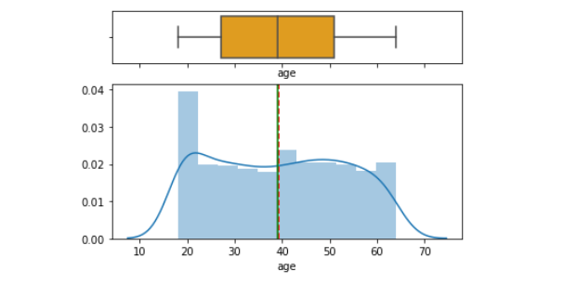
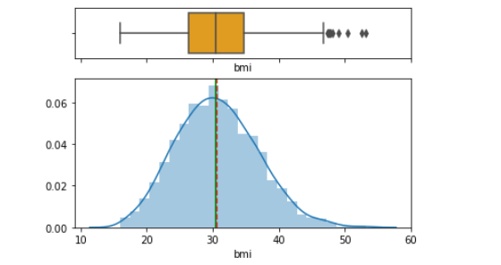
Exploratory Data Analysis
Age
BMI
Observations:
Distribution of age variable is not skewed to any particular side.
No outliers in Age variable.
Majority of people are in the 18 to 22 age group.
Observations:
There are some outliers in BMI variable.
Distribution of BMI variable is normal.

Slide 5
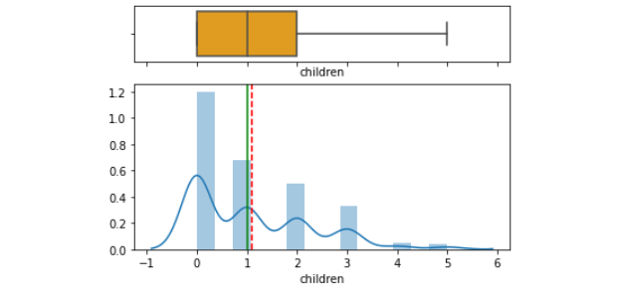
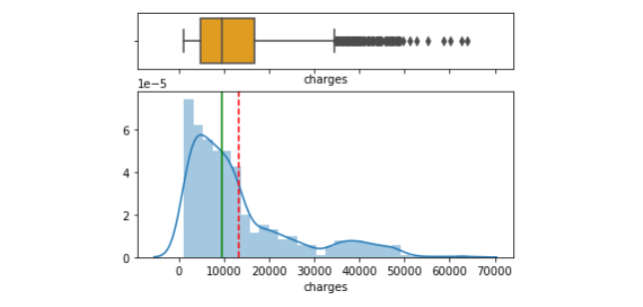
Exploratory Data Analysis
Children
Charges
Observations:
Distribution of Children variable is rightly skewed.
Majority of people have no children.
Observations:
There are many outliers in Charges variable
Distribution of Charges variable is rightly skewed
Median is bit closer to 25th percentile
Most of the charges are below 13000

Slide 6
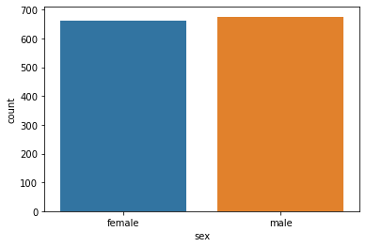
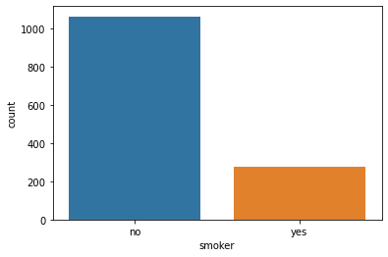
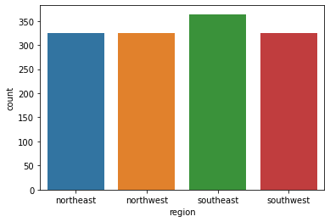
Exploratory Data Analysis
Sex
Smoker
Region
Observations:
Male population is slightly higher than female
Observations:
Non-smokers are higher in number than the smokers
Observations:
Among the 4 regions, Southeast region has slightly higher population than other 3 regions

Slide 7
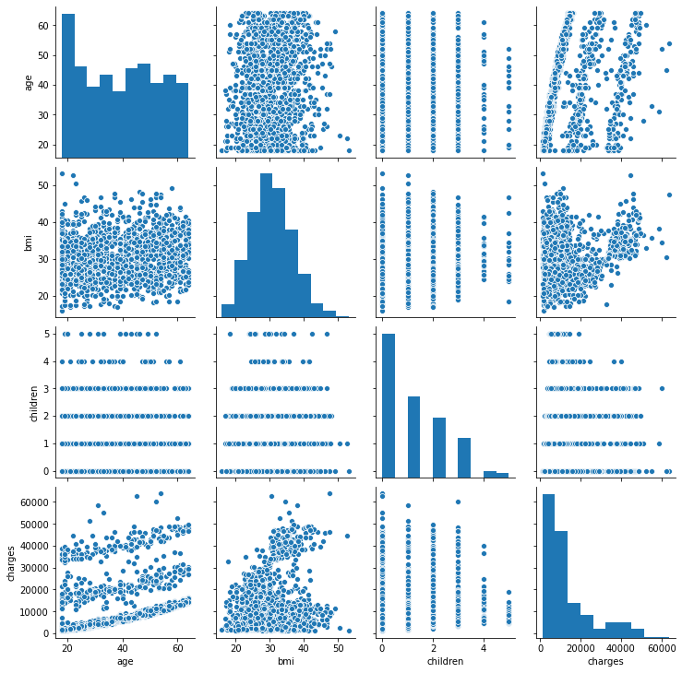
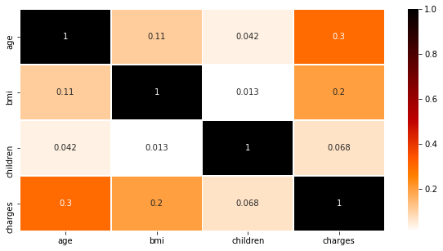
Exploratory Data Analysis – Correlation Matrix
Observations:
Age has correlation with charges; older people are billing more medical costs to the health insurance.
BMI and charges also have some positive correlation. Higher BMI people are also billing medical costs to the health insurance.
Age and BMI also have some correlation that needs to be investigated further.
People with any number of children has almost no correlation with any other variables.

Slide 8
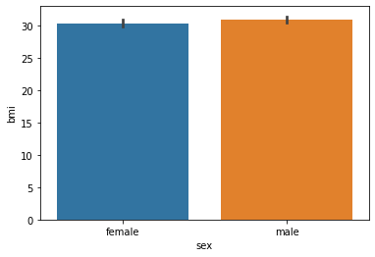
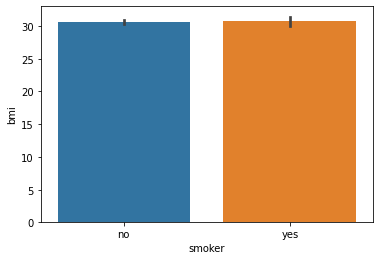
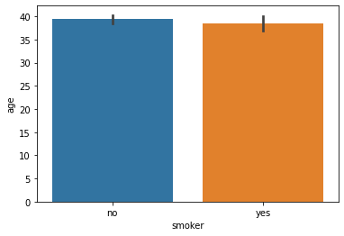
Exploratory Data Analysis
BMI Vs. Sex
BMI Vs. Smoker
Age Vs. Smoker
Observations:
Average BMI of males is slightly higher than females.
Observations:
No significance difference between average BMI of smokers and non-smokers.
Observations:
Average age of non-smokers is slightly higher than the smokers.

Slide 9
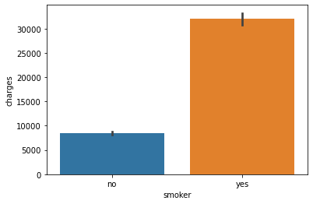
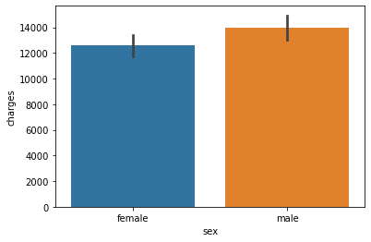
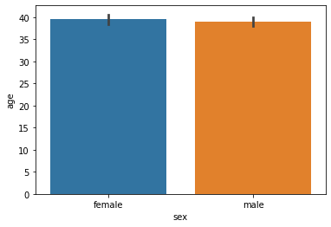
Exploratory Data Analysis
Charges Vs. Smoker
Charges Vs. Sex
Age Vs. Sex
Observations:
Average insurance charges of smokers are higher than non-smokers.
Observations:
Average insurance charges of males are higher than females.
Observations:
Average age of females is slightly higher than males.

Slide 10
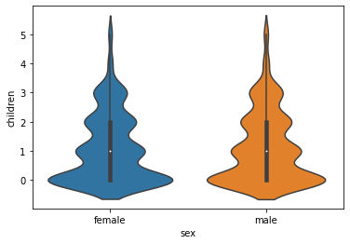
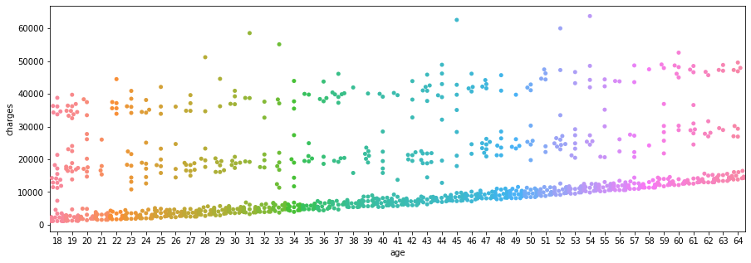
Exploratory Data Analysis
Children Vs. Sex
Charges Vs. Age
Observations:
No. of children is no different for males Vs. females.
Observations:
As the age of the person increases, insurance charges are also increasing.

Slide 11
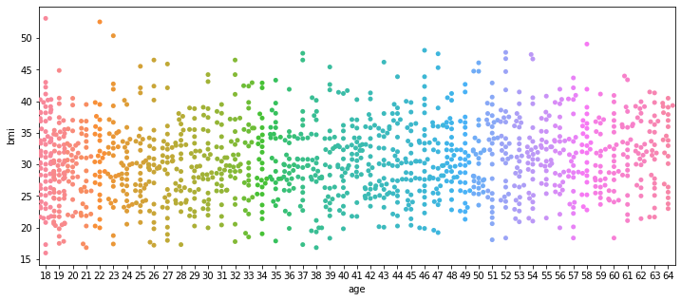
Exploratory Data Analysis
BMI Vs. Age
Observations:
BMI is spread across a wide range irrespective of the age of a person.

Slide 12
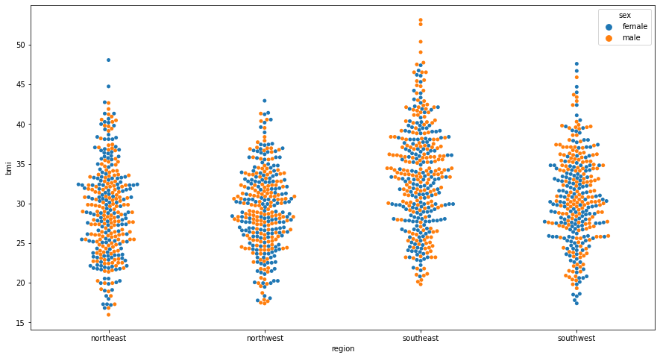
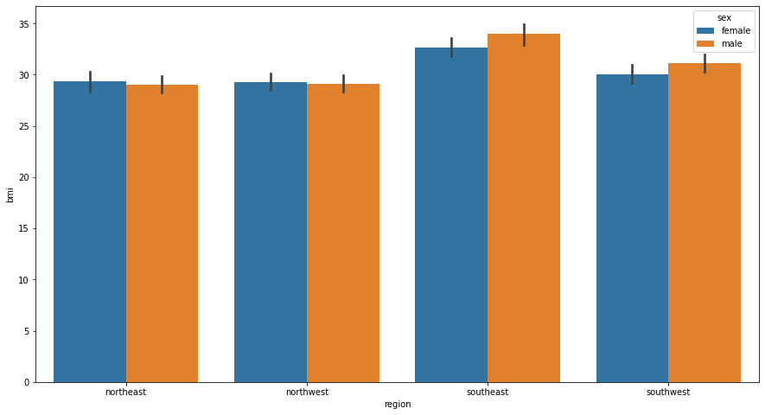
Exploratory Data Analysis
Region Vs. BMI Vs. Sex
Observations:
Among the four regions, both males and females in the Southeast region have higher avg BMI, followed by Southwest region.
Within the Southeast region, males have higher avg BMI than females. Similar trend is seen in Southwest region.
Both Northeast and Northwest regions shows that females have slightly higher avg BMI than males.

Slide 13
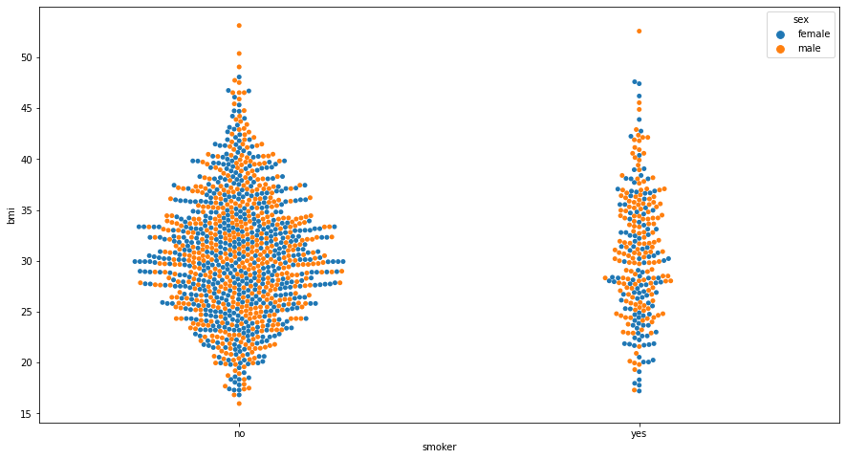
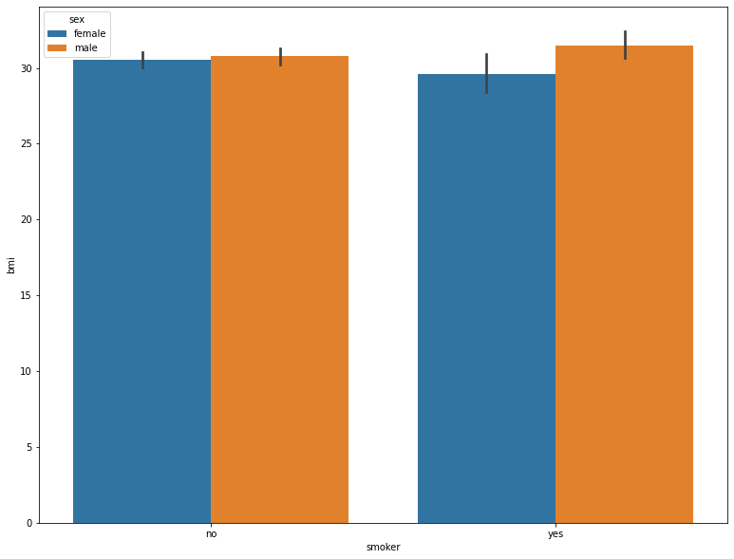
Exploratory Data Analysis
Smoker Vs. BMI Vs. Sex
Observations:
There is no significant difference between male and females avg BMI among non-smokers.
Avg male BMI is higher than female avg BMI among smokers.
Avg female BMI of non-smokers have slightly higher avg BMI than smokers.

Slide 14
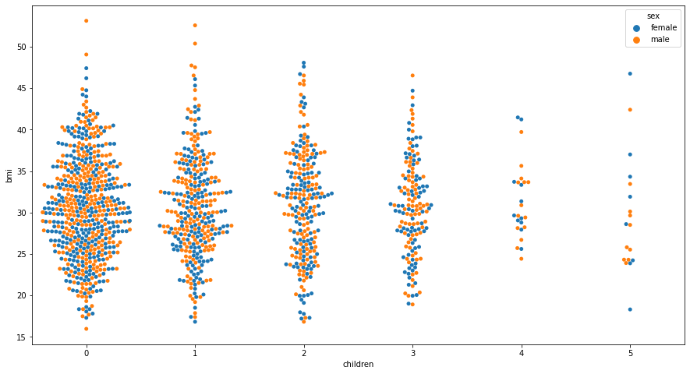
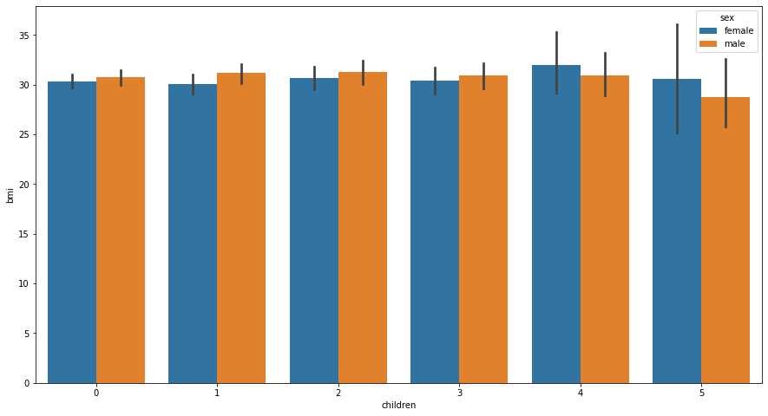
Exploratory Data Analysis
Children VS BMI VS Sex
Observations:
Females with 4 or more children have a higher avg BMI compared to both, females with 3 or less children and males with 4 or more children.
Males with 3 or less children have slightly higher avg BMI than females with 3 or less children.

Slide 15
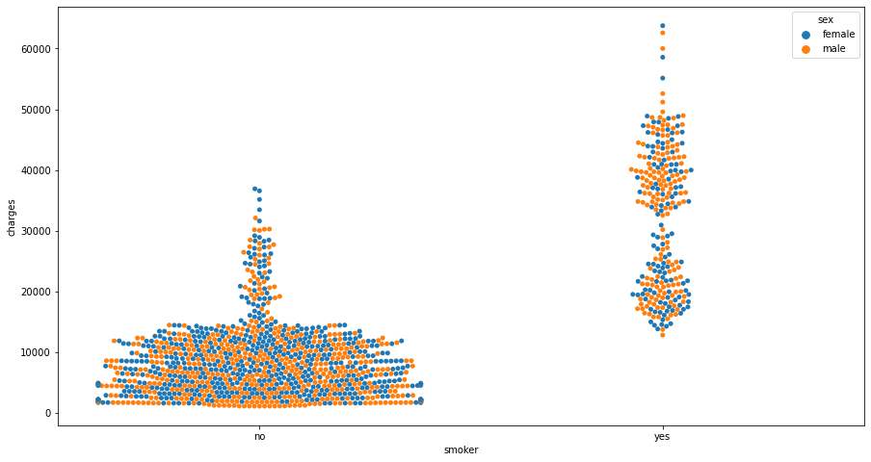
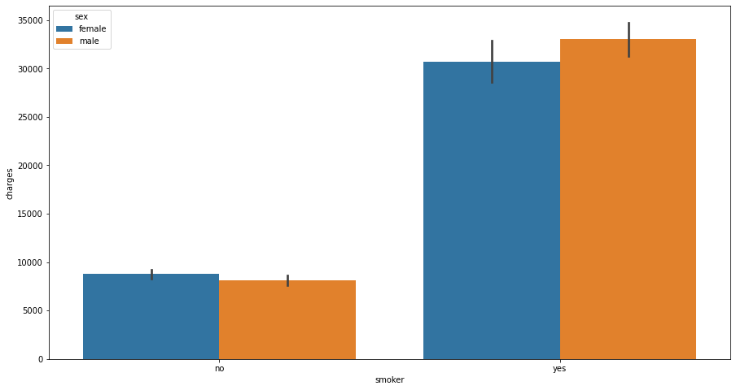
Exploratory Data Analysis
Smoker Vs. charges Vs. Sex
Observations:
Avg. insurance charges for smokers is significantly higher than charges for non-smokers.
Among smokers, avg. charges for males are higher than females.
Among non-smokers, avg. charges for females are slightly higher than males.

Slide 16
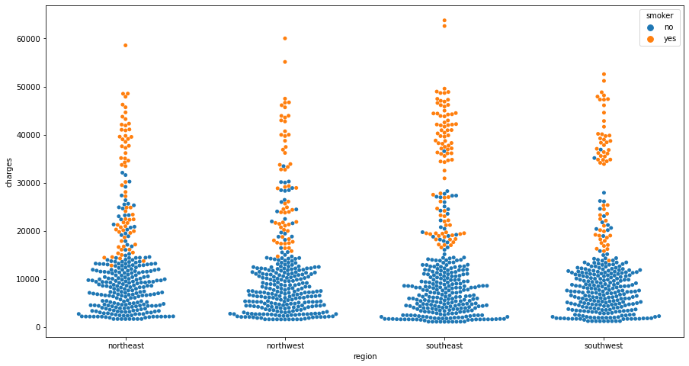
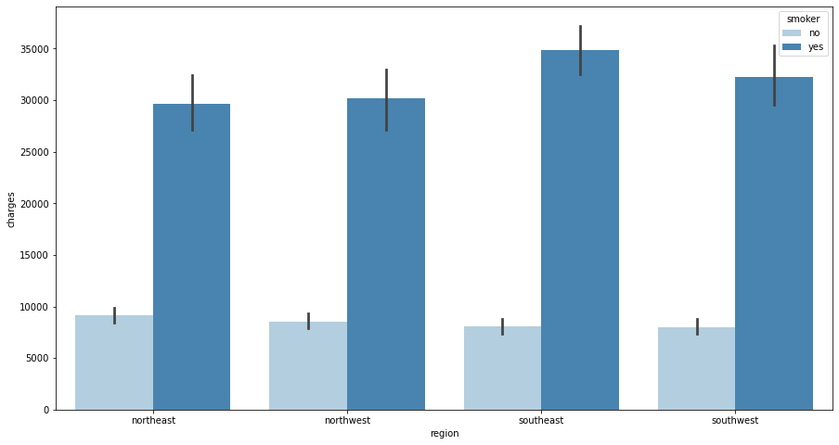
Exploratory Data Analysis
Region Vs. Charges Vs. Smoker
Observations:
In all four regions, smokers avg. insurance charges are higher than non-smokers.
Non-smokers avg. insurance charges are similar across all the four regions.
Among smokers, Southeast region’s avg. insurance charges are the highest, followed by Southwest.

Slide 17
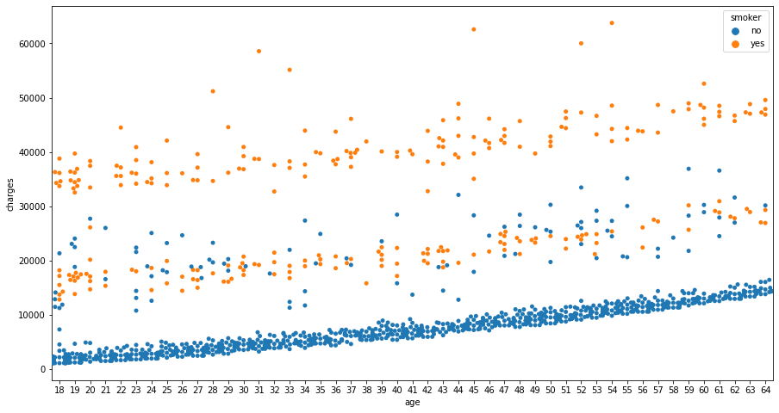
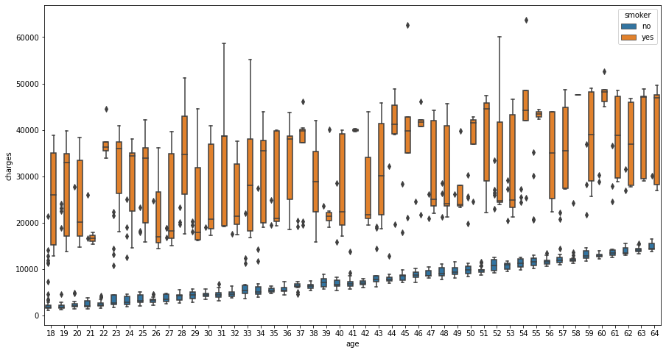
Exploratory Data Analysis
Age Vs. Charges Vs. Smoker
Observations:
Charges increase with increase in age.
Charges are higher for smokers than non-smokers.
Younger-age non-smoker avg. charges are in the lower range and Older-age smoker avg. charges are in the higher-range (with some outliers).

Slide 18
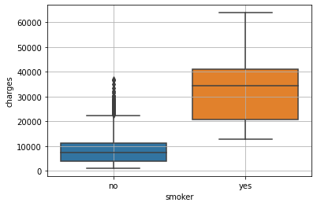
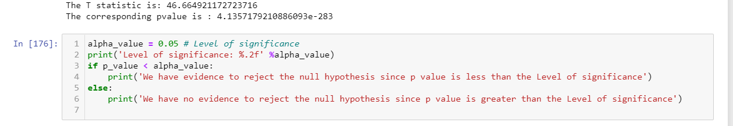
Proven that claims made by the people who smoke is greater than those who don’t
​
Ho : 𝑠𝑚𝑜𝑘𝑒𝑟𝑐𝑙𝑎𝑖𝑚𝑠<=𝑁𝑜𝑛𝑆𝑚𝑜𝑘𝑒𝑟𝑐𝑙𝑎𝑖𝑚𝑠 − 𝑁𝑢𝑙𝑙𝐻𝑦𝑝𝑜𝑡ℎ𝑒𝑠𝑖𝑠
Ha : 𝑠𝑚𝑜𝑘𝑒𝑟𝑐𝑙𝑎𝑖𝑚𝑠>𝑁𝑜𝑛𝑆𝑚𝑜𝑘𝑒𝑟𝑐𝑙𝑎𝑖𝑚𝑠 − 𝐴𝑙𝑡𝑒𝑟𝑛𝑎𝑡𝑒𝐻𝑦𝑝𝑜𝑡ℎ𝑒𝑠𝑖𝑠
Significance level - 0.05 (Alpha value).
Must perform one-tailed test.
Level of significance: 0.05
We have evidence to reject the null hypothesis since p value is less than the Level of significance. Therefore, we reject the null hypothesis at 5% level of significance.
So, at 95% confidence level, there is sufficient evidence to prove that medical claims made by the people who smoke is greater than who don't.

Slide 19
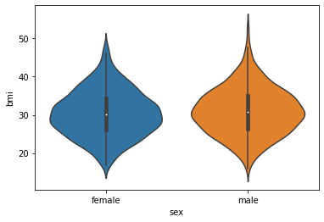
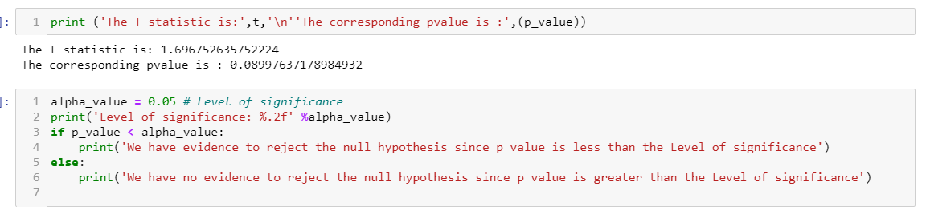
Proven with statistical evidence that the BMI of females is not different from that of males
​
Ho: Females BMI = 𝑀𝑎𝑙𝑒𝑠 𝐵𝑀𝐼 − 𝑁𝑢𝑙𝑙 𝐻𝑦𝑝𝑜𝑡ℎ𝑒𝑠𝑖𝑠
Ha: Females BMI ≠≠ 𝑀𝑎𝑙𝑒𝑠 𝐵𝑀𝐼 − 𝐴𝑙𝑡𝑒𝑟𝑛𝑎𝑡𝑒 𝐻𝑦𝑝𝑜𝑡ℎ𝑒𝑠𝑖𝑠
Significance level - 0.05 (Alpha value)
Must perform two-tailed test
Level of significance: 0.05
We have no evidence to reject the null hypothesis since p value is greater than the level of significance.
Therefore, we fail to reject the null hypothesis at 5% level of significance.
So, at 95% confidence level, there is sufficient evidence to prove that BMI of females is equal to males.

Slide 20
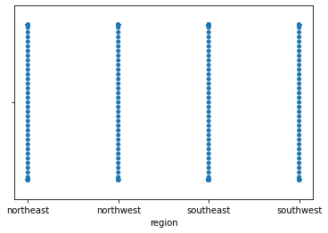
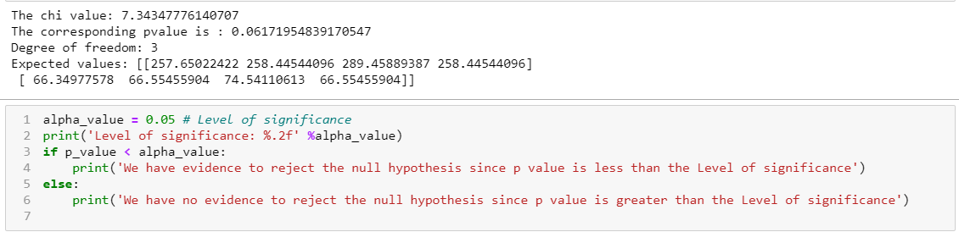
Proven with statistical evidence that smokers are not significantly different across regions
​
Ho: Smokers are not significantly different across the regions - Null Hypothesis
Ha: Smokers are significantly different across the regions - Alternate Hypothesis
Significance level - 0.05 (Alpha value)
Must perform two-tailed test
Level of significance: 0.05 We have no evidence to reject the null hypothesis since p value is greater than the Level of significance.
Therefore, we fail to reject the null hypothesis at 5% level of significance.
So, at 95% confidence level, there is sufficient evidence to prove that smokers are not significantly different across regions.

Slide 21
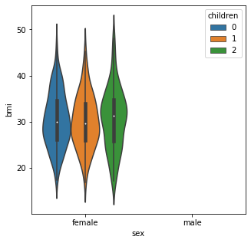
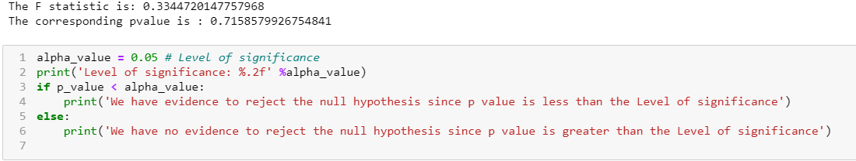
Proven with statistical evidence that the BMI of women with no children, one child, and two children are same
​
Ho: 𝜇0𝑐 = 𝜇1𝑐 = 𝜇2𝑐 - 𝑁𝑢𝑙𝑙 𝐻𝑦𝑝𝑜𝑡ℎ𝑒𝑠𝑖𝑠
Ha: 𝜇0𝑐 ≠≠ 𝜇1𝑐 ≠≠ 𝜇2𝑐 - 𝐴𝑙𝑡𝑒𝑟𝑛𝑎𝑡𝑒 𝐻𝑦𝑝𝑜𝑡ℎ𝑒𝑠𝑖𝑠
Significance level - 0.05 (Alpha value)
Must perform one-way ANOVA test
𝜇0𝑐 = Mean BMI of female with no children
𝜇1𝑐 = Mean BMI of a female with 1 child.
𝜇2𝑐 = Mean BMI of a female with 2 children.
Level of significance: 0.05
We have no evidence to reject the null hypothesis since p value is greater than the Level of significance.
Therefore, we fail to reject the null hypothesis at 5% level of significance.
So, at 95% confidence level, there is sufficient evidence to prove that the BMI of women with no children, one child, and two children are same.

Slide 22
Conclusion
Based on the exploratory data analysis and statistical analysis, we can conclude the following insights from the Axis Insurance data set:
There are more male smokers than female smokers in the given dataset, and insurance charges for smokers is significantly higher than that of non-smokers. Also, charges show an increasing trend with age. Therefore, charges are dependent on age & smoking-status.
No significant correlation is observed for BMI with age or charges. However, it is observed that the Southeast region has the highest population, highest avg. BMI for both genders with males at a higher avg. than females, and that insurance charges for smokers is highest in this region compared to the rest.
Medical claims made by the people who smoke is greater than those who don’t
BMI of females is not different from that of males
Proportion of smokers is not significantly different across different regions
Mean BMI of women with no children, one child, and two children is the same

